Slide 1

Integrating the Child Outcomes into the IFSP Process
Vera Stroup-Rentier, KS 619
Sarah Walters, KS Part C
Anne Brager, VA Part C
Sherri Britt Williams, NC Part C
Kathi Gillaspy, ECTA Center
2014 Improving Data, Improving Outcomes Conference, New Orleans

Slide 2
Army EDIS
Notes:
Nationally, states are recognizing that are many benefits to an integrated process and are shifting away from completing the outcomes process in isolation. States with red stars have either integrated or are in the process of integrating the outcomes into the IFSP process. States with beige stars are those that are doing the same for the IEP.
Mention there are many that are integrating their process even if not their forms; Illinois, MA, TX are examples; others have it in both form and process.

Slide 3
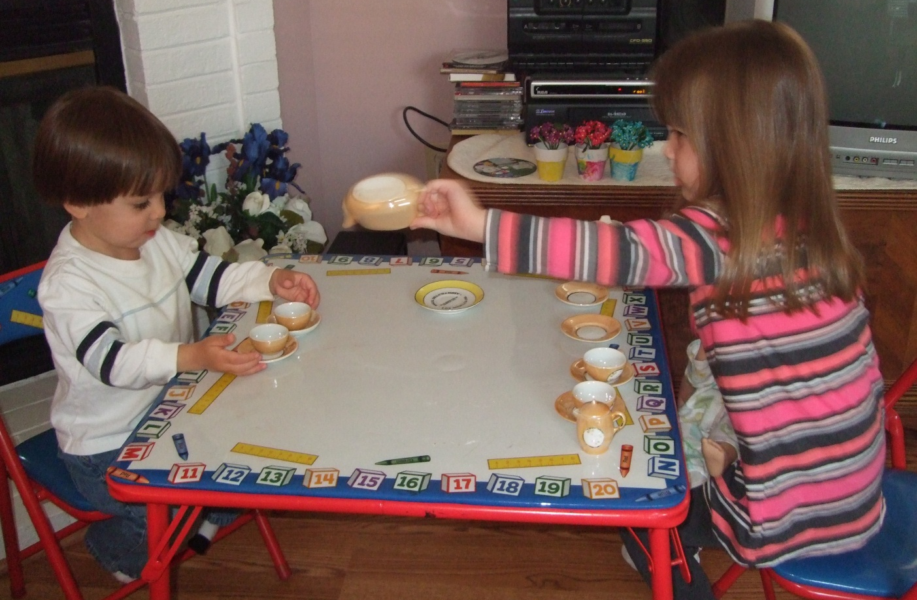
Integrating Outcomes Measurement:
Focus and Purpose
Notes:
Let’s take a moment to step back and think about why we might strive to integrate child outcomes measurement activities within the IFSP or IEP process.

Slide 4
Goal of Early Intervention and Early Childhood Special Education
For children
to enable young children to be active and successful participants during the early childhood years and in the future in a variety of settings – in their homes with their families, in child care, preschool or school programs, and in the community
For families
to enable families to provide care for their child and have the resources they need to participate in their own desired family and community activities
The Early Childhood Outcomes Center (2005). Family and Child Outcomes for Early Intervention and Early Childhood Special Education. Retrieved August 2012. From http://www.fpg.unc.edu/~eco/assets/pdfs/ECO_Outcomes_4-13-05.pdf
Notes:
Let’s focus on making the connection between what we know about how children learn and how the adults in a child’s life can best support his/her development and what professionals do with children and families. The ultimate goal of EI/ECSE services is to enable children to be active and successful participants in a variety of settings throughout their lives. In order to accomplish this goal, professionals must use the methods, models and interventions supported by research to help reinforce the confidence and competence of families to meet their child’s needs and to participate in the community in ways that are meaningful to them.
The goals for children and families, as they are worded here, were developed by the Early Childhood Outcomes (ECO) Center in the process of developing the three outcomes that we now measure to show the effect of IDEA services on the development of young children ages birth through 5 years. A year long process involving stakeholders from all over the nation and from many perspectives – providers, state and local administrators, researchers, family members, TA providers, and so forth – resulted in defining the overarching goals and the specific outcomes of early intervention and early childhood special education programs.

Slide 5
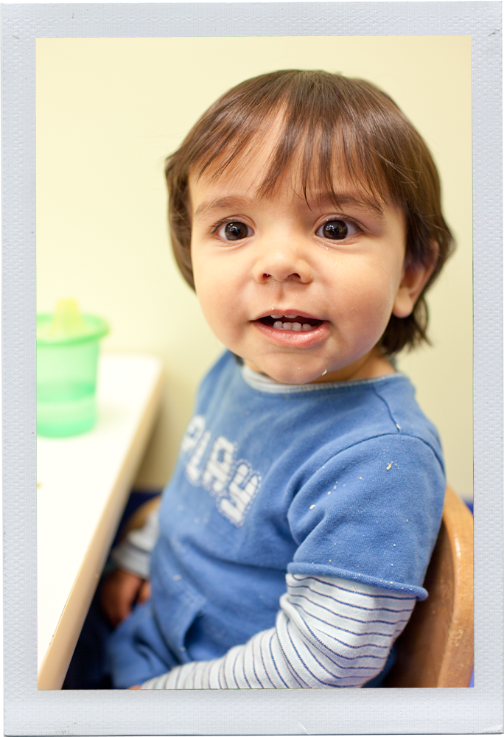
3 Global Child Outcomes
Positive social emotional skills (including positive social relationships)
Acquisition and use of knowledge and skills (including early language/communication and for preschool, literacy)
Use of appropriate behaviors to meet their needs
Notes:
Now let’s shift our focus from the goals and mission of early intervention and early childhood special education to the outcomes of the programs. These are the three outcomes of early intervention and early childhood special education programs, defined by the year-long stakeholder process. Notice they are functional, they are the same for infants, toddlers and preschool children, and they are the kinds of outcomes any parent would want for their child.
And, when a child’s individual IFSP outcomes or IEP goals are functional and meaningful to everyday life, they support the child’s growth and development in positive social relationships, the acquisition and use of knowledge and skills, and using appropriate behaviors to get his or her needs met.

Slide 6
Integration – Outcomes and IEP Processes
Not just about creating a more seamless process…not just details and how
BIG
Critical to the picture of what we are all trying to accomplish
Notes:
Integrating outcomes measurement is not just about streamlining forms or making the entire process feel more cohesive for families. Those benefits will occur. But, the main reason for integration is that embedding the global outcomes in all facets of our practice helps us achieve the vision of what we want to accomplish for and with children and their families.

Slide 7
Disconnect?
States accountable for….
Programs working toward….
Providers focus on….
Children achieve….
Notes:
Now we have a global set of outcomes that states are held accountable for. Programs are working to ensure they can help children show progress on these, and want to see that children’s progress in their program is moving in the direction of state targets.
And, we have providers focusing on individualized outcomes with children and families. These help guide children’s achievements and progress…
But, is there a disconnect?
Does the emphasis at the level of the intervention support the global outcomes that the program is trying to achieve and that the state is held accountable for?

Slide 8

Alignment Across Levels
States accountable for….
Programs working toward….
Providers focus on….
Children achieve….
Notes:
We want these pieces to come into alignment.
Focusing on the 3 global outcomes is the glue that can connect these pieces.
Integrating the 3 global outcomes into the IEP process brings what we want to accomplish for all children and families into the discussion about how we can best support each individual child and family.’
State examples today will show you how they are connecting those dots and even connecting to SSIP work to bring all aspects of EI/ECSE together.
Refer back to the goal…successful participation.

Slide 9
Thinking
Notes:
How might the outcomes become the way in which we think about or FRAME our work in EI and ECSE.
There is always some kind of thinking, or a framework, that teams are using.
They use frameworks as they gather and interpret assessment information and use it to formulate an individualized plan for each child.

Slide 10
What is the Framework Guiding
Our Thinking?
Providers always bring some kind of framework for taking information about the skills a child currently uses and planning where they want to see the child go next
Are these guiding ideas explicit or unspoken?
Are they using a unified framework or multiple frameworks?
Notes:
What is the framework that guides your thinking for identifying outcomes for a child?
Is it explicit?
Is it one framework?
Or are there really multiple frameworks? Maybe each provider on the team is using a different one.

Slide 11


Examples of Guiding Frameworks
The items on a specific assessment tool
A milestone checklist or series of skills to learn based on a provider’s specialty area
A specific curriculum, with assessment identifying starting point
Whatever the family wants
Notes:
Here are some examples of the kinds of frameworks that practitioners might use:
Teams might use items from a specific assessment tool. They might look at the next item in the sequence and use that to plan an intervention.
Or, the framework might be a series of skills or a specific milestone checklist based on the provider’s specialty area that guides planning.
Another option is that a specific curriculum might be the guide for planning.
Or, sometimes teams completely follow the family member’s lead. The plan is based on whatever the family wants.

Slide 12
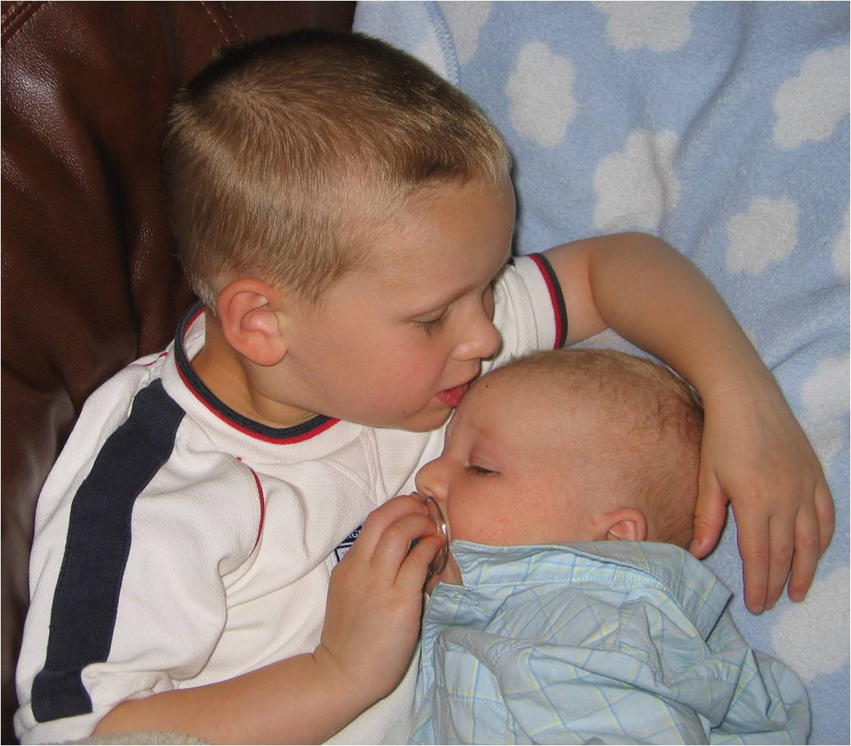
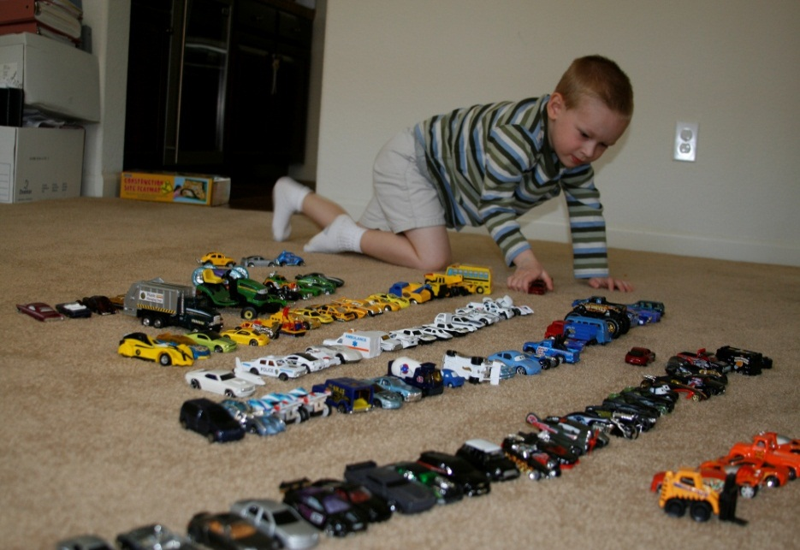
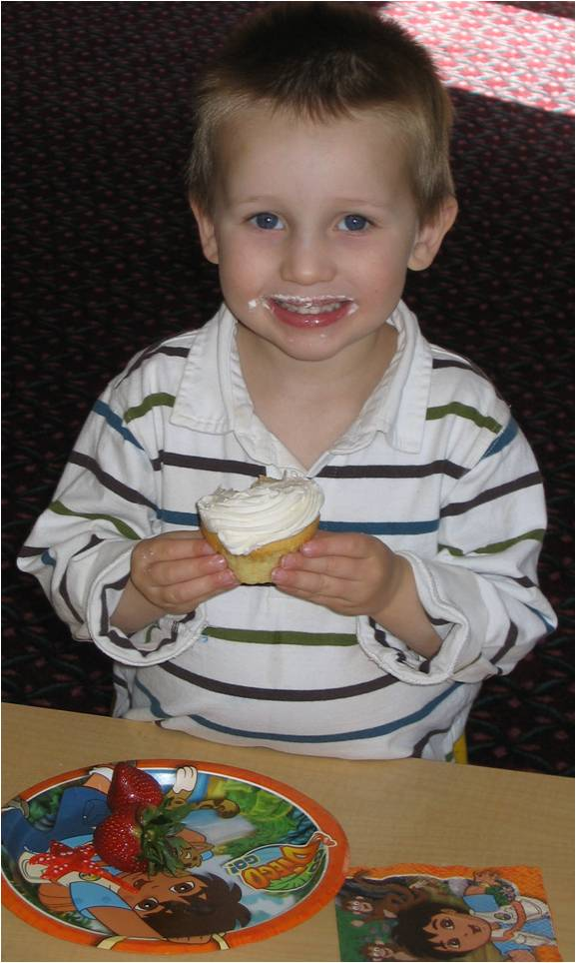
The 3 Outcomes as a
Guiding Framework
The 3 functional outcomes can be a framework, a lens, for viewing child functioning and planning intervention
Notes:
The three functional outcomes are an alternative framework.
They are a lens through which to view child functioning and plan interventions.
This does NOT mean that the family’s concerns and priorities are not considered. It means that what matters to families is talked about with regard to each of the three outcomes.

Slide 13
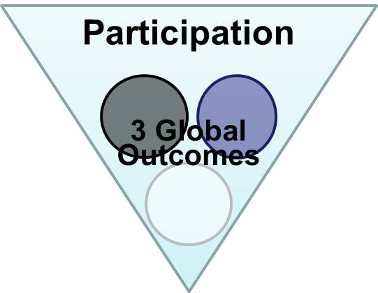
Global Outcomes =
Having positive social relationships
Taking appropriate action to meet needs
Acquiring and using knowledge and skills
Notes:
The 3 outcomes are general statements of what we want the child to achieve. Remember, we want all children to be successful participants in a variety of settings.
The global outcomes are a way to think about what skills the child uses. They also provide a lens to organize how to help the child continue to learn to use his/her skills in richer, more complex, successful ways.

Slide 14

Why Use the Outcomes??
Socially validated – reflect what we are trying to achieve
Functional
They’re integrated – emphasize the whole child
Flexible – not wedded to one particular assessment, curriculum, or level of child functioning
Notes:
With all these frameworks, why should we use the 3 global outcomes?
The 3 global outcomes have been socially validated - thousands of stakeholders all over the country, including families of children with disabilities, have said that these are important outcomes for children
The 3 global outcomes also are functional. So, they reinforce the need to gather functional information about how children use their skills to perform meaningful tasks during assessments and they reinforce the need to write functional individualized IFSP outcomes or IEP goals.
The 3 outcomes focus on the whole child. They aren’t tied to any one domain. Instead, they emphasize the whole child. Integration across domains is critical for effective participation.
Finally, the 3 outcomes are flexible. Because they are global, they are not wedded to the use of any one particular assessment, curriculum, or level of child functioning.

Slide 15
Using the Outcomes to Connect Our Thinking
The IFSP/IEP Process plans supports and services to address priorities and to support successful participation in daily activities
Individual outcomes or goals for each child build on his/her interests/skills and reduce barriers to successful participation in daily learning opportunities
Through participation – all children learn (interest-based learning, practice and independence)
Notes:
When we establish clear connections between the purpose of early intervention/early childhood special education, the global child and family outcomes, and individual child’s IFSP outcomes and IEP goals, services have a greater impact on children and families. It stands to reason that if we integrate the process of measuring child and family outcomes with the IFSP/IEP process, children’s outcomes are also more likely to be written in a way that promote successful participation in daily activities and consequently, promote learning and development, and paperwork is more streamlined and easier for families to understand and for practitioners to complete.

Slide 16
What Might It Look Like?
Assessment
What does our assessment tell us about the child’s functioning in each outcome area across settings and situations?
  Organizer for planning breadth and type of assessment approaches needed and who should be involved in it
  Organizer for writing or sharing results
  Produces information for outcomes and planning
Notes:
What does assessment look like when it is organized around the 3 outcomes?
The global outcomes focus the collection and reporting of information on the child’s functioning in each outcome area across settings and situations.
The 3 outcomes serve as an organizer for the type of assessment approaches to use.
The 3 outcomes also are an organizer for how teams write or share results, organizing results by outcome rather than by the domains.
Assessments are still individualized to the child, but the outcomes provide a useful framework for organizing the information.

Slide 17

Making the Connection:
Using Functional Assessment
Functional assessment is the means by which we accomplish an integrated process, including developing individual outcomes/goals as well as determining the rating for each of the three global child outcomes.
Notes:
Through functional assessment we can gather information about the child’s functioning in daily routines and activities needed to determine the rating through the Child Outcome Summary (or COS) process, as well as the information about the child’s interests, strengths and needs that is necessary to develop individualized, functional outcomes or goals for the child.

Slide 18
What Might It Look Like?
IFSPs and IEPs
Planning IFSP outcomes and IEP goals:
  Has the team considered how to write individualized outcomes or goals that continue help the child progress in each of the 3 outcome areas?
  Will the individualized goals written support effective participation (overarching goal)?
  With global outcomes as an organizer for where we want the child to go, use of discrete, domain-specific objectives won’t make sense.
Notes:
What do IFSPs and IEPs look like when the global outcomes provide the framework?
Thinking about the global outcomes challenges teams to consider how the individualized outcomes and goals help the child progress in each of the 3 global outcome areas--again, because success in the three global outcomes is critical to the overarching goal of effective participation.
The global outcomes do not dictate the individualized outcomes or goals. Rather, they provide a framework for thinking about development and learning. They help a team identify where they need to support the child’s functioning in a way that will be far more effective than domains or discrete skills.
It does not mean that there should be a one-to-one correspondence between each global and individualized goals. The team decides what the right mix should be.

Slide 19
What Might It Look Like?
Intervention and Progress Monitoring
Planning intervention:
Interventions are selected and implemented based on what will support the child’s active participation
Progress Monitoring:
Ongoing reviews of the child’s development are organized by the three outcomes
Reviews include discussion about the child’s progress on their individual outcomes or goals as well as the three outcome areas
Notes:
Using the outcomes to frame interventions focusing on successful participation
At reviews, we discuss progress on the individualized outcomes and revisit the 3 global outcomes to identify if the intervention and support activities are making a difference. If the child did not have an individualized outcome in one or more of the 3 outcome areas, the review is a good time for the team to make sure that the child’s development remains on target in this outcome. This review discussion informs the development of new individualized outcomes and interventions that will help the child continue to make progress in the 3 global outcomes.

Slide 20
The Right People, the Right Situation, the Right Time
Why not complete the Child Outcome Summary (COS) rating while talking about the child’s functioning and development?
Providers who are integrating the outcomes work, suggest that the completing the COS rating at the IFSP or IEP meeting to summarize the assessment results is a natural and enriching conversation
Outcomes and goals become more functional – routine and activity based
For more information about integrating outcomes into the IFSP/IEP process, please visit the ECO website at http://ectacenter.org/eco/pages/integration.asp
Notes:
So why not complete the child outcomes summary, or COS, rating while you’re already talking about the child’s functioning and development? It’s the perfect time with the right people – the child’s team, including the parent – at the right time – while discussing the child’s present levels of development – to add to the family’s understanding of their child’s development. Many programs are already integrating the two processes. They are reporting that it is a logical addition to the conversation about assessment information, and supports the family’s understanding of their child’s development. They also report that the outcomes developed are naturally more functional and based in the child’s routines and activities.
For more information about integration, there are resources on the ECTA Center’s website. We’ll talk a little more about it later in the presentation.

Slide 21

Benefits of Integrating Outcomes into the IFSP/IEP Process
More understandable, measureable individualized IFSP outcomes and IEP goals
Families can tell when their children are achieving desired outcomes
Reinforces the assessment and planning cycle
Improves practice
Supports progress in the overarching areas that are central to early intervention
Notes:
Using the 3 global outcomes as a framework produces understandable, measureable, individualized outcomes that are meaningful to families. The 3 outcomes also help families understand what programs are trying to do.
The 3 outcomes tie assessment, planning, and intervention together. They improve practice and help programs to keep the focus firmly on what it is trying to achieve and what the state is being held accountable for. Supporting children in acquiring the outcomes is critical….

Slide 22
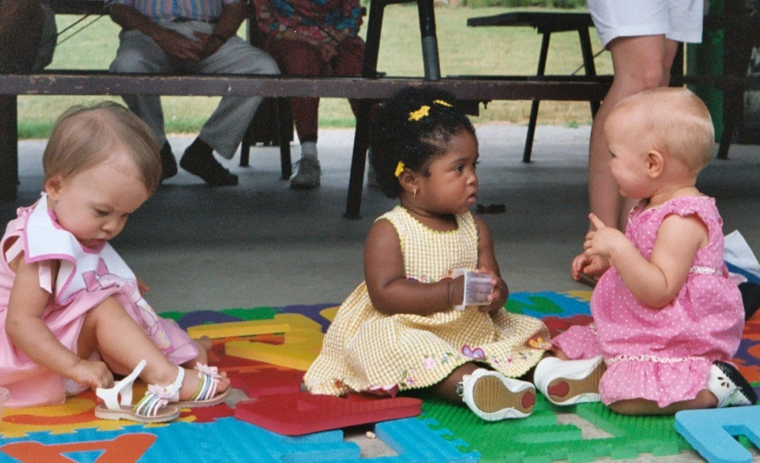
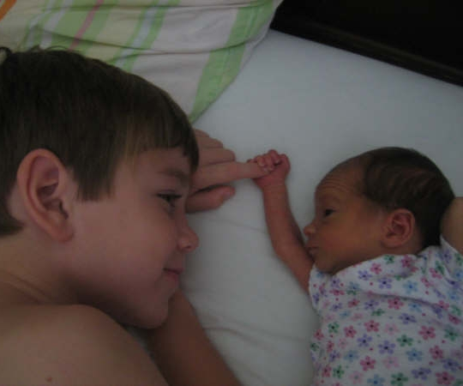
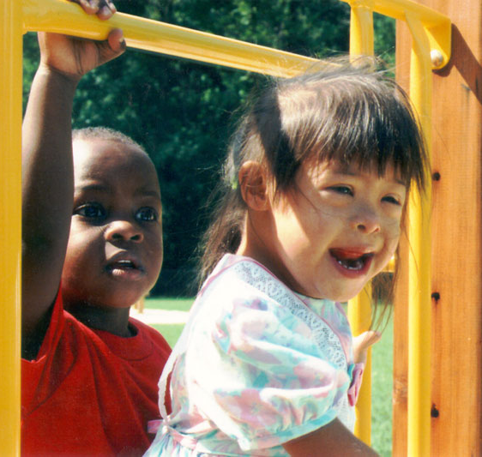
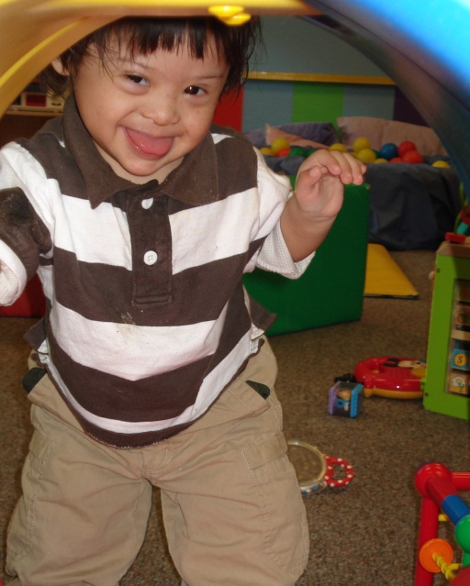
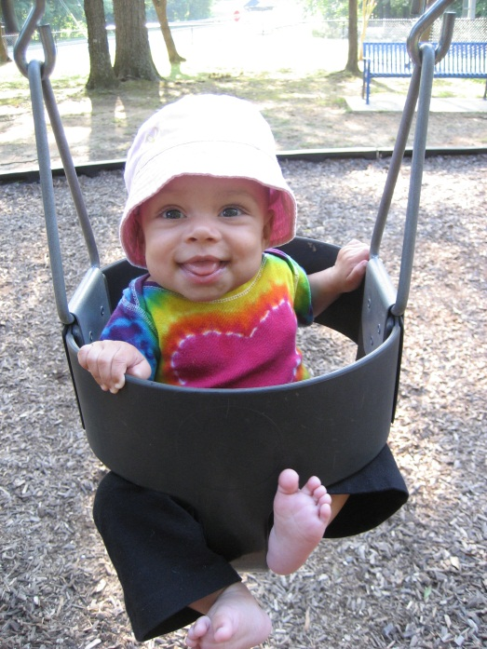

Active and Successful Participation
Notes:
To helping all children achieve what matters.
Turn over to Sara and Vera

Slide 23



Vera Stroup-Rentier, KS 619
Sarah Walters, KS Part C
Integrating the Child and Family Outcomes into the IFSP and IEP in Kansas

Slide 24

Kansas Landscape
Part C – Kansas Department of Health and Environment (KDHE) http://www.ksits.org/
Part B/619 – Kansas State Department of Education (KSDE) http://www.ksde.org/
Outcome Web System (OWS) – Birth to 6 http://kskits.org/OWS/index.html
Kansas Inservice Training System – Birth to 8
http://www.kskits.org/
Notes:
There is a long history of collaboration between Part C and Part B, as evidenced by the decision that C and B would work together to implement the Early Childhood Outcomes initiative, developing a state database, common procedures, training and guidance, supported by the statewide training and technical assistance project

Slide 25
Goal
Understand the connections among:
    Functional Assessment
    Developing meaningful IFSP Outcomes and IEP Goals
    Measuring the 3 global child outcomes
Meaningful
IFSP Outcomes
and IEP Goals
3 Global Child Outcomes
Functional Assessment

Slide 26

Implementation
Kansas Infant-Toddler Services
Rationale for incorporating Early Childhood Outcomes into the IFSP
Development of Statewide IFSP
Mission and Key Principles
Training and On-going TA

Slide 27




IFSPalooza: an all-out crazy party; partying at one place with a ton of people like there's no tomorrow

Slide 28
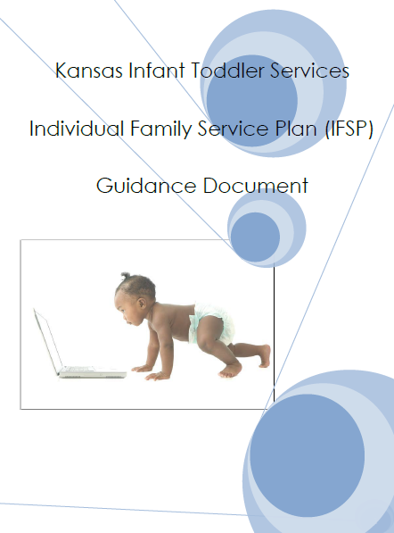
Statewide IFSP for tiny-k Programs
http://www.ksits.org/download/IFSP_Guidance_Document.pdf
Notes:
KDHE paved the way for integration of the COS and IFSP processes by including language from the ratings process in the new electronic IFSP adopted by tiny k programs in 2012. In 2012-13, the Kansas Department of Health and Environment (KDHE), Part C Services and Kansas Inservice Training System (KITS) partnered to offer a series of training opportunities for tiny-k programs focused on development of the IFSP. Information about functional assessment, integration of ECO outcomes, and inclusion of parents as partners are just some of the topics of this training series.
The IFSP Guidance Document gives step by step direction for completion of the IFSP along with tips and guidance to support the IFSP process.
In addition, there is a technical assistance packet on Writing Family Guided IFSP Outcomes on the KITS website.

Slide 29


My Child’s Story
The Family Services Coordinator can gather and record this information from conversations with the family and through the assessment process. It must be reviewed for accuracy at the IFSP Meeting

Slide 30

My Child’s Story
Early Childhood Outcomes

Slide 31

My Child’s Story
Hitting all of the Developmental Domains

Slide 32

My Child’s Story
Example:
Mateo loves to take a bath washing his face, hands and feet all by himself.

Slide 33

My Child’s Story
Reflection Time

Slide 34
My Child’s Story
Reflection Time
Review Sample IFSPs
How have I been writing my child’s Story?
What do I need to change?
What tools make this process easier?
One thing I will do differently.

Slide 35
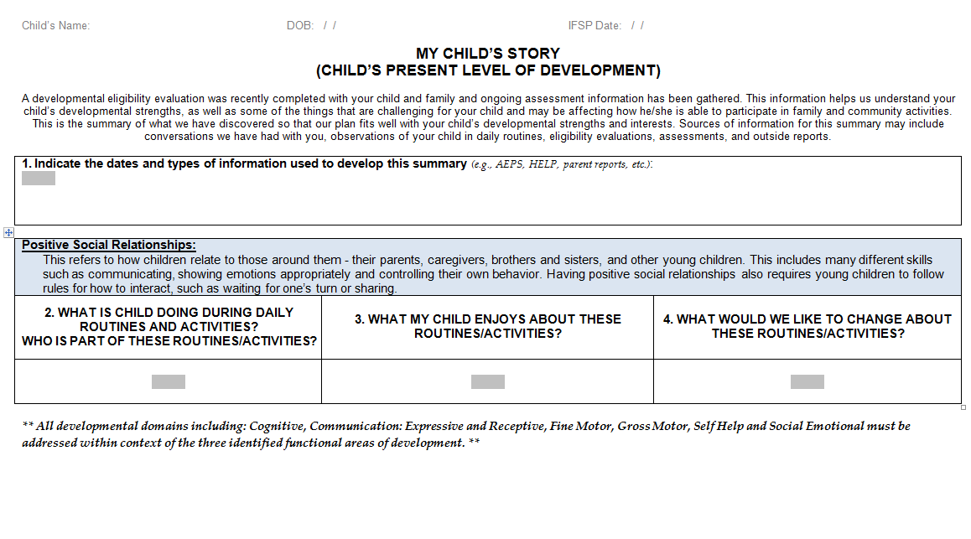
My Child’s Story
http://www.ksits.org/forms.htm

Slide 36
Developing Functional IFSP Outcomes
Step 1: Determine the functional area(s) to support participation based on identified needs. | Using words/signs to communicate choices to his mother during daily routine and activities
Step 2: What routine(s) or activity(ies) does this affect? | Meal time. Play time.
Step 3: Draft the context portion of the outcome. [routines or activities] | During meals, Davy will use the sign for “more” to indicate the need for more milk in order to communicate his needs to his mother
Step 4: Draft the measurement portion of the outcome and add the family’s chosen time frame | By his birthday, …when he wants more milk at mealtime
Adapted from McWilliam, R.A. (2006)
Notes:
McWilliam’s 4 Steps to Build a Functional Outcome
We have many Robin McWilliam fans in our state. He was the keynote speaker for our KDEC conference last February.
We used it to develop a functional outcome from a child story that was created for a case study example, based on the present levels identified for Davy in outcome 3.

Slide 37
IEP Training for Kansas Schools
Early Childhood: Writing IEPs for Young Children
Notes:
Part B programs in Kansas do not have a statewide IEP form although statewide training and guidance on IEPs is available on the the TASN website. Beginning in 2010 suggestions for integrating early childhood outcomes were added to training specific to early childhood programs, along with a case study and sample materials.

Slide 38
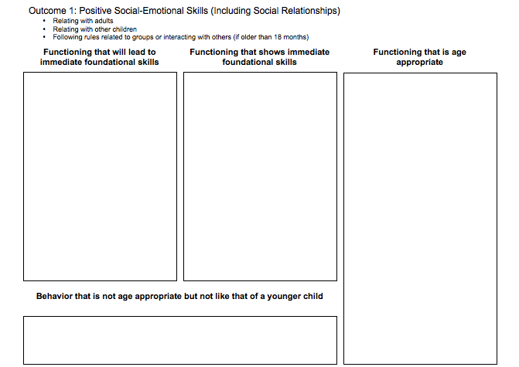
Using Information to Develop Child and Family Story or PLAAFP
Skills/ behaviors
of much younger
child
Immediate foundational skills/
behaviors
(3-6 months delay)
Age- appropriate skills/
behaviors
Notes:
KS uses the Child Outcome Summary process. This is the tool that we are counting on to make our ratings process more consistent, and eventually more valid and reliable.
One place teams might begin integrating the ECOs with the IFSP/IEP is by summarizing functional assessment information using the 3 categories of the DBRF tool. Teams use the combined expertise of family members, childcare providers, early educators, and special education professionals to identify the functional skills and behaviors, that the child demonstrates across settings, in each of the 3 outcomes. Together, the team then determines which of those skills and behaviors is age appropriate functioning, functioning that shows immediate foundational skills, or functioning that will lead to immediate foundational skills, but is like that of a much younger child. Teams report that use of the DBRF makes the ratings process easier, quicker, and more reliable. So why not use the same information to describe the child’s present levels of FUNCTIONING in each of the 3 global outcome areas on the IFSP and IEP?
Poll indicated that only 12-14% of participants were using the DBRF in this manner.

Slide 39
The Right People, the Right Situation, the Right Time
Why not complete the Child Outcome Summary (COS) rating while talking about the child’s functioning and development?
Providers who are integrating the outcomes work, suggest that the completing the COS rating at the IFSP or IEP meeting to summarize the assessment results is a natural and enriching conversation
Outcomes and goals become more functional – routine and activity based
For more information about integrating outcomes into the IFSP/IEP process, please visit the ECO website at www.the-eco-center.org.
Notes:
W
So why not complete the child outcomes summary, or COS, rating while you’re already talking about the child’s functioning and development? It’s the perfect time with the right people – the child’s team, including the parent – at the right time – while discussing the child’s present levels of development – to add to the family’s understanding of their child’s development. Many programs are already integrating the two processes. They are reporting that it is a logical addition to the conversation about assessment information, and supports the family’s understanding of their child’s development. They also report that the goals and outcomes developed are naturally more functional and based in the child’s routines and activities.

Slide 40
Steps to Integrating
EC Outcomes (ECO) with the IEP
In the review of existing data, look for information related to the ECO
IF the child is transitioning from a Part C Infant Toddler Program, organize the discussion of the child at the 90 day transition meeting in relation to the ECO
During the evaluation, probe for information on caregiver concerns related to the ECO.
  Encourage families to describe their child’s typical day in the context of ECO areas, such as how he interacts with others, how he learns and solves problems, and how he gets his own needs met.
Compare the child’s functional skills and behaviors with those expected for other children his age.
Notes:
There are multiple ways that teams can use the early childhood outcomes to collect, organize and share information during the assessment and IEP process.
As teams review existing data, they can look for information related to how the child uses skills across the three outcomes.
IF a child is transitioning from a Part C Infant Toddler Program, teams might choose to organize the discussion of the child at the transition meeting in relation to each of the outcomes rather than by developmental domains. Early childhood outcomes are a reflection of a child’s functional use of skills, Discussions related to what children can and can not do within a specific developmental domain, often lack information about a child’s functional use of those skills.
During the evaluation, teams should probe for information on caregiver concerns related to the ECO.
Encourage families to describe their child’s typical day in the context of how he interacts with others, how he learns and solves problems, and how he gets his own needs met.
In addition to comparing where a child is developmentally in relation to his or her same age peers, teams should compare the child’s functional use of skills and behaviors in every day activities with those expected for other children of the same age.
.

Slide 41
Steps to Integrating
EC Outcomes (ECO) with the IEP
Include functional authentic assessment in the evaluation that will provide the team with information on all three ECO.
  Consider the child’s functioning in the context of everyday activities and routines, in the three ECO areas.
Document supporting evidence for ECO rating throughout the assessment and evaluation process
During the IEP meeting, organize the discussion of the child in relation to the ECO;
  Discuss how the child is functioning in the ECO areas and how the child’s skill’s and behaviors in the ECOS areas compare with other children the same age.
In the PLAAFP, organize the description of strengths and need as they relate to the three outcome areas.
Notes:
During the assessment process, teams should select assessment methods that will help them consider a child’s functioning in everyday activities and routines.
Keeping in mind that the team will have to provide an early childhood outcome rating if a child is found eligible for Part B services, the team should begin early in the evaluation process to document supporting evidence for ECO ratings
During the IEP meeting, teams can also organize the discussion of the child in relation to each of the ECO; present level statements can be written as a description of the child’s strengths and need as they relate to the three outcome areas. Teams should also consider the three outcomes as they prioritize goals for a child’s IEP.

Slide 42
Develop Functional IEP Goals
Step 1: Determine the academic (preschool activities) and functional area(s) based on identified needs. | Following directions independently
Step 2: What routine(s) or activity(ies) does this affect? | Familiar multi-step routines at home and in the classroom
Step 3: Draft the condition and behavior portion of the goal [routines or activities] | Provided correspondence training and using verbal rehearsal, Johnny will follow 3 consecutive directions within familiar classroom routines
Step 4: Draft the criterion portion of the goal and add the time frame | Independent of adult prompts at least 2 out of 3 opportunities for 3 consecutive days by Dec. 20xx
Adapted from McWilliam, R.A. (2006)

Slide 43
Developing Measurable and Functional IFSP Outcomes/Strategies and IEP Goals/Objectives
What are the family’s wishes, hopes and dreams for their child?
What are the family’s/caregiver’s/teacher’s concerns regarding the child’s development and participation in everyday routines and activities?
What are the child’s developmental needs?
How does information from 1-3 translate into the child’s functioning or participation in everyday activities and routines? Consider barriers and strengths.
What are the family’s and team’s priorities (e.g., those things they want to work on first)?
Notes:
This tool is in a worksheet format, but we captured the questions on the next 2 slides. NECTAC adapted the worksheet from one of our KITS TA packets. It’s intended to be used by a team, including the child’s family, of course, and other caregivers or community service providers. The first page of the worksheet uses 5 questions to help the team identify priority outcomes or goals.

Slide 44
Developing Measurable and Functional IFSP Outcomes/Strategies and IEP Goals/Objectives
What strengths, resources and supports are already in place?
Are changes needed to make these strengths more effective?
What possible opportunities exist within existing family/classroom routines or environments for meeting the outcome/goal?
What strategies will help achieve the changes we want?
Who can help? What roles can team members or others play?
What services/supports are needed to achieve the outcome/goal?
How will we know we have made progress,achieved the outcome/goal, or need to modify it?
Notes:
The second page of the worksheet walks the team through questions intended to identify IFSP strategies or IEP objectives and services/supports to meet the outcome or goal selected as a priority from page 1. The team considers these 7 questions for each outcome or goal identified as a priority.

Slide 45

Resources
IFSP
IEP
Agreed Upon Practices For Providing Early Intervention Services In Natural Environments http://www.nectac.org/~pdfs/topics/families/AgreedUponPractices_FinalDraft2_01_08.pdf
Key Practices Underlying the IEP Process http://nectac.org/~pdfs/knowledgepath/ifspoutcomes-iepgoals/Key_Practices_IEP_Process.pdf

Slide 46

Opportunities for Outcomes Measurement in IFSP/IEP Process
Part C to B Transition Meeting
Curriculum Based Assessment
Child Outcome Web System Training
Parent Input
IEP Development/Eligibility
Ongoing Intervention
IFSP/IEP Reviews

Slide 47
Lessons Learned
Challenges Identified by Participants
Time (most frequent response)
Getting whole team together
Overloading families during process
Team buy-in; seeing utility of process
Staff training
Notes:
We also have heard from some part B programs whose districts require IEP goals to be linked to standards that this is a barrier to integrating the outcomes with their process. We have aligned the three outcomes with our original state early learning standards and will do the same with our newly revised standards that are now aligned with our college and career ready state standards.

Slide 48
Lessons Learned
Benefits Identified by Participants
Makes outcomes, IFSPs/IEPs and the assistance we provide more meaningful for families
More family involvement in the process to develop more functional outcomes and goals
Documentation more consistent; exit ratings more reliable
Use of existing data to identify present levels
No longer two disconnected processes
Help us write better outcomes/goals

Slide 49

What people are saying!
Local tiny-k Coordinator
“The new IFSP has given staff an opportunity to really see how the levels of development and priorities of the family can provide extremely functional, measureable goals for child and family.”

Slide 50
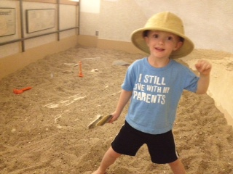
What people are saying!
Parent
“Oh my goodness, I actually see my child on paper, not what he can or can’t do.”

Slide 51

What people are saying!
2 Special Education Directors
“When can we get a statewide IEP?”

Slide 52

What people are saying!
Provider
“I had a very nice talk with a Developmental Pediatrician out of KU med in Wichita. He said the descriptive part of the IFSP was very helpful. Our conversation was great! Over 40 minutes on a Friday evening. Anyway, I’m glad that he felt the IFSP gave him some good information.”

Slide 53
Next Steps In Integrating ECO with the Kansas IFSP/IEP Process
Use information from the Child Outcomes Summary narrative, and language (not numbers) from the COSF ratings to describe present levels (this means COSF would need to be completed as part of the evaluation/eligibility/IFSP/IEP process).
Refine process for determining the ratings as part of the IFSP/IEP process (initially and annually thereafter).
Continue to update curriculum based assessment information quarterly, or as recommended by publisher, for ongoing progress monitoring.
Continue to update family interview information at reviews and annually.
Notes:
And here’s where we brought home the key messages for the coming year. New guidance is in bold print.
Recent guidance from both KDHE and KSDE suggests that “ideally” the child outcome summary ratings are determined during the IFSP or IEP process, but must be determined within 30 days of the date when services begin.
Recent guidance from Sarah and Tiffany also suggests that making the ECO ratings part of your annual IFSP or IEP review is best practice in Kansas. However, the OWS doesn’t have a place to enter COS ratings from your annual reviews of the IFSP or IEP and at this time there are no plans for adding this field. When you begin integrating the early childhood outcomes with your initial IFSP or IEP process, it will be a natural and necessary step to determine child progress on the ratings at your annual reviews as well.

Slide 54

Next Steps In Integrating ECO with the Kansas IFSP/IEP Process
Web-based IFSP
Incorporate rating on IFSP document and integrate data collection into ITS database
Improving process for better data for the SSIP
Notes:
And here’s where we brought home the key messages for the coming year. New guidance is in bold print.
Recent guidance from both KDHE and KSDE suggests that “ideally” the child outcome summary ratings are determined during the IFSP or IEP process, but must be determined within 30 days of the date when services begin.
Recent guidance from Sarah and Tiffany also suggests that making the ECO ratings part of your annual IFSP or IEP review is best practice in Kansas. However, the OWS doesn’t have a place to enter COS ratings from your annual reviews of the IFSP or IEP and at this time there are no plans for adding this field. When you begin integrating the early childhood outcomes with your initial IFSP or IEP process, it will be a natural and necessary step to determine child progress on the ratings at your annual reviews as well.

Slide 55
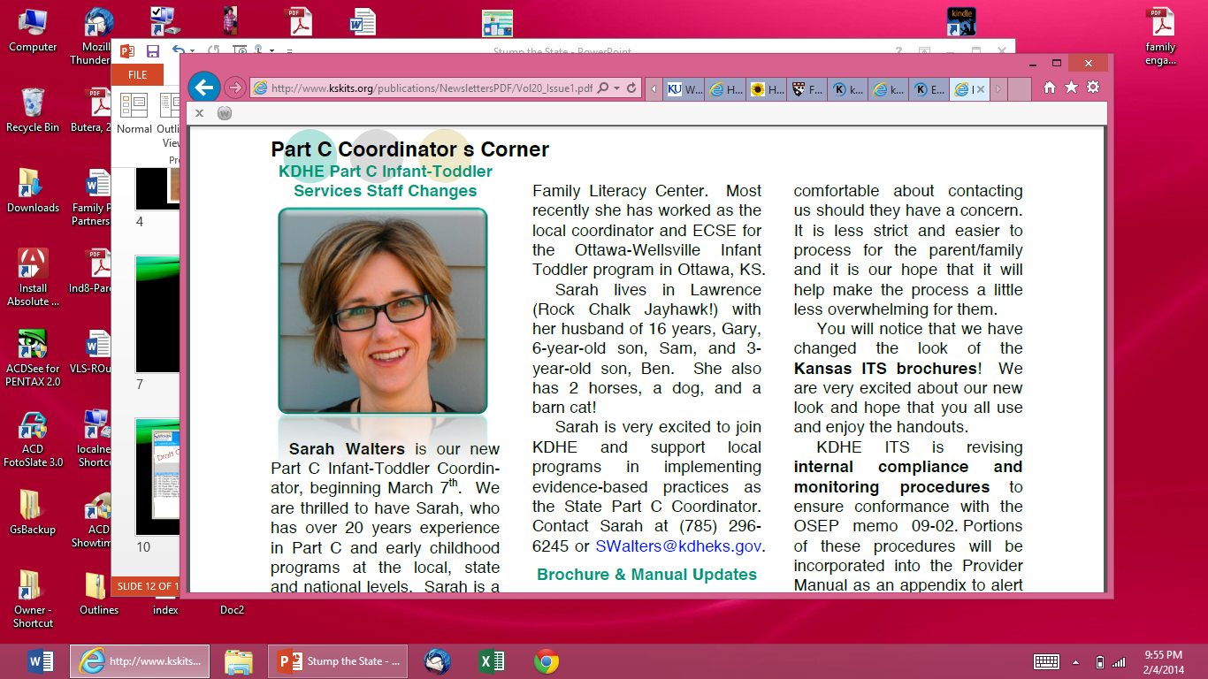

State Program Coordinators
Part C and Part B 619
Sarah Walters
Part C Infant-Toddler Coordinator
Kansas Department of Health & Environment
785-296-6245
Swalters@kdheks.gov
Vera Lynne Stroup-Rentier
Part B 619 Coordinator
Kansas State Department of Education
785-296-5081
vstroup-rentier@ksde.org

Slide 56
Using an Implementation Science Framework to Plan
Child Outcomes Integration
Sherri Britt Williams
Statewide Planning & TA
NC Part C Program

Slide 57
Stages of Implementation
Exploration
Articulate Desired Changes/ Results
Compare Approaches
Installation
Secure Leadership Support
Build Implementation Team
Initial Implementation
Implement Training & TA
Implement an Integration IFSP & COM Process
Full Implementation
Explore Implementation
Conduct Public Awareness
Move on To Installation
Develop a Communication Plan/ Message Materials
Determine System Supports
Build Training & TA Capacity
Develop an Implementation Plan
Move on to Initial Implementation
Support Reflection & Use of Feedback Loops
Adapt & Adjust Infrastructure to Support Practices
Evaluate Fidelity & Quality of Initial Efforts
Make changes to support Sustainability
Maintain & Improve Skills & Practice
Maintain Infrastructure for Data Collection & Monitoring
Assess Implementation of Integrated Process
Create Organizational Structures to Support Integrated Process
Take Action to Ensure Sustainability
Notes:
NIRN &
Implementing an Integrated Child & Family Outcomes and IFSP/IEP Process

Slide 58
Expansion/ Scale-Up
Pilot Sites Assist in Expansion
Establish Mechanisms for Sustaining Fidelity of Practices
Select New Sites & Provide Necessary Supports
New Sites Begin Their Implementation Process
Notes:
ECTA Center’s A Guide to the Implementation Process: Stages, Steps, and Activities

Slide 59
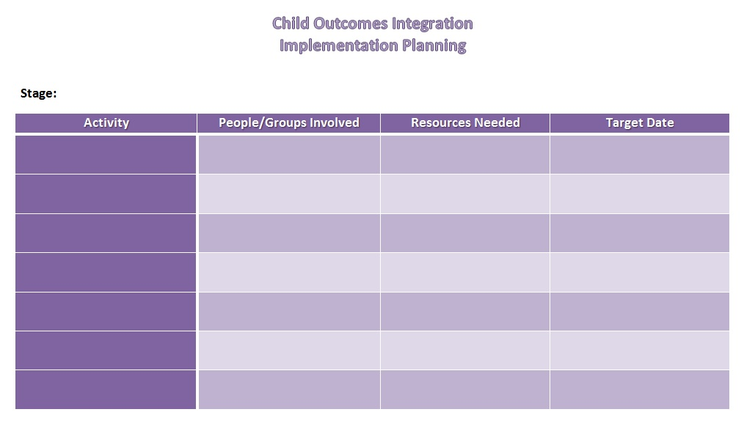
Implementation Planning Table

Slide 60
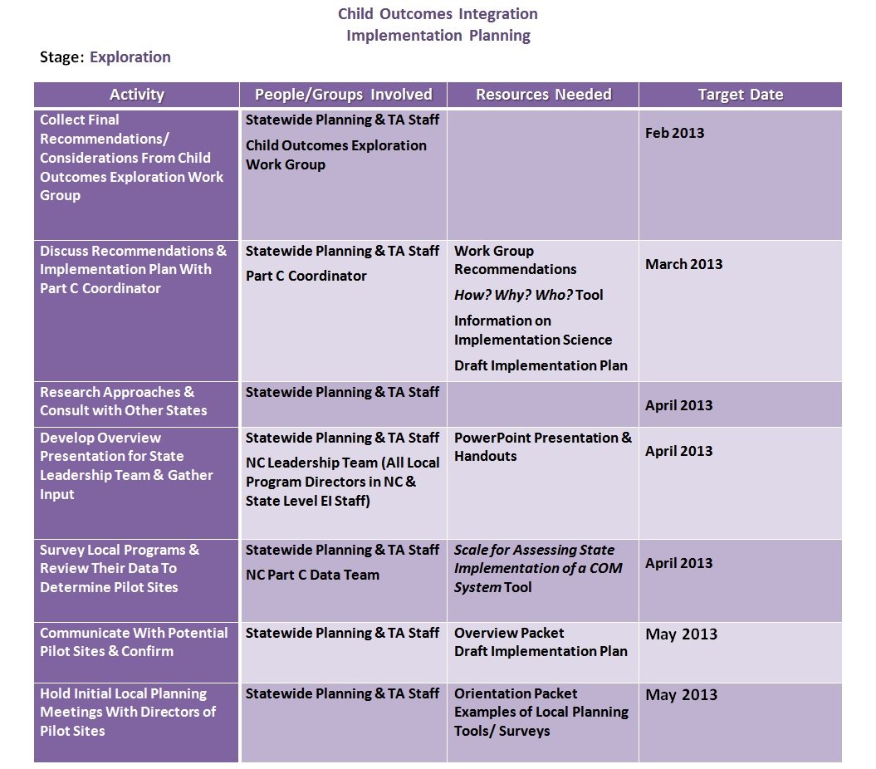
Sample Implementation Planning Table
Notes:
Example of what the Implementation Planning Table might look like with some activities filled in from the Exploration Stage of Implementation

Slide 61
Local Implementation Teams
Meet Regularly
Plan & Support Implementation Activities
Identify Opportunities For Integrating Work With Current Practice And Building Upon Existing Processes
Identify Training And Information Needs
Align Processes, Functions, And Roles With Accompanying Supports
Facilitate Communication/Feedback Loops
Evaluate Implementation Process And Fidelity

Slide 62
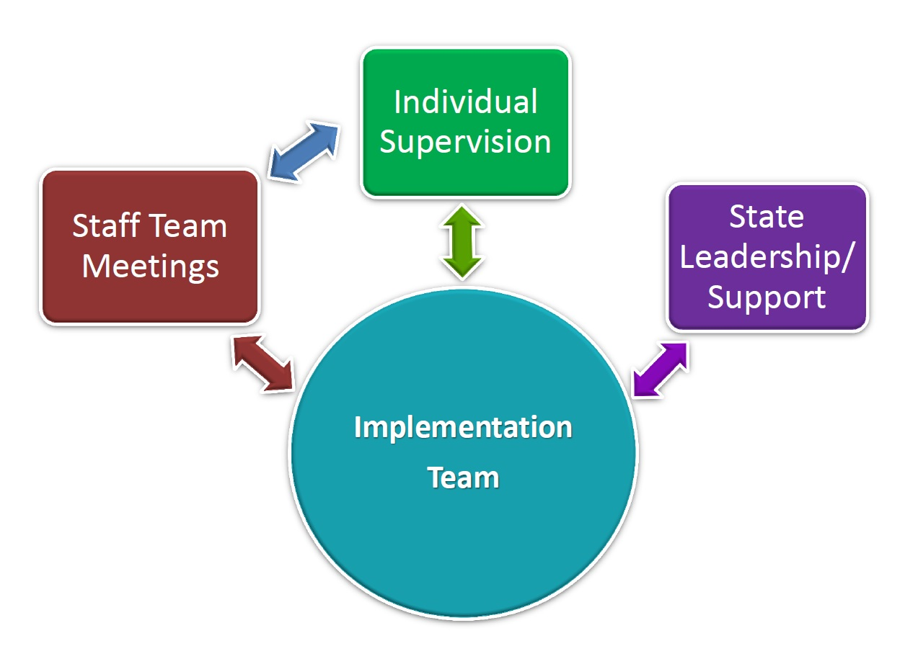
Communication & Feedback

Slide 63
Evaluation Planning
Start with Logic Model or
Other Description of the Initiative with
Desired Activities, Outputs and Outcomes
What Is Our Focus Area?
What Do We Want To Know? (Evaluation Questions)
How Can We Find Out? (Data Collection Indicators/Methods)
What Support Do We Need To Get This Done? (Necessary Technical Assistance)
With Whom Will We Share Our Findings/Insights? (Stakeholders)
What Will We Do With The Evaluation Results? (Recommendations/Decisions)

Slide 64
Improve
Sustain
Expand
Data Collection/Monitoring Is Ongoing
Communication/Feedback Loops Continue

Slide 65
Helpful Resources
National Implementation Research Network
  http://nirn.fpg.unc.edu/
An Interactive Guide to Implementing an Integrated Child & Family Outcome and IFSP/IEP Process
  http://www.ectacenter.org/implementingintegrated/
A Guide to the Implementation Process: Stages, Steps and Activities
  http://ectacenter.org/~pdfs/implementprocess/implementprocess-stagesandsteps.pdf
W.K. Kellogg Foundation Evaluation Handbook
  http://www.wkkf.org/resource-directory/resource/2010/w-k-kellogg-foundation-evaluation-handbook

Slide 66

Integrating the Child Indicators in Virginia
Option to integrate narratives from initial training in Jan/Feb 2007.
In 2011, identified need to update training materials.
  Task Force: Group of LSMs, providers, state TA, state staff
  Outcome: Training wasn’t enough – it was philosophical shift that was needed
Notes:
Virginia has a long history of allowing localities quite a bit of flexibility. As a local, I love this option! When we implemented the child outcomes summary process in March 2007, we gave all localities the option of integrating the narrative. A handful of us chose to do this.
Over the next five years, a few more systems came on board with integrating the child outcomes, but not all. Everyone who integrated the child outcomes into their narratives were happier with the process.
In 2011, the need to update the training materials was a glaring issue. Our materials were too focused on the initial implementation of the child outcomes process, rather than on bringing new staff on to a system already in place.
Gathered a group of stakeholders –state office staff, TA Partners, and locals at varying places in the integration workChild outcomes are not a “task” on our to do list – they are the foundation of everything we do from the initial referral all the way through transition.

Slide 67

The 3 Child Indicators
The Foundation of everything we do
Starts at referral to intake to assessment and carries through into the IFSP
Notes:
One of the things everyone agreed on was we cannot possibly gather all the information we need about how a child performs across settings and situations (such as daycare, at WalMart, when visiting grandma, meeting a friend at the park) in the very limited time we have for the assessment. We must rely on the information we receive at referral and at intake as well as the information that we gather from the parent. The parent is a critical reporter of this information unless we plan to shadow the family 24/7 for at least a week!

Slide 68
Notes:
By the Spring of 2012, we had revised the IFSP to reflect this change. We had planned to implement 7/1/12, but decided we needed to utilize early implementers to ensure we had all materials ready for statewide use.
Virginia has 40 local systems grouped into 6 regions. We purposefully chose systems from each region of the state as the early implementers so they could support the statewide implementation through the monthly regional meetings with their TAs

Slide 69

Virginia’s Integration of Child Outcomes into IFSP Process
Quality Practices provided the foundation of VA’s integration
Focus was on process not changes to the IFSP form
Consistent framework statewide
Notes:
Anne
Used as the foundation of our integration to help service coordinators and providers see the link between what they do and the child outcomes. It was very important to take the emphasis off of it being a new way to complete the IFSP but instead a whole new way of doing business starting from that very first phone call at referral, thru each step of the family’s journey in early intervention until the time they eave the program at transition. The Quality Practices document provided that consistent framework for systems to integrate child and family outcomes into each step of their local processes.

Slide 70
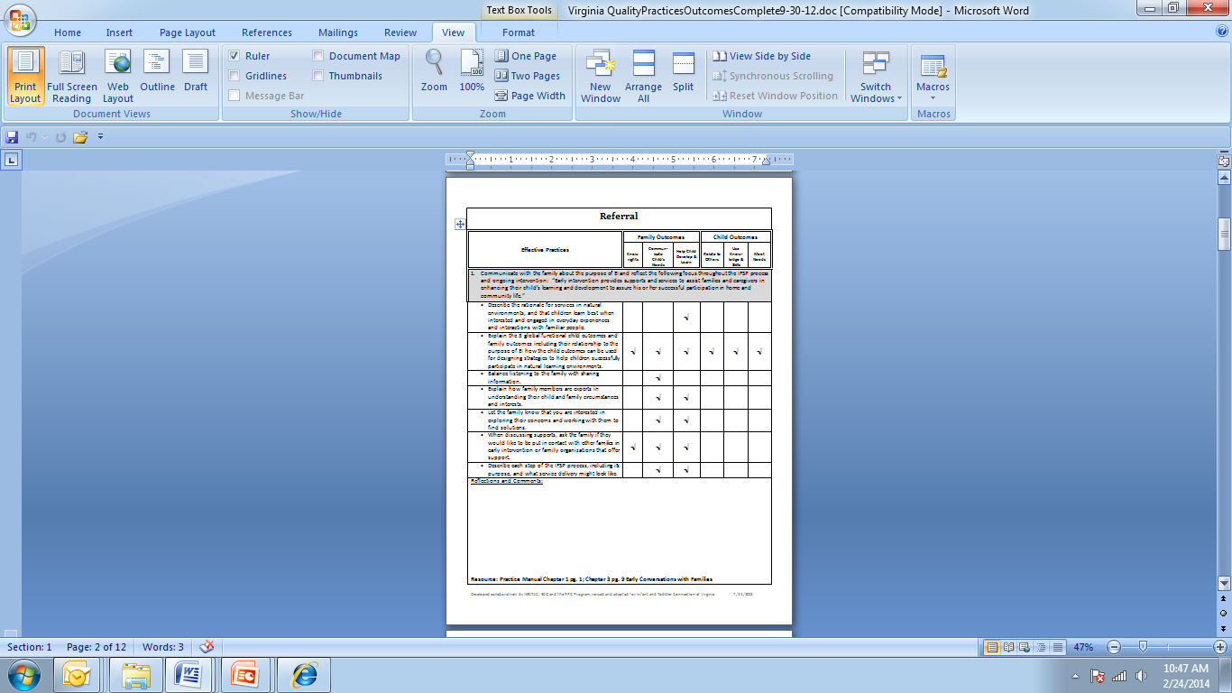
Keys to Successful Implementation
Quality Practices were aligned with Virginia’s IFSP process
Each component rolled out one month at a time
Notes:
By breaking QP and our process into components, it gave Local systems time to review what was presented and discussed and integrate it that month for each particular function in the EI process (for example – what the people on the phone say when they get a referral, revision of intake form, training staff in how to communicate about outcomes as the purpose of EI, not about services EI provides), etc.

Slide 71

Regular Meetings with Ongoing Assessment
Notes:
We had monthly meetings with all early implementers including the local system managers, service coordinators, providers, single point of entry staff, who ever was involved in the process. Each call included presentation of information including that months section of the Quality Practices for implementation plus discussion and questions. In order to keep the focus on the process and not the document, we didn’t share the new IFSP until month three of the early implementer roll out. An essential piece was local system ongoing assessment of where the local system currently was in their processes and what they could do to improve. There were two documents that we used to guide this phase.

Slide 72
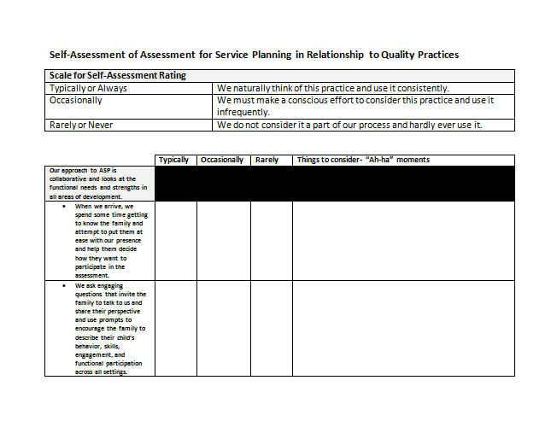
Self-Assessment
Notes:
one is a self assessment that we developed using the quality practices that systems used to review their process

Slide 73
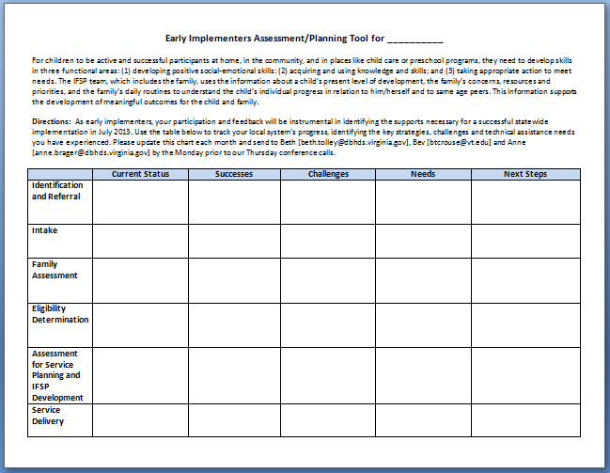
Monthly Feedback Tool
Notes:
and the other is a planning tool that systems completed based on their findings of the self assessment and turned into to us each month. A lot of months, the feedback resulted in changes to materials, the development of new materials and changes to the proposed IFSP.

Slide 74
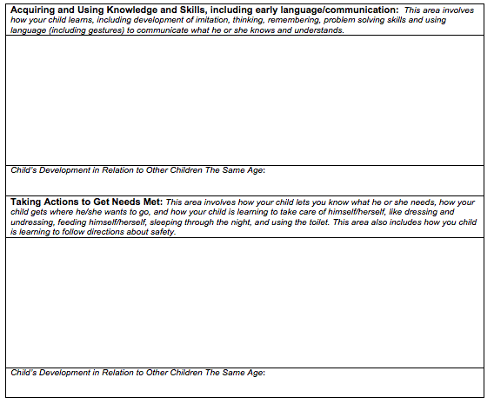
Functional narrative related to the specific indicator
Indicator Statement
Functional narrative related to the specific indicator
Indicator Statement
Notes:
We also included the statement on the IFSP which has really led to honest communication with families as they are now part of the discussion. This is the assessment for service planning section of out IFSP. Narrative are written functionally in the context of the three child outcomes instead of developmental domains.

Slide 75

Getting From Domains to Functional Assessment
The “Book”
Guiding Questions
Outcome Rating
Statements
Feedback on Narratives
Notes:
For some, making the shift from thinking in developmental domains to functioning in the three child outcomes was uncomfortable. So before implementation, tools were developed to help support the shift in thinking

Slide 76

Where is Near Somewhat?
Notes:
we were getting feedback from the field that the language of the rating statements were confusing to some providers and families

Slide 77
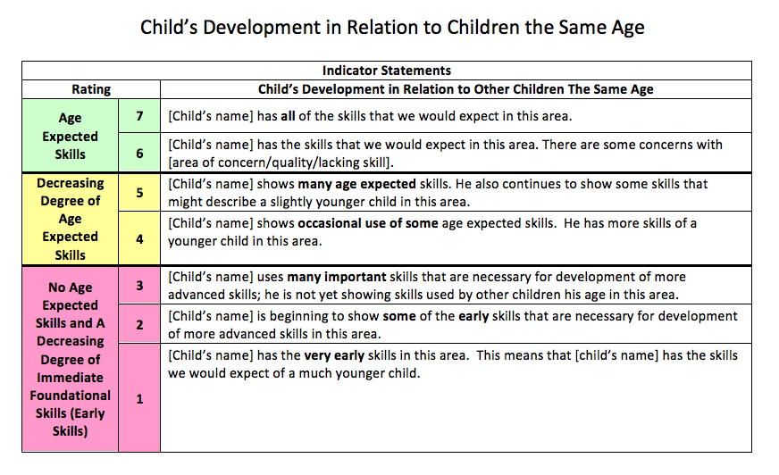
Notes:
We tweaked the statements and color coded them. 6 and 7 green for all age expected skills. Yellow some age expected and pink no age expected. We also have the statements on a laminated card without the numbers for providers to share with families during discussions.

Slide 78


Notes:
We also revised our child indicators booklet that provides the resources for completing the ratings including a description of age expected functional skills for each month range birth to 36 months. We are in the process of updating to version three based on what we’ve learned thru our implementation process.

Slide 79

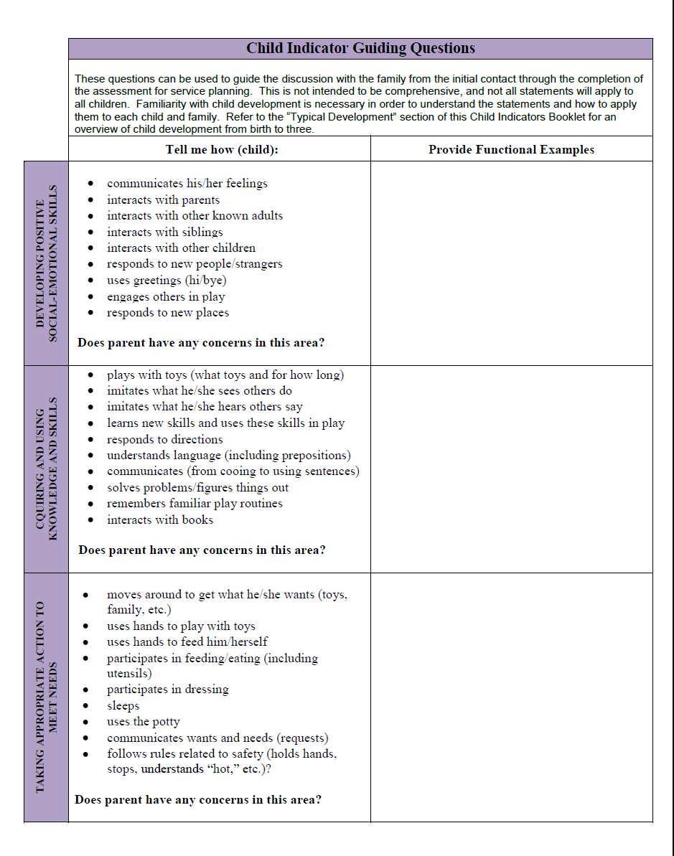
Child Indicator Guiding Questions
Notes:
Many use the Guiding Questions document to begin capturing the rich, functional information families share at each step of the process. The information is then passed on to the Intake and eligibility teams who continue to add to it and it ultimately becomes a useful starting point of the assessment for service planning process. Families appreciate that someone has listened, captured and shared with team members along the way the information the family has shared.
Began using this in MD as a way to capture the rich functional information service coordinators were gathering during their initial conversations with families so that it could be shared with the assessment team.

Slide 80
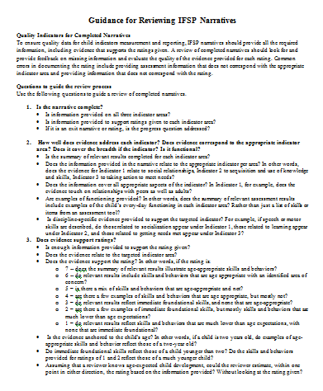
Feedback on Narratives
Feedback provided to each system on 2-3 IFSPs per month
Feedback also provided to each system statewide before full statewide implementation
Notes:
Providing feedback on the IFSP narratives was huge for us for quality assurance purposes. While it was very time consuming it allowed us the opportunity to see what supports folks needed and the additional training that was needed as we planned for the statewide rollout. Switching from writing the narrative from the perspective of the five developmental domains to the three child outcomes was definitely a challenge for some as well as writing functional assessment findings vs discreet test items. Thru the feedback process we did a lot of work around the supporting evidence of the rating and interrater reliability.
Feedback continued during statewide rollout during monthly regional meetings. Each system brought an IFSP that was reviewed during the meeting with the intent of modeling to the local system managers how to provide feedback to their staff. The TAs made this a standing activity at regional meetings until the LSMs were confident in their systems understanding of the process and the validity of the data.
The other piece we saw through the process was how our focus on the three child indicators and using the QP document leads NATURALLY to identification of specific functional individualized child outcomes (and supports earlier work of the state in providing statewide training/TA on functional individualized child outcomes).

Slide 81
Connecting the Dots in Virginia
Replaced state principles with national 7 Key Principles
Child Outcomes Gone Awry: Putting the Pieces Together trainings
  http://www.youtube.com/watch?v=BoTuVtijx34
Statewide Coaching Initiative
Connection of Key Principals Visual
Notes:
Virginia has adopted the 7 Key Principles as our way of doing business and replaced our 10 principles (which pretty much aligned with the national principles except for a couple of process items around family cost) in Chapter 1 of our Practice Manual.
Last summer at our annual Creating Connections to Shining Stars conference we launched our Putting the Pieces Together focus. While searching the internet for videos for the training, I came across Judy Swett’s Child Outcomes Gone Awry video and it has become a wonderful tool for training and discussion of how the key principals like functional outcomes, coaching, families as the best teachers and using familiar routines and activities all fit together to influence child and family outcomes results. This work continues around the state thru local and regional trainings.
Kathy, can we watch this video?
To support the work we have been doing with the quality practices and key principles, we have brought Dathan Rush and M’Lisa Sheldon to most of the regions of the state. They have provided master coaches and coaches training with six month followup support via coaching logs and phone calls. We have two more trainings scheduled in the spring and we will have reached the entire state. The implementation of QP has also reinforced the information team members need to be able to use coaching and natural learning environments practices.
A draft visual of what early intervention is and looks like for use with families, physicians and stakeholders. This and a quote or two from the American Academy of Pediatrics Position Statement on Early Intervention will be added to our Child Indicator booklet in an attempt to really explain what early intervention really looks like in every day life. These principles really describe what it is that we want to do with children and families to support the overall achievement of the mission.

Slide 82

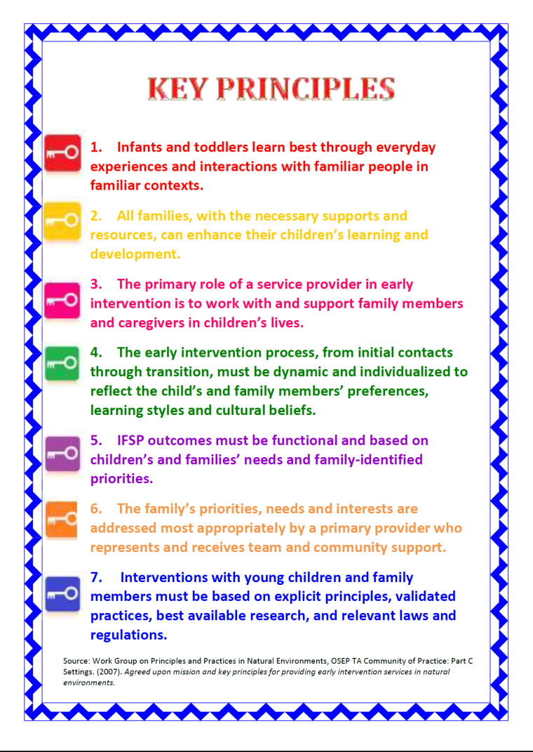
Connecting the Dots- the what, the why and the how
Notes:
Laminated cards providers use to explain early intervention to families based on the nationally recognized mission and purpose as well as the 7 key principles

Slide 83
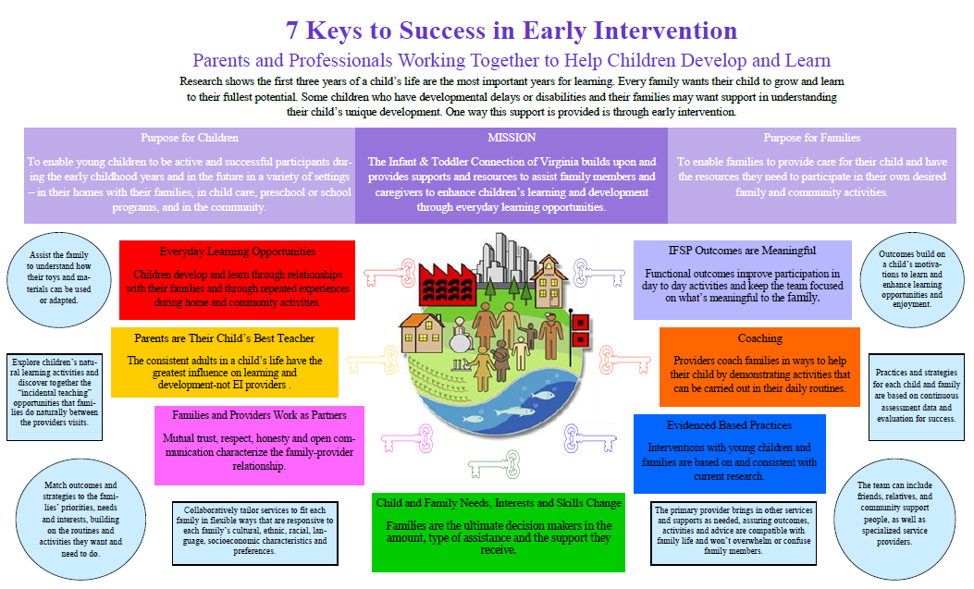
Notes:
Providers have been asking for a simpler, family friendly way to explain what early intervention is and what it looks like for use with families, physicians and stakeholders. They like the key principles but at times find them too jargony for some families so we developed this poster that also has the mission, purpose, key principles and an example of each principle in action. This and a quote or two from the American Academy of Pediatrics Position Statement on Early Intervention will be added to our Child Indicator booklet in an attempt to explain what early intervention really looks like in every day life. These principles really describe what it is that we want to do with children and families to support the overall achievement of the mission.

Slide 84

Essential Components/Next Steps
Essential Components:
Feedback
Not a one time training
Next Steps:
Continue to connect the dots
Data analysis thru pattern checking
Explore formal integration of family outcomes
Coordinate this work with the SSIP
Notes:
Creating a safe learning environment was essential! Providers were initially hesitant to send their IFSP’s but by providing constructive feedback often referencing back on the Quality Practices and Key Principles turned out to be the key to in helping the field feel competent and confident. And for us, being open to the feedback from the field whether it was changes recommended by our early implementers prior to the statewide rollout and ongoing. We are in the process now of making the third revision to our child indicator booklet as well as making changes to the decision tree to better align to our indicator statements.
When we did our statewide trainings, we did it regionally to allow for the maximum number of providers to be present. We also did them early enough before the July 1 rollout date so providers had a lot of time to practice and receive feedback. If local systems found they needed more support, we did follow-up trainings geared specifically at their needs. Building the capacity of the local system managers to provide the ongoing training and feedback was also critical. We continue to provide feedback on narratives thru our Quality Management Review process and regional work.
Continue to help providers connect the dots. We are revising many of our training materials, online modules, Kaleidoscope (required training for SCs) and our practice manual in a way that helps providers see the connection. As we move forward in our professional development activities, especially the increased focus on evidence based practices, the key principles and coaching we will continue to tie it all back to the relationship between quality practices and outcomes for children and families.
How might use the tool to facilitate the integration of outcomes in your state?

Slide 85
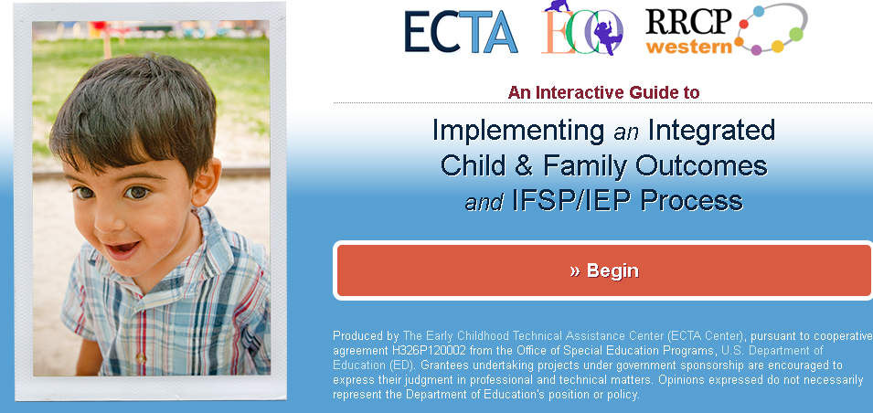
Resources
Integrating Outcomes Web Page
http://ectacenter.org/eco/pages/integration.asp
An Interactive Guide to Implementing an Integrated Child and Family Outcomes and IFSP/IEP Process
http://ectacenter.org/implementingintegrated/default.asp
Notes:
Let’s focus on making the connection between what we know about how children learn and how the adults in a child’s life can best support his/her development and what professionals do with children and families. The ultimate goal of EI/ECSE services is to enable children to be active and successful participants in a variety of settings throughout their lives. In order to accomplish this goal, professionals must use the methods, models and interventions supported by research to help reinforce the confidence and competence of families to meet their child’s needs and to participate in the community in ways that are meaningful to them.
The goals for children and families, as they are worded here, were developed by the Early Childhood Outcomes (ECO) Center in the process of developing the three outcomes that we now measure to show the effect of IDEA services on the development of young children ages birth through 5 years. A year long process involving stakeholders from all over the nation and from many perspectives – providers, state and local administrators, researchers, family members, TA providers, and so forth – resulted in defining the overarching goals and the specific outcomes of early intervention and early childhood special education programs.

