Slide 1
Section 619 and Part C Meeting of States With RTT-ELC Grants September 8, 2014

Slide 2
Intended Outcomes
This meeting will provide an opportunity for sharing ideas and strategies for:
developing partnerships that ensure that services for children with disabilities are included in RTT-ELC planning efforts and initiatives,
developing local program capacity to support inclusive practices,
developing professional development and TA strategies utilizing coaching and virtual approaches, and
integrating IDEA early childhood data and procedures with States’ data and TQRIS systems.

Slide 3
State Highlights and Discussion
Nancy Vorobey
Section Chief, Early Childhood Intervention and Education
Maryland State Department of Education
Kate Rogers
619 Coordinator
Vermont Agency of Education
Bruce Sheppard
EI/ECSE Specialist
Oregon Department of Education

Slide 4
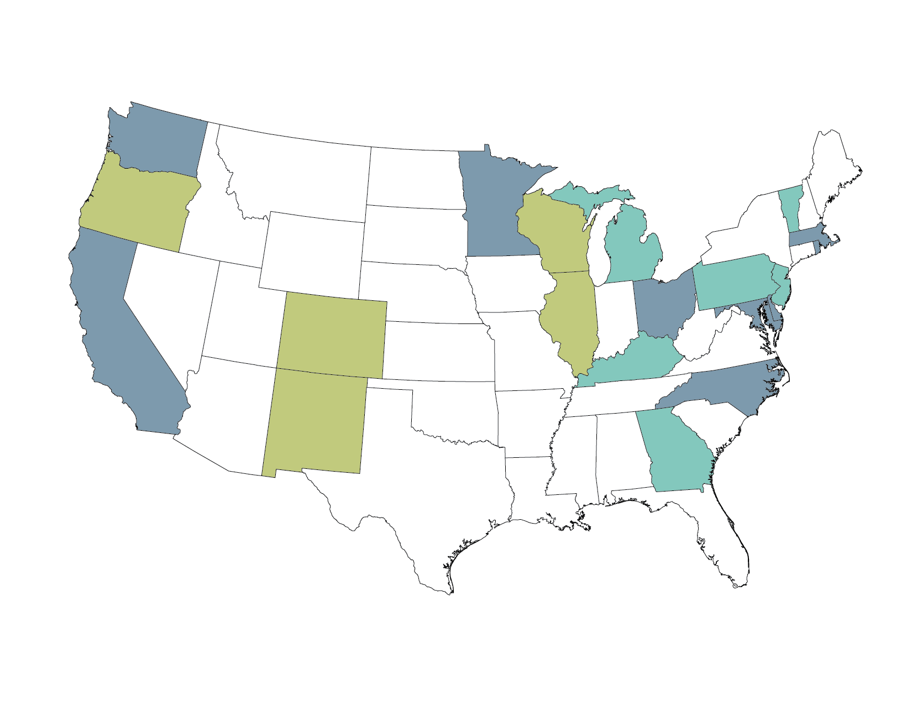
Race to the Top Early Learning Challenge States
Phase 1- 2011
CA | $75,000,000
DE | $49,878,774
MD | $49,999,143
MA | $50,000,000
MN | $44,858,313
NC | $69,991,121
OH | $69,993,362
RI | $50,000,000
WA | $60,000,000
Phase 2- 2012
CO | $44,888,832
IL | $52,498,043
NM | $37,500,000
OR | $30,763,353
WI | $34,052,084
Phase 3- 2013
GA | $51,739,896
KY | $44,348,482
MI | $51,737,456
NJ | $44,286,728
PA | $51,734,519
VT | $36,931,076

Slide 5
What is RTT-ELC?
Federal discretionary grant program designed to support states in building statewide systems that help all children enter kindergarten ready to succeed by
raising the quality of Early Learning and Development Programs and
increasing access to high-quality programs for children with high needs
Jointly administered by the U.S. Department of Education and the U.S. Department of Health and Human Services
Notes:
systems-building grant program that is designed to support states in raising the quality of their early learning and development program and increasing access to these high quality programs for children with high needs.
Let's take a quick look at which states we're talking about..

Slide 6
Early Learning Governance in Race to the Top Early Learning Challenge States
Source: https://elc.grads360.org/services/PDCService.svc/GetPDCDocumentFile?fileId=3935

Slide 7
RTT-ELC Definitions: Early Learning and Development Programs
(a) State-licensed or State-regulated program or provider, regardless of setting or funding source, that provides early care and education for children from birth to kindergarten entry, including, but not limited to, any program operated by a child care center or in a family child care home;
(b) preschool program funded by the Federal Government or State or local educational agencies (including any IDEA-funded program);
(c) Early Head Start and Head Start program; and
(d) a non-relative child care provider who is not otherwise regulated by the State and who regularly cares for two or more unrelated children for a fee in a provider setting.
A State should include other programs that may deliver early learning and development services in a child’s home, - Maternal, Infant and Early Childhood Home Visiting; Early Head Start; and Part C of IDEA[1].
[1] Note: Such home-based programs and services will most likely not participate in the State’s TQRIS unless the State has developed a set of Tiered Program Standards specifically for home-based programs and services.
Notes:
So under RTT-ELC , an early learning and development program is broadly defined to include any state-licensed or regulated child care or family care program, any preschool program - notice that Part B, Section 619 preschool programs are included in this definition. any early head start and head start, and any non-relative child care provider who meets these definitonal elements. Further , sates are encouraged to include home visiting programs and programs that deliver services through Part C of IDEA. There is an important note here however, is that the definition clarifies that some programs like Part C and home visiting might not participate in the TQRIS, given the home-based nature of those programs. Some states are, however, establishing quality standards for home based programs and services and you'll hear more about that from the states themselves.

Slide 8
Promoting Participation in the State's TQRIS
States are implementing effective policies and practices to reach the goal of having all publicly funded Early Learning and Development Programs participate in a statewide TQRIS system, including --
(1) State-funded preschool programs;
(2) Early Head Start and Head Start programs;
(3) Early Learning and Development Programs funded under section 619 of Part B of IDEA and Part C of IDEA;
(4) Early Learning and Development Programs funded under Title I of the ESEA; and
(5) Early Learning and Development Programs receiving funds from the State’s CCDF program;
States set targets for the numbers and percentages of Early Learning and Development Programs that will participate in the TQRIS.

Slide 9
Increasing the number and percentage of Early Learning and Development Programs participating in the statewide TQRIS
Type of Early Learning and Development Program in the State | Number of programs in the State | Baseline and Annual Targets -- Number and percentage of Early Learning and Development Programs in the Tiered Quality Rating and Improvement System
 |  | Baseline | Annual Targets
State-funded preschool
Early Head Start and Head Start
Programs funded by IDEA, Part C
Programs funded by IDEA, Part B, section 619
Programs funded under Title I of ESEA
Programs receiving from CCDF funds
Other
Performance Measure (B)(2)(c)
Notes:
think about where data comes from in your state. may want to learn more about it.

Slide 10
Increasing the number of Early Learning and Development Programs in the top tiers of the TQRIS
 | Baseline | Annual Targets
Total number of programs covered by the TQRIS
Number of programs in Tier 1
Number of programs in Tier 2
Number of programs in Tier 3
Number of programs in Tier 4
Performance Measure (B)(4)(c)(1)

Slide 11
Increasing the number and percentage of Children with High Needs who are enrolled in Early Learning and Development Programs that are in the top tiers of the TQRIS
Type of Early Learning and Development Program in the State | Number of Children with High Needs served by programs in the State | Baseline and Annual Targets -- Number and percent of Children with High Needs Participating in Programs that are in the top tiers of the Tiered Quality Rating and Improvement System
 |  | Baseline | Annual Targets
State-funded preschool
Early Head Start and Head Start
Early Learning and Development Programs funded by IDEA, Part C
Early Learning and Development Programs funded by IDEA, Part B, section 619
Early Learning and Development Programs funded under Title I of ESEA
Early Learning and Development Programs receiving funds from the State’s CCDF program
Other
Performance Measure (B)(4)(c)(2)
Notes:
^{[1]} Including Migrant and Tribal Head Start located in the State.
(B)(4) Promoting access to high-quality Early Learning and Development Programs for Children with High Needs. (20 points)
The extent to which the State and its Participating State Agencies have developed and implemented, or have a High-Quality Plan to develop and implement, a system for improving the quality of the Early Learning and Development Programs participating in the Tiered Quality Rating and Improvement System by--
(a) Developing and implementing policies and practices that provide support and incentives for Early Learning and Development Programs to continuously improve (e.g., through training, technical assistance, financial rewards or incentives, higher subsidy reimbursement rates, compensation);
(b) Providing supports to help working families who have Children with High Needs access high-quality Early Learning and Development Programs that meet those needs (e.g., providing full-day, full-year programs; transportation; meals; family support services); and
(c) Setting ambitious yet achievable targets for increasing--
(1) The number of Early Learning and Development Programs in the top tiers of the Tiered Quality Rating and Improvement System; and
(2) The number and percentage of Children with High Needs who are enrolled in Early Learning and Development Programs that are in the top tiers of the Tiered Quality Rating and Improvement System.

Slide 12
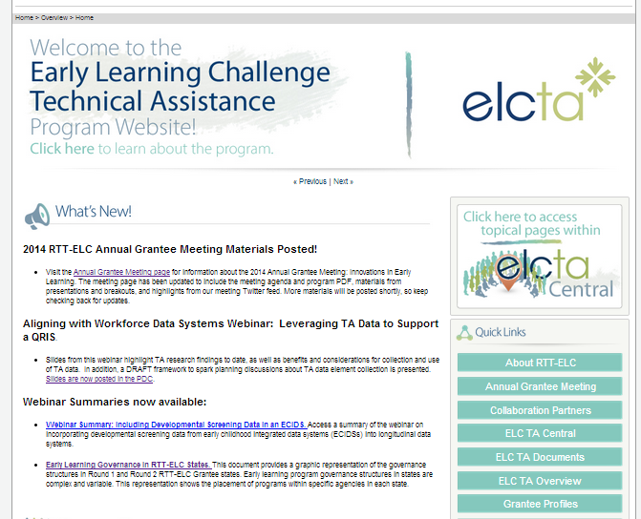
Communities360 visit at elcta.org

Slide 13
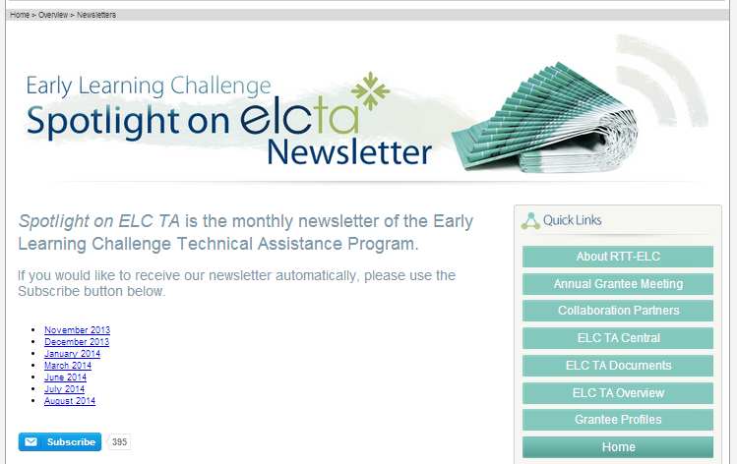
Communities360 visit at elcta.org

Slide 14
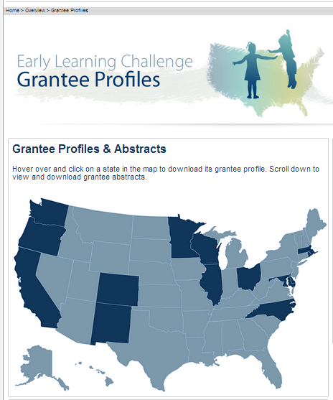
Communities360 visit at elcta.org

