Slide 1
ECIDS and DaSy: Frameworks for Building Better Data Systems
Presented at: Improving Data, Improving Outcomes
New Orleans, LA
September 2014
Notes:
Make font larger

Slide 2
Today’s Presenters
Missy Cochenour
SLDS State Support Team/DaSy/CEDS
Colleen Murphy
Parent Support Programs Manager, Utah Department of Health, Bureau of Child Development
Donna Spiker
Project Co-Director, DaSy

Slide 3
Session Objectives
Share overview of ECIDS Toolkit and DaSy framework
Discuss how these frameworks can help you use your data through current state examples
Present implications for integrating early childhood program data into P-20+ State Longitudinal Data Systems (SLDS)

Slide 4
Overview:
The ECIDS Toolkit

Slide 5
ECIDS Toolkit – Purpose
Provide a method for states to assess progress in developing and ECIDS
Enhance the capacity of states working to integrate data across early childhood to understand the key pieces of an ECIDS and how it connects with the other states integrated data system efforts so they can lead or actively participate.
Provide resources and state examples to help build better systems of services and programs that will improve outcomes for young children and families.
Offer practical suggestions for each step in the overall process of integrating EC data and connecting it to an SLDS.

Slide 6
Purpose of Revision
Update content based on information learned over the last two years
― Terms change (E.g. EC LDS → ECIDS)
Expand the focus beyond planning to planning and beyond
― Drop the “planning” in “Planning Guide”
Add criteria to the self-assessment tool
Update resources and to PDC for state reference.
States can continue to learn from each other across states as they work on the guide.

Slide 7
Components of the ECIDS Toolkit

Slide 8
What is the ECIDS Toolkit?
The ECIDS Toolkit includes:
Self-Assessment
Guide (the narrative)
These documents are being revised in response to states’ requests to update the information.

Slide 9
The ECIDS Toolkit
Self-Assessment Tool | Guide
Introduction to the self-assessment | Introduction to the guide
Definition of key indicators and elements of quality | Glossary of terms
Each component will have:
 | Definition of terms for that component
Purpose of the component | Purpose for the component
Key indicators | Content Subsections (aligned to key indicators)
Elements of quality | Resources

Slide 10
ECIDS Toolkit – Intended Uses
Intended Users:
ECIDS Leads, Core Teams, Early Childhood Executive Leadership, P-20W+ Partners
Intended Uses:
Determine progress made around ECIDS and alignment to P-20W+
Understand the key pieces of an ECIDS and how it connects with the other states integrated data system efforts
Allow states to determine their strengths and areas of needed improvement
TA Goals
Resource allocation in states
Facilitate State discussions
Share lessons learned from other states

Slide 11
ECIDS Toolkit Release!

Slide 12
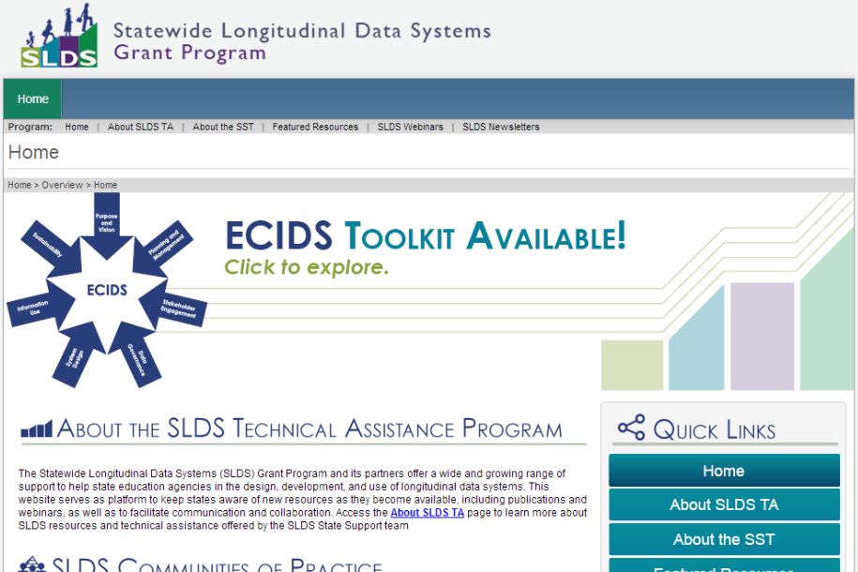
Main SLDS Page

Slide 13
ECIDS Toolkit Home Page (1 of 2)

Slide 14
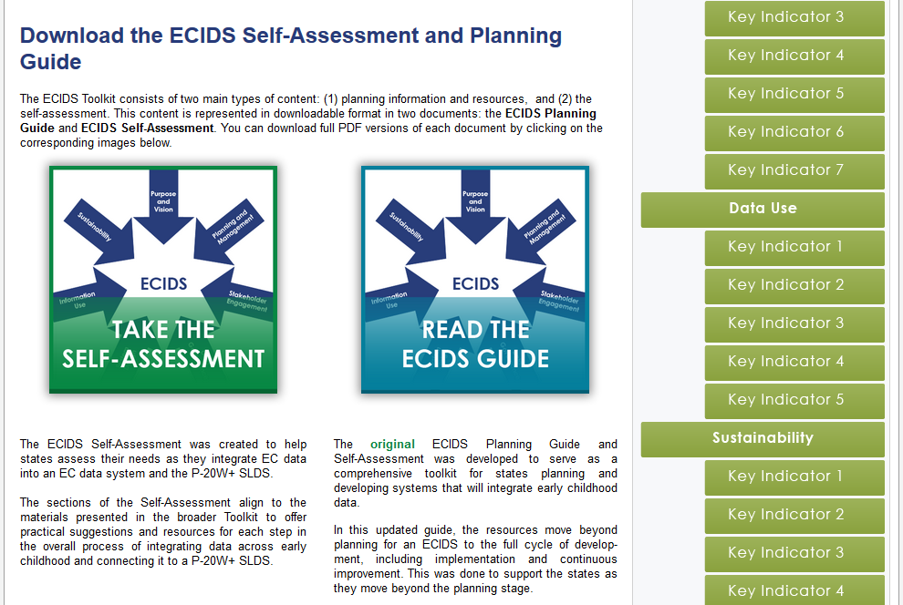
ECIDS Toolkit Home Page (2 of 2)

Slide 15
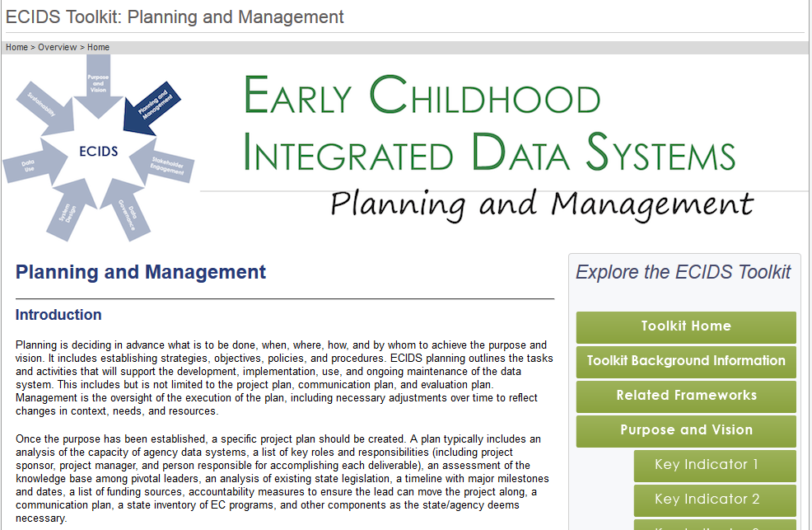
Component Page (1 of 2)

Slide 16
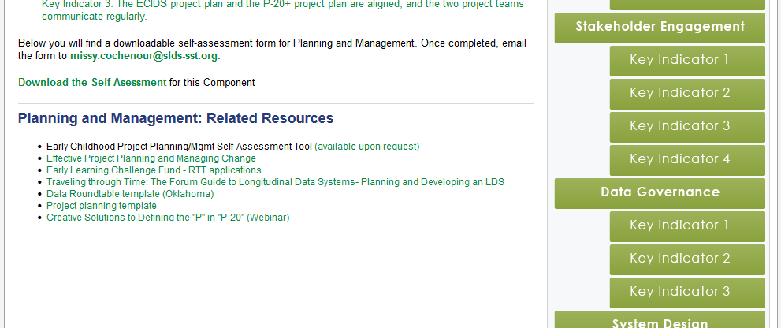
Component Page (2 of 2)

Slide 17
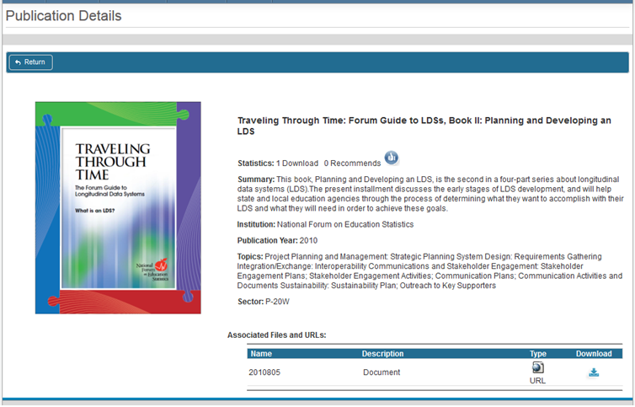
Resources Link to PDC

Slide 18
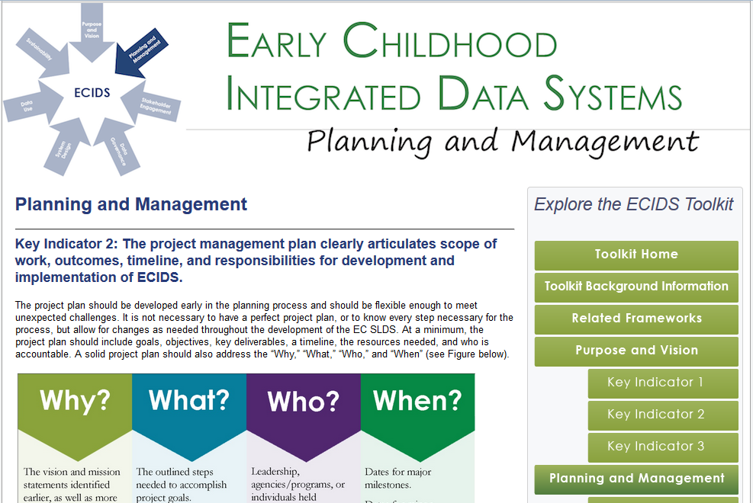
Key Indicator Page (1 of 2)

Slide 19
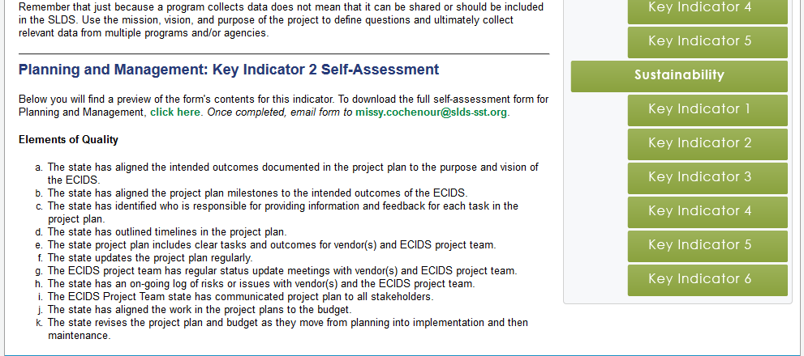
Key Indicator Page (2 of 2)

Slide 20
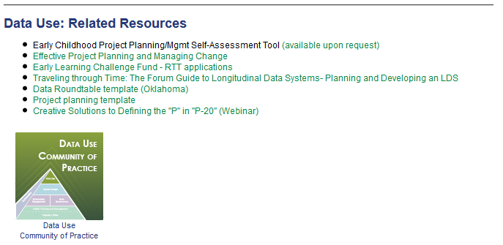
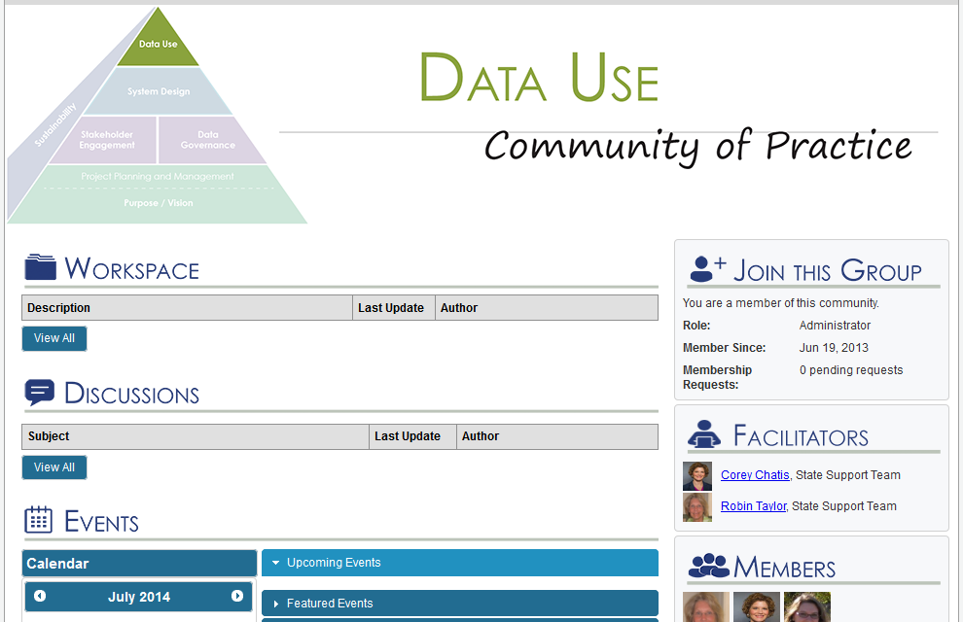
Connection to COPs

Slide 21
Brief Discussion
What did you see that you like?
What enhancements would you like to see in future developments?

Slide 22
Overview: The DaSy Framework
Notes:
Need to redo the DaSy slides on the DaSy template

Slide 23
Purpose of the DaSy Framework
To enhance the capacity of Part C and Part B 619 staff to
Understand the characteristics and capabilities of a good data system, so they can…
Lead or actively participate in state data system’s development efforts, including cross agency work, so they can…
Use their data system(s) to address IDEA reporting requirements and to answer important program and policy questions, which will…
Allow states to build better systems of services and programs that will improve outcomes for young children with disabilities and families.

Slide 24
The DaSy Framework
Introduction
Self-Assessment, with scoring rubric
Subcomponents, each has:
Introduction
Quality indicators
Elements of quality
Some subcomponents have sections
Glossary of terms
Subcomponent
Quality Indicator
Elements of Quality

Slide 25
DaSy Framework Subcomponents

Slide 26
The DaSy Framework will…
Provide a common language for DaSy and other TA providers to use in discussing Part C and Section 619 data systems with states.
Provide an organizing structure for categorizing resources and state examples related to Part C and Section 619 data systems (to be developed).
Serve as the organizing structure for a self-assessment (to be developed).

Slide 27
Collaborative Development

Slide 28
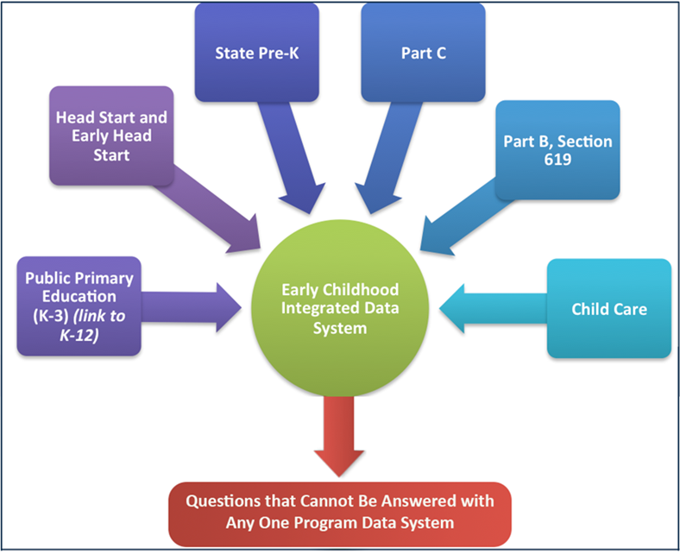
Why do we have both?
Critical factors for success are different for program data systems vs. integrated data systems
Audience varies
DaSy: Part C and 619 (program focused)
ECIDS: State teams working to integrate early childhood data (multiple programs and/or agencies)
Keep it from being too overwhelming to be together

Slide 29
Framework Relationships

Slide 30
Comparison of Components
ECIDS | DaSy
Purpose and Vision | Purpose and Vision
Planning and Management
Stakeholder Engagement | Stakeholder Engagement
Data Governance | Data Governance and Management
System Design | System Design and Development
Data Use | Data Use
Sustainability | Sustainability

Slide 31
State Partners
ECIDS (ECIDS Lead and IT Staff) | DaSy (Part C and 619 Staff)
Kansas | Alaska
Maine | Arkansas
Minnesota | Connecticut
Missouri | Georgia
North Carolina | Idaho
Utah | Massachusetts
Washington | Pennsylvania

Slide 32
External Reviewers
ECIDS | DaSy
Elliot Regenstein, Ounce of Prevention | Elliot Regenstein, Ounce of Prevention
Albert Wat, NGA | Albert Wat, NGA
Carlise King, ECDC | Carlise King, ECDC
Maria Taylor, National Registry Alliance | Andy Gomm, New Mexico Part C
Kathryn Tout, INQUIRE | Mary Corey, Missouri Special Education
Michelle Thomas, RTT-ELC | Lisa Backer, Minnesota Early Childhood Special Education
Fran Majestic, OHS | Colleen Murphy, Utah Early Childhood
Christina Kasprzak, ECTA | Chris Robin Payne, Rhode Island Part C

Slide 33
So What?
How can these frameworks help you use your data?

Slide 34
State Lessons Learned
Utah
To quote Aristotle, "The whole is greater than the sum of its parts." Through this work I have learned many ways to make my data system more efficient and more inclusive while gaining experience from "lessons learned." It has also helped to guide the timeline of my work. I have been able to collaborate with experts, save time, and this collaboration has given credibility to the work in Utah.

Slide 35
In Utah these tools have…
Helped to establish where to start
Used to assist in determining where are we going
Prevented scope/vision creep
Allowed Utah to individualize our data system

Slide 36
Alignment with P-20W+
Utah
The Early Childhood Integrated Data System is not located with the SLDS system.
It has been imperative to keep the larger vision in view as we have both developed our system.
This guide has helped delineate the different roles and responsibilities which helps our two systems to compliment each other.

Slide 37
Live Demo
https://slds.grads360.org/#program/ecids-toolkit

Slide 38
Discussion
How might this ECIDS guide/DaSy framework be helpful to you in your work?

Slide 39
Resources
ECIDS Toolkit Link:
https://slds.grads360.org/#program/ecids-toolkit
DaSy Link:
http://dasycenter.org/

Slide 40
Contact Information
Missy Cochenour, missy.cochenour@aemcorp.com
Colleen Murphy, cmurphy@utah.gov
Donna Spiker, donna.spiker@sri.com

Slide 41
Thank you!

Slide 42
The contents of this presentation were developed under a grant from the U.S. Department of Education, #H373Z120002. However, those contents do not necessarily represent the policy of the U.S. Department of Education, and you should not assume endorsement by the Federal Government. Project Officers, Meredith Miceli and Richelle Davis.

