Slide 1


Digging Deeper: Helping Programs Use Child Outcomes Data to Improve Services
Sarah Whitman (MA Part B Education Specialist)
Kristy Feden (NE Public Schools EC Supervisor)
Chelsea Guillen (IL Early Intervention Ombudsman)
Lauren Barton (DaSy, ECTA)
Barb Jackson (UNMC, ECTA)
September 2014, New Orleans

Slide 2
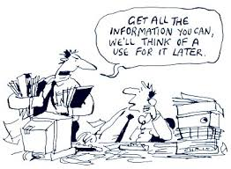

Slide 3

Importance of Building State and Local Capacity to Use data
Where have we been?
Building and Improving Processes for
Data Collection and Reporting

Slide 4

Now Collecting Data and Sharing Targets Around……
Summary Statement 1: Narrowing the Gap
Of those children who entered or exited services below age expectations in each Outcome, the percent
who substantially increased their rate of growth
when they exit the program.
Summary Statement 2: Meeting Age Expectations
The percent of children within age expectations
in each Outcome by the time they exit the program.

Slide 5
Importance of Building State and Local Capacity to Use data
Where are we going?
Building and Improving Process for Using Data
Improve Data Quality
Improve Services

Slide 6
Continuous Program Improvement Process
Review
Are we where we want to be?
Is there a problem?
Why is it happening?
Is it working?
What should be done?
Plan
Identify strategies based on child and program characteristics
Check
(Collect and analyze data)
DO
Notes:
The idea is that data is a critical piece in the continuous improvement process
Note though that there is variation from state to state in types of data available and when and what they have access to for use in this cycle….Some places this is part of what is being ironed out still…
Mechanism for distribution of data/analyses between local and state programs
Degree local programs have access to data
Timeliness of reports
As states shift from focusing only on the quality of the data into thinking about ways to use it, we see that the uses of data for program improvement vary depending on the level where the data is being reviewed… for instance…(3 levels) Note: for each of these uses, a variety of stakeholders are involved in reviewing, interpreting, and using the data. A key stakeholder in that is families.
How does this fit with what you are seeing in your state. Are there other ways you are using data???
Barb, I took out the what approaches are states using slide and the much variability in state approaches slide. The header slide I just wanted to cut down time and it didn’t seem essential. The variability slide content is incorporated between here and the summary statement slide in the words… See what you think.

Slide 7
Local staff participate as stakeholders reviewing data
States share data with local programs and encourage local review and use
States provide TA to support programs to understand and use their data
State expects local programs to submit plans and are accountable for improvement strategies
Examples of Variations in State Approaches and Expectations about How Programs Use their Data

Slide 8
Use data to inform practice with individual children or at caseload level
Review aggregate data to inform specific decisions
Variation in organizational structure, who takes responsibility to work with data and time available
Integration of data into ongoing program planning and improvement activities
Local program reports data with no expectation to use data
Variation in Local Program Use of Data:
Differences in capacity to access and interpret data, use software, know what it means

Slide 9
Engaging families in conversation about their own child’s outcomes
Support staff comfort with talking about data and process for how they are using it
Support parents’ understanding of child outcomes data in aggregate
Address staff concerns about how stakeholder input informs actions.
Integration of families and broader stakeholders in using data for continuous improvement and planning
Variations Involving Families in Data Use Activities:
Families are valued for their input as stakeholders

Slide 10
Using Child Outcomes Data to Improve Services
State-Level Perspective: Helping Programs or Districts Understand and Use Child Outcomes Data
Local-Level Perspective: Translating data into specific strategies to target planful changes
Family Perspective: Strategies to provide families with the background to discuss data and its local use

Slide 11

A State-Level Perspective: Helping Districts Understand and Use
Child Outcomes Data to Improve Services in Massachusetts
Sarah Whitman

Slide 12
Context
MA uses the COS Process & COSF
Data is collected based on a cohort model
  Districts collect entry data once every four years
  Exit data is submitted once per year until all students who participated in entry data collection have exited
  We do not collect progress data
Beginning in 2012, a statewide focus on improving data quality

Slide 13
ECSE Strategic Plan
Improve systems to engage effectively with families
Improve systems to assist transition from early intervention to prekindergarten and from prekindergarten to kindergarten
Improve instruction to increase educational outcomes in:
Social/Emotional Skills and Social Relationships
Acquiring and Using Knowledge and Skills
Taking Appropriate Action to Meet Needs
Early Childhood Special Education Leadership Academy
Comprehensive System of Personnel Development (CSPD) for Early Childhood Special Education (ECSE)
Home/School Partnership Initiative
Grant and Communities of Practice
Promoting Positive Social/Emotional Outcomes
Grant and Communities of Practice
Partnership with FCSN
Transition Forums and MOUs

Slide 14
Statewide Activities
Survey of Early Childhood Special Education Personnel
  Assess experiences with COS Process and need for additional PD
In 2013-2014 the Department of Elementary and Secondary Education sponsored state-wide 1-Day Trainings in the COS Process and Aligning the Outcomes to the IEP
We also offer several webinars throughout the year:
  Collecting Entry & Exit Data
  Technical Aspects of Data Collection & Reporting

Slide 15

Individualized Support
Purpose: To support data analysis, interpretation, and use, including improving data quality
Process:
  Districts upload data to the Department
  Conduct an initial review for data quality concerns/questions
  Schedule individual calls with relevant district personnel

Slide 16
Individualized Support
  Checking for Quality
  Is the data complete (includes ratings on each outcome, answers to progress questions, etc)?
  Do ratings across students at entry and at exit vary in expected ways?
  Is there a pattern of unusual progress or stagnation?
    Do all children enter or exit at the same rating?
    Are most or all children seeing the same change from entry to exit?
    Do children’s outcome ratings increase by more than 2 points on the 7 point scale from entry to exit?

Slide 17
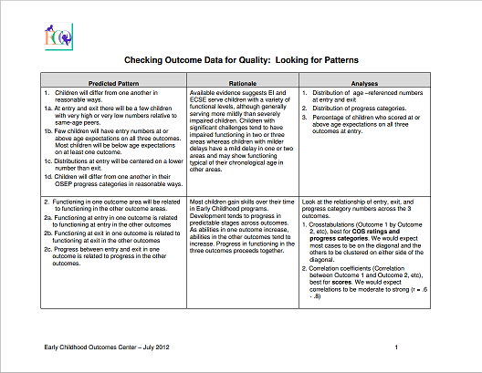
ECTA Guidance for Pattern Checking
    http://ectacenter.org/eco/assets/pdfs/Pattern_Checking_Table.pdf

Slide 18
Individualized Support –
Guiding Questions
Do you use any age-anchoring resources in the COS process?
Tell me about how the COS process is completed in your district….
How do you involve families in developing the ratings?
Given what we discussed, do these data make sense to you? Does it align with how you believe your students are performing?
Meaningful conversation about the data…

Slide 19
Reviewing Child Outcomes
Summary Forms
Supporting further integration and analysis
A sample of districts were asked to submit copies of their COSFs to the Department
Individual calls were scheduled with districts to discuss their COSFs
ECTA Guidance for Reviewing COSFs:
http://ectacenter.org/eco/assets/pdfs/8_GuidanceReviewingCOSFs.pdf

Slide 20

Challenges
Time Intensive Process
  Scheduling calls can be challenging
Level of Engagement
  Individuals’ interest in engaging in a conversation about the outcomes can vary
Correcting data mid-stream
  What do you do when you realize the rating scale wasn’t used appropriately at entry?

Slide 21

Benefits
Opportunity to address questions and concerns one-on-one
Some people are more comfortable being open about local level challenges on the phone
Opportunity to generate buy-in to the process through a meaningful conversation about the data and what it means
Taken together, we have seen trends in the calls that have helped us identify needed resources

Slide 22
Anticipated Outcomes at the Local Level
Districts have a better understanding of:
  How to identify problems with their data prior to submission
  How the state uses the data
  How to use embedded tools in the data-collection spreadsheet for analysis
  What the data for their program looks like
These conversations can model data conversations to have at the local level
Ultimately, local level personnel can have a better understanding of what their data mean and how to interpret it for use in their program.

Slide 23

Planning for the Future
Developing new resources to support the use of the COS Process
Worked with ECTA to develop a train-the-trainer model to increase our capacity to offer trainings and local-level support
Working with our data team to conduct additional statewide data analyses
Funding Opportunities:
  Early Childhood Special Education Program Improvement Grant
  Professional Development Grant with the opportunity to target improving data quality and use
MA Executive Office of Education Birth to 3rd Grade Initiative
Working with Part C to assign individual student identifiers in EI

Slide 24

Child Outcomes Data:
Integration at the Local/District Level
Connecting Outcomes/Child Data to Professional Goals and Staff Development
Kristy Feden

Slide 25

“Data-based decision making should be the driving force in any early care and education setting”
(Krugly, Stein, & Centeno, 2014)

Slide 26

Nebraska: What is Results Matter?
Results Matter is the process through which data is collected for State/Federal reporting requirements
Teaching Strategies GOLD—Universal Assessment tool
COSF data is calculated internally within GOLD online system
Districts are able to compare local/district performance against State Performance Plan (SPP) targets
Data is compiled at the state level on the SPP based on state-wide data submissions in GOLD
LEA’s provide majority of Part C services—Nebraska data includes children as young as 6 months of age (Nebraska is a Birth Mandate State)

Slide 27
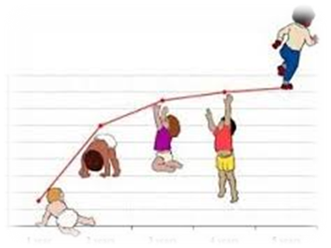
Teacher/Practitioner Level
Engaging Staff through Continuous Improvement

Slide 28
Engaging Teachers/Staff through the
I.D.E.A.L. Process:
I.D.E.A.L. process
  Identify: Staff monitor assessment data
  Describe: Data is used to identify strengths/weaknesses
  Evaluate: Ideas generated improve teaching and learning for all
  Act: Actions/strategies are evidence based
  Learn: Professional Learning is aligned with child outcomes—know what works/what didn’t
  Mueller, M. & Hanson, R. (2014). Leading in learning: Nebraska district nets success with evidence-based learning, Journal of Staff Development, 35(4), 56-59.

Slide 29

Engaging Teachers/Staff through the
I.D.E.A.L. Process:
I: Identify: a teacher-made (and/or district) common formative and/or common summative assessment.
What common learning goal(s)/standard(s) are being measured by this assessment?
A. Problem solving, reasoning, communication, fluency, writing, speaking, etc.
What level of thinking does this assessment require? A. Knowledge, application, analysis, synthesis, evaluation, etc.

Slide 30

D: Describe: students’ strengths and limitations/concerns.
1. What strengths in student performance does this data source reveal?
2. What limitations/weaknesses in student performance does this data source reveal?
3. How does students’ performance this year compare to students’ performance last year?
4. Is there evidence of improvement or decline, over all, and/or in disaggregated groups?
5. Are these results consistent with other achievement data?
6. What are the biggest area(s) of concern? What skills, objectives, or learning goal(s) are in need of improvement? What student sub-populations are in need of improvement?

Slide 31
School District | Mathematics
PLSD | # of Children | % Met or Exceeded
3 Year Olds | 66 | 68.2%
4 Year Olds | 208 | 94.8%
School District | Mathematics
PLSD | # of Children | % Met or Exceeded
3 Year Olds | 48 | 60.5%
4 Year Olds | 218 | 85.3%
2013-2014 End of Year
2012-2013 End of Year

Slide 32
School District | Mathematics
PLSD | # of Children | % Met or Exceeded
3 Year Olds (2012-13) | 48 | 60.5%
4 Year Olds (2013-14) Spec Ed Only | 62 | 83.8%
Special Education Cohort
(3 year olds who qualify for special ed 2012-2013 move up to
4 year olds who qualify for special ed 2013-2014)

Slide 33
Identify (at least 2 common data sets): GOLD Comparative Report (3 and 4 year olds), OSEP end of year report
Describe (briefly) what students’ outcomes in these data sets are telling you:
Widely Held Expectations
Preschoolers have made gains in the area of math
Gap exists between 4 years with and without disabilities
Cohort data showed improvement with children with disabilities across a two year period.
OSEPS Data
2013-2014: Acquiring and using knowledge and skills
District exceeded state targets for SSI (68.4%) and SSII (75%)
.

Slide 34

E: Evaluate: Why? Have your classroom goal, department/grade level team pose questions to address the concerns related to students’ performance data viewed as a limitation/concern.
1. ANY alternative explanations for the results?
2. What classroom strategies/activities prepared students for this assessment?
3. What results were unexpected?
4. What might have caused the changes for the better and/or for the worse?
5. What history, background information,
or best practice research/strategies
might be useful?

Slide 35

A: Act: by planning strategies/activities to address the questions posed in the evaluation stage.
1. What actions, interventions, strategies, and/or formative assessments will be tried?
2. Based on each tangible hypothesis, what actions should be taken to improve student learning?
3. What is the timeline, etc.?

Slide 36
E: Evaluate (pose questions that address concerns about students’ outcomes/adult actions) | A: Act (strategies, activities, interventions) to improve the quality of instruction that will impact student learning
1) Does the amount/type of documentation in GOLD make a difference in the quality of the assessment results? 2) Do we need a more standardized CSA/assessment across settings for children ages 3-5? 3) Do we need to implement intervention groups to address deficits in math? How do we identify students for intervention? | Discuss GOLD observation and documentation strategies in PLC by end of September 2014. Discuss methods for gathering documentation (e.g. sources of information) Discuss GOLD scoring rubric/revisit reliability and consistency of scoring among teachers/providers. Compare checkpoint data/scoring following Fall checkpoint (share documentation/compare/discuss scores during PLC) Develop CSA, cut scores, and timeline for administration in the area of math skills by the end of first Semester 2014-2015 Implement intervention groups (e.g. Teaching Preschool and Kindergarten Math, Math Right from the Start) during 2014-2015. Provide training to staff regarding interventions—fidelity)

Slide 37

L: Learn: by monitoring students’ progress in the concern area(s) and by gauging the consistency of your implementation and follow through (fidelity).
1. What assessment(s) will be used to monitor students’ progress across concern areas and sub-populations?
2. How often will students’ progress be monitored in this concern area?
3. How will the consistency of the intervention, strategies, activities decided upon be gauged for consistency of implementation and follow through (fidelity)?
4. What other student performance indicators might be helpful to track student progress and the effectiveness of the instructional strategies used?

Slide 38

Principal/Administrator Level
Principals find themselves supervising early
childhood “by default”
Barriers can exist when working to engage Building Principals in data analysis:
  Have little to no experience working in early childhood settings
  EC data requirements differ greatly from local and state level assessment and reporting requirements
  Staff evaluation/classroom observations have different “look fors” than in K-6th classrooms

Slide 39
Increasing Administrator Awareness and Understanding of Early Childhood Data
Link data to formative and summative staff evaluations as well as to the Continuous Improvement Process:
  “Look For” Documents can be used during classroom walk-through—Administrators need to understand what quality instruction looks like in early childhood settings
  Provide reflective questions that focus on local and outcomes data
  Crosswalk existing staff evaluation tools with quality indicators for early childhood settings
    Danielsen/Marzano Effective Teaching Components Crosswalk
    Special thanks to Jean Ubbelohde from Millard Public Schools for sharing some of the documents used in this presentation

Slide 40
WHEN | Ongoing | Fall Checkpoint Due 10/31/14 | Winter Checkpoint Due 2/14/15 | Spring Checkpoint Due 5/31/2015
QUESTIONS TO ASK | What reports have you run in GOLD to help guide your instruction? How does your PLC use reports from GOLD? What modifications have you made to your classroom environment based upon your last ECERS-R observation? What methods of data collection do you find most useful? When a child demonstrates a weakness in one of the domains, what resources do you find helpful when coaching a parent/childcare provider? How did you utilize the entry data for one your newly verified children? | What patterns of strengths/weaknesses show in the fall checkpoint data? What percentage of students are below expectations in each domain on the Widely Held Expectations? What percentage of students have met or exceeded expectations in each domain on the Widely Held Expectations? When looking at the Class Profile Report, how have you adjusted your instruction? | Which students are performing below age expectations? What other data do you have to show progress with students who are performing below age expectations? What patterns do you see in the data? What have been areas of growth thus far? What areas continue to be a challenge? What are some steps you plan to take to address those challenges? What are your hunches as to why XXX area of development (or student name) is below expectations? | What were the greatest areas of growth this year? What might your indicators be that you are successful? What reports in GOLD did you find helpful when coaching families and child care providers?

Slide 41
Marzano Teacher Evaluation Model: | Danielson Framework for Teaching: | What this could look like in Family Home/Community Childcare Settings: | What this could look like in Center-Based Preschool Settings :
Domain 4: Collegiality and Professionalism | Domain 4: Professional Responsibilities | Early interventionist understands Nebraska Department of Education Rule for special education/early intervention eligibility and services Early interventionist understands the differences between an IFSP and IEP and can explain these differences effectively to parents Early interventionist participates in team meetings and regular coaching opportunities with other team members Early interventionist accepts feedback from colleagues during coaching sessions Early interventionist brings suggestions from coaching sessions with colleagues back to families/caregivers Early interventionist understands and complies with Results Matter Early interventionist recognizes family outcomes are a shared responsibility between the EI team members (including parents/caregivers) | Early interventionist understands Nebraska Department of Education Rule for special ed./EI eligibility and services Early interventionist understands and complies with Results Matter Paraeducators are treated with respect (e.g. tone of voice used to give directions/feedback is positive) Early interventionist demonstrates flexibility when working with related service providers
Nebraska’s Core Competencies for Early Childhood Professionals Related Competencies: H. Professionalism and Leadership Competencies

Slide 42
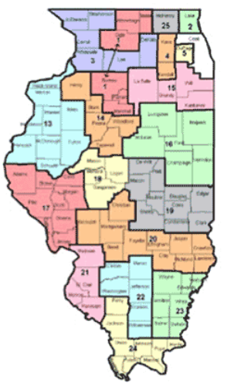
A Family Perspective: Helping Family Engagement in Illinois
Chelsea Guillen

Slide 43

Child Outcomes Data:
Illinois’ efforts to involve families
Initial rollout
Reporting of early results
Expansion through family assessment
System resources
Family resources

Slide 44
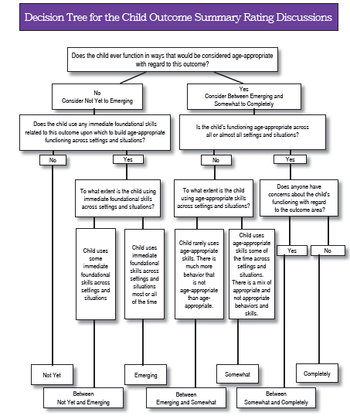
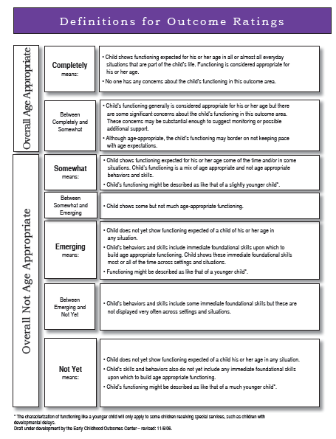
Outcomes folder
Notes:
Borrowed from PA

Slide 45
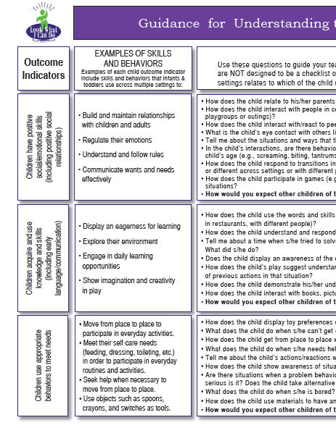
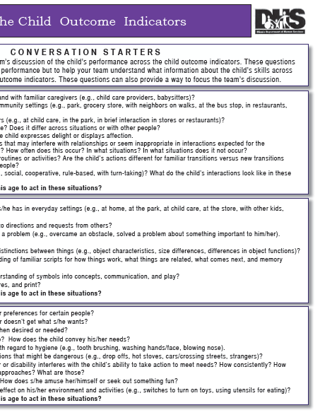
Outcomes Folder

Slide 46

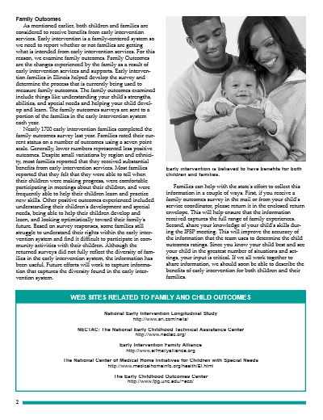
Newsletter

Slide 47

Newsletter
Shared initial child outcomes and family outcomes information
Ideas for improvement
Resources for more information

Slide 48
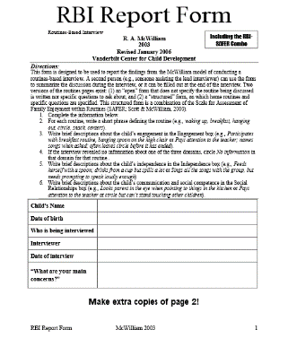
Family Assessment
Using Routines Based Interview during intake
Focus on child’s role in routines
Questions about social relationships, engagement/participation, and independence
Service coordinators bring information into outcomes rating discussion
Helps bring fuller answer to “across settings and situations”

Slide 49

System resource
Bureau identified resource for families
Shared with Child and Family Connections (system points of entry) for review
Felt it would be too long to review in meeting
Wanted one page summary

Slide 50

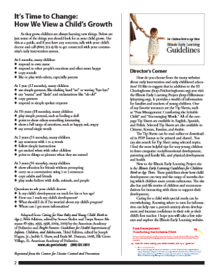
Sharing information with families

Slide 51

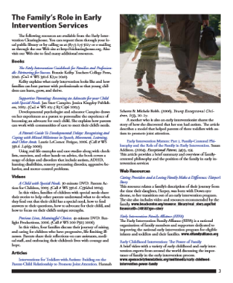
Sharing information with families

Slide 52

Illinois Conclusions
Continuous process-always looking for new resources and better ways to share information
Child outcomes part of our SSIP, quality is important
Believe in importance of quality process that incorporates family input
Want to make sure people have needed tools and information

Slide 53
Questions for Discussion?
Other ways locals or states are reviewing and using data in their continuous improvement process?
How are you engaging stakeholders including families in the process of using data? Determining who should be part of it and engaging them successfully in the work?
How did you successfully overcome challenges in your state/local area to using outcomes data?

Slide 54
Contact Information
Sarah Whitman
  MA Department of Elementary and Secondary Education
  781-338-3364 or swhitman@doe.mass.edu
Kristy Feden
  Papillion-La Vista School District, Nebraska
  402-514-3242 or kfeden@paplv.org
Chelsea Guillen
  IL Early Intervention Ombudsman
  217-244-2621 or cguillen@illinoiseitraining.org
  ECTA website: http://ectacenter.org/

