Slide 1
<?xml version="1.0"?><AllQuestions><Question><slideID>322</slideID><slideType>Q&amp;A_QSlide</slideType><questionText>How many of you have visited ideadata.org?</questionText><teamScoringFlag></teamScoringFlag><correctValue></correctValue><incorrectValue></incorrectValue></Question><Question><slideID>325</slideID><slideType>Q&amp;A_QSlide</slideType><questionText>Are you a member of a community of practice or other online communities?</questionText><teamScoringFlag></teamScoringFlag><correctValue></correctValue><incorrectValue></incorrectValue></Question><Question><slideID>329</slideID><slideType>Q&amp;A_QSlide</slideType><questionText>Select which Social Media platforms you use professionally</questionText><teamScoringFlag></teamScoringFlag><correctValue></correctValue><incorrectValue></incorrectValue></Question></AllQuestions>
<?xml version="1.0"?><Settings><answerBulletFormat>Numeric</answerBulletFormat><answerNowAutoInsert>No</answerNowAutoInsert><answerNowStyle>Explosion</answerNowStyle><answerNowText>Answer Now</answerNowText><chartColors>Use PowerPoint Color Scheme</chartColors><chartType>Horizontal</chartType><correctAnswerIndicator>Checkmark</correctAnswerIndicator><countdownAutoInsert>No</countdownAutoInsert><countdownSeconds>10</countdownSeconds><countdownSound>TicToc.wav</countdownSound><countdownStyle>Box</countdownStyle><gridAutoInsert>No</gridAutoInsert><gridFillStyle>Answered</gridFillStyle><gridFillColor>0,0,0</gridFillColor><gridOpacity>100%</gridOpacity><gridTextStyle>Keypad #</gridTextStyle><inputSource>Response Devices</inputSource><multipleResponseDivisor># of Responses</multipleResponseDivisor><participantsLeaderBoard>5</participantsLeaderBoard><percentageDecimalPlaces>0</percentageDecimalPlaces><responseCounterAutoInsert>No</responseCounterAutoInsert><responseCounterStyle>Oval</responseCounterStyle><responseCounterDisplayValue># of Votes Received</responseCounterDisplayValue><insertObjectUsingColor>Blue</insertObjectUsingColor><showResults>Yes</showResults><teamColors>User Defined</teamColors><teamIdentificationType>None</teamIdentificationType><teamScoringType>Voting pads only</teamScoringType><teamScoringDecimalPlaces>1</teamScoringDecimalPlaces><teamIdentificationItem></teamIdentificationItem><teamsLeaderBoard>5</teamsLeaderBoard><teamName1></teamName1><teamName2></teamName2><teamName3></teamName3><teamName4></teamName4><teamName5></teamName5><teamName6></teamName6><teamName7></teamName7><teamName8></teamName8><teamName9></teamName9><teamName10></teamName10><showControlBar>Slides with Get Feedback Objects</showControlBar><defaultCorrectPointValue>100</defaultCorrectPointValue><defaultIncorrectPointValue>0</defaultIncorrectPointValue><chartColor1>187,224,227</chartColor1><chartColor2>51,51,153</chartColor2><chartColor3>0,153,153</chartColor3><chartColor4>153,204,0</chartColor4><chartColor5>128,128,128</chartColor5><chartColor6>0,0,0</chartColor6><chartColor7>0,102,204</chartColor7><chartColor8>204,204,255</chartColor8><chartColor9>255,0,0</chartColor9><chartColor10>255,255,0</chartColor10><teamColor1>187,224,227</teamColor1><teamColor2>51,51,153</teamColor2><teamColor3>0,153,153</teamColor3><teamColor4>153,204,0</teamColor4><teamColor5>128,128,128</teamColor5><teamColor6>0,0,0</teamColor6><teamColor7>0,102,204</teamColor7><teamColor8>204,204,255</teamColor8><teamColor9>255,0,0</teamColor9><teamColor10>255,255,0</teamColor10><displayAnswerImagesDuringVote>Yes</displayAnswerImagesDuringVote><displayAnswerImagesWithResponses>Yes</displayAnswerImagesWithResponses><displayAnswerTextDuringVote>Yes</displayAnswerTextDuringVote><displayAnswerTextWithResponses>Yes</displayAnswerTextWithResponses><questionSlideID></questionSlideID><controlBarState>Expanded</controlBarState><isGridColorKnownColor>True</isGridColorKnownColor><gridColorName>Yellow</gridColorName><AutoRec></AutoRec><AutoRecTimeIntrvl></AutoRecTimeIntrvl><chartVotesView>Percentage</chartVotesView><chartLabelsColor>0,0,0</chartLabelsColor><isChartLabelColorKnownColor>True</isChartLabelColorKnownColor><chartLabelColorName>Black</chartLabelColorName><chartXAxisLabelType>Full Text</chartXAxisLabelType></Settings>
<?xml version="1.0"?><SlideMaster><tagSlideID>322</tagSlideID><slideID>322</slideID><tagSlideID>325</tagSlideID><slideID>325</slideID><tagSlideID>329</tagSlideID><slideID>329</slideID></SlideMaster>
<?xml version="1.0"?><AllAnswers><Answers><slideID>322</slideID><answerID>0</answerID><answerText>Yes</answerText><isCorrect>None</isCorrect><pointValue>0</pointValue></Answers><Answers><slideID>322</slideID><answerID>1</answerID><answerText>No</answerText><isCorrect>None</isCorrect><pointValue>0</pointValue></Answers><Answers><slideID>322</slideID><answerID>0</answerID><answerText>Yes</answerText><isCorrect>None</isCorrect><pointValue>0</pointValue></Answers><Answers><slideID>322</slideID><answerID>1</answerID><answerText>No</answerText><isCorrect>None</isCorrect><pointValue>0</pointValue></Answers><Answers><slideID>325</slideID><answerID>0</answerID><answerText>Yes</answerText><isCorrect>None</isCorrect><pointValue>0</pointValue></Answers><Answers><slideID>325</slideID><answerID>1</answerID><answerText>No</answerText><isCorrect>None</isCorrect><pointValue>0</pointValue></Answers><Answers><slideID>329</slideID><answerID>0</answerID><answerText>Facebook</answerText><isCorrect>None</isCorrect><pointValue>0</pointValue></Answers><Answers><slideID>329</slideID><answerID>1</answerID><answerText>Twitter</answerText><isCorrect>None</isCorrect><pointValue>0</pointValue></Answers><Answers><slideID>329</slideID><answerID>2</answerID><answerText>Linked in</answerText><isCorrect>None</isCorrect><pointValue>0</pointValue></Answers><Answers><slideID>329</slideID><answerID>3</answerID><answerText>All of the above</answerText><isCorrect>None</isCorrect><pointValue>0</pointValue></Answers><Answers><slideID>329</slideID><answerID>4</answerID><answerText>I don’t use any social media</answerText><isCorrect>None</isCorrect><pointValue>0</pointValue></Answers></AllAnswers>

Slide 2
Helping IDC Work for You Thursday, September 11, 2014
Kay Gallagher
IDEA Data Center
Linda Lynch
IDEA Data Center

Slide 3
Session Agenda
Background on IDC Communication and Dissemination Activities
IDC Communication Strategies
Using Social Media
Let’s Learn to Tweet
Next Steps and Wrap-Up

Slide 4
Session Goals
Understand the role of IDC’s Communication and Dissemination team
Understand how you can contribute to IDC
Learn how to use social media to interact with IDC
Invite you to keep in touch

Slide 5
Purpose of Communication and Dissemination Activities
Develop and implement a website for:
1) communicating about IDC and its products and services
2) supporting IDC’s provision of universal/ general TA related to IDEA data quality to a broad audience
Support the Part B and Part C listserves

Slide 6
Purpose of Communication and Dissemination Activities (cont.)
Create, build, and support a social media network
Support all IDC activities in general and the specific activities of IDC’s four other activity areas

Slide 7
Purpose of Communication and Dissemination Activities (cont.)
Help IDC produce products and tools for dissemination through the IDC website and activity area activities
Support consistent branding of all IDC tools, products, and other project materials

Slide 8
How many of you have visited ideadata.org?
Yes
No
0
10

Slide 9
Website
ideadata.org
Public Site
Registered User Login

Slide 10
Public Website
About Us
Tools and Products
Technical Assistance
Contact Us
To Come – Events, Links

Slide 11
Website – Registered Users
Registered users are:
state and local data managers
state and local special education directors
619 coordinators
other related state and district personnel
IDEA data-related TA providers
ED staff
IDC project staff

Slide 12
Website – Registered User Login (cont.)
Main areas will include:
Learning Communities for collaboration, discussion, and sharing of ideas
State Data Quality Profiles – An interactive tool for storing and reporting out by state and across states information that reflects data quality (i.e., timeliness, accuracy, and completeness)
Resource Library – compilation of relevant resources collected from the field

Slide 13
Resource Library
IDC Resources
Other Resources
Establishing Policies and Procedures for Identifying Appropriate Resources
Public Site and Registered User Site

Slide 14
Are you a member of a community of practice or other online communities?
Yes
No
0
10

Slide 15
Learning Communities
Possible IDC Communities
Assessment
Data Quality/Data Use
Discipline
Educational Environments – Online Learning
MOE and CEIS
Part C Exiting
Preschool Environments
Public Reporting of 618 Data

Slide 16
Learning Communities (cont.)
Possible IDC communities (cont.)
Data Quality Profiles
Privacy and Confidentiality
SSIP
Your suggestions?

Slide 17
Are you receiving our listserve messages?
Yes
No
3
7

Slide 18
Have you ever replied to a message?
Yes
No
0
4

Slide 19
Listserves
Listserve members
Communicate about IDEA data quality, collection, and reporting
Discuss ideas, problems, and solutions
Share helpful tools and products in a semi-private environment that encourages open and honest dialogue
The listserves provide instructions for
Replying to discussions/topics
Creating new discussions/topics
Unsubscribing

Slide 20
Select which Social Media platforms you use professionally
Facebook
Twitter
Linked in
All of the above
I don’t use any social media
0
10

Slide 21
Social Media
Follow us on Twitter: @ideadatacenter
Join our LinkedIn Group: search Idea Data Center on LinkedIn to join

Slide 22
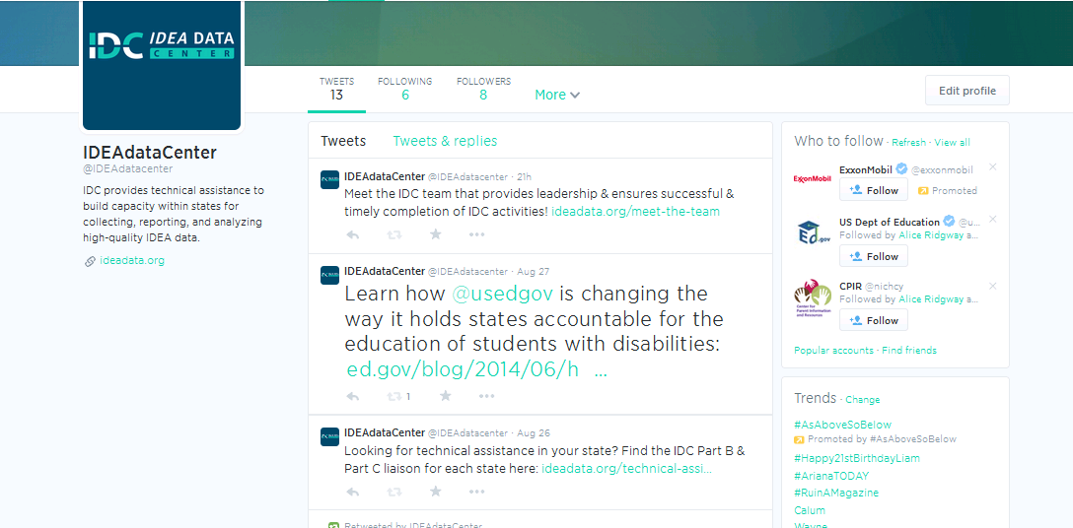
Learn to use Twitter

Slide 23
Some Twitter Basics
It’s an open public network and unless you protect your tweets (that is, make your account private) everything you say can be seen by anyone, right from the start.
Twitter has some really strange jargon.
The maximum length of your username is 15 characters.
It’s okay to lurk.
The maximum number of characters in a tweet is 140.
Any link you share on Twitter will automatically be shortened.
You can only send a direct message to somebody if they are following you.
You don’t have to follow people back.
If you start a tweet with @username, it’s a reply.
If you tag a username anywhere but at the start of the tweet, everybody following you will see that message.
Notes:
It’s an open public network and unless you protect your tweets (that is, make your account private) everything you say can be seen by anyone, right from the start.
Twitter has some really strange jargon. And Twitter knows this, so they’ve created an official glossary. Bookmark it and refer to it often – and definitely read up on hashtags.
The maximum length of your username is 15 characters.
It’s okay to lurk. In fact, it’s normal – more than half of all Twitter users never tweet, they simply consume the content of the people they follow.
The maximum number of characters in a tweet is 140. But you should quickly get into the mentality of leaving at least 20 characters free to leave plenty of space for people to retweet you, Any link you share on Twitter will automatically be shortened. This saves you space.
You can only send a direct message to somebody if they are following you. And vice versa. (Note: you don’t have to both be following each other. Direct messages can be very one-way, i.e., celebrities and their millions of fans.)
You don’t have to follow people back. You’re under no obligation to follow anybody. Twitter doesn’t work unless you’re careful to only follow people who are right for YOU.
If you start a tweet with @username, it’s a reply. And will only be seen by the person you replied to and people who are following both of you. Nobody else will see it in their stream (although it will show up on your profile page and in Twitter search).
If you tag a username anywhere but at the start of the tweet, everybody following you will see that message. This is called a mention. It’s important to quickly learn the difference between this and a reply, as above.

Slide 24
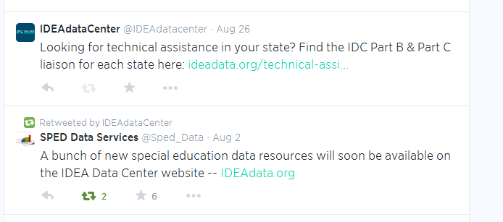
Anatomy of a tweet
140 characters max
Include links
Include pictures and videos
Establish your brand voice – be personable not personal

Slide 25
Retweets and Hashtags

Slide 26
Favorite

Slide 27
Next Steps and Wrap Up
Think about how you can provide input to IDC activities.
Think about how you can get the most out of IDC services, tools and products, and other activities.

Slide 28
Contact Us!
Kay Gallagher
kaygallagher@westat.com
Linda Lynch
lindalynch@westat.com

Slide 29
Visit the IDC Website http://ideadata.org/
Follow us on Twitter @IDEAdataCenter

Slide 30
Thank You!
We appreciate your time and participation!

Slide 31
The contents of this presentation were developed under a grant from the U.S. Department of Education, #H373Y130002. However, the contents do not necessarily represent the policy of the Department of Education, and you should not assume endorsement by the Federal Government. Project Officers: Richelle Davis and Meredith Miceli

