Slide 1
An Interactive Guide to
Implementing an Integrated
Child & Family Outcomes
and IFSP/IEP Process
Improving Data, Improving Outcomes Conference
Washington, D.C. – September 2013

Slide 2
Purpose of the Guide
The Integrating Outcomes Learning Community
The connection with implementation science

Slide 3
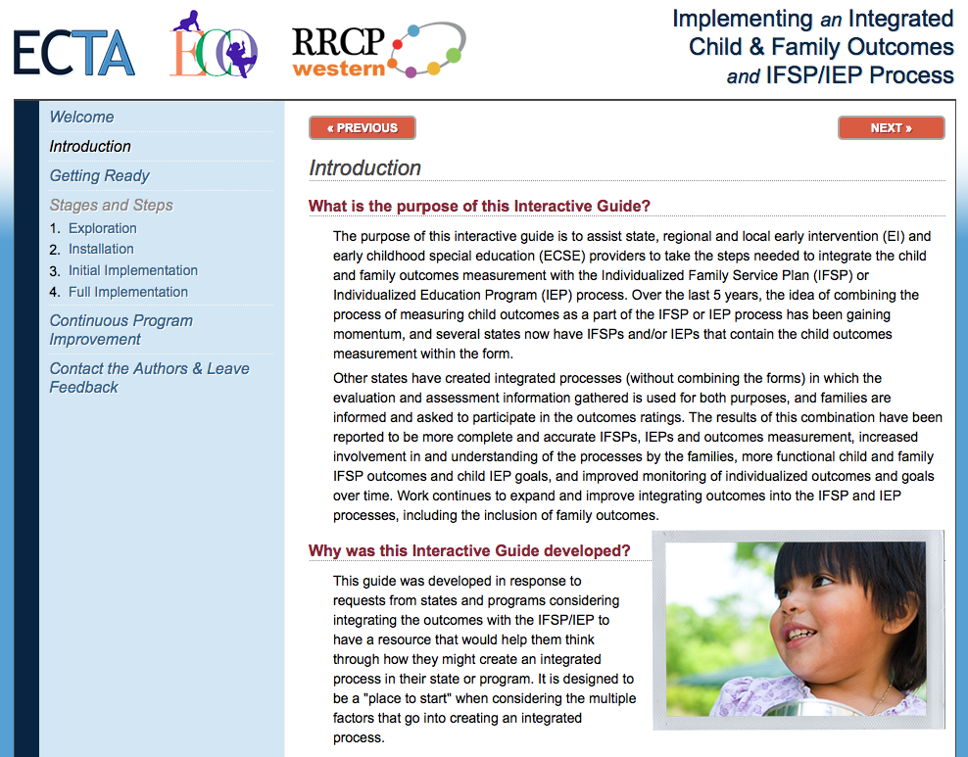

Slide 4
Thanks to the Workgroup!
Shannon Dunstan, Idaho
Lenita Hartman, Colorado
Peggy Kemp, Kansas
Phoebe Rinkel, Kansas
Michelle Staley, New Mexico
Kristen Votava, North Dakota
Naomi Younggren, Army EDIS
Lauren Barton, ECO
Joicey Hurth, ECTA
Megan Vinh, WRRC
Kathi Gillaspy, ECO

Slide 5
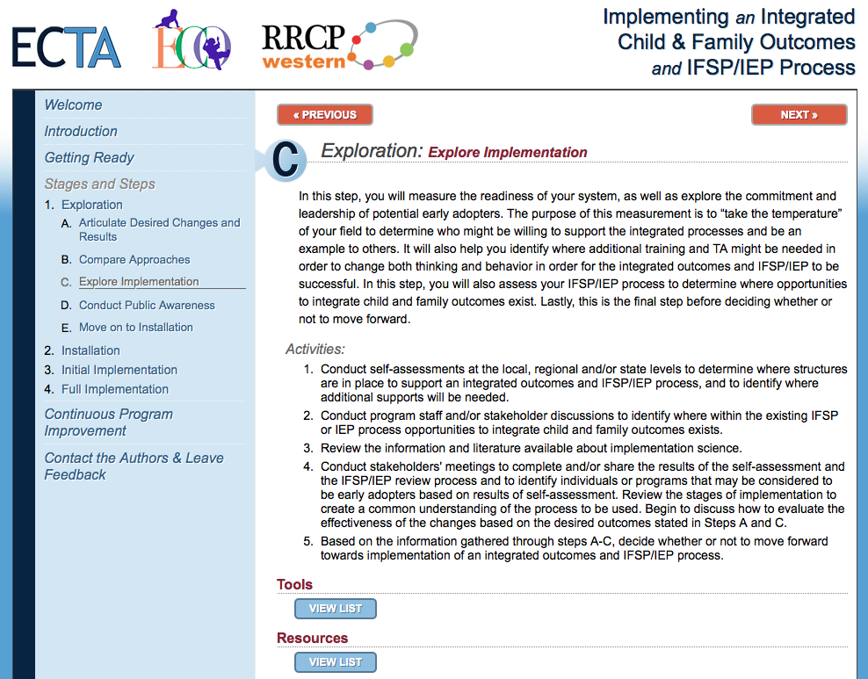
Features of the Guide
Navigation by Implementation Stage
Tools
Resources
Notes:
Megan

Slide 6
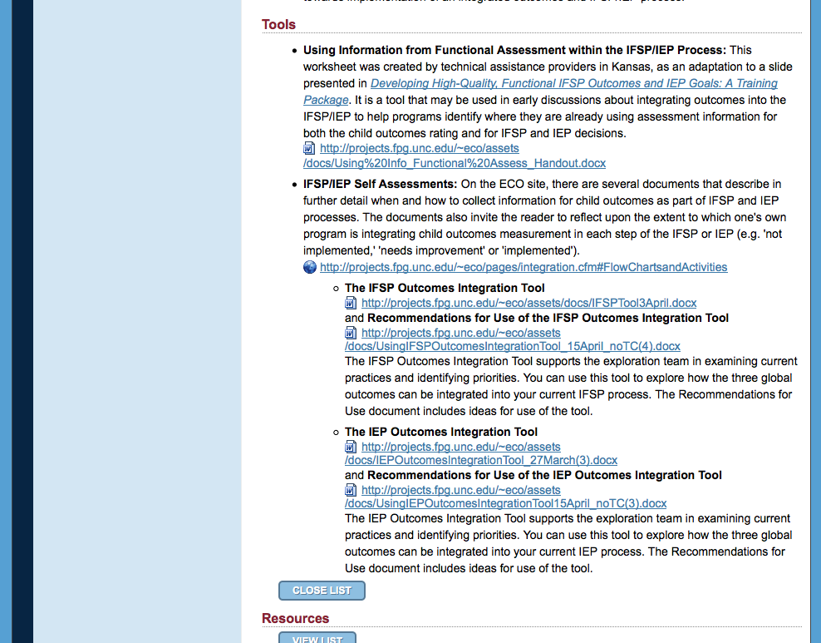
Tools
Developed by members of the work group
Specific to integration of outcomes into the IFSP or IEP
Developed by members of the work group
Specific to integration of outcomes into the IFSP or IEP

Slide 7
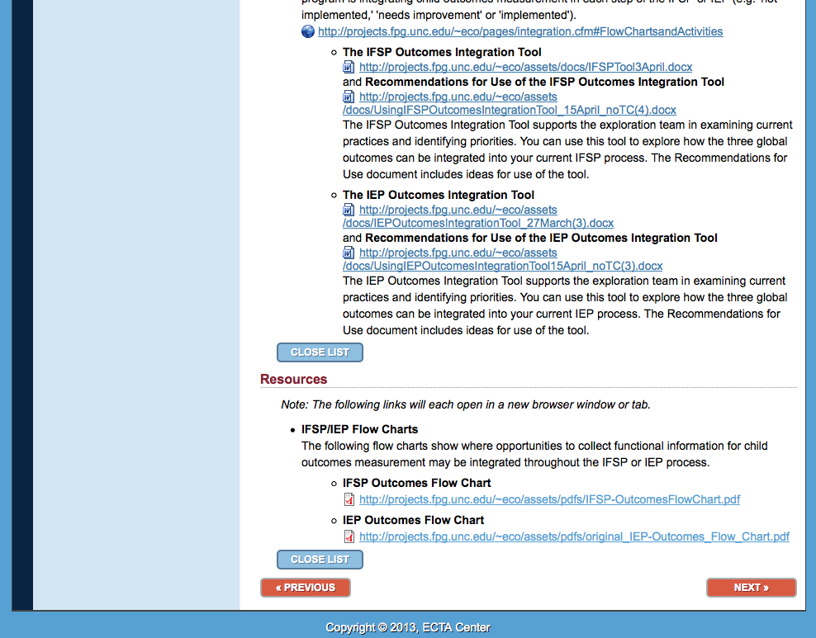
Resources
Examples of both ECO and state developed materials
Representative of both Part C and 619 Programs
Examples of both ECO and state developed materials
Representative of both Part C and 619 Programs

Slide 8
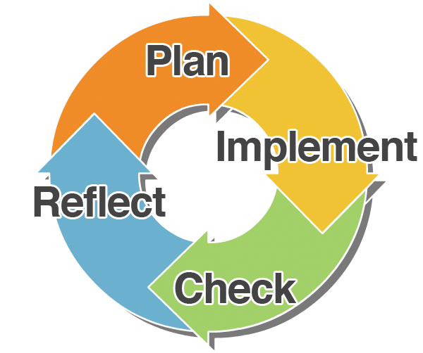
Continuous Program Improvement
Support for sustainability
Addition of new initiatives
Updates to integrated process

Slide 9
Let us know what you think!

Slide 10
Share this Resource
ectacenter.org/implementingintegrated

Slide 11
What do you think? What questions do you have?

Slide 12
Contact:
Kathi Gillaspy: kathi.gillaspy@unc.edu
Megan Vinh: mvinh@uoregon.edu

