Slide 1
Preschool Educational Environments
Kim Mitchell, OSEP, Office of
Special Education Programs
Debbie Cate, ECTA Center
Mary Peters, DaSy, ECTA
Albert Einstein

Slide 2
Session Outcomes
Share 2011 Indicator 6 data
Discuss data collection process
Discuss how this process can be used to improve service delivery to children and families.
Identify TA resources/tools
Notes:
To make data-informed decisions, we need data sources that are individually meaningful, useful for mandated reporting, and coordinated with other data sources. This session will focus on Educational Environments data for preschool aged children, and Indicator 6 reporting. Participants will have a better understanding of early childhood data around inclusion, and participate in a discussion of how this data can be used to improve service delivery to children and families.

Slide 3
Welcome
&
Introductions
Notes:
Introductions of those in audience. By name or show of hands by role, depending on number of attendees.

Slide 4
Why collect data on where young children with disabilities are enrolled and receive special education and related service?

Slide 5
Policy Forum : High Quality Inclusion Opportunities
for Preschool-Aged Children with Disabilities
December 13-15, 2004
Data on the extent to which preschoolers are educated with their non-disabled peers needs to be collected since this is what least restrictive environment (LRE) is all about.
The method of collecting data is also a powerful intervention – information we value and collect influences practice in the field, so these changes are very important.
Lou Danielson, former Director,
Research to Practice Division, OSEP

Slide 6
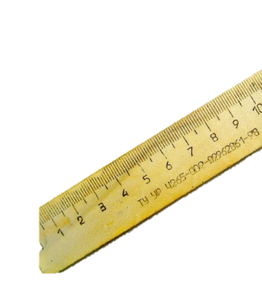
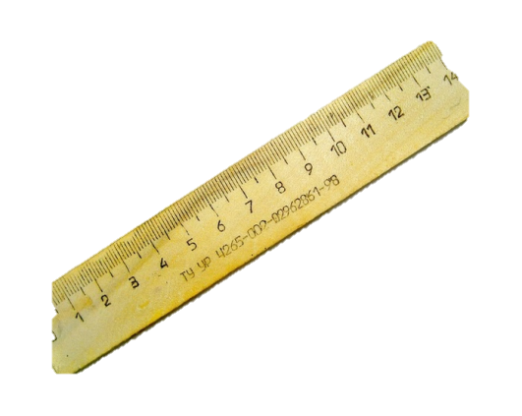
We Measure
What We Value
State Performance Plan - SPP
Annual Performance Report - APR
Notes:
What are some things measured in your programs? Discussion

Slide 7
Educational Environments Data
Educational environments data are collected for every preschool child receiving services under the IDEA.
Notes:
Educational environments data is collected yearly for every preschool child receiving services under the Individuals with Disabilities Education Act. IDEA
Data is collected on a date between October 1st and December 1st every year. The count is unduplicated, meaning that every child is counted one time in one category.

Slide 8
Educational Environments Data
Educational Environments Data Includes:
Age 3, 4 or 5
Disability category
Race/ethnicity
Gender
Limited English Proficiency
Every child with an IEP on the child count date should be reported with an educational environment

Slide 9
Current 618 Educational Environments Data Collection
What and Where?
What Program Type
Regular early childhood program
Special education program
Neither regular or special education program
Where are the majority of special education and related services delivered?
AND

Slide 10
Decision making process for determining where to report children ages 3-5
Identify the type program the child attends
Identify the number of hours per week in attendance if RECP
Identify the setting in which the child receives the majority of special education & related services
Notes:
The flow chart demonstrates the decision making process for determining where to place children ages 3-5. You should determine if the child is in a regular early childhood program for more or less than 10 hours a week and then determine where they are receiving the majority of their services.

Slide 11
Identify the type program the child attends
Row Set (A) CHILDREN ATTENDING A REGULAR EARLY CHILDHOOD PROGRAM AT LEAST 10 HRS PER WEEK, … | (A1) And receiving the MAJORITY of SPECIAL EDUCATION and related SERVICES in the REGULAR EARLY CHILDHOOD PROGRAM
 | (A2) …and receiving the majority of SPECIAL EDUCATION and related SERVICES in some OTHER LOCATION
Row Set (B) CHILDREN ATTENDING A REGULAR EARLY CHILDHOOD PROGRAM LESS THAN 10 HRS PER WEEK, … | (B1) And receiving the MAJORITY of SPECIAL EDUCATION and related SERVICES in the REGULAR EARLY CHILDHOOD PROGRAM
 | (B2) …and RECEIVING the majority of SPECIAL EDUCATION and related SERVICES in some OTHER LOCATION
Row Set (C) CHILDREN ATTENDING A SPECIAL EDUCATION PROGRAM (NOT in any regular early childhood program), … | (C1) Separate Special Education Class
 | (C2) Separate School
 | (C3) Residential Facility
Row Set (D) CHILDREN ATTENDING NEITHER A REGULAR EARLY CHILDHOOD PROGRAM NOR A SPECIAL EDUCATION PROGRAM (NOT INCLUDED IN ROW SETS A, B, OR C) | (D1) receiving the MAJORITY of SPECIAL EDUCATION and related SERVICES in the home
 | (D2) And receiving special education and related service provider location
Notes:
Selection of the appropriate reporting category involves a multi-stage procedure – identifying (in column 1) the type of program the child attends, if any, (and the number of hours per week in attendance for Row Set A), then further identifying (in column 2) the setting in which the child receives the majority of special education and related services.

Slide 12
Identify the number of hours per week
in attendance if RECP
Row Set (A) CHILDREN ATTENDING A REGULAR EARLY CHILDHOOD PROGRAM AT LEAST 10 HRS PER WEEK, … | (A1) And receiving the MAJORITY of SPECIAL EDUCATION and related SERVICES in the REGULAR EARLY CHILDHOOD PROGRAM
 | (A2) …and receiving the majority of SPECIAL EDUCATION and related SERVICES in some OTHER LOCATION
Row Set (B) CHILDREN ATTENDING A REGULAR EARLY CHILDHOOD PROGRAM LESS THAN 10 HRS PER WEEK, … | (B1) And receiving the MAJORITY of SPECIAL EDUCATION and related SERVICES in the REGULAR EARLY CHILDHOOD PROGRAM
 | (B2) …and RECEIVING the majority of SPECIAL EDUCATION and related SERVICES in some OTHER LOCATION
Row Set (C) CHILDREN ATTENDING A SPECIAL EDUCATION PROGRAM (NOT in any regular early childhood program), … | (C1) Separate Special Education Class
 | (C2) Separate School
 | (C3) Residential Facility
Row Set (D) CHILDREN ATTENDING NEITHER A REGULAR EARLY CHILDHOOD PROGRAM NOR A SPECIAL EDUCATION PROGRAM (NOT INCLUDED IN ROW SETS A, B, OR C) | (D1) receiving the MAJORITY of SPECIAL EDUCATION and related SERVICES in the home
 | (D2) And receiving special education and related service provider location
Notes:
Selection of the appropriate reporting category involves a multi-stage procedure – identifying (in column 1) the type of program the child attends, if any, (and the number of hours per week in attendance for Row Set A), then further identifying (in column 2) the setting in which the child receives the majority of special education and related services.

Slide 13
Identify the setting in which the child receives the majority of special education & related services
Row Set (A) CHILDREN ATTENDING A REGULAR EARLY CHILDHOOD PROGRAM AT LEAST 10 HRS PER WEEK, … | (A1) And receiving the MAJORITY of SPECIAL EDUCATION and related SERVICES in the REGULAR EARLY CHILDHOOD PROGRAM
 | (A2) …and receiving the majority of SPECIAL EDUCATION and related SERVICES in some OTHER LOCATION
Row Set (B) CHILDREN ATTENDING A REGULAR EARLY CHILDHOOD PROGRAM LESS THAN 10 HRS PER WEEK, … | (B1) And receiving the MAJORITY of SPECIAL EDUCATION and related SERVICES in the REGULAR EARLY CHILDHOOD PROGRAM
 | (B2) …and RECEIVING the majority of SPECIAL EDUCATION and related SERVICES in some OTHER LOCATION
Row Set (C) CHILDREN ATTENDING A SPECIAL EDUCATION PROGRAM (NOT in any regular early childhood program), … | (C1) Separate Special Education Class
 | (C2) Separate School
 | (C3) Residential Facility
Row Set (D) CHILDREN ATTENDING NEITHER A REGULAR EARLY CHILDHOOD PROGRAM NOR A SPECIAL EDUCATION PROGRAM (NOT INCLUDED IN ROW SETS A, B, OR C) | (D1) receiving the MAJORITY of SPECIAL EDUCATION and related SERVICES in the home
 | (D2) And receiving special education and related service provider location
Notes:
Selection of the appropriate reporting category involves a multi-stage procedure – identifying (in column 1) the type of program the child attends, if any, (and the number of hours per week in attendance for Row Set A), then further identifying (in column 2) the setting in which the child receives the majority of special education and related services.

Slide 14
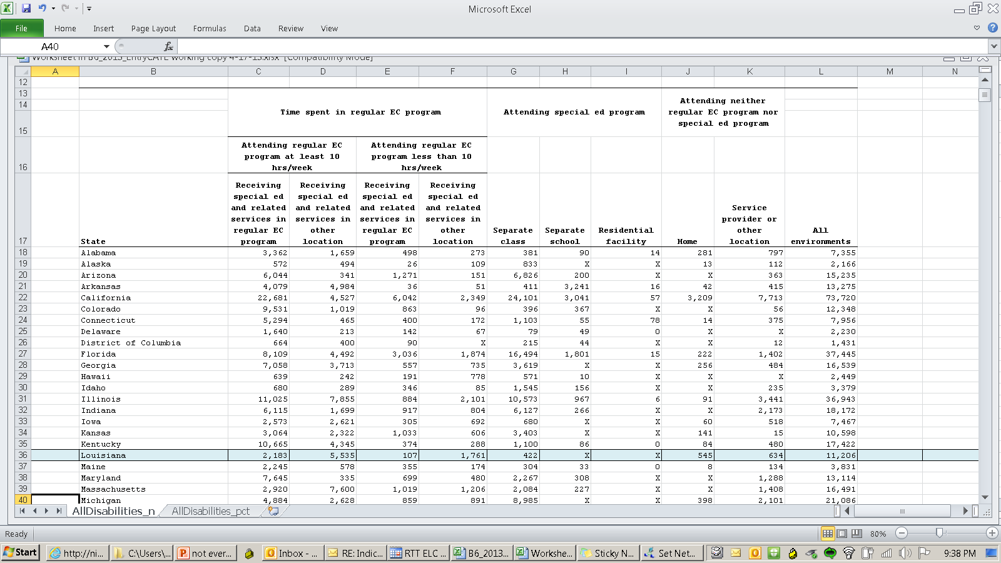
Number and percentage of children aged 3-5 served under IDEA, Part B
by educational environment and state, Fall 2011

Slide 15
We Measure
What We Value
Understanding the Data
Notes:
What are some things measured in your programs? Discussion

Slide 16
Educational Environments Data Collection
Row Set (A) CHILDREN ATTENDING A REGULAR EARLY CHILDHOOD PROGRAM AT LEAST 10 HRS PER WEEK, … | (A1) And receiving the MAJORITY of SPECIAL EDUCATION and related SERVICES in the REGULAR EARLY CHILDHOOD PROGRAM
 | (A2) …and receiving the majority of SPECIAL EDUCATION and related SERVICES in some OTHER LOCATION
Row Set (B) CHILDREN ATTENDING A REGULAR EARLY CHILDHOOD PROGRAM LESS THAN 10 HRS PER WEEK, … | (B1) And receiving the MAJORITY of SPECIAL EDUCATION and related SERVICES in the REGULAR EARLY CHILDHOOD PROGRAM
 | (B2) …and RECEIVING the majority of SPECIAL EDUCATION and related SERVICES in some OTHER LOCATION
Row Set (C) CHILDREN ATTENDING A SPECIAL EDUCATION PROGRAM (NOT in any regular early childhood program), … | (C1) Separate Special Education Class
 | (C2) Separate School
 | (C3) Residential Facility
Row Set (D) CHILDREN ATTENDING NEITHER A REGULAR EARLY CHILDHOOD PROGRAM NOR A SPECIAL EDUCATION PROGRAM (NOT INCLUDED IN ROW SETS A, B, OR C) | (D1) receiving the MAJORITY of SPECIAL EDUCATION and related SERVICES in the home
 | (D2) And receiving special education and related service provider location
Notes:
Selection of the appropriate reporting category involves a multi-stage procedure – identifying (in column 1) the type of program the child attends, if any, (and the number of hours per week in attendance for Row Set A), then further identifying (in column 2) the setting in which the child receives the majority of special education and related services.

Slide 18
Indicator 6 Measurement:
Percent of children aged 3 - 5 with IEPs attending a regular early childhood program and receiving the majority of special education and related services in the regular early childhood program
B. Percent of children aged 3 - 5 with IEPs attending a separate special education class, separate school or residential facility

Slide 19
SPP/APR SY 2011-2012
National mean of states & territories, Indicator SPP/APR 6 Report

Slide 20
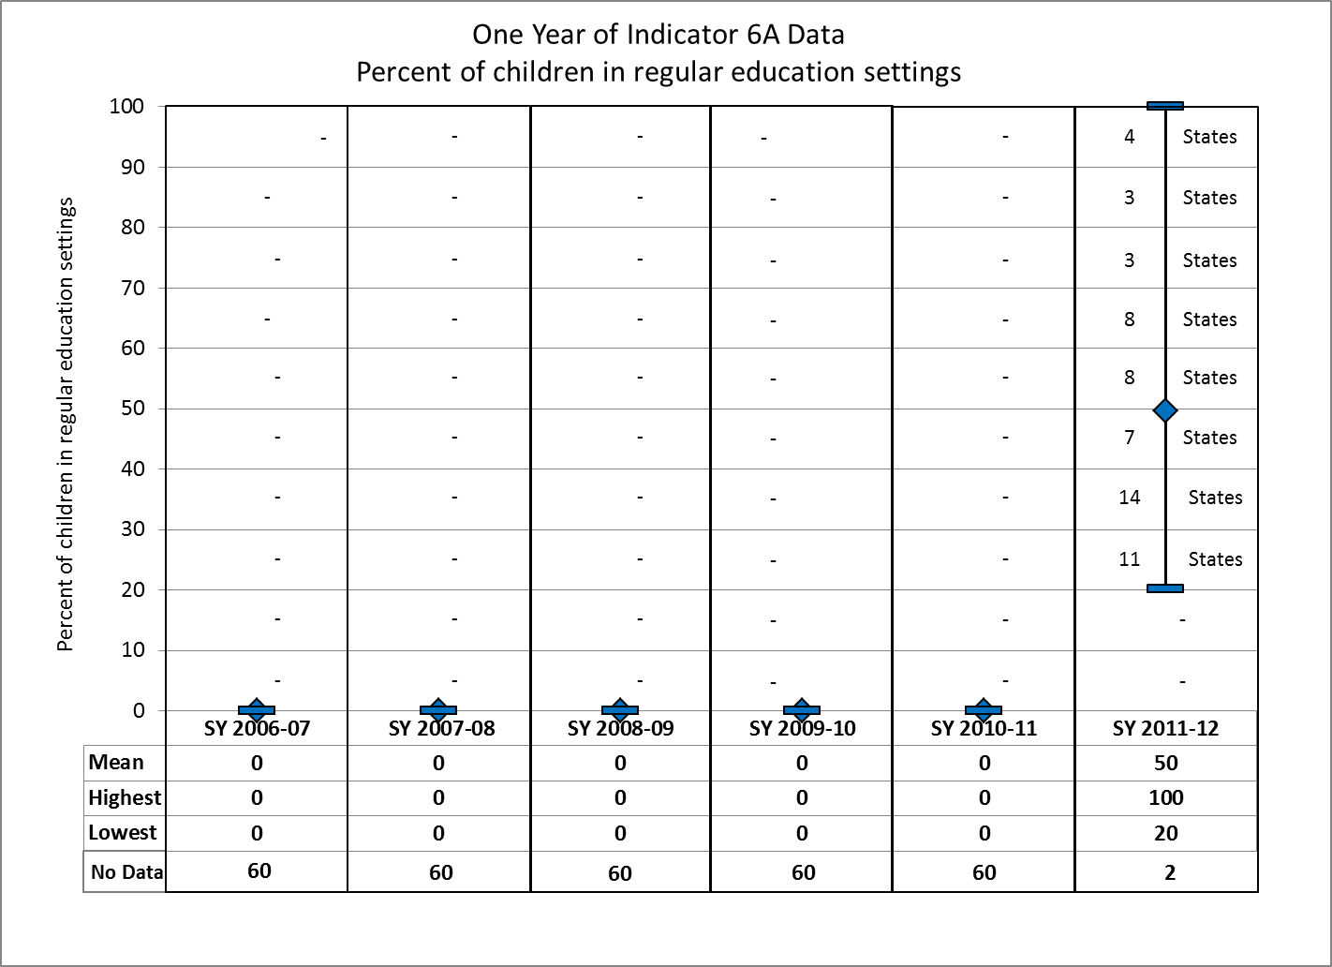

Slide 21
Children with IEPs Attending a Regular Early Childhood Program (RECP) and Receiving the Majority of Services in the Program
Each diamond represents a state or territory, SPP/APR SY 2011-2012
Notes:
Preliminary 2011 data

Slide 22
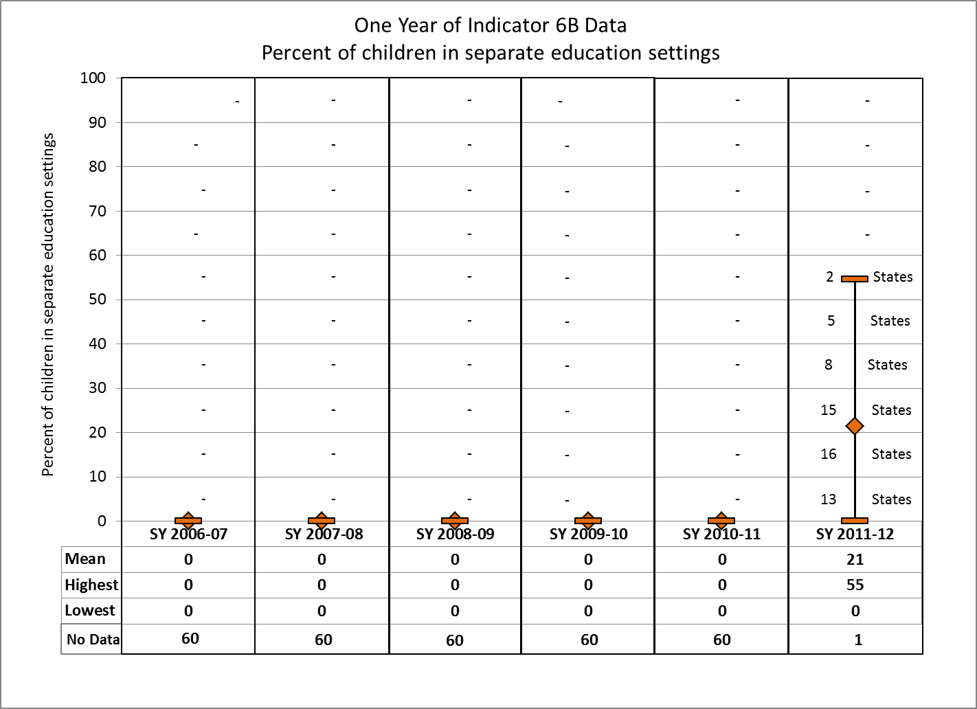

Slide 23
Children with IEPs Attending a Special Education Program
Each diamond represents a state or territory, SPP/APR SY 2011-2012
Notes:
Preliminary 2011 data

Slide 24
To make data-informed decisions, we need data sources that are individually meaningful, useful for mandated reporting, and coordinated with other data sources.

Slide 25
New Hampshire Training Module

Slide 26
Discussion
What Strategies Support this data collection?
Policy, procedures, professional development
What are the Challenges? Why?
Collection
Professional development
Reporting

Slide 27
Find Your Data Group
Web-based IEP or data system determines the setting
IEP Documentation on electronic or paper IEP
Data Entry into 618 report based on interpretation of IEP
Other

Slide 28
Discussion
How is the state and/or LEAs using the data?
State resources to share
What resources/tools are needed?
How we can help support best practices?

Slide 29
Resources

Slide 31
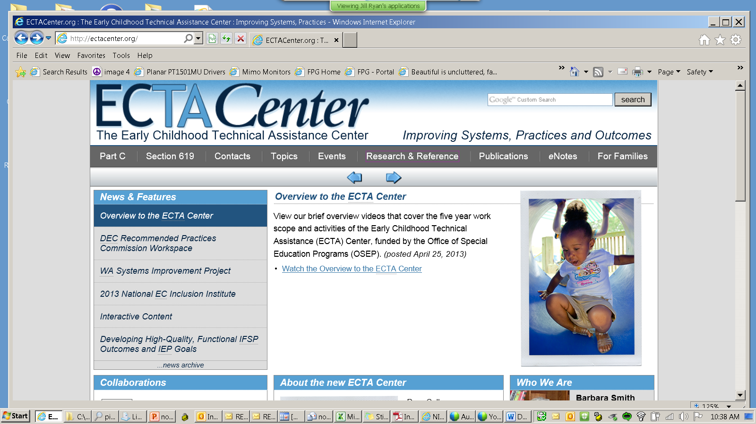

Slide 32
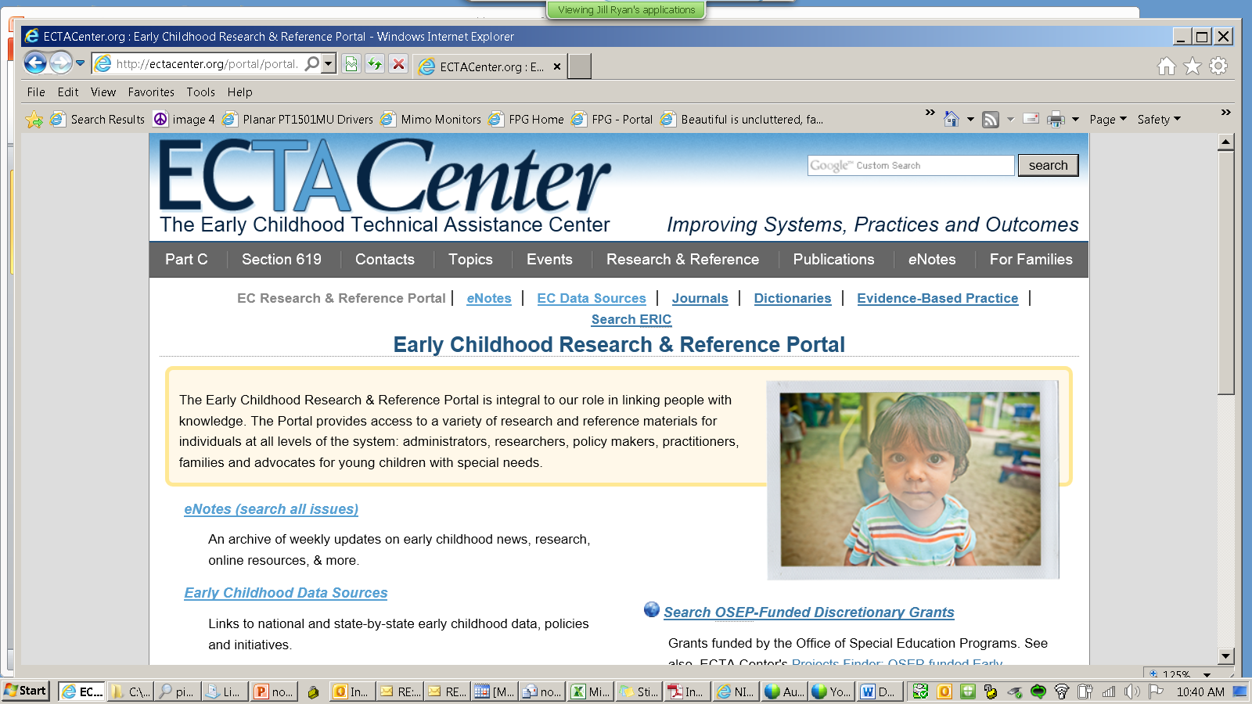

Slide 33
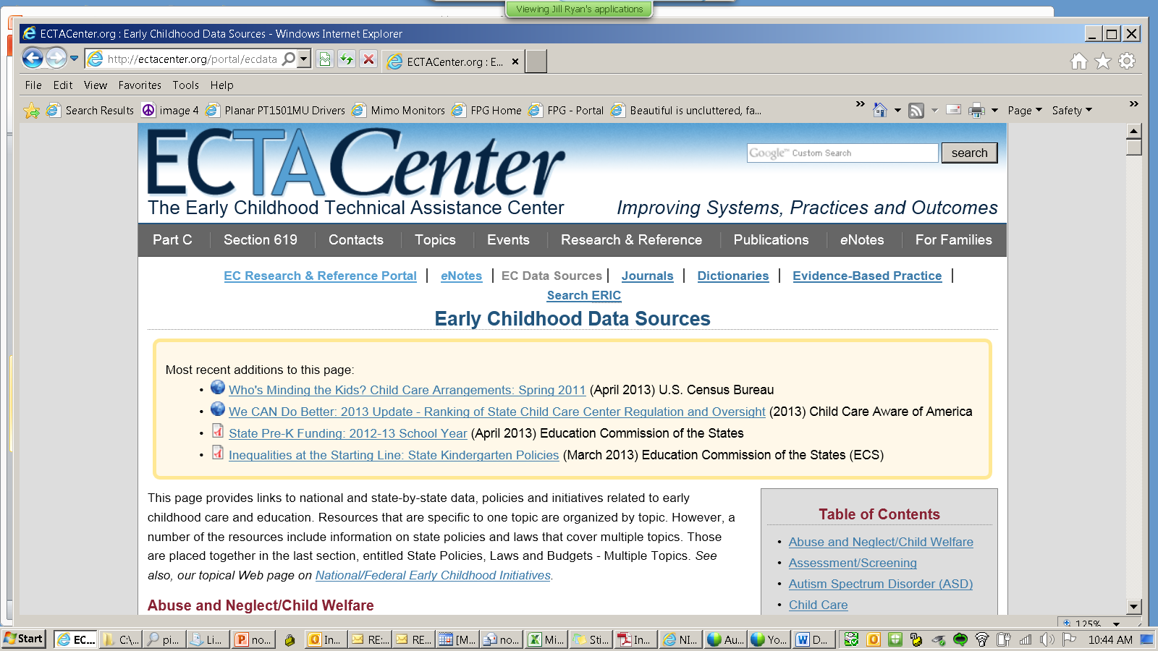

Slide 34
www.ideadata.org
Google: DAC IDEA

Slide 35
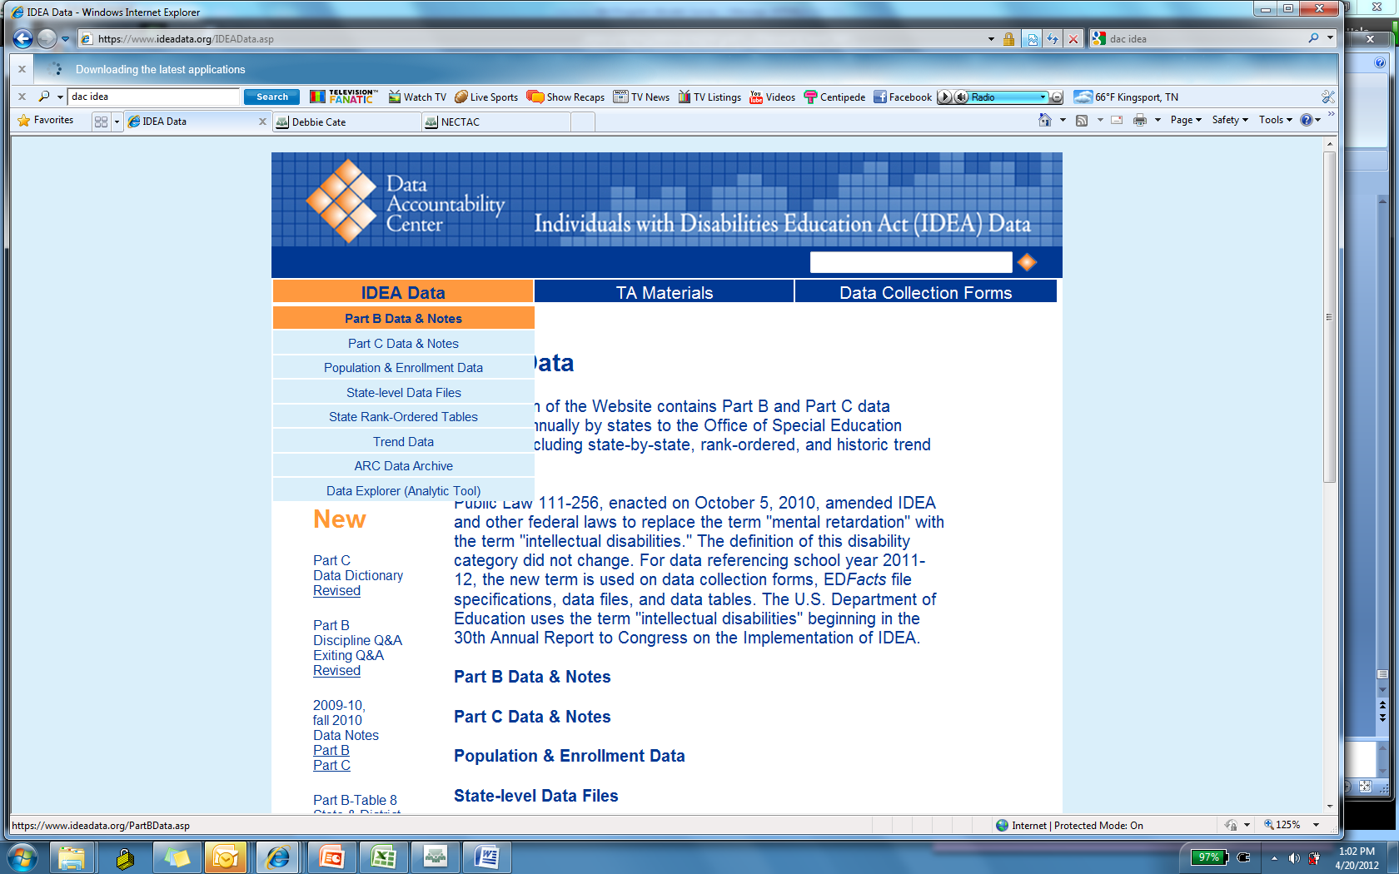

Slide 37
Number and percentage of children aged 3-5 served under IDEA, Part B
by educational environment and state, Fall 2011

Slide 38
To make data-informed decisions, we need data sources that are individually meaningful, useful for mandated reporting, and coordinated with other data sources.
Thank you for your participation

Slide 39
Identify the type program
the child attends
Row Set (A) CHILDREN ATTENDING A REGULAR EARLY CHILDHOOD PROGRAM AT LEAST 10 HRS PER WEEK, …
Row Set (B) CHILDREN ATTENDING A REGULAR EARLY CHILDHOOD PROGRAM LESS THAN 10 HRS PER WEEK, …
Row Set (C) CHILDREN ATTENDING A SPECIAL EDUCATION PROGRAM (NOT in any regular early childhood program), …
Row Set (D) CHILDREN ATTENDING NEITHER A REGULAR EARLY CHILDHOOD PROGRAM NOR A SPECIAL EDUCATION PROGRAM (NOT INCLUDED IN ROW SETS A, B, OR C)
Notes:
Selection of the appropriate reporting category involves a multi-stage procedure – identifying (in column 1) the type of program the child attends, if any, (and the number of hours per week in attendance for Row Set A), then further identifying (in column 2) the setting in which the child receives the majority of special education and related services.

Slide 40
Identify the number of hours per week
in attendance if RECP
Row Set (A) CHILDREN ATTENDING A REGULAR EARLY CHILDHOOD PROGRAM AT LEAST 10 HRS PER WEEK, …
Row Set (B) CHILDREN ATTENDING A REGULAR EARLY CHILDHOOD PROGRAM LESS THAN 10 HRS PER WEEK, …
Row Set (C) CHILDREN ATTENDING A SPECIAL EDUCATION PROGRAM (NOT in any regular early childhood program), …
Row Set (D) CHILDREN ATTENDING NEITHER A REGULAR EARLY CHILDHOOD PROGRAM NOR A SPECIAL EDUCATION PROGRAM (NOT INCLUDED IN ROW SETS A, B, OR C)
Notes:
Selection of the appropriate reporting category involves a multi-stage procedure – identifying (in column 1) the type of program the child attends, if any, (and the number of hours per week in attendance for Row Set A), then further identifying (in column 2) the setting in which the child receives the majority of special education and related services.

Slide 41
Data
Collection
Questions?
How is the Data Collected in Your State?
Challenges?

Slide 42
Data
Reporting
How is data shared in your state?
How is the data guiding decisions?

Slide 43
We Measure
What We Value
Improvement Activities

Slide 44
Improvement Activities
Promote best inclusive practices and collaborative teaching models
Analyze data
Share and explain local data
Compare state and local data
Include in monitoring

Slide 45
Improvement Activities
Develop ways to improve IEP team
Increase team participation and discuss options
Provide supports and training for staff in regular early childhood programs

Slide 46
Improvement Activities
Foster Partnerships
Strengthen relationships with families
Promote community partners:
Head Start
State Pre-K
Title I
Child care
Community programs

