Slide 1
Identification and Referral of Children with Deaf-Blindness
Robbin Bull
Emma Nelson

Slide 2
Welcome
Introduction
POLL: Who’s here? Role/State

Slide 3
Purpose
To provide an overview of:
The Deaf-Blind Technical Assistance Network
The National Deaf-Blind Child Count
To discuss and share strategies for:
Under identification & under referral
Notes:
Clarify Terms & Definitions
Deaf-Blindness: Any degree of combined vision and hearing loss (mild to significant) that impacts learning
Increase awareness of the diversity and complex needs of the population
Geography
Disparity in service delivery across districts & states
Lack of trained personnel and access to individualized supports
Representatives from two different states will share strategies they have used to partner within their states.

Slide 4
Outcomes
Identify new partnerships for collaboration to maximize outcomes
Locate resources to expand efforts in intervention strategies
Increase awareness of the need for a broader team approach to meet specific developmental needs
Enhance understanding of the importance of early integrated family supports to provide a vision for the child’s success

Slide 5
Polls
Awareness of State Deaf-Blind Project?
If collaborated, how you have partnered with your state Deaf-Blind Project?

Slide 6
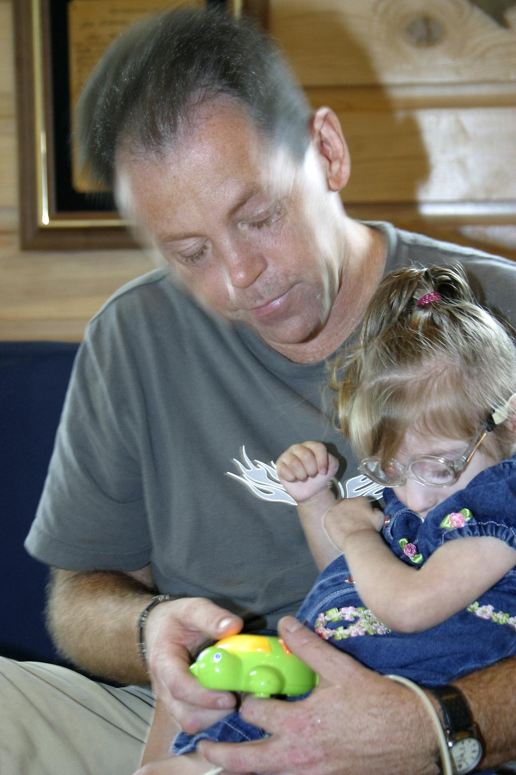
Deaf-Blind Technical Assistance Network
National Center on Deaf-Blindness
Partner Organizations
State and Multi-State Deaf-Blind Projects
Serve Birth - Age 21

Slide 7
About NCDB
Technical Assistance and Information Dissemination Center
Goal: To improve services, educational results, and quality of life for children who are deaf-blind
Work closely with state deaf-blind projects and other partners across the country
Funded by the U.S. Department of Education’s Office of Special Education Programs (OSEP)
Notes:
NCDB is comprised of five established agencies with a track record of serving children who are deaf-blind.
The Helen Keller National Center (HKNC) holds the grant and sub contracts with four other agencies and universities.
We also have a variety of staff members across the country who have extensive knowledge and skills in areas needed to operate a technical assistance center.

Slide 8
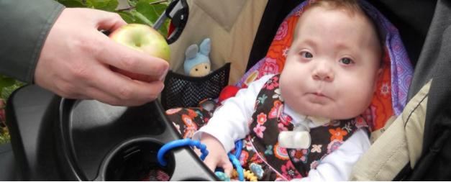
NCDB Initiatives
Family Engagement
Identification and Referral
Interveners and Qualified Personnel
Transition
Notes:
NCDB’s technical assistance activities are aligned with four national initiatives:
Family Engagement – Increasing the quality of family support and helping families acquire the knowledge and skills needed for partnering with service providers and advocating for their children
Identification and Referral – Increasing identification so children can begin receiving appropriate services as early as possible
*** This is similar to what you know of as Child Find in Part C
Interveners and Qualified Personnel – Building the knowledge and skills of educators serving children who are deaf-blind through expansion of personnel development opportunities and adoption of interveners and teachers of the deaf-blind
Transition – Improving transition outcomes so that students successfully move from high school to post-secondary education or employment and community life
Partnering with National Partners to advance the work in these initiatives

Slide 9
About State Deaf-Blind Projects
Resources, support, and information
Individual, on-site (or virtual) consultations at school, home, or in the community
Workshops, training, and conferences for families and professionals
Opportunities for families and professionals to connect
Guidance through transitional periods
Child Find and maintain a state child count of individuals birth through age 21 with combined vision and hearing loss

Slide 10
Overview of Deaf-Blindness
“Deaf-Blindness” refers to combined vision and hearing loss.
Any range of combined vision and hearing loss that significantly limits the child’s ability to get information from people, objects, and activities around them.
Losses can cause developmental delays: language/communication, social emotional skills, cognition, adaptive, and motor.
Notes:
Only about 1% of children are profoundly deaf and totally blind
Any combined hearing and vision loss that significantly limits the child’s ability to get information from people and objects around them.
Losses can cause developmental delays: language, social skills, and mobility.
Combined vision and hearing losses do not always limit the individual’s learning potential.

Slide 11
Most Common Causes
Hereditary Syndromes/Disorders
Examples: CHARGE Syndrome, Usher syndrome, Down syndrome (Trisomy 21 syndrome)
Prenatal complications
Examples: Cytomegalovirus (CMV), Hydrocephaly, Microcephaly
Postnatal complications
Examples: Asphyxia, Severe Head Injury, Meningitis, Trauma/Loss of Oxygen at Birth
Learn more about the causes of deaf-blindness →
Notes:
Hydrocephalus & Microcephaly are frequently associated with other factors that lead to challenges or delays
Prematurity is not a cause directly but many complication that arise in infants who are premature can lead to combined vision and hearing loss. Birth trauma at any
We have a link on the powerpoint, which you all will have access that gives further information about causes of deaf-bindness

Slide 12
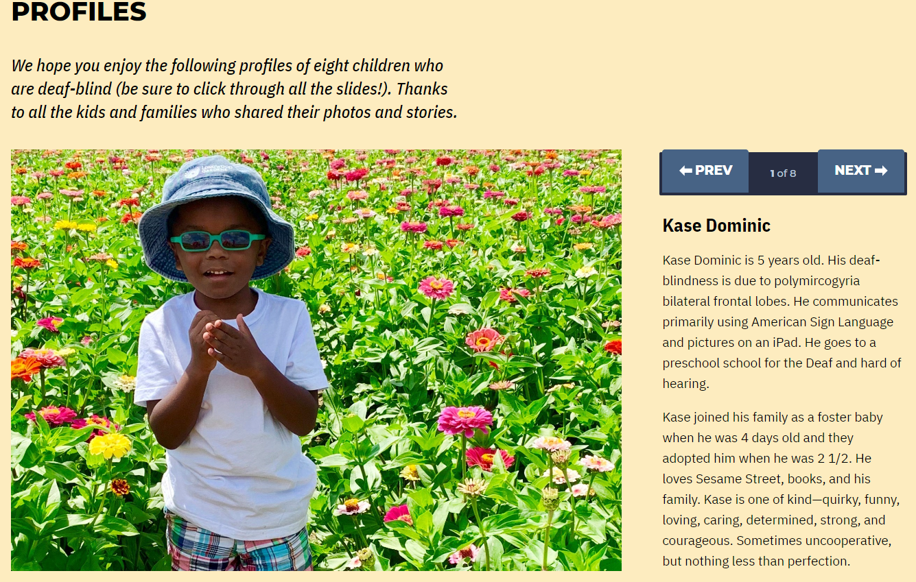
Learn about Deaf-Blindness
Notes:
Causes of deaf-blindness, Overview of deaf-blindness, an overview of educational practices, and profiles of children who are deaf-blind. These profiles provide insight into the diversity of children who are deaf-blind.

Slide 13
National Deaf-Blind Child Count
Authorized by the U.S. Department of Education, Office of Special Education
Started in 1986
Each state conducts a count of children and youth who are deaf-blind (birth through age 21).
State data is compiled and reported in the annual National Child Count of Children and Youth who are Deaf-Blind.
87% of children on the deaf-blind child count have one or more disabilities - in addition to deaf-blindness
Notes:
It was initially requested by the U.S. Department of Education to examine the discrepancy between the state deaf-blind project child counts and the Department’s Office of Special Education Program’s annual Special Education Child Count, which counts children as deaf-blind only when deaf-blindness is a child’s sole disability. In contrast, the National Deaf-Blind Child Count also includes children and youth who are deaf-blind and have additional disabilities. This is an important distinction because approximately 87% of children and youth on the National Deaf-Blind Child Count have one or more additional disabilities.

Slide 14
Low Incidence Population
Children Birth - 21
Blue circle: All children in the U.S. (~90 mil*)
Yellow circle: Children in special education (7,426,720*) 8% of U.S.
Red circle: Children with deaf-blindness (9,904^)
.16% of special education
*42nd Annual Report to Congress; ^2018 National Deaf-Blind Child Count
Notes:
Large blue circle demonstrating U.S. population; small yellow circle representing special ed population; tiny red dot representing deaf-blind population. Red dot is so small it has to be magnified to be seen. Highlights the importance of partnerships- every family who has a child with deaf-blindness, although small on this graph and on caseloads, that red dot is everything to the family, it is their whole world. It is important that we remember that and need to make sure that resources are available to them.
U.S. and special education numbers are from 42nd Annual Report to Congress; # for deaf-blindness are from 2018 National Deaf-Blind Child Count

Slide 15
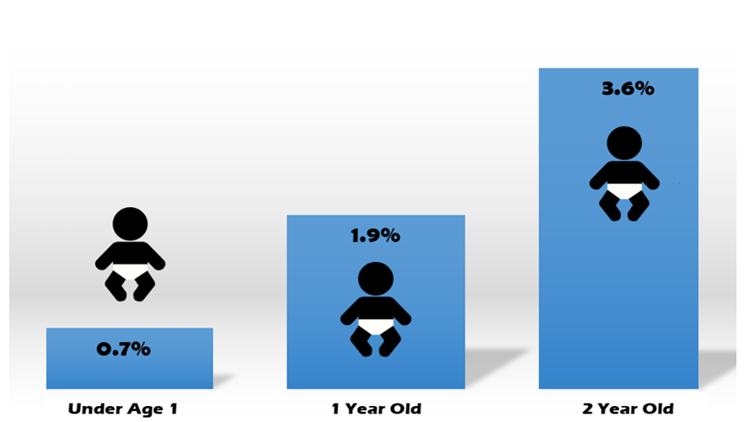
Deaf-Blind: Ages 0-2 Population
2019 National Child Count of Children and Youth Who Are Deaf-Blind Report, National Center on Deaf-Blindness
Notes:
Of the Birth - 21 deaf-blind population, under 1% are reported under the age of 1 (72); increases to 1.9% for 1 year olds (206); 2 year olds make up 3.6% (380)

Slide 16
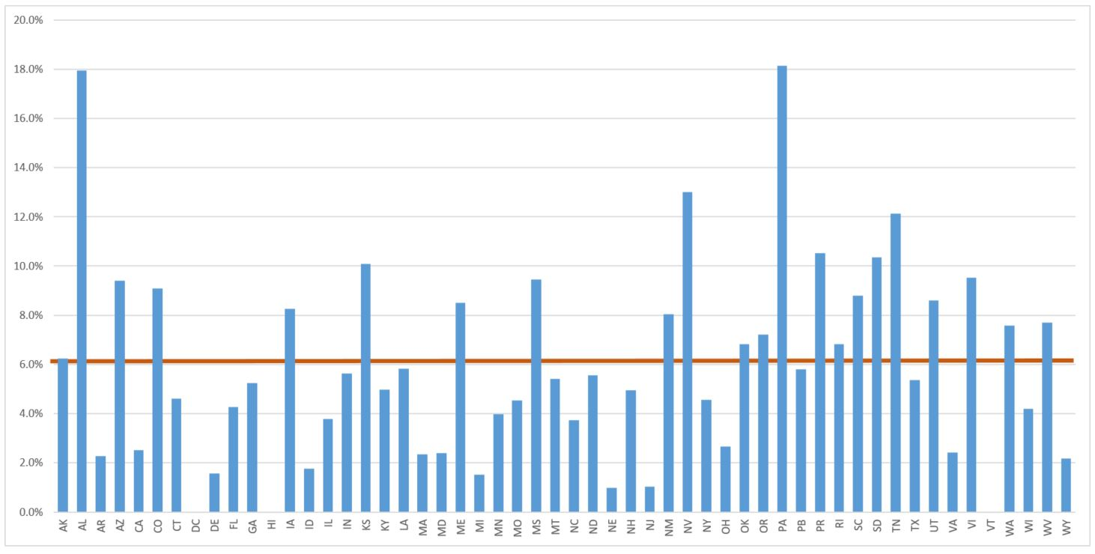
National DB Count: Percent Birth - 2
2019 National Child Count, NCDB
Notes:
Percentages of Total Birth - 21 Deaf-Blind Child Count. 6.2% National average for Birth - age 2.
See some trends that parallel Part C reporting, however you may notice in your state above average or below average. This is a good opportunity for dialogue with the state deaf-blind project.
PA and AL are outliers. PA has an automatic referral system. AL has increased significantly over the past couple of years due to targeted efforts related to identification at the early ages.

Slide 17
National DB Child Count: Birth - 6
Age | N | % DB Total
Under 1 | 72 | 0.7%
1 | 206 | 1.9%
2 | 380 | 3.6%
3 | 431 | 4.1%
4 | 435 | 4.1%
5 | 433 | 4.1%
6 | 495 | 4.7%
2019 National DB Child Count, NCDB
Notes:
Low incidence = small numbers. Slowly make progress identifying birth - 2, generally doubling the number each year of age, but then often lose track of children as they transition to pre-school. Referrals pick up again when they hit school-age.

Slide 18
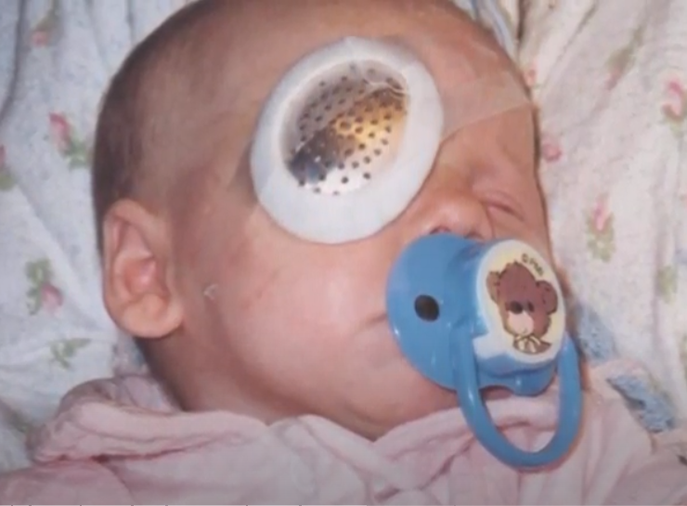
Importance of Identification & Referral (1 of 2)
Children with a loss in one sensory area (vision/hearing) should be evaluated for a loss in the other sensory area
Evaluations should be repeated regularly
Children with unidentified combined vision and hearing loss can lack access to key skills across domains and require unique techniques to help access their environment
Notes:
Tie in- now that you see that our numbers are so small, even though it’s a small population it is so important to identify early because their needs are so great.
Recommended red flag. If you have families that are worried about their child’s vision or hearing, recommend that they visit an opthalmologist/audiologist for further testing. Offer to support them to write down their questions ahead of time
For bonding and social interaction, communication, cognitive and conceptual skills, gross and fine motor skills, and self help/adaptive.

Slide 19
Importance of Identification & Referral (2 of 2)
Proper identification requires partnership and collaborative actions
Training can provide early intervention providers and families tools to:
Help young children learn how to access residual vision and hearing
Learn skills to support the child’s learning, communication, social emotional development, motor development and increase independence

Slide 20
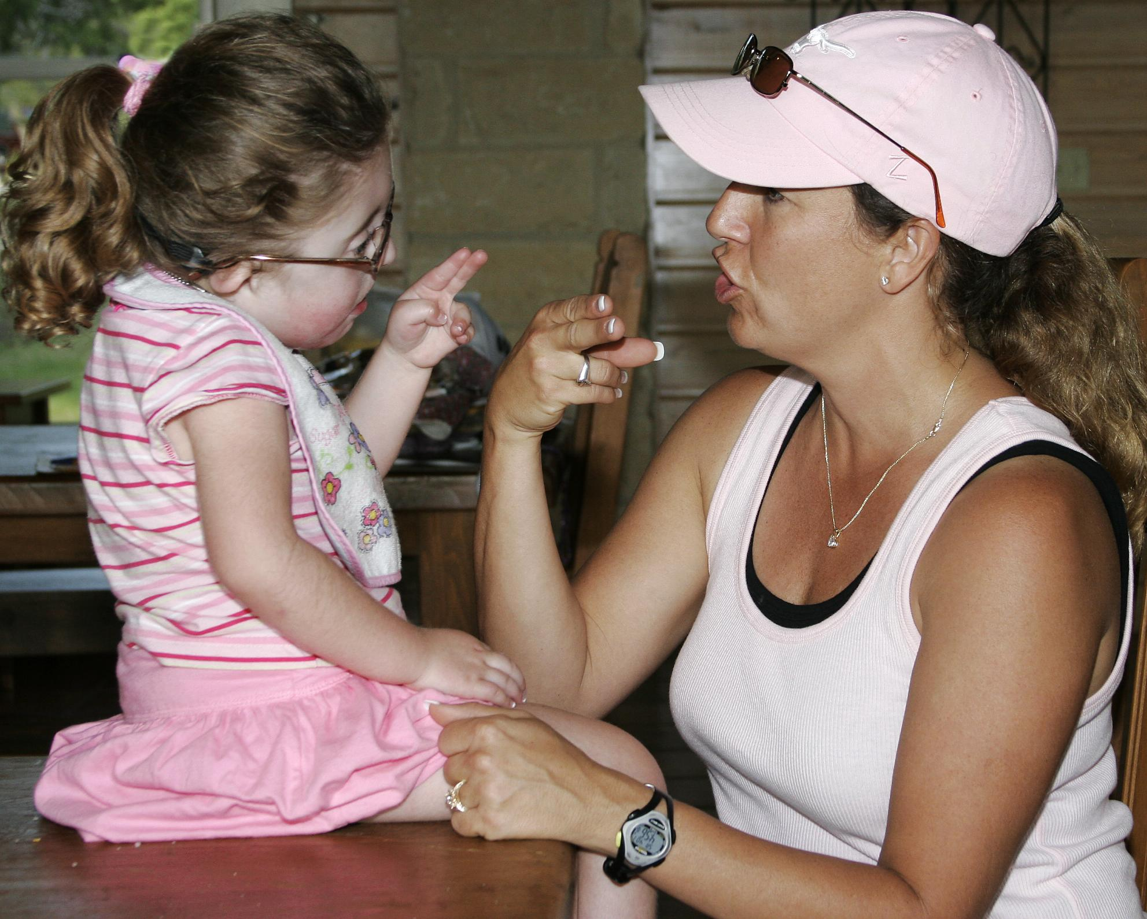
Ways to Partner with Your State’s Deaf-Blind Project
Access to resources on deaf-blindness
Family support
Provider and family training opportunities
Involve project staff in Part C activities and planning (e.g., advisory council, family events, conferences etc.)
Expand child find efforts through additional connections
Notes:
You will hear more about his in state examples that you will hear in just a moment.
Will turn to some examples of how states are actively partnering at this moment. First we will hear from Washington where they will provide an example of how they are providing training and supports to their family resource consultants. We have some representatives from WA, so if you have questions that occur during the presentation or afterward, you can place them in the chat.

Slide 21
State Examples -
Washington
Partnering to Create Tools and Trainings
Videos:
Katie Humes - Washington Sensory Disabilities Services, DeafBlind Project (Video)
Adrienne O’Brien - Early Support for Infants and Toddlers (ESIT) (Video)
Notes:
Next we will hear from Tennessee where they will share examples of how they are actively partnering with a variety of state systems to support families. The first video occurred during a recorded conversation between Tennessee’s state deaf-blind project coordinator and the parent leader for the state’s H&V chapter.

Slide 22
State Examples -
Tennessee
Supporting families through collaborative partnerships
Videos:
Kodi Ogle - Executive Director, TN Hands & Voices (Video)
Rachael Stough - Program Director 2, EHDI Coordinator – Newborn Hearing Follow-Up Program (Video)
Danna Conn - Project Coordinator, TN Deaf-Blind Project (Video)

Slide 23
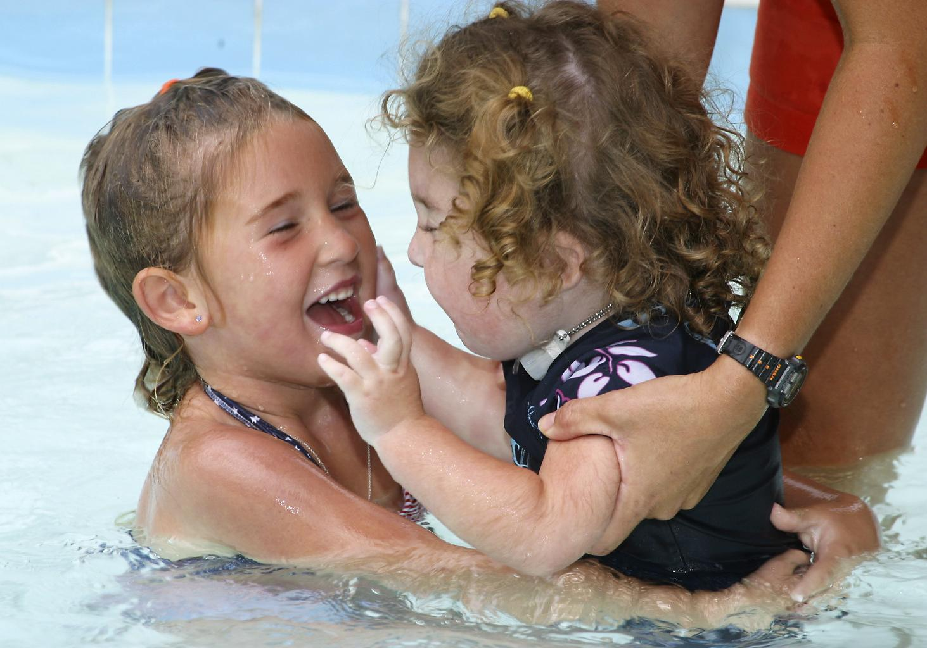
Training Tools
Training Resources
Sooner the Better: A Framework for Training Early Intervention Practitioners
Learning Module: Deaf-Blindness for Early Intervention Practitioners (VA - open to all)
Open Hands, Open Access: Deaf-Blind Learning Modules
Notes:
Contact your state deaf-blind project for free training opportunities or to co-create training materials, some examples are...
The Sooner the better is what was mentioned in Washington’s video that they used to support their trainings.
Virginia’s learning module was built using materials from the Sooner the Better materials: This course offers Early Intervention providers with content that focuses on (1) the identification of infants and toddlers with combined vision and hearing loss (deaf-blindness), (2) key instructional strategies, and (3) developmental domains. The selection of resources was guided by the Council of Exceptional Children’s Division for Early Childhood (DEC) Recommended Practices. This is a link to a comprehensive collection of learning modules that cover a variety of topics relevant to deaf-blindness.
OHOA: These are not geared specifically toward early childhood providers, but the techniques and information included are relevant to anyone working with children with complex needs including those who are deaf-blind.
These include resources for strategies and techniques to support access and learning for children who are deaf-blind, state support will additionally support learning of techniques

Slide 24
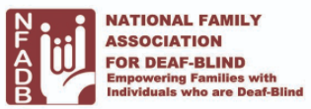
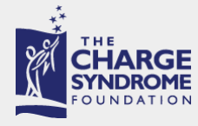
Family Organizations
Hands & Voices
National Foundation for Deaf Blind (NFADB)
CHARGE syndrome Foundation
Usher syndrome Coalition

Slide 25
Resources at Your Fingertips
Information on nationaldb.org:
Deaf-blindness, educational practices, and professional development opportunities
The National Deaf-Blind Child Count
Risk Factors
Risk Factors for Combined Vision and Hearing Loss
Risk Factors and Behaviors Decision Tree
Chart: Range of Combined Vision and Hearing Loss
State Deaf-Blind Projects Contacts
Family Services and Supports

Slide 26
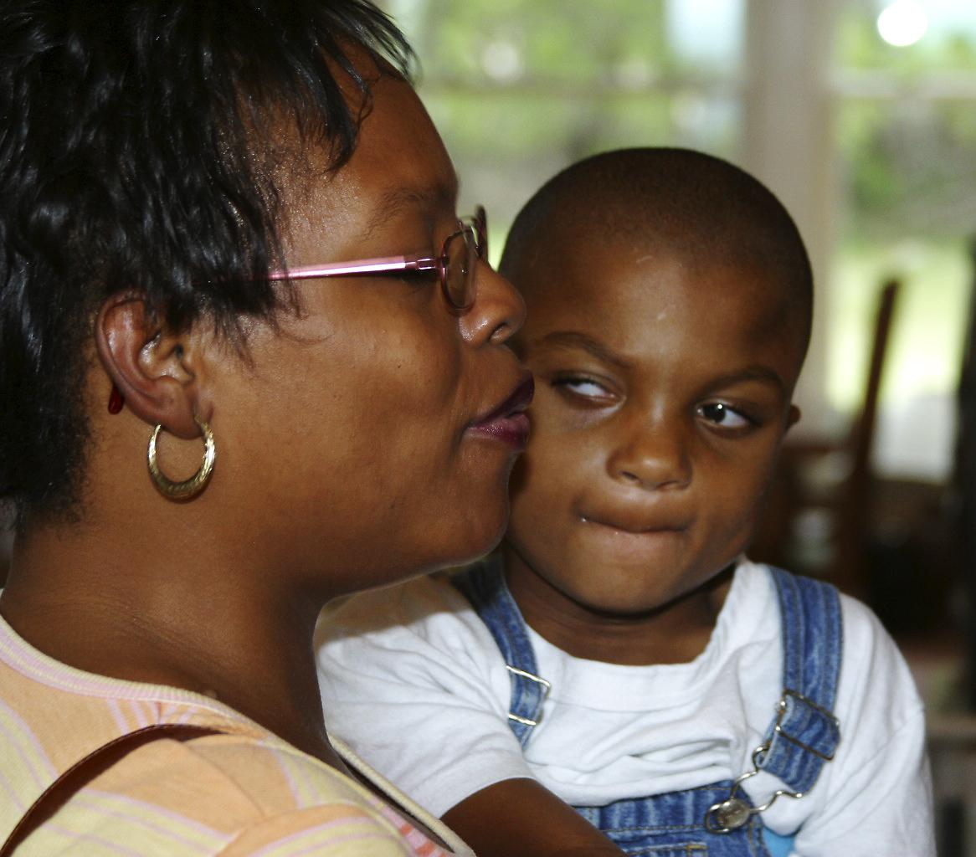
Pulse Check
Share any reactions you have to what was presented..
What is something you want to know that wasn’t covered in the presentation?

Slide 27
Questions to Consider
How could the Deaf-Blind TA Network assist Part C on a national and state level?
What types of data would be helpful?
What collaborative efforts and ideas come to mind for...
Family Support/Engagement
Professional Development/Training
Sharing of State, Regional, and Local Partnerships and Resources
Notes:
You may want to ask your staff to look at and listen to the webinar and then possibly bring this to your staff meetings or other conversations, ICC meetings, conversations with local providers etc…
Please fill out the evaluation we look forward to your feedback

Slide 28
Thank you
Emma Nelson: emma.nelson@hknc.org
Robbin Bull: robbin.bull@hknc.org
The contents of this presentation were developed under a grant from the U.S. Department of Education, #H326T180026. However, those contents do not necessarily represent the policy of the U.S. Department of Education, and you should not assume endorsement by the Federal Government. Project Officer, Susan Weigert.

