Slide 1
Applying Assessment Principles to Determining Eligibility Remotely
Kathy Hebbeler, SRI International
619 Coordinators Call
April 22, 2020
Notes:
Focusing on the process, not informed consent. Preparing other resources for child outcomes assessment.

Slide 2
Ex cathedra

Slide 3
Ex cathedra

Slide 4
Goal is to continue to meet the needs of children with delays and disabilities who need special education
And that includes taking children into services who have not received them before.
Notes:
So what can we do?

Slide 5
We will co-create possible approaches

Slide 6
A question to think about
Do you want to rebuild to what you had?
OR
Do you rebuild to what you want?

Slide 7
Purposes of Assessment
Screening
(is there a need to do more assessment?)
Diagnosis (Determination of eligibility)
Program planning/progress monitoring
Accountability (AKA child outcomes)
Notes:
Different purpose require different tools. Validity is connected to the use of a test

Slide 8
Purposes of Assessment
Screening
(is there a need to do more assessment?)
Diagnosis (Determination of eligibility)
Program planning/progress monitoring
Accountability (AKA child outcomes)

Slide 9
Can you reduce the need for evaluations? Choices and Options
For children coming from Part C, are there evaluations that can be used?
Are programs able to use data from community screenings or conduct screenings remotely to identify children who might not need a full evaluation?

Slide 10
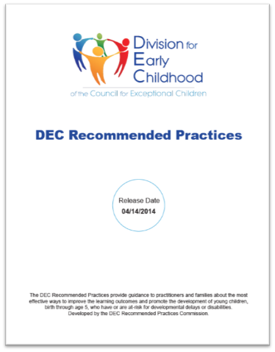
Assessment
A6. Practitioners use a variety of methods, including observation and interviews, to gather assessment information from multiple sources including the child’s family and other significant individuals in the child’s life.
A7. Practitioners obtain information about the child’s skills in daily activities, routines, and environments such as home, center, and community.
A8. Practitioners use clinical reasoning in addition to assessment results to identify the child’s current levels of functioning and to determine the child’s eligibility and plan for instruction.

Slide 11
Regulations – Key points
Use a variety of assessment tools and strategies
Not use a single measure as sole criterion
Use technically sound instruments
Not discriminatory on racial or cultural basis
Administered in native language
Use for the purposes for which they were validated
Administered by trained personnel
Administered according to the assessment’s instructions
Assessed in all areas of suspected disability

Slide 12
General Resources on Assessment
DEC Recommended Practices - https://ectacenter.org/decrp/decrp.asp
Assessment Practice Guides - https://ectacenter.org/decrp/type-pgpractitioner.asp
Engaging in Informed Clinical Reasoning
Engaging Families as Assessment Partners
Authentic Child Assessment
Building on Child’s Strengths
Identifying Child’s Strengths
Assessment Checklists- https://ectacenter.org/decrp/type-checklists.asp
Engaging Families as Partners in Their Child’s Assessment
Authentic Child Assessment
Building on Child’s Strengths
Informed Clinical Reasoning
Assessment Module - https://rpm.fpg.unc.edu/modules-list

Slide 14
Multiple ways of learning about children’s skills and behaviors
Formal assessment tools
Direct assessment
Assessment that is completed based on parent/caregiver or teacher report (how frequently does the child….?)
Observation-based assessment (Teaching Strategies Gold)
Some combination of the above
Informal assessment processes
Information solicited from knowledgeable adults (tell me about how your child lets you know she wants something?)
Observation (real time, video)

Slide 15
If your state…
Relies heavily on a one standardized direct assessment (even if there are different ones used across the state) for determining eligibility –
the pivot to tele-assessment will be more difficult.
Why? Programs have one tool in their tool box and that tool requires standardized administration and the norms are based on a trained evaluator administering the items.
Includes direct assessment as one of its methods, then you “down one” but have other tools to rely on.

Slide 16
Validity and Norms
What is validity?
When do the norms not apply?
Validity refers to the degree to which evidence supports the interpretation of an assessment’s scores for a proposed use.
Validity of a standardized assessment requires strict adherence to administration procedures.
Notes:
Validity is not a characteristic of the tools. It is a characteristic of the interpretation of the scores. A tool can produce valid scores for one purpose but not for another. A tool also can produce valid scores when poorly administered even for its intended purpose. Implication: Validity can come and go.

Slide 17
Validity and Norms
What is validity?
When do the norms not apply?
Answer: When there is a significant difference between this administration and the norming population or conditions.
What is significant?
Cultural differences
Language issues (items translated on the fly)
Administration issues
Assessor doesn’t follow the directions
Notes:
Threats to validity: When the assessor has not been well trained, repeats the item 3 time. Helps the child point.

Slide 18
Can direct assessments produce valid scores and inferences when the assessor is not face to face with the child?

Slide 19
Considerations
Formal assessments have rules, especially if they generate a score that compares to a norm.
Rules apply to how the tool was normed
If those rules are violated, the norm data does not apply (potential validity problems)
How serious is the difference?
Is it reasonable to expect the difference would impact the child’s behavior during the assessment?
Both formal and informal assessments can provide valuable information
All formal assessments are constrained because they are limited to the content of the assessment tool. Possible issues that can be missed:
Atypical behaviors
Parental concerns
Notes:
All forms of assessment have limitations - there is no perfect one size fits all tool or method.

Slide 20
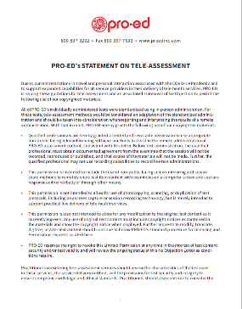
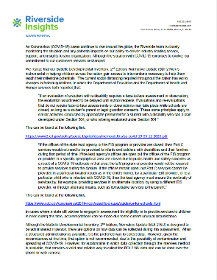
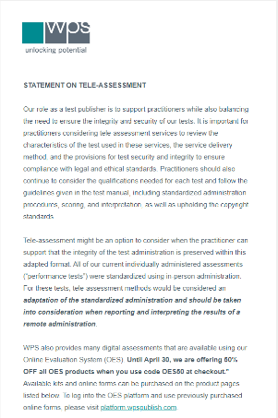
Publisher statements
Vested interest in having programs continue to use their tools
Has links to many professional association web pages at end.
https://padlet.com/eita/statments

Slide 21
Which is why good assessment requires multiple sources of information

Slide 22
Direct assessment via Tele-assessment: Some options
Parent is asked to administer the items
Does the assessment have its own test materials (e.g., blocks, pictures)?
Professional directs the parent in how to administer the items while watching
Parent is asked whether the child can do the items
But are they good options?
CRITICAL QUESTION: How different is this administration from the conditions under which the norm data for the assessment were collected?
Notes:
Note: If there is a test kit, it means those materials are to be used. If an assessment includes a task but not directions for how to administer the task, then there is more leeway in how to adminster.

Slide 23
Other methods – Formal assessments that make use of parent information
Examples
(THESE ARE NOT ENDORSEMENTS)
Vineland Adaptive Behavior Scales
Developmental Assessment of Young Children (DAYC)
Adaptive Behavior Assessment System (ABAS)
Devereux Early Childhood Assessment (DECA – Social Emotional)
MacArthur-Bates Communicative Development Inventories (CDI) (8 to 37 months but can be used with older children with delays)
Tools that use parent interview or parent report and provide standard scores

Slide 24
Informal Assessments (Developed by the assessor, the program, etc.)
Developmental history
Parent Interview/Report
Real time video conference observation of the child
Videos made by the parents (can request parent capture specific activities such a book-reading, playing with toys, interacting with an adult.
Many video libraries of children’s behavior on the web to train observation skills. Examples:
https://www.desiredresults.us/practice-videos
https://www.cde.state.co.us/resultsmatter/rmvideoseries

Slide 25
Putting it altogether: Informed clinical reasoning
Is a process team members use to gather information about a child’s developmental functioning in order to make a decision about the child’s eligibility for services.
Team uses all of the information to portray an accurate picture of the child’s developmental status and determine the child’s eligibility.
Think about: If policy will allow it and the assessment information is ambiguous, err on the side of finding the child eligible
Can re-assess child later
Resources on Informed Clinical Reasoning
https://ectacenter.org/decrp/type-pgpractitioner.asp
https://ectacenter.org/decrp/type-checklists.asp

Slide 26
Helping families now -- and later
If the family is not interested in pursuing an eligibility evaluations now
Consider asking if they would be willing to have a follow up contact later
Track those who say “yes,” and get back to them later.

Slide 27
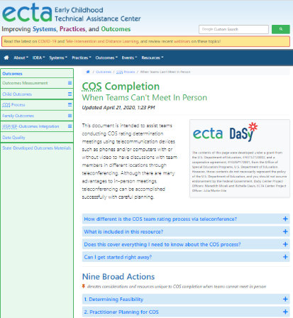
New Resources for COS Process
https://ectacenter.org/eco/pages/cos-distance.asp
About COS but has lots of good information and resources about how to hold team meetings and work with families remotely

Slide 28
Questions?
Comments?

Slide 29
Find out more at ectacenter.org
The ECTA Center is a program of the FPG Child Development Institute of the University of North Carolina at Chapel Hill, funded through cooperative agreement number H326P170001 from the Office of Special Education Programs, U.S. Department of Education. Opinions expressed herein do not necessarily represent the Department of Education's position or policy.

