Slide 1
Applying Assessment Principles to Determining Eligibility Remotely
Kathy Hebbeler, SRI International
Naomi Younggren, ECTA
Part C Coordinators Call
April 28, 2020
Notes:
K
Focusing on the process, not informed consent. Preparing other resources for child outcomes assessment.

Slide 2
Goal is to continue to meet the needs of children with delays and disabilities who need early intervention
And that includes taking children and families into services who have not received them before.
Notes:
K
So what can we do?

Slide 3
We will co-create possible approaches
Notes:
K
There are no easy or perfect answers. There is no research comparing alternate approaches. There are a lot of dedicated and experienced people across the country trying to solve this together.
Not everyone’s quilt will look the same. Some common squares to all the quilts. Some that are unique to your state.

Slide 4
Poll Questions 1 and 2
Notes:
K

Slide 5
A question to think about
Do you want to rebuild to what you had?
OR
Do you rebuild to what you want?
Notes:
N -- Problems can be opportunities

Slide 6
Purposes of Assessment
Screening
(is there a need to do more assessment?)
Diagnosis (Determination of eligibility)
Program planning/progress monitoring
Accountability (AKA child outcomes)
Notes:
N
Different purpose require different tools. Validity is connected to the use of a test

Slide 7
Purposes of Assessment
Screening
(is there a need to do more assessment?)
Diagnosis (Determination of eligibility)
Program planning/progress monitoring
Accountability (AKA child outcomes)
Notes:
N
We are not focusing on screening today but we do want to call your attention to the connection between screening and evaluation for eligibility.

Slide 8
Can state minimize the need for evaluations? Choices and Options
If state policy provides for screening, are programs able to use data from community screenings or conduct screenings to identify children who might not need a full evaluation?
Developmental screenings can be conducted remotely
Notes:
N

Slide 9
Purposes of Assessment
Screening
(is there a need to do more assessment?)
Diagnosis (Determination of eligibility)
Program planning/progress monitoring
Accountability (AKA child outcomes)
Notes:
N
We are not going to address written consent; also not going to addressed technology issues including security issues.

Slide 10
Part C Eligibility
Developmental Delay
As measured by appropriate diagnostic instruments and procedures in one or more areas:
Cognitive development
Physical development including vision and hearing
Communication development
Social or emotional development
Adaptive development
Has a diagnosed physical or mental condition with high probability of resulting in delay
(state discretion) At risk
(state discretion) Continuing in EI after age 3
States’ and territories’ definitions of/criteria for IDEA Part C eligibility
https://ectacenter.org/~pdfs/topics/earlyid/partc_elig_table.pdf
Notes:
N
Eligibility determination can be different for different types of children.

Slide 11
Can state minimize the need for evaluations? Choices and Options
Are children with diagnosed conditions presumed to be eligible?
More on presumptive eligibility:
Dunst (2006) An eligibility algorithm for Part C intervention enrollment
Dunst (2010) Streamlining eligibility determination for Part C early intervention
Notes:
N

Slide 12
Poll Question 3 and 4
Notes:
N

Slide 13
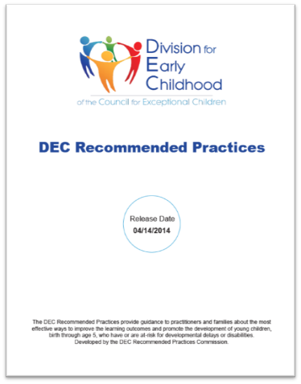
Assessment
A6. Practitioners use a variety of methods, including observation and interviews, to gather assessment information from multiple sources including the child’s family and other significant individuals in the child’s life.
A7. Practitioners obtain information about the child’s skills in daily activities, routines, and environments such as home, center, and community.
A8. Practitioners use clinical reasoning in addition to assessment results to identify the child’s current levels of functioning and to determine the child’s eligibility and plan for instruction.
Notes:
K
These principles apply to all assessment – eligibility evaluations and for intervention planning

Slide 14
Part C Regulations: Evaluation
Timely, comprehensive, multidisciplinary
Qualified personnel
Medical records may be used
If they indicate the child’s level of functioning constitutes a delay or otherwise meets criteria
Still need to do assessment
Informed clinical opinion as an independent basis (even when the instrument results do not support eligibility)
Not culturally or racially discriminatory
Native language of child
No single procedure used as the sole criterion
Child’s history
Information from other sources to understand the full scope of child’s unique strengths and needs
Medical, educational and other records
Notes:
K
303.24 Multidisciplinary – 2 or more separate disciplines

Slide 15
Part C Regulations
To identify child’s unique strengths and needs and services
Review the evaluation results
Personal observation of the child
Child’s needs in each developmental area
Assessment
Physical (including vision, hearing, and health status
Cognitive, communication, social or emotional, adaptive
Taken from the evaluation and assessments
Present levels of functioning
Notes:
K
303.24 Multidisciplinary – 2 or more separate disciplines
EI services may commence before completion of the evaluation and assessment
Parental consent
Interim IFSP
Complete evaluation and assessment within 45 days

Slide 16
Multiple ways of learning about children’s skills and behaviors
Formal assessment tools
Direct assessment
Assessment that is completed based on parent/caregiver or teacher report (how frequently does the child….?)
Observation-based assessment (e.g., HELP)
Some combination of the above
Informal assessment processes
Information solicited from knowledgeable adults (tell me about how your child lets you know she wants something?)
Observation (real time, video)
Notes:
K
Formal assessment tools are tools that have been developed by someone else. They should be have undergone a systematic research and development process. Most formal tools are purchased.

Slide 17
Multiple ways of learning about children’s skills and behaviors
Formal assessment tools
Direct assessment
Assessment that is completed based on parent/caregiver or teacher report (how frequently does the child….?)
Observation-based assessment (Teaching Strategies Gold)
Some combination of the above
Informal assessment processes
Information solicited from knowledgeable adults (tell me about how your child lets you know she wants something?)
Observation (real time, video)
Each of these methods has strengths and weaknesses.
There is no perfect method.
Direct assessment does not necessarily produce more valid information than the other methods.
Notes:
K

Slide 18
Which is why good assessment requires multiple sources of information
Notes:
K

Slide 19
If your state…
Relies heavily on a one standardized direct assessment (even if there are different ones used across the state) for determining eligibility –
the pivot to tele-assessment will be more difficult.
Why? Tool requires standardized administration with the norms are based on a trained evaluator administering the items are not well-suited to tele-assessment.
Includes direct assessment as one of its methods, then you “down one” but assessors have other tools and methods to provide information about the child.
Notes:
K

Slide 20
Poll Question 5
Notes:
K

Slide 21
Can direct assessments produce valid scores and inferences when the assessor is not face to face with the child?
Notes:
K

Slide 22
Validity and Norms
What is validity?
When do the norms not apply?
Validity refers to the degree to which evidence supports the interpretation of an assessment’s scores for a proposed use.
Validity of a standardized assessment requires strict adherence to administration procedures.
Notes:
K
Validity is not a characteristic of the tools. It is a characteristic of the interpretation of the scores. A tool can produce valid scores for one purpose but not for another. A tool also can produce valid scores when poorly administered even for its intended purpose. Implication: Validity can come and go.

Slide 23
Validity and Norms
What is validity?
When do the norms not apply?
Answer: When there is a significant difference between this administration and the norming population or conditions.
What is significant?
Cultural differences
Language issues (items translated on the fly)
Administration issues
Assessor doesn’t follow the directions
Notes:
K
Threats to validity: When the assessor has not been well trained, repeats the item 3 time. Helps the child point.

Slide 24
Considerations
Standardized direct assessments have rules for administration, especially if they generate a score that compares to a norm.
Rules apply to how the tool was normed
If those rules are violated, the norm data does not apply (potential validity problems)
How serious is the difference?
Is it reasonable to expect the difference would impact the child’s behavior during the assessment?
Direct assessments (and all formal structured) assessments are constrained because they are limited to the content of the assessment tool. Possible issues that can be missed:
Atypical behaviors
Parental concerns
Notes:
K
Again, all forms of assessment have limitations - there is no perfect one size fits all tool or method.

Slide 25
Direct assessment via Tele-assessment: Some options
Parent is asked to administer the items
Does the assessment have its own test materials (e.g., blocks, pictures)?
Professional directs the parent in how to administer the items while watching
Professional asks the parent to engage the child in a particular activity (e.g., eating a snack, playing with a favored toy/activity...)
Parent is asked whether the child can do the items
But are they good options?
CRITICAL QUESTION: How different is this administration from the conditions under which the norm data for the assessment were collected?
Notes:
K
Note: If there is a test kit, it means those materials are to be used. If an assessment includes a task but not directions for how to administer the task, then there is more leeway in how to administer.

Slide 26
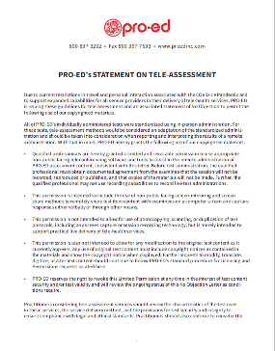
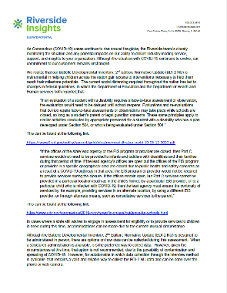
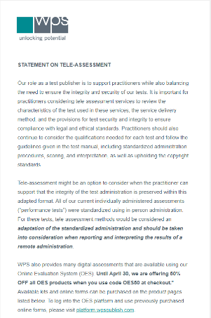
Publisher statements
Vested interest in having programs continue to use their tools
Has links to many professional association web pages at end.
https://padlet.com/eita/statments

Slide 27
Other methods – Formal assessments that make use of parent information
Examples
(THESE ARE NOT ENDORSEMENTS)
Vineland Adaptive Behavior Scales
Developmental Assessment of Young Children (DAYC)
Adaptive Behavior Assessment System (ABAS)
Devereux Early Childhood Assessment (DECA – Social Emotional)
MacArthur-Bates Communicative Development Inventories (CDI)
Receptive-Expressive Emergent Language Test (REEL)
Tools that use parent interview or parent report and provide standard scores
Notes:
K
We are compiling a list of parent report tools that will include these and more examples.

Slide 28
Other methods – Formal assessments that are not normed
Examples
(THESE ARE NOT ENDORSEMENTS)
Assessment, Evaluation and Programming System (AEPS)
Measure of Engagement, Independence and Social Relationships (MEISR)
Hawaii Early Learning Profile (HELP)
Learning Accomplishments Profile (LAP)
Rossetti Infant-Toddler Language Scale
Transdisciplinary Play Based Assessment (TPBA)
Carolina Curriculum
Formal tools that use parent interview, report or observation but do not produce standard scores can provide valuable information for clinical opinion and intervention planning
Notes:
K

Slide 29
Informal Assessments (Developed by the assessor, the program, etc.)
Developmental history
Parent Interview/Report
Real time video conference observation of the child
Videos made by the parents (can request parent capture specific activities such a book-reading, playing with toys, interacting with an adult.)
Many video libraries of children’s behavior on the web to train observation skills. Examples:
https://www.desiredresults.us/practice-videos
https://www.cde.state.co.us/resultsmatter/rmvideoseries
Notes:
N

Slide 30
Putting it altogether: Informed clinical reasoning
Is a process team members use to gather information about a child’s developmental functioning in order to make a decision about the child’s eligibility for services.
Team uses all of the information to portray an accurate picture of the child’s developmental status and determine the child’s eligibility.
Think about: If policy will allow it and the assessment information is ambiguous, err on the side of finding the child eligible
Can re-assess child later
Resources on Informed Clinical Reasoning
https://ectacenter.org/decrp/type-pgpractitioner.asp
https://ectacenter.org/decrp/type-checklists.asp
Notes:
N

Slide 31
General Resources on Assessment
DEC Recommended Practices - https://ectacenter.org/decrp/decrp.asp
Assessment Practice Guides - https://ectacenter.org/decrp/type-pgpractitioner.asp
Engaging in Informed Clinical Reasoning
Engaging Families as Assessment Partners
Authentic Child Assessment
Building on Child’s Strengths
Identifying Child’s Strengths
Assessment Checklists- https://ectacenter.org/decrp/type-checklists.asp
Engaging Families as Partners in Their Child’s Assessment
Authentic Child Assessment
Building on Child’s Strengths
Informed Clinical Reasoning
Assessment Module - https://rpm.fpg.unc.edu/modules-list
Notes:
N

Slide 32
Assessment Module –
https://rpm.fpg.unc.edu/modules-list
Notes:
N

Slide 33
Practice Perks
Engaging Families as Partners in Their Child’s Assessment
Your hands are on the other side of the screen
More transparency in describing what you're seeing and looking for
Family understanding and capacity building
Authentic Child Assessment
Parent-initiated interactions
Their actions and interactions
Building on Child’s Strengths
Seeing what the child does beyond what they don't do
Seeing child's interests
Informed Clinical Opinion
Qualified personnel must use informed clinical opinion when conducting an evaluation and assessment of the child.https://sites.ed.gov/idea/regs/c/d/303.321/a
Notes:
N

Slide 34
Poll Questions 6 and 7
Notes:
N

Slide 35
Helping families now -- and later
If the family is not interested in pursuing an eligibility evaluations now
Consider asking if they would be willing to have a follow up contact later
Track those who say “yes,” and get back to them later.
Provide information/screenings they can do on their own and invite/encourage them to call back if they have questions/concerns
Notes:
N

Slide 36
Documentation of Tele-assessment
Look ahead to the need to examine events during the pandemic separately
Document in the child’s records
If you can, document in your program and state data system
Notes:
N

Slide 37
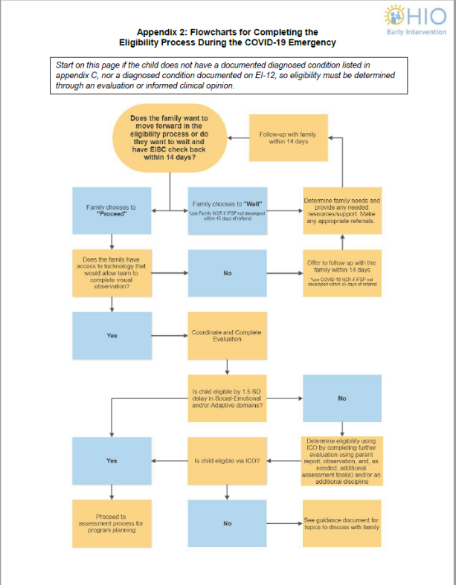
Some really cool state flow charts laying out the process
Notes:
N
These are from Ohio laying out a series of decisions and what providers should do depending on the answer.

Slide 38
State Resources on Eligibility Determination
CO | Referral, Evaluation and Child Find Questions Updated 4/16/20 Child Find Resources
CT | Interim Remote Evaluation and Assessment Remote Early Intervention Guidance: Evaluation
MN | Part C Identification, Evaluation and Provision of Services
OH | Completing EI Eligibility Process during State of Emergency
VA | https://veipd.org/main/downloads/covid_updates/covid19_q_and_a_4.10.20.pdf (See question #14 about evaluations for eligibility)
WA | https://content.govdelivery.com/accounts/WADEL/bulletins/28703ea
Notes:
N

Slide 39
Other Resources
Early identification and Part C eligibility
(2010) Series of 4 webinars that include sessions on informed clinical opinion and streamlining eligibility determination
Informed clinical opinion
(2012) Anne Lucas & Evelyn Shaw explain informed clinical opinion for Part C
Formalizing informed clinical opinion assessment procedures is more likely to yield accurate assessment results
(2006) Steven Bagnato identifies important practices when using clinical opinion for eligibility determination
Notes:
N

Slide 40
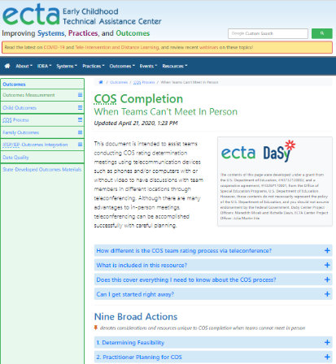
New Resources for COS Process
https://ectacenter.org/eco/pages/cos-distance.asp
About COS but has lots of good information and resources about how to hold team meetings and work with families remotely
Notes:
N

Slide 41
Questions?
Comments?
Notes:
N and K

Slide 42
Find out more at ectacenter.org
The ECTA Center is a program of the FPG Child Development Institute of the University of North Carolina at Chapel Hill, funded through cooperative agreement number H326P170001 from the Office of Special Education Programs, U.S. Department of Education. Opinions expressed herein do not necessarily represent the Department of Education's position or policy.

