Slide 1
Implementing, Sustaining and Scaling-Up High Quality Inclusive Preschool Policies and Practices: Application for Intensive TA
September 10, 2019
Lise Fox, University of South Florida
Barbara J. Smith, University of Denver

Slide 2
Agenda
Overview of the purpose of the TA
Description of the TA model and activities
Discussion of the responsibilities of the state, LEAs and ECTA staff
Description of selection and notification timeline
Ask Your Questions at
Any Point!

Slide 3
Intensive TA Goal
Enhance state capacity to implement, sustain, and scale-up high quality inclusive preschool policies and practices for children ages 3 to 5 years participating in early childhood programs and receiving Part B services.
Selected states (2) will receive on-site and distance technical assistance and training to result in the sustainable implementation of the ECTA and NCPMI Indicators of High Quality Inclusion at the state, LEA, and demonstration site levels.

Slide 4
IMPLEMENTING, SUSTAINING AND SCALING-UP HIGH QUALITY INCLUSIVE PRESCHOOL POLICIES AND PRACTICES
RFA posted on ECTA website; online submission
Applications due October 15, 2019
Submitted by Part B 619 Coordinator and state Special Education Director
TA Provided from November, 2019-June, 2022

Slide 5
High Quality Inclusion: What is It?
Early childhood inclusion embodies the values, policies, and practices that support the right of every infant and young child and his or her family, regardless of ability, to participate in a broad range of activities and contexts as full members of families, communities, and society. The desired results of inclusive experiences for children with and without disabilities and their families include a sense of belonging and membership, positive social relationships and friendships, and development and learning to reach their full potential. The defining features of inclusion that can be used to identify high quality early childhood programs and services are access, participation, and supports.
DEC/NAEYC 2009

Slide 6
High Quality Inclusion: How do We Get There?
“values, policies, and practices”
“access, participation, and supports”
Changing minds, beliefs, attitudes and values: increase understanding of the importance of high quality preschool inclusion
Changing state and program policies: implementing funding, personnel and other policies that promote high quality preschool inclusion
Changing practice: implementing high quality inclusion practices within ECE environments

Slide 7
Using the ECTA & NCPMI High Quality Indicator Tools
A national initiative with partners across early care and education to develop indicators of high quality inclusive policies and practices at the
state
local program and
early care and education environments levels
The three sets of indicators will be used to define and measure progress

Slide 8
https://ectacenter.org/topics/inclusion/indicators.asp

Slide 9
https://ectacenter.org/topics/inclusion/indicators.asp

Slide 10
https://ectacenter.org/topics/inclusion/indicators.asp

Slide 11
Terms We Use and What They Mean
State Leadership Team: an interagency, collaborative team (this may be an already existing group) to develop or strengthen policies, procedures, funding and other system infrastructure components. The State Leadership Team will use the State Indicators of High Quality Inclusion to guide planning and measure progress. This team of about 15 people agrees to meet monthly and make decisions collaboratively to build the state capacity to implement, sustain and scale-up high quality inclusion.
Professional Development Network of Program Coaches: provide training and coaching to local education agency (LEA) inclusion leadership teams leading to high fidelity implementation of high-quality inclusion practices. The Local Program and the ECE Environment Indicators of High Quality Inclusion will be used to guide planning and to measure progress. Additional resources will be used including the Preschool Inclusion Toolbox (Barton & Smith, 2015) and the First Steps to Preschool Inclusion (Gupta, Henninger & Vinh, 2014).
Practitioner Coaches: provide onsite coaching to practitioners in high quality inclusive practices as measured by the ECE Environment Indicators of High Quality Inclusion.

Slide 12
Terms We Use and What They Mean
LEA-based preschool inclusion leadership teams: An Inclusion Leadership Team is a team comprised of LEA administrators, community program administrators, program staff, family members, and others as appropriate. The team implements action plans, using the Local Program Indicators of High Quality Inclusion, to guide and support the availability of high-quality inclusive early care and education environments and serves as a model for others in the state.
Implementation sites: the LEA Inclusion Leadership Team establishes a minimum of 2 sites to use the ECE Environment Indicators of High Quality Inclusion to implement the critical teaching practices and environments needed to maximize the access, meaningful participation, and developmental outcomes of young children with disabilities in early care and education environments and to serve as demonstration sites for the community and the state.
Annual Inclusion Implementation Academy: is convened by the state to bring together the State Leadership Team members, all Program Coaches, LEA Inclusion Leadership Teams as well as their implementation sites, and new LEA Inclusion Leadership Teams for scale-up. The logistics of the first Academy will be carried out by SLT and the ECTA staff.

Slide 13
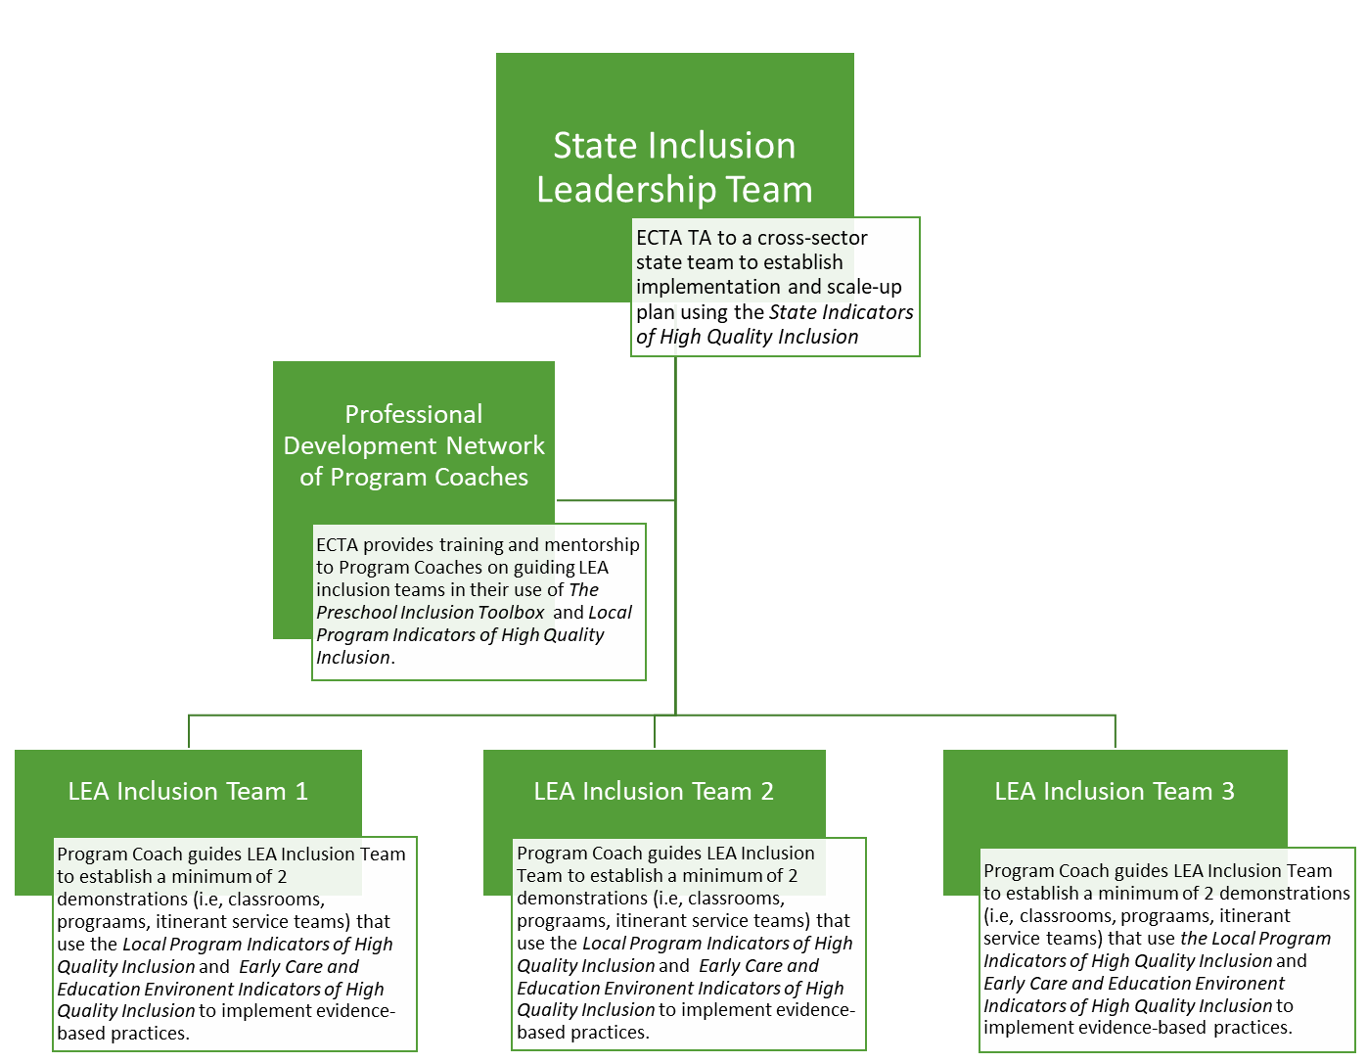

Slide 14
Intensive TA to be provided by ECTA across two and 1/2 years
ECTA will provide technical assistance in two phases over a period of two and ½ years.
Phase I involves relationship building and understanding ongoing state context and current inclusion initiatives. Activities include several on-site training and TA visits to the state leadership team, program coaches and LEA Inclusion Leadership Teams along with a regular schedule of distance/virtual TA.
Phase II involves fewer on-site visits and more distance/virtual TA with a focus on state independence, sustainability and scale up.

Slide 15
State Leadership Team: Activities and TA
State Leadership Team (SLT) selected and monthly meeting schedule established.
ECTA staff will meet face to face with the SLT the first meeting to provide orientation to the initiative within the context of the state and to provide recommendations for effective meeting strategies and tools
SLT coordinator and ECTA staff communicate regularly to plan monthly meetings, discuss progress, share information.
SLT meets monthly using the State Indicators of High Quality Inclusion to guide planning and measure progress (selecting and guiding LEA Inclusion Teams, Program Coaches, data collection and analysis)
ECTA staff meet several times with the SLT in the first year; fewer visits the second year
The SLT convenes an Annual Inclusion Implementation Academy to bring together the SLT members, all Program Coaches, implementing LEA Inclusion Leadership Teams as well as their demonstration sites, and new LEA Inclusion Leadership Teams for scale-up
The logistics of the first Academy will be carried out by the SLT and the ECTA staff

Slide 16
Program Coaches: Activities and TA
ECTA staff will provide ongoing distance support to Program Coaches and Practitioner Coaches as they work toward establishing high quality inclusive programs and practices. ECTA staff will support Program Coaches to:
Support LEA Inclusion Leadership Teams to implement high quality inclusive policies and practices as measured by the Local Program and ECE Environment Indicators of High Quality Inclusion
Guide Practitioner Coaches at implementation sites as they strive for implementation of the ECE Environment Indicators of High Quality Inclusion
Assist LEA Inclusion Leadership Teams in collecting relevant data to make decisions across sites
Collaborate with the SLT to expand LEAs and implementation sites and maintain quality across years

Slide 17
LEA Inclusion Leadership Teams: Activities and TA
LEAs establish (or confirm) their Inclusion Leadership Team that meets monthly
Program Coaches support meetings, data collection and data-based decision making and the implementation of inclusive policies and practices as measured by Local Program and ECE Environment Indicators of High Quality Inclusion with ECTA distance support
LEA Inclusion Leadership Teams select 2-3 sites to serve as high fidelity demonstrations with Program Coach support
LEA Inclusion Leadership Teams provide Practitioner Coaches to assist site practitioners in reaching high fidelity as measured by the ECE Environment Indicators of High Quality Inclusion
Program Coaches support Practitioner Coaches as needed with ECTA distance support
LEA Inclusion Leadership Teams provide data on quality indicator improvement
Program Coaches assist LEA and state leadership teams to make data-based decisions with ECTA distance support

Slide 18
Our Implementation and Scale-up Approach: Statewide Implementation Guide
A process for implementing evidence-based practices statewide
Includes tools, materials, and examples
http://ectacenter.org/sig/

Slide 19
Major Components of the Guide
4 Essential Support Structures
State Leadership Team
Professional Development Network of Program Coaches
Demonstration and Implementation Sites
Data Evaluation Systems
Implementation Science: stages of implementation
Exploration and Planning
Installation
Implementation: Initial to Full
Scale-up
Resources, templates and examples

Slide 20
Intended Outcomes
The State Leadership Team (SLT) will make sustained progress on the State Indicators of High Quality Inclusion
The SLT will have established a cadre of Program Coaches
The SLT will have increased the number of Program Coaches to scale-up
The LEA Inclusion Leadership Teams will make sustained progress on the Local Program Indicators of High Quality Inclusion
The demonstration sites will make sustained progress on the ECE Environment Indicators of High Quality Inclusion
SLT will have selected at least 2 more LEA teams and their programs for scale up
The SLT and LEA Inclusion Leadership Teams will be collecting and using data to make decisions about progress, and the quality and effectiveness of the inclusive opportunities
The SLT and LEA teams will have written sustainability and scale-up plans and budgets
The SLT will have hosted 2 annual Inclusion Implementation Academies and planning a 3rd

Slide 21
Application Requirements
Submitted by Part B 619 Coordinator and state Special Education Director
Description of cross-agency State Leadership Team (letters of commitment)
Ability to allocate $20,000 per year to support your implementation activities
Committed FTE to implementation (1.0; can be two people)
Commitment of 2-3 LEAs to serve as initial implementation sites
In it for the long haul! Commitment to implementation is evident in the narrative.

Slide 22
Selection and Award
Applications due: October 15, 2019
States notified on or about: November 10, 2019
OSEP must approve before we accept a state
We will not select more than 2 states
Once selected, we will schedule a planning call on or about: November 15, 2019

Slide 23
Frequently Asked Questions
What are our considerations for LEA selection? Should we select LEAs that have struggled with providing FAPE and LRE?
Will you do training on preschool inclusion practices?
We have a statewide system for training in inclusive practices and provide technical assistance to LEAs when requested. Are we eligible to apply?
Who should be selected as a program coach? Are they staff already within the LEA?
Our state wants to do a birth to five implementation in all settings and IDEA services. Can you help us with that?
We have a state team already, but it is not cross-sector. Should we form a new one?

Slide 24
Any Other Questions? Thank you!

