Slide 1
Kathy Hebbeler Early Childhood Outcomes Center SRI International
Success at an Early Age:
Improving Outcomes for Young Children with Disabilities
Urban Special Education Leadership Collaborative
Chicago, IL
November, 2013
Notes:
Some basic concepts. A 3 year old is not a 9 year old in a small body. I will be talking about disability , delay, and poverty because they are linked in young children and because any and all put a child at risk for poor outcomes.

Slide 2
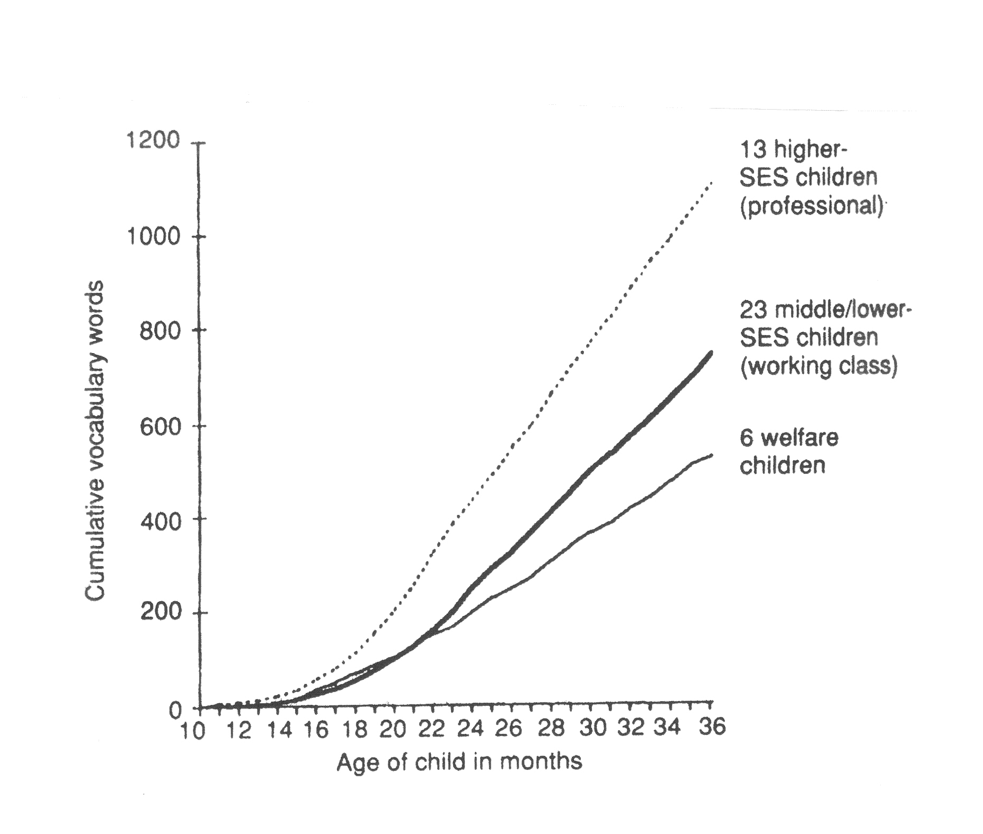
Vocabulary Growth (Hart & Risley, 1995)
Notes:
Let’s begin by looking a graph from one of the more famous studies in child development. Recent study at Stanford found that the gap is clearly established at 18 months. You probably wouldn’t be surprised to find out that there is another graph showing how many words the children were exposed to – and it looks a lot like this on. But it turns out these children are not just learning words, they were having their brains formed.
Hart, B., & Risley, T. (1995). Meaningful differences in the everyday experience of young American children. Baltimore: Paul H. Brookes Publishing.

Slide 3
Notes:
For years, we thought of the brain as something to be filled – the more one learned, the fuller the brain became. This analogy was not quite right because, unlike the glass in the picture, we knew we could never fill the brain up. We knew some brains were a lot easier than others to fill with knowledge. We always knew the analogy was not perfect but the basic concept of the brain as something to be filled was a pretty easy way to understand the brain and learning.

Slide 4
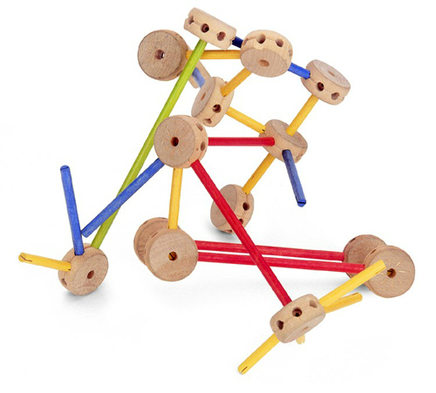
Basic architecture of the brain is built in early childhood
Notes:
What neuroscience has shown us is that the brain is not something to be filled – especially in early childhood, it is something to be built.

Slide 5
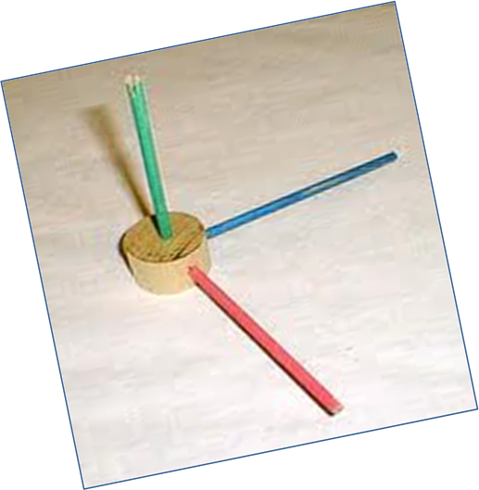
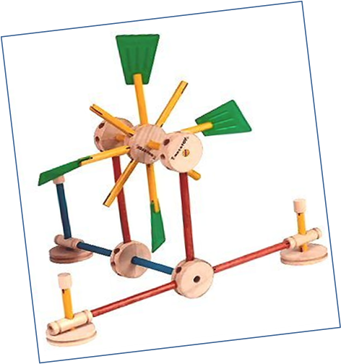
Experience shapes the architecture of the brain
Notes:
What builds the brain is the child’s early experiences, especially the experiences caregivers provide to their babies like being talked to them, and played with them, and responded to their coos and giggles. Some children get more of this than other children and consequently some of the get better brain architecture. Now if you aren’t inclined to think about the brain as tinker toys…

Slide 6
Notes:
We can talk about neural connections. The magic number is 700 neural connections being formed every second in the first few years of life. One of the main ways they are formed are through “contingent reciprocity” which is also known as serve and return – the baby does something, caregiver responds, baby responds. Those serve and return exchanges are literally building the child’s brain.
Going back to the growth in vocabulary graph – what is happening there? Children in working class and welfare families are not getting as many serve and returns.
http://developingchild.harvard.edu/resources/multimedia/interactive_features/five-numbers/

Slide 7
Poverty and Brain Development
Poverty reduces brain volume.
Poverty was associated with smaller white and cortical gray matter and hippocampal and amygdala volumes in children.
The effects of poverty on brain volume were mediated by caregiving support/hostility and stressful life events.
(JAMA Pediatrics, October 2013)
Notes:
Poverty is devastating to the brain’s architecture. Stressful life events compound the problem.
http://archpedi.jamanetwork.com/article.aspx?articleid=1761544

Slide 8
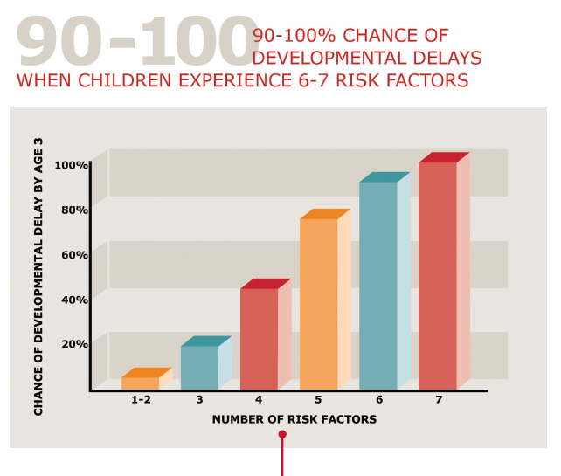
Poverty
Caregiver mental illness
Single parent
Low maternal education
Child maltreatment
Notes:
http://developingchild.harvard.edu/resources/multimedia/interactive_features/five-numbers/

Slide 9
(From Lee & Burkam, 2002)
Notes:
Lee, V. E., & Burkam, D. T. (2002). Inequality at the starting gate: Social background differences in achievement as children begin school. Washington, DC: Economic Policy Institute.

Slide 10
IDEA 2004, Sec. 602
The term ‘specific learning disability’ means…
… (C) Disorders not included.--Such term does not include a learning problem that is primarily the result of visual, hearing, ….., or of environmental, cultural, or economic disadvantage.
Notes:
With all due respect to Congress, developmental science tells us that this last clause is totally bogus. Economic disadvantage causes disability.

Slide 11
The Importance of Developmental Trajectories
The Importance of Developmental Trajectories
Score
Age in Months
Notes:
I am going to come back to the concept of developmental trajectories several times today.
Development and early learning in many different areas follows a predictable course; vocabulary, motor skills, problem solving skills, social interaction. We know what it should look like and we can track it. That is the green line. Individual children don’t track right on the line but there is a zone that we want to see children stay in because when they fall outside the zone, it is a marker of a developmental problem.
Children who are on lower or slower trajectories get farther and farther behind their peers with each passing year so that what is a little difference at 2 is a rather large difference by 5. The gap gets bigger each year.
The children who are behind at 5 didn’t get there overnight. They weren’t tracking in the green zone and then the summer before kindergarten fall way down here. Chances are they have been tracking on a slow line for years.
This isn’t just about poverty. We have lots of children who experience delays for reasons we do not understand, children who did have nurturing environments, but for some reasons something is wrong in their brain and they don’t develop the way they should.
One other feature of development that enters in here in addition to the gap. It is much easier to change a child’s trajectory in the early years than the later years. These dots can be thought of as having weights. The dots at 60 months that are off course are a lot harder to lift back up to where we want them to be than it takes to lift the dots at 20 or 30 months. The earlier we intervene the easier it is to change trajectories.

Slide 12
The Importance of Developmental Trajectories
Notes:
Who are we serving in our Early Childhood special education programs? Although most children’s development more or less tracks on the green line, some children’s acquisition of the outcome is below the line. Some children substantially below typical. We call these children “developmentally delayed” because their skill acquisition is so far away from typical. Note the placement of the yellow line, our criteria for delay, is socially constructed and it is arbitrary. Note also that there is far more variation in the skill level of this group of children especially as children get older. Also, you can see why can’t really talk about developmental delay in infants. It is assessment that allows for the identification of children in this triangle.

Slide 13
The Importance of Developmental Trajectories
Score
Age in Months
Notes:
Purple line = children at risk. These children do not meet eligibility criteria for developmental delay but their development on this outcome is not where we want it to be. Many of these are children live in poverty. These are the children for whom we operate programs like Head Start and state operated pre-K. These are the children who have a high probability of having learning or behavior problems in kindergarten and first grade because their trajectories are too low. They are not acquiring skills fast enough.

Slide 14
Differences Not So Clear
There are children in programs for children from low income families whose skills are lower than children receiving early intervention and early childhood special education.
The difference between these two groups of children is not so clear cut.
Early Head Start, FACES, State data
Study in CA: Many entering kindergartens in low performing schools had skills in the 3 - 4 year old range.

Slide 15
Why do we intervene?
The Importance of Developmental Trajectories
Score
Age in Months
Notes:
Why do we provide early intervention? Early childhood special education? Head Start?
Because we want to change trajectories.
We recognize that some children with delays will never catch up but we want to do all we can to get them on the highest possible trajectory.
For some children, it is to keep their skill levels tracking on typical. We will not cure blindness but we want to give children with visual impairment strategies to learn from the world around them so they can maintain “on track” trajectories.
I want to be clear that (1) poverty leads to developmental delay but (2) there are many children out there who experience nurturing and enriching care giving and still develop delays or disabilities. But whatever the etiology of the child’s atypical development, for the overwhelming majority of preschool children, we know enough to change their trajectories.

Slide 16
What We Know about
Intervening with Young Children

Slide 17
It Works
Notes:
Plasticity of the developing brain

Slide 18
What we know
High quality early childhood programs improve developmental outcomes
Large body of evidence to support the effectiveness of a number of intervention practices for children birth to age 5 including those with delays and disabilities
Conclusion: We know enough to know how to change trajectories.
Notes:
This is the potential we didn’t know about 50 years ago. We can change trajectories for young children with delays and disabilities and we can change trajectories for children who are

Slide 19
“Large-scale public preschool programs can have substantial impacts on children’s early learning.”
October 2013
Notes:
I could stack the research on the effectiveness of preschool services from floor to ceiling. We have been accumulating this evidence for 50 years. For many years, we did not understand the neuroscience behind it but we knew that good early childhood programs could made d
http://fcd-us.org/sites/default/files/Evidence%20Base%20on%20Preschool%20Education%20FINAL.pdframatic differences in children’s lives.

Slide 20
“What’s missing in the current debate over economic inequality is enough serious discussion about investing in effective early childhood development from birth to age 5….”
James Heckman
Sept. 13, 2013
Notes:
Return on investment is high. President Obama is proposing universal pre-K for 4 year olds. Many states operate state pre-K programs for 4 year olds and sometime 3 year olds.
How many of you are in states with state or locally funded preschool programs for 4 year olds? How many of you operate them in the public schools? We are going to come back to that later.

Slide 21
October 16, 2013

Slide 22
WSJ, Letters to the Editor
“Preschool is neither partisan nor ineffective…”
M. Brian Maher, Former Chairman and CEO, Maher Terminals LLC
“…. it’s time our policymakers in Washington take seriously the overwhelming evidence that early childhood education works.”
John Pepper, Former CEO, Procter & Gamble and Jim Zimmerman, Former CEO, Macy's
“…high-quality early childhood education strengthens our economy and society by giving children the strong start they need…”
Philip A. Peterson, Partner, Aon Hewitt and Maxine Clark, Founder, Build-A-Bear Workshop

Slide 23
Why business cares about preschool
http://www.investinginkids.info/your-taxes-preschool/

Slide 24
1,081,868
745,349
336,519
Notes:
Let’s take an in depth look at children under 5 with delays or disabilities. About 2.6% of the population in EI and about 5.8% of the population receiving ECSE
http://tadnet.public.tadnet.org/pages/712

Slide 25
The other 10%
Other health impairments | 2.8%
Intellectual disabilities | 1.6%
Hearing impairments | 1.3%
Specific learning disabilities | 1.2%
Multiple disabilities | 1.1%
Orthopedic impairments | 1.0%
Visual impairments | 0.5%
Emotional disturbance | 0.4%
Traumatic brain injury | 0.1%
Deaf-blindness | 0.0%
Notes:
Developmental delays and language impairment overwhelmingly have no known etiology. We can’t point to a gene that caused the problem. These children look like typically developing children. They have really atypical communication skills or they have a very serious delay in one of more domains of development. Something went wrong in their brains. And to be referred for special education before kindergarten, someone in the community has to notice that something is wrong. Could be the parent, could be the pediatrician, could be a child care provider but because 90% of these children have no physical signs of a disability, someone has to be concerned about their development.

Slide 26
Notes:
For many years, we assumed that the children identified under 1 the next year became the 1-2 year olds because these with the children with Down Syndrome, blind at birth, spina bifada, cp. We assumed that these children who were identified the earliest had life long disabilities.

Slide 27
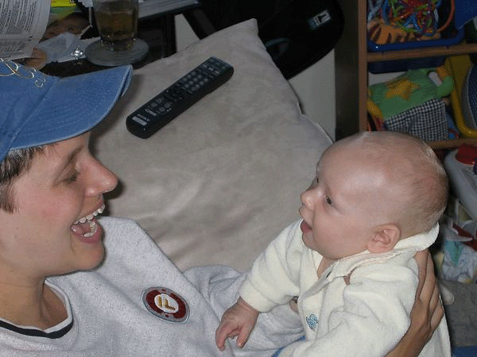
National Early Intervention Longitudinal Study
Longitudinal. NEILS followed 3,338 children and families from initial entry into early intervention (1997-98) through kindergarten.
Data collected from families, early intervention service providers and directors, and kindergarten teachers.

Slide 28
How many former EI recipients did not have an IEP in kindergarten?
0 – 15%
16 – 30%
More than 30%
I have no idea

Slide 29
Kindergarten Outcomes:
Former EI Participants’ Receipt of Special Education and Disability Status
Notes:
http://www.sri.com/work/publications/national-early-intervention-longitudinal-study-neils-final-report

Slide 30
Percentage of Children Rated by Kindergarten Teachers as Intermediate or Proficient in Language and Literacy Skills, By IEP Status Compared with General Kindergarten Population (ECLS-K data)
Kindergarten Outcomes:
Former EI recipients without IEPs were performing comparably to peers

Slide 31
Disability and delay in young children can be transitory.

Slide 32
Realizing the Potential of Early Childhood Intervention

Slide 33
Notes:
Let’s talk this. What is going on here?
There are two hypotheses. Either the incidence of disability across these states is very different or states and locals are using different criteria.

Slide 34
Implications of Developmental Trajectories
The Importance of Developmental Trajectories
Score
Age in Months
Notes:
Remember developmental trajectories. Those children below the orange line qualify. Those above don’t. Developmentally they are not that different nor are their trajectories. If there are not programs in the community to address these children’s needs, high probability these children will slip below the orange line at some point. Is there a safety net in your community?

Slide 35
Programs only help the children who receive them.
What percent of the population in your district is receiving…
Early intervention?
Early childhood special education?
Head Start?
Early Head Start ?
Home visiting?

Slide 36
Some important distinctions
Early childhood programs can work (potential)
≠
Early childhood programs in my district work
≠
Early childhood programs in my district are working as effectively as they could be
Notes:
The elephant in the room in early childhood is quality.

Slide 37
(From Greenwood, Carta et al, 2012)
Notes:
Classroom Assessment Scoring System
Instructional support: Concept Development, Quality of Feedback, Language Modeling
Is a Response to Intervention (RTI) Approach to Preschool Language and Early Literacy Instruction
^{Needed?}
Charles R. Greenwood, Judith J. Carta, Jane Atwater, Howard Goldstein, Ruth Kaminski and Scott McConnell
Topics in Early Childhood Special Education 2013 33: 48 originally published online 28 August 2012
^{DOI: 10.1177/0271121412455438}
The online version of this article can be found at:
http://tec.sagepub.com/content/33/1/48

Slide 38
Building Quality ECSE Programs
Foundation: Developmentally appropriate practices
DEC (Division of Early Childhood of the Council for Exceptional Children) Recommended Practices
Currently being revised
Notes:
DAP provides the foundation for good early childhood programming.

Slide 39
The current Recommended Practices
The RPs were developed in 2005 to provide guidance on practices related to better outcomes for young children with disabilities, their families, and the personnel who serve them.
240 Recommended Practices
5 Direct Service Strands
2 Indirect Support Strands

Slide 40
Notes:
http://www.decrecpractices.org/

Slide 41
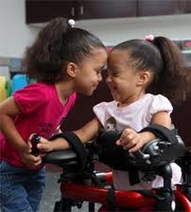
DEC and NAEYC Joint Position Statement on Inclusion
Early childhood inclusion embodies the values, policies, and practices that support the right of every infant and young child and his or her family, regardless of ability, to participate in a broad range of activities and contexts as full members of families, communities, and society.
http://www.dec-sped.org/uploads/docs/about_dec/position_concept_papers/PositionStatement_Inclusion_Joint_updated_May2009.pdf

Slide 42
Key features of EC inclusion
Access to a wide range of learning opportunities, activities, settings, environments
Individualized accommodations and supports to participate fully in play and learning activities with peers and adults.
System-level supports for individuals and institutions providing inclusive services.

Slide 43
The Not So Good News
24% of 3-5 year olds receive services in separate classes.
Another 40% attend a regular EC program but receive their special education services somewhere else.
Only 45% of center based general EC teachers have a college degree.
Their average pay is $11.90/hour.
Notes:
http://tadnet.public.tadnet.org/pages/712
http://www.acf.hhs.gov/programs/opre/resource/number-and-characteristics-of-early-care-and-education-ece-teachers-and

Slide 44
Measuring Outcomes:
What We Know Nationally

Slide 45
Critical Events in Accountability for Programs for Young Children with Disabilities
1992 –Osborne and Graebler, Reinventing Government
1993 – GPRA (Government Performance and Results Act) passed
Time passes…..no progress on outcomes measurement….
2002 – OMB review finds there are no data on outcomes for Part C or 619; Scored 0 for accountability
2003 – OSEP funds the ECO Center
2005 – ECO submits recommendations of stakeholder process for what to measure
2005, 2006 – OSEP releases revisions to the reporting requirements

Slide 46
Ultimate Goal of Providing Services
“To enable young children to be active and successful participants during the early childhood years and in the future in a variety of settings – in their homes with their families, in child care, preschool or school programs, and in the community.”
Based on the ECO stakeholder process when identifying 3 child outcomes
Entire document available at http://projects.fpg.unc.edu/~eco/assets/pdfs/ECO_Outcomes_4-13-05.pdf
Notes:
Outcomes aren’t just about accountability…
This is where we want our children (EI and ECSE children) to accomplish and so we want to be accountable for helping children/families achieve this goal…

Slide 47
Three Child Outcomes
Children have positive social-emotional skills (including social relationships)
Children acquire and use knowledge and skills (including early language/ communication [and early literacy])
Children use appropriate behaviors to meet their needs

Slide 48
Child Outcomes Step by Step
Available at:
http://projects.fpg.unc.edu/~eco/pages/videos.cfm
Notes:
How many of you are familiar with these outcomes?

Slide 49
Outcomes Are Functional
Functional outcomes:
Refer to using skills to accomplish things that are meaningful to the child in the context of everyday life
Refer to an integrated series of behaviors or skills that allow the child to achieve the important everyday goals

Slide 50
Children Have Positive Social Relationships
Involves:
Relating with adults
Relating with other children
For older children, following rules related to groups or interacting with others
Includes areas like:
Attachment/separation/autonomy
Expressing emotions and feelings
Learning social rules and expectations
Social interactions and play

Slide 51
Children Acquire and Use Knowledge and Skills
Involves:
Thinking
Reasoning
Remembering
Problem solving
Using symbols and language
Understanding physical and social worlds
Includes:
Early concepts—symbols, pictures, numbers, classification, spatial relationships
Imitation
Object permanence
Expressive and receptive language and communication
Early literacy

Slide 52
Children Take Appropriate Action to Meet Their Needs
Involves:
Taking care of basic needs
Getting from place to place
Using tools (e.g., fork, toothbrush, crayon)
In older children, contributing to their own health and safety
Includes:
Integrating motor skills to complete tasks
Self-help skills (e.g., dressing, feeding, grooming, toileting, household responsibility)
Acting on the world to get what one wants

Slide 53
Appropriate Measurement Strategies
Recurring theme in EC community about evils of assessing young children
Good vs. bad assessment strategies
Good vs. bad uses of the information
Developmentally appropriate assessment should be a component of every EC program.
Notes:
Assessment is not the problem, bad assessment or bad used of the information, such as denying children entrance to kindergarten.

Slide 54
OSEP Reporting Categories Percentage of children who:
a. Did not improve functioning
b. Improved functioning, but not sufficient to move nearer to functioning comparable to same-aged peers
c. Improved functioning to a level nearer to same-aged peers but did not reach it
d. Improved functioning to reach a level comparable to same-aged peers
e. Maintained functioning at a level comparable to same-aged peers
” = 15 numbers

Slide 56
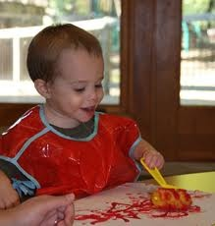
The Summary Statements
Of those children who entered or exited the program below age expectations in each outcome, the percent who substantially increased their rate of growth by the time they turned 3 [6] years of age or exited the program.
The percent of children who were functioning within age expectations in each outcome by the time they turned 3 [6] years of age or exited the program.
Notes:
States set targets on the Summary Statements

Slide 57
Early Childhood Special Education: Greater Than Expected Growth, 2011-12

Slide 58
Early Childhood Special Education: Greater Than Expected Growth, 2008-09 to 2011-12

Slide 59
Early Childhood Special Education: Exited within Age Expectations, 2011-12

Slide 60
Early Childhood Special Education: Exited within Age Expectations, 2008-09 to 2011-12

Slide 61
Early Intervention: Greater than Expected Growth, 2008-09 to 2011-12

Slide 62
Early Intervention: Exited Within Age Expectations, 2008-09 to 2011-12

Slide 64
Is anyone looking at these numbers?
YES

Slide 65
…..on behalf of the President and the White House…
We know that state collection of data is very complicated and can be very difficult related to infants and toddlers with disabilities. But the rewards far outweigh any complications because that data, that information that we gain, demonstrates that early intervention works and that Part C program can be a model for state coordination of statewide services.
And so what we know from these data, what we know from the data that everybody is collecting under the Part C program, which is vital, is that 74% of infants and toddlers with disabilities who receive Part C services show increases in their rate of development. And we also know that 60% of infants and toddlers with disabilities who receive the Part C services exit the program at the age of three or earlier with the skills expected, or that are expected, for their age. These are good numbers but we all know that we need to and we must do better and these percentages must go up.
These Part C regulations that we are releasing today support the development of high-quality state and local data so that we can collect the valid and reliable information that we need related to Part C Early Intervention, including data on early childhood outcomes.
Kareem Dale, Special Assistant to the President for Disability Policy
Part C Final Regulations Conference Call, September 6, 2011
Notes:
7 years ago when we started talking about what the outcomes should be who would have thought that someone would have been citing these data on behalf of the President.

Slide 66
Early intervention and early childhood special education are the only federal early childhood programs routinely collecting data on child outcomes.

Slide 67
Number of States that Met Criteria for Inclusion in the National Analysis
Footnote: We need to improve data quality
 | 08-09 | 09-10 | 10-11 | 11-12
Part C | 19 | 29 | 39 | 33
Preschool | 15 | 33 | 36 | 39
Notes:
Minimum expectations of quality at this point. Low amounts of missing data and within reasonably expected patterns for ‘a’ and ‘e’

Slide 68
Using Data to Drive Program Improvement

Slide 69
Building measurement system
Using data to improve programs
Implementing and sustaining quality practices

Slide 70
Working Assumptions for Program Improvement
There are high quality services and programs.
There are [a few/some/many] children who are not getting the most appropriate services and programs for their needs.
If we can identify problems and find ways to improve their services/programs, these children will experience better outcomes.

Slide 71
Do you know….
Who is being served in your EI and ECSE program?
How they differ from who was served last year?
The average age at entry this year? Last year?
The average length of time in program?
The % of children who do not need special education after they leave the program?

Slide 72
Which group of children in your program has the best outcomes? The poorest outcomes?
Among children with similar characteristics at entry, which children did especially well? Were there program characteristics associated with their good outcomes?

Slide 73
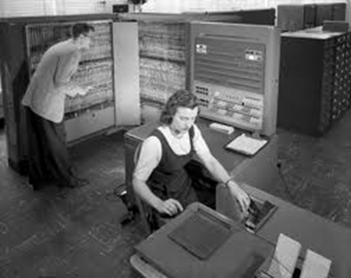
Who is looking at your district data on 3-5 years?
What do you know about their outcomes?
How can you use data to improve their services and programs?

Slide 74
Continuous Program Improvement
Reflect
Are we where we want to be?
Check
(Collect and analyze data)
Plan (vision)
Implement
Notes:
Vision – so important. Logically impossible to check to see if the system is where it should be if the leadership has no sense of where it should be.
Start with a plan or vision of what the service system should be and what it should accomplish.
Vision can be expansive – what we want for all children and families in our state
Vision can be more constrained – what we want for children and families in early intervention
Vision can be driven by outside forces – extent of our vision for early intervention is to be in compliance.
All of you entered systems that were already implemented which means some articulated or unarticulated vision (not yours) was in place.
This is a cycle – means it was already operating but it also means it is never too late to articulate the vision is in place or expand it.
You will find it very difficult to analyze data for program improvement if there is not a sense of what the programs are supposed to look like and what they are supposed to be achieving.

Slide 75
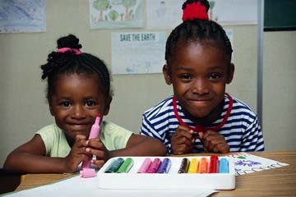
Find more resources at:
http://www.the-eco-center.org

Slide 76
The Center for IDEA Early Childhood Data Systems (DaSy)
A new 5-year Center funded by OSEP to assist states with improving Part C and Part B preschool data by:
Building better data systems
Coordinating data systems across early childhood programs
Building longitudinal data systems
Building the capacity of states to use data
http://dasycenter.org/

Slide 77
What You Can Do
Work to support high quality early intervention (Part C) services
Prevention
Work to support high quality early care and learning programs in your community
Prevention
Notes:
Work to build the community safety net to reduce the need for preschool special education.

Slide 78
What You Can Do
Prevention/
Intervention
Evaluate your child find activities. Work to find and serve every eligible child.
Prevention/
Intervention
Use data to monitor and improve the quality of your ECSE programming and child outcomes.

Slide 79
What You Can Do
.
Prevention/
Intervention
Provide ECSE in high quality inclusive setting (See Recommendation #2*)
*Work to support high quality early care and learning programs in your community.

Slide 80
We can change trajectories
The Importance of Developmental Trajectories
Age in Months
Notes:
I want to leave you thinking about trajectories. The child who is born in your district today will be 5 years old in 60 short months. The child’s brain is built -- and losing plasticity -- over this time period. We know there are young children whose development is compromised for various reasons and, if they live in poverty, there are lots of them. We also have the know how to change their trajectories. The only question is do we have the political will. The child’s brain is built -- and losing plasticity -- over this time period. Today’s poor outcomes are highly predictive of tomorrow’s outcomes unless we provide the high quality programs that are needed to change them.

