Slide 1



Guidance for Implementing Effective Training and TA on the Child Outcomes Summary (COS) Process
National Webinar
November 29, 2018

Slide 2
Presentation Team
Katrina Martin
Early Childhood Technical Assistance Center/ Center for IDEA Early Childhood Data Systems
Katrina.Martin@sri.com
Katie McCarthy
Vermont State Agency of Education (Part B 619)
Katie.McCarthy@vermont.gov
Pam Miller
Maryland State Department of Education (Part C and Part B 619)
Pamela.Miller@maryland.gov
Amy Nicholas
Early Childhood Technical Assistance Center/
Center for IDEA Early Childhood Data Systems
Amy.Nicholas@unc.edu
Naomi Younggren
U.S. Department of Defense (Part C) Naomi.O.Younggren.civ@mail.mil

Slide 3
Webinar Purpose
To provide an overview of the national resources that are available to support COS training and TA, and how they might be incorporated into ongoing professional development (PD).
State presenters will share information about their COS PD systems, including how they are using national training resources to address critical staff knowledge and skill development needs.

Slide 4
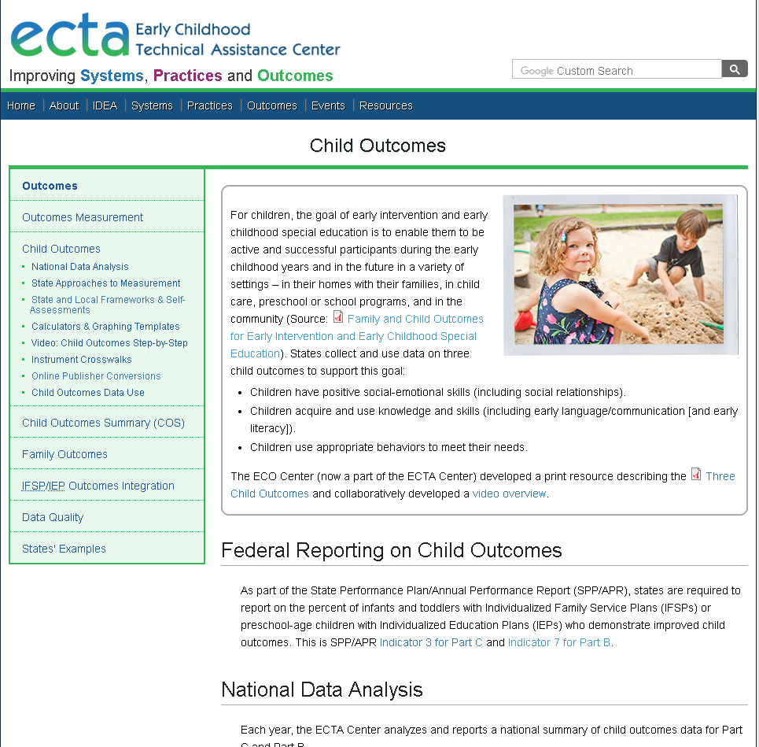

ECTA Center website
Stay Connected with the Outcomes TA Team
Outcomes TA provided in collaboration with
We got a makeover!
http://ectacenter.org/outcomes.asp

Slide 5
National Child Outcomes Data
What do we know about results obtained using the COS process?

Slide 6
Approaches to Measuring Child Outcomes: FFY 2016-17
Approach | Part C (N=56) | Part B/619 (N=59)
Child Outcomes Summary (COS) | 42 (75%) | 41 (69%) (decrease -2)
One tool statewide | 8 (14%) | 10 (17%) (increase +2)
Publisher's online system | 3 (5%) | 6 (10%)
Other | 3 (5%) | 2 (3%)
TOTAL | 56 | 59

Slide 7
National Child Outcomes Data for Children Exiting in 2016-17: COS States and DC Only
Outcome | Part C Early Intervention (n=35) |  | Part B 619 Preschool (n=33)
 | Summary Statement 1 | Summary Statement 2 | Summary Statement 1 | Summary Statement 2
Social Relationships | 68 | 57 | 83 | 55
Knowledge and Skills | 74 | 49 | 84 | 52
Action to Meet Needs | 75 | 56 | 84 | 64
Note: Only states with high-quality data were included.

Slide 8
Part C Completeness* of Child
Outcomes Data for 2016-17:
COS States and DC Only (n=37)
* Completeness = total with outcomes data/total exiters

Slide 9
Part B 619 Completeness* of Child
Outcomes Data for 2016-17:
COS States and DC Only (n=33)
* Completeness = total with outcomes data/child count

Slide 10
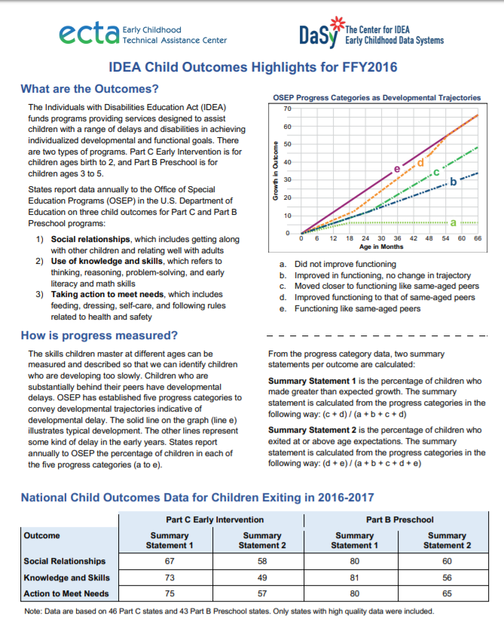
National Child Outcomes Analysis Resources
http://ectacenter.org/eco/pages/childoutcomes.asp#dataanalysis
Child Outcomes Highlights for FFY16: A 2-page summary of the national results.
National Child Outcomes Data Webinar: Presenters discuss national estimates, state variations in performance, and how to interpret the state-specific data quality profiles.

Slide 11
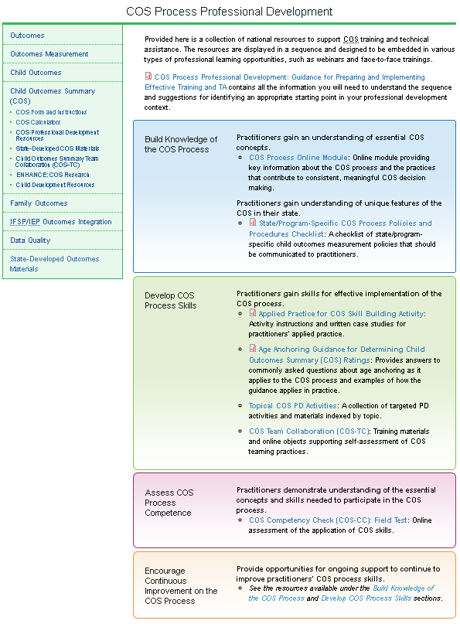
TA Resources for COS Professional Development
http://ectacenter.org/eco/pages/cos.asp
4 sections:
Build Knowledge of the COS Process
Develop COS Process Skills
Assess COS Process Competence
Encourage Continuous Improvement on the COS Process

Slide 12
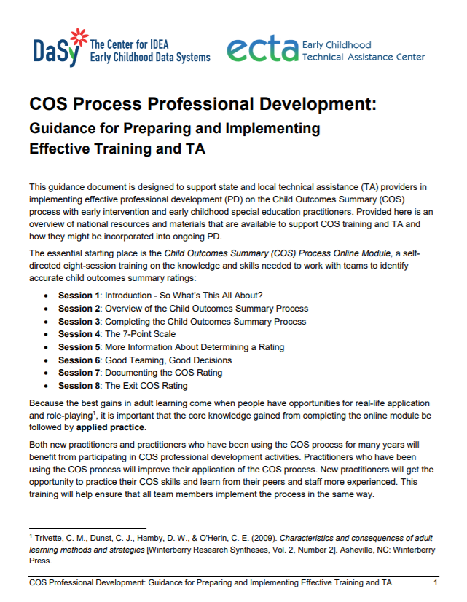
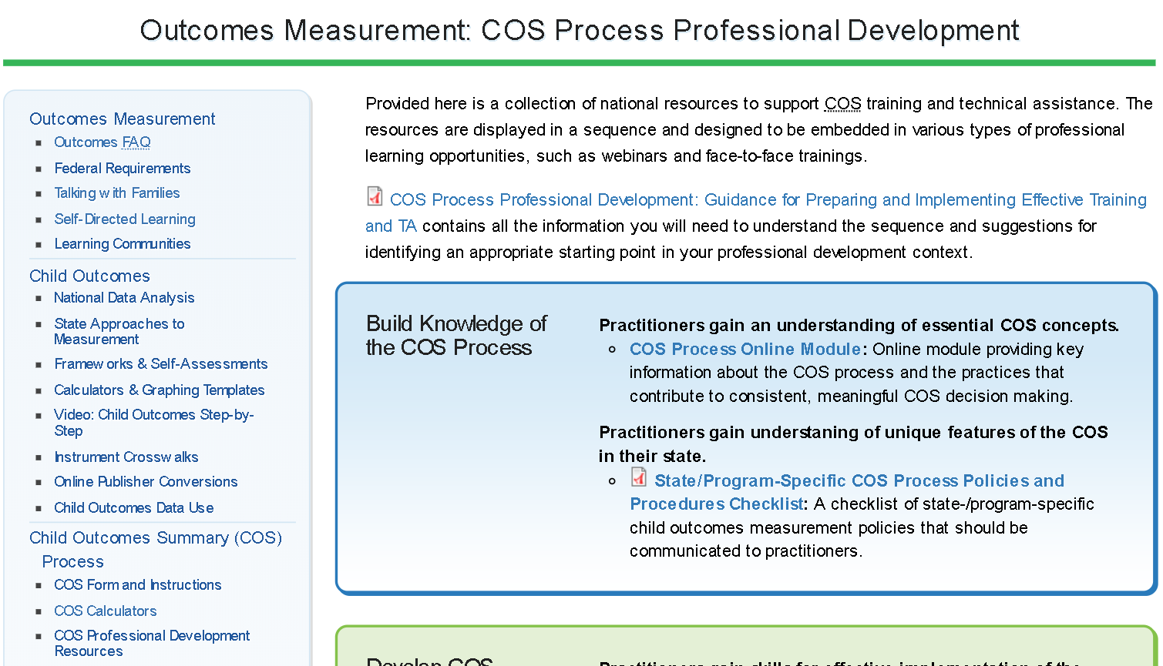
COS Process Professional Development Screenshot

Slide 13
States’ Uses of National COS Professional Development Resources

Slide 14
Continuous Improvement of the COS Process
Katie McCarthy, IDEA Part B 619/Early Childhood Coordinator

Slide 15
Vermont’s COS (ECO) Timeline to Quality
2013
2014
Poor Data Quality
2015
DaSy/ECTA
2016
Practices & Procedures Manual
Training & TA
2017
Data Quality
Self-Assessment
Self-Assessment
Data Days Events
2018/19
On-going Training & TA
Universal PreK
Compiled Field Notes
619 Survey
ECO IEP
Online COS Module

Slide 16
Child Outcomes “Data Days” Objectives
Participants will:
Gain knowledge about how statewide early childhood outcomes data are collected and reported
Learn about critical questions that can drive early childhood outcomes data analysis and use
Be better able to use early childhood outcomes data to sustain improved data quality and decision-making at the local level
1
2
3

Slide 17
Data Days Content
Sessions
DaSy and ECTA Materials Used/Shared
Early Childhood and School Readiness: The Building Block to Discuss- Tony Ruggiero, DaSy
Discovering the Practices and Procedures Manual- Katie McCarthy, VT AOE
Vermont’s Early Childhood Outcomes Practices and Procedures Session- Kellen Reid, DaSy/ECTA
What Can My Data Tell Me? Developing Critical Questions to Guide Early Childhood Program Improvement- Gary Harmon, DaSy/ECTA
Data Quality Matters- Tony Ruggiero, DaSy
ENHANCE Survey
The COS Decision Tree
A Family Guide to Participating in the Child Outcomes Measurement Process
Integrated COS-IEP Flow Chart
COS Module
COS Teaming and Collaboration (COS-TC)
Critical Questions about EI/ECSE

Slide 18
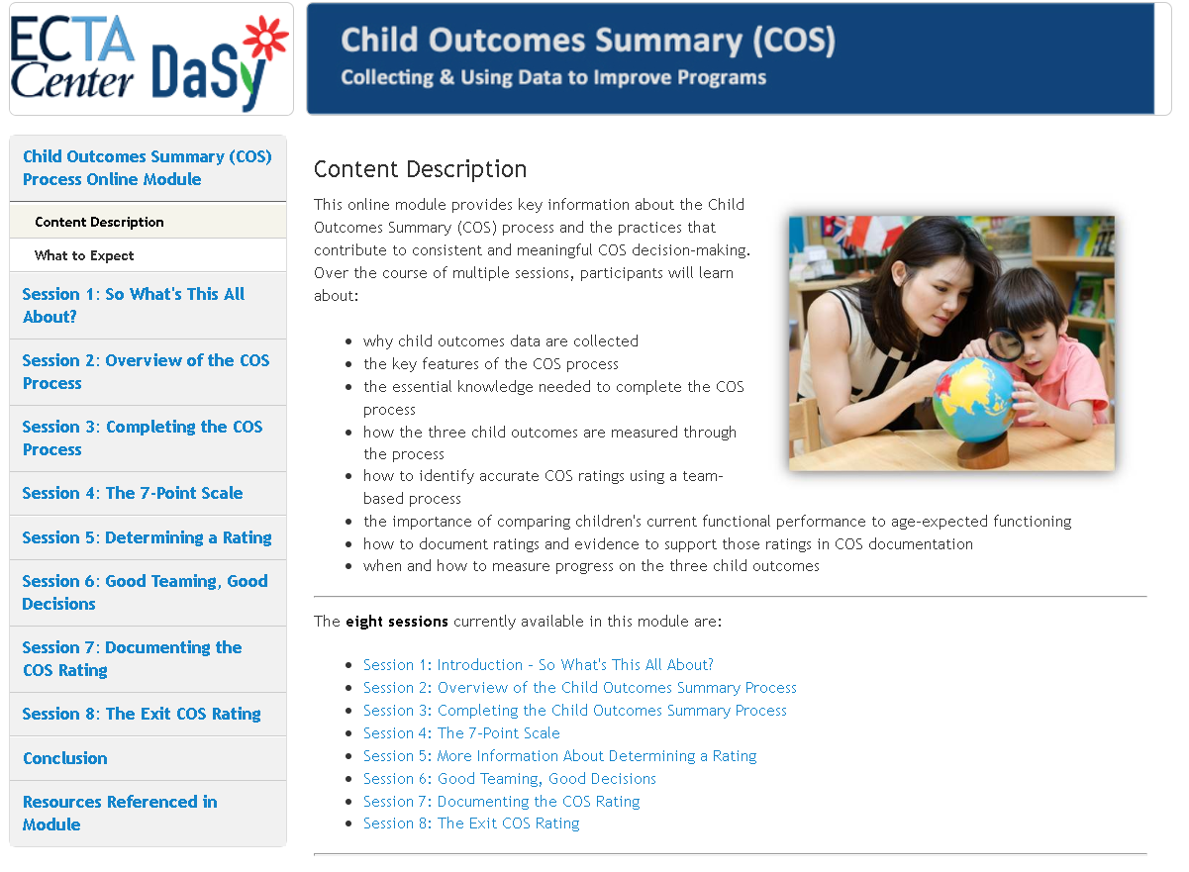
Key National Resource:
COS Online Module
http://ectacenter.org/eco/pages/cos.asp#COSProcessModule

Slide 19
Vermont’s Continuous Improvement in 2018 and Beyond
Working with local teams to expand data knowledge and ensure high-quality data.
1. Incorporation of COS module into online PD and partnering with Part C
2. October ECSE training
3. Inclusion of new supplemental COS materials
Working with our state data team.
SLDS
Partnering with Special Education Data Manager/Business Analyst to investigate data
All with a little help from our ECTA and DaSy friends!

Slide 20
DoD EDIS
COS Professional Development Journey
Naomi Younggren, CSPD/Part C Coordinator

Slide 21
A Slow and Separate Start
Learned about what others were doing
Reviewed our processes
COS was entirely separate (and often forgotten) within the IFSP process
Missing data

Slide 22
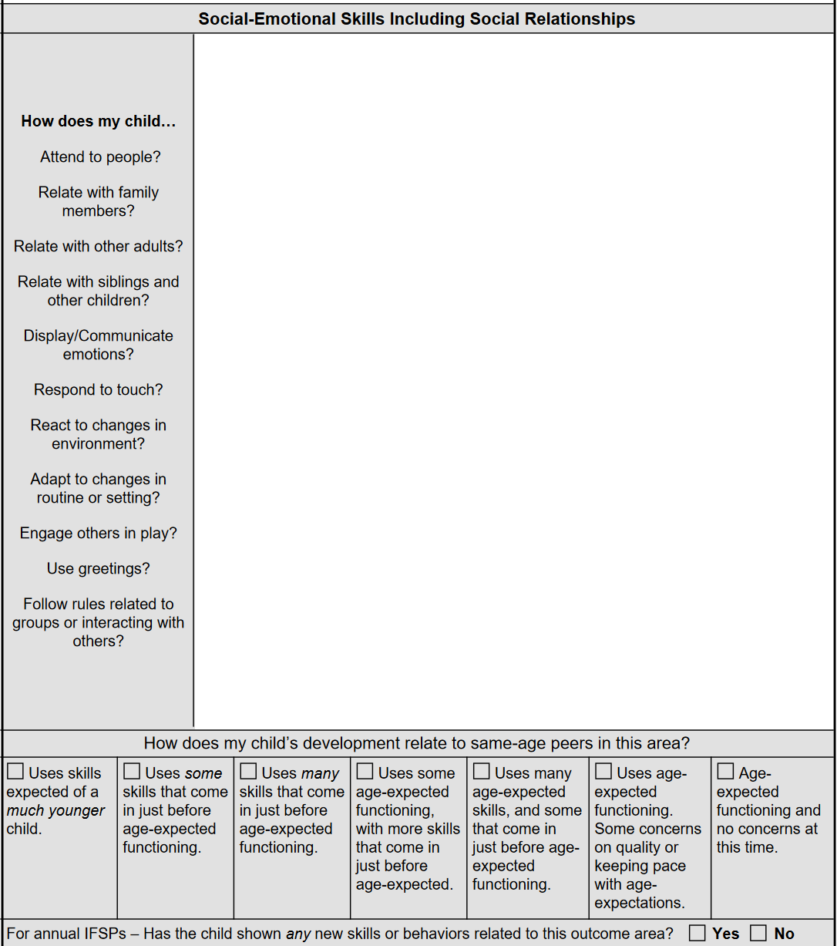
Ongoing COS PD
Lots of training—articles, data review, case study work, quizzes, demonstration of understanding…
Integrated COS into IFSP—aligned PLOD by 3 Outcomes and embedded COS rating descriptors
Data completeness improved
https://www.edis.army.mil/Forms/MEDCOM_Form_721_IFSP-PD.pdf

Slide 23
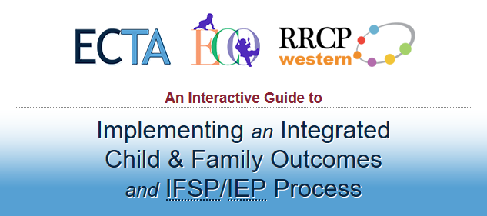
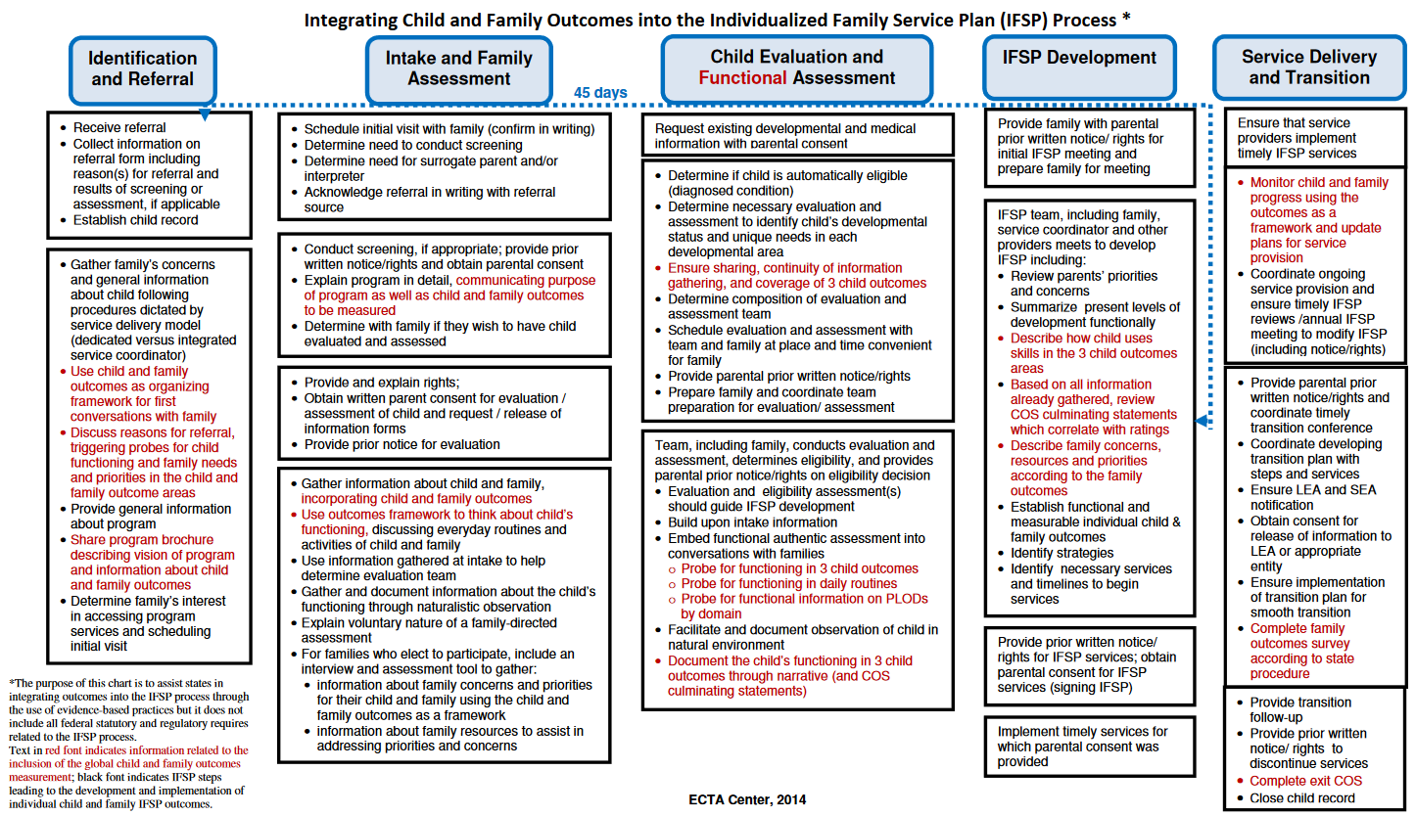
ECTA Center Resources
Key National Resources
Integrating Outcomes Interactive Guide
Integrating IFSP/Outcomes Flow Chart
http://ectacenter.org/eco/assets/pdfs/IFSP-OutcomesFlowChart.pdf
http://ectacenter.org/implementingintegrated

Slide 24
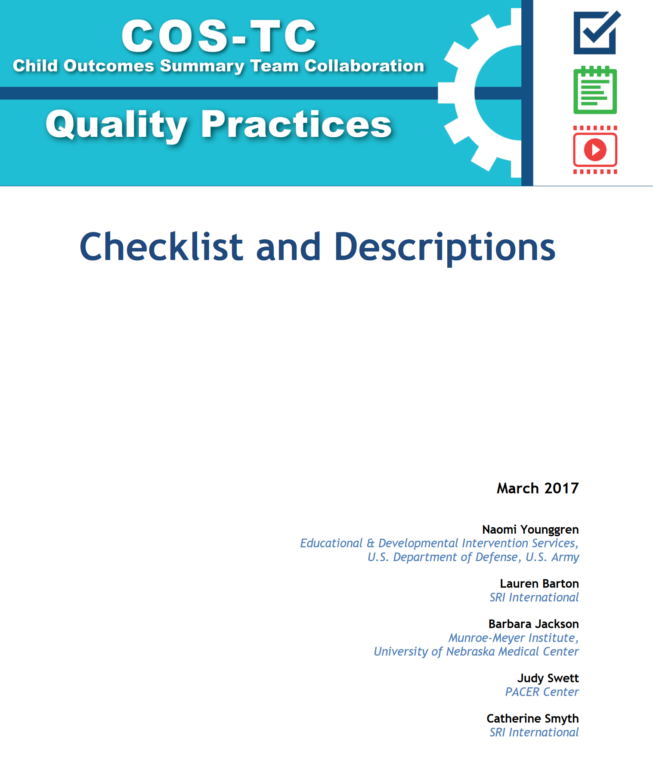
Key National Resource:
Child Outcomes Summary Team Collaboration (COS-TC)
Quality Practices
http://ectacenter.org/eco/pages/costeam.asp

Slide 25
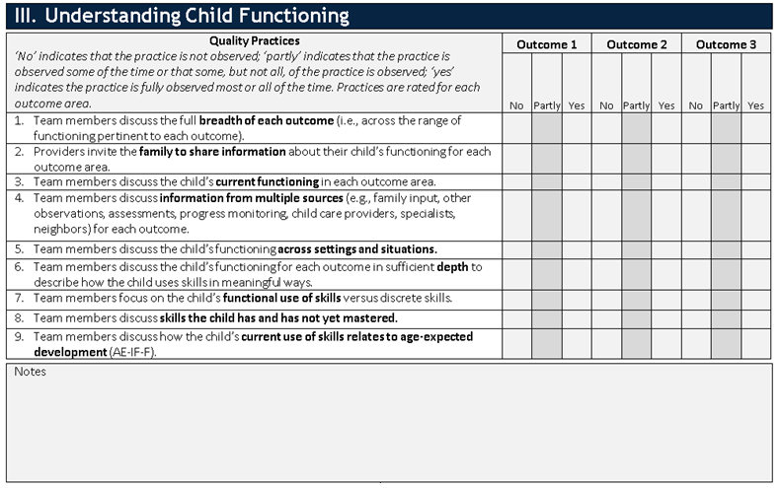

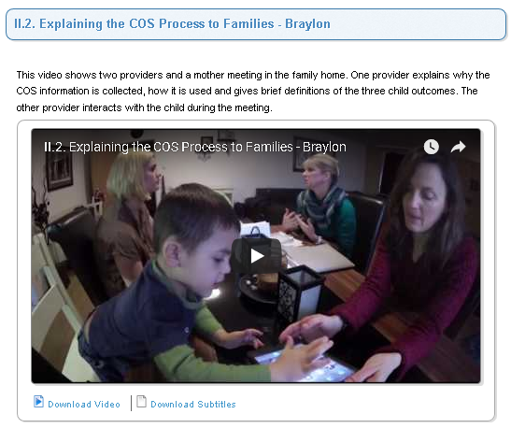
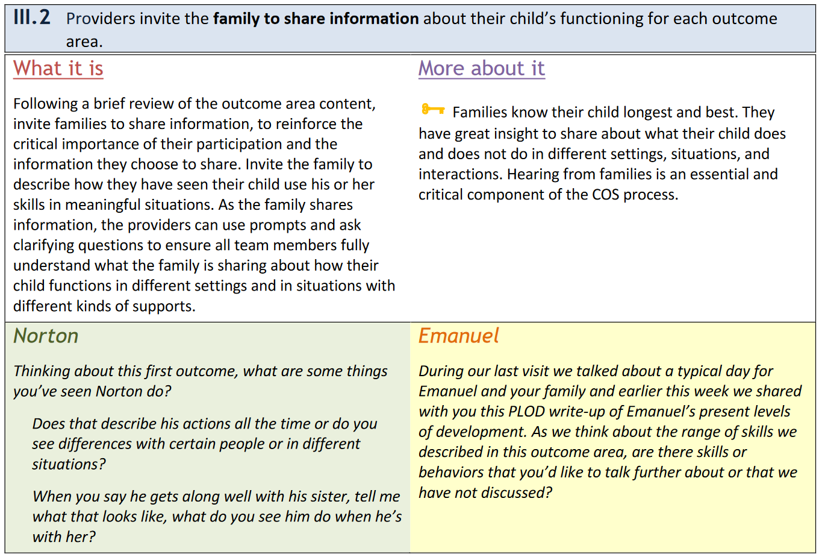
What’s included?

Slide 26
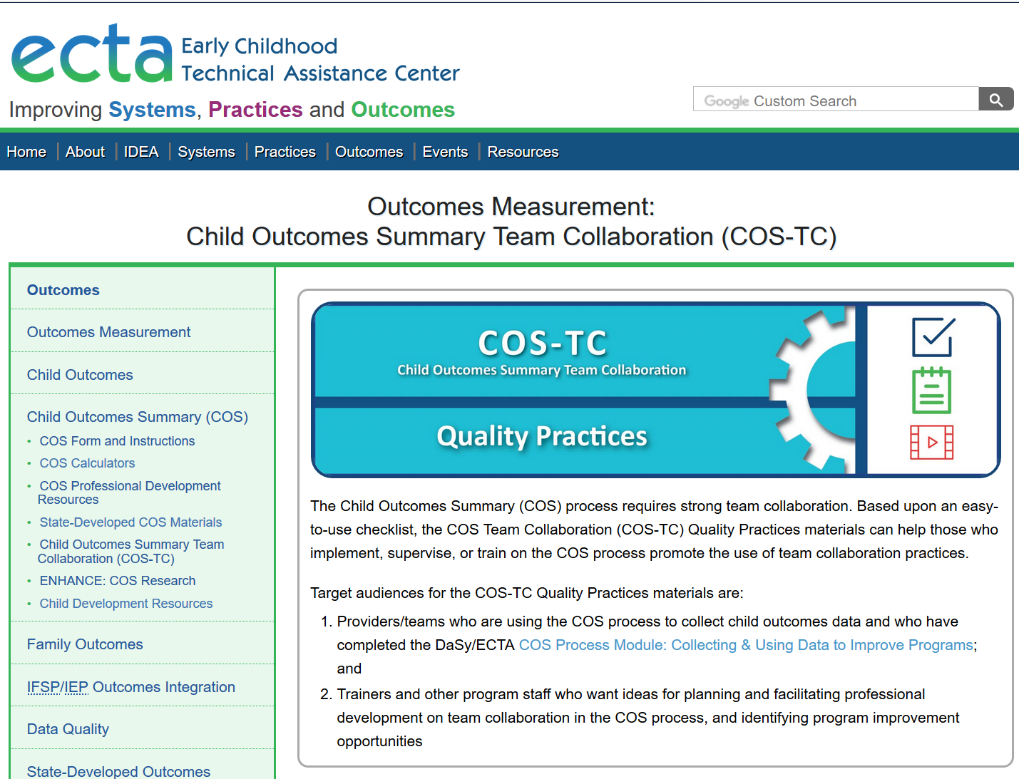
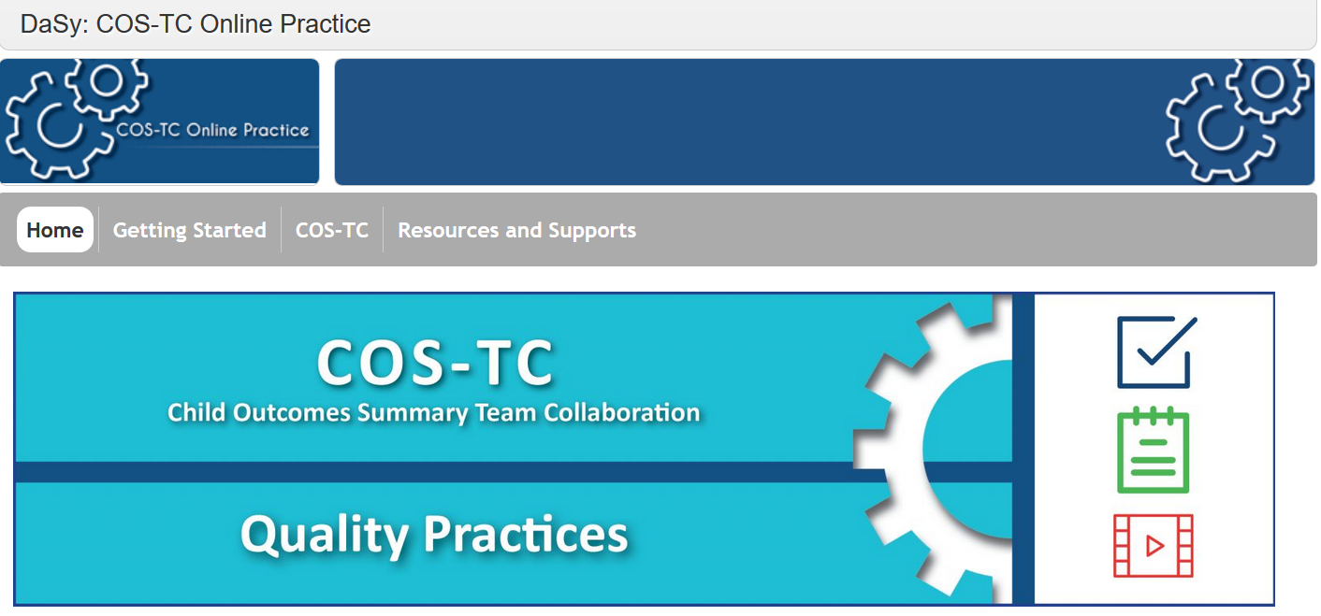
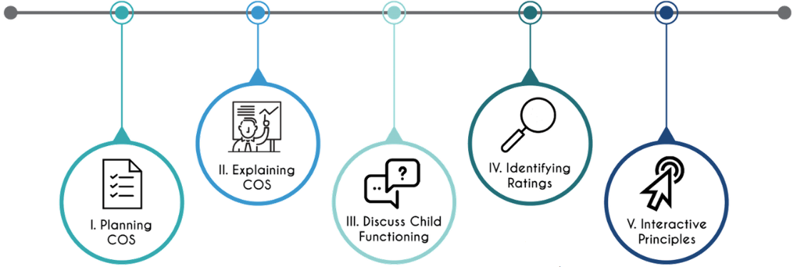
Where is it?
http://ectacenter.org/eco/pages/costeam.asp

Slide 27
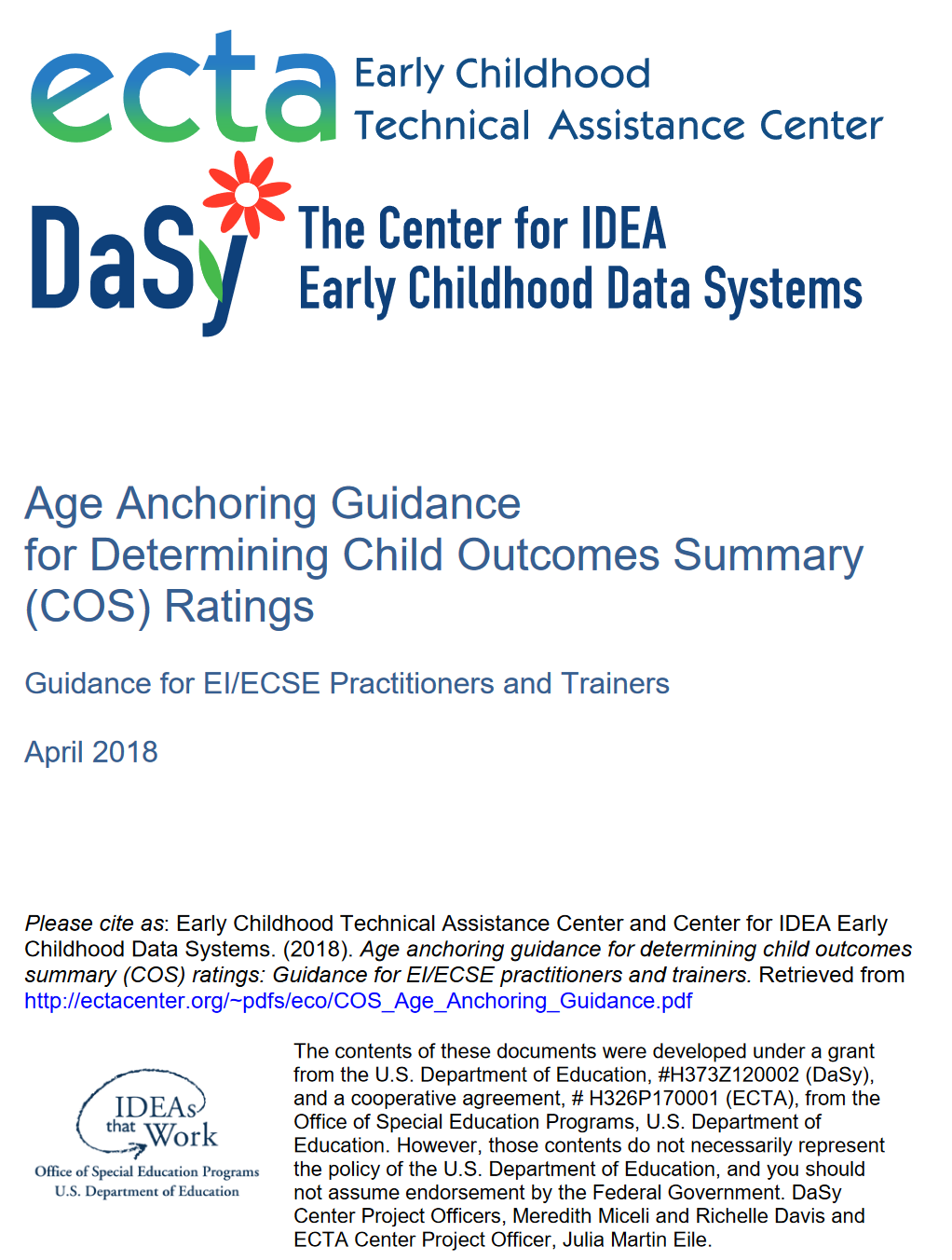
COS-TC Quality Practices
Key National Resource:
Age Anchoring Guidance
http://ectacenter.org/~pdfs/eco/COS_Age_Anchoring_Guidance.pdf

Slide 28
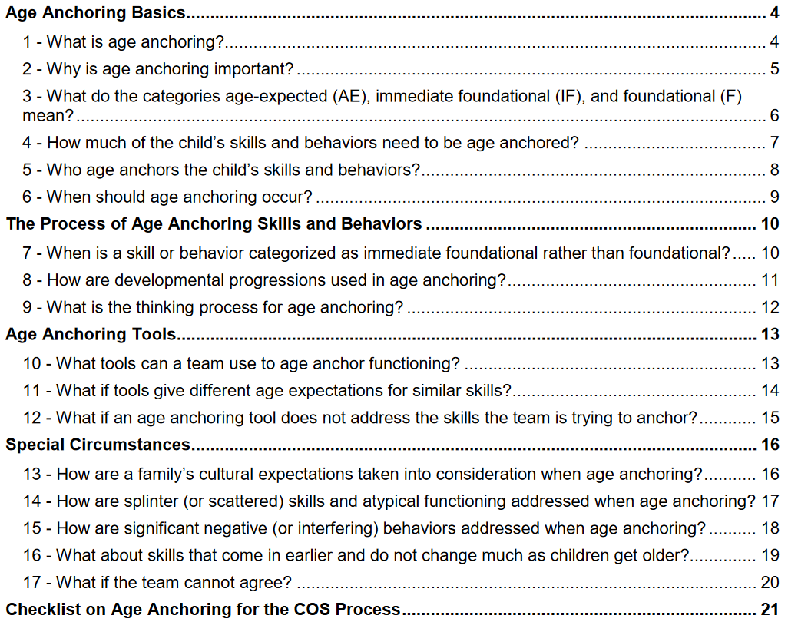
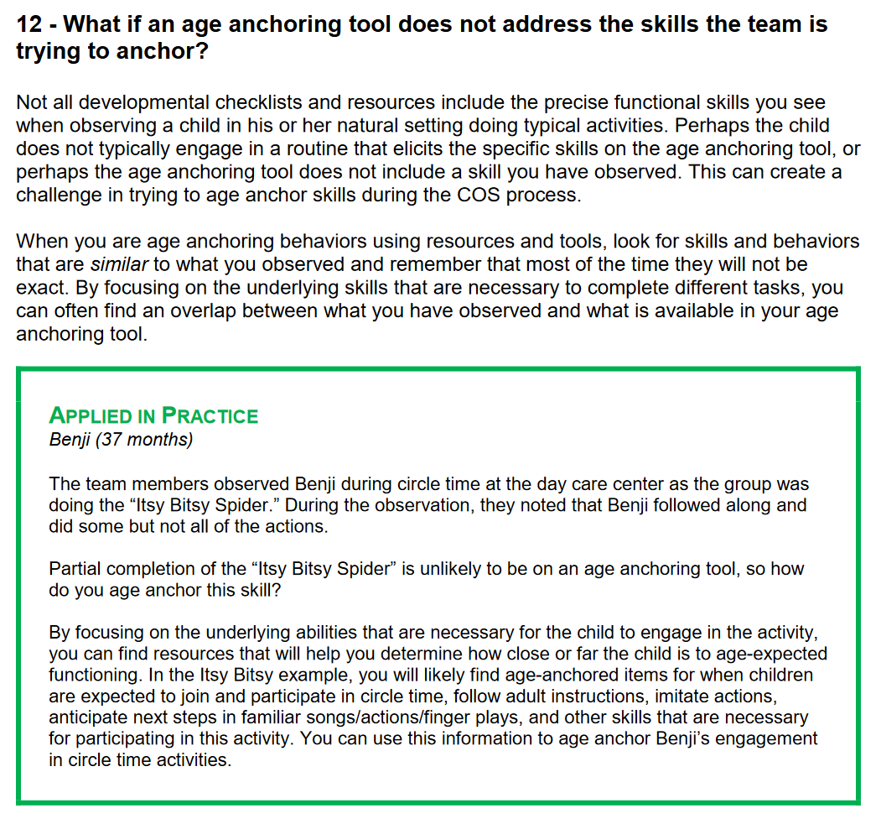

Slide 29
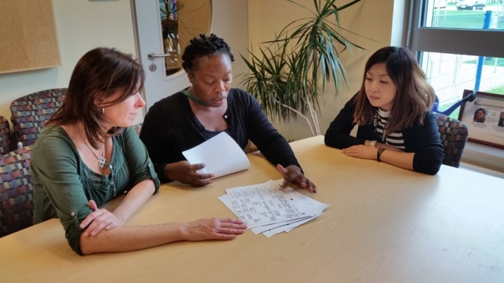
Next Steps
Modules & Certification
Child-Family Linkage Emphasis
Mentoring & Training Hubs

Slide 30


Maryland’s Birth to Kindergarten
COS Process Professional Development
Pam Miller, Part C Coordinator

Slide 31
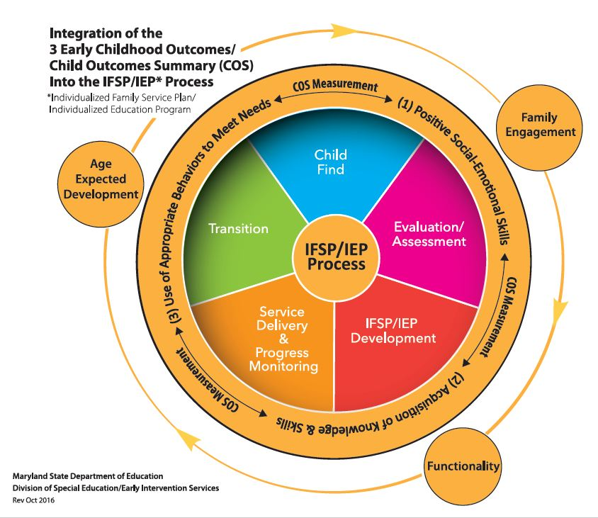
Evolution of COS Process and
COS Professional Development in MD
SFY 2011 - Began using the COS process to measure child outcomes in early intervention
SFY 2012 – Integrated COS process into the IFSP (strengths/needs summary) Birth – 4
SFY 2016 – Began using the COS process to measure child outcomes for preschoolers AND integrated COS process into the IEP (strengths/needs summary), ages 3 to Kindergarten
January 2016 - Issued Child Outcomes Summary (COS) Technical Assistance Bulletin Birth to Kindergarten

Slide 32
Focus on Fidelity
Framework for B-K COS Training and Support (SFY 2017)
Maryland COS Core Components Rationale
Maryland’s Core Components of the COS Process
  Functional Child and Family Assessment
  Age-Anchoring Tools
  COS Rating Prep Tool (AE, IF, F)
  Decision Tree

Slide 33

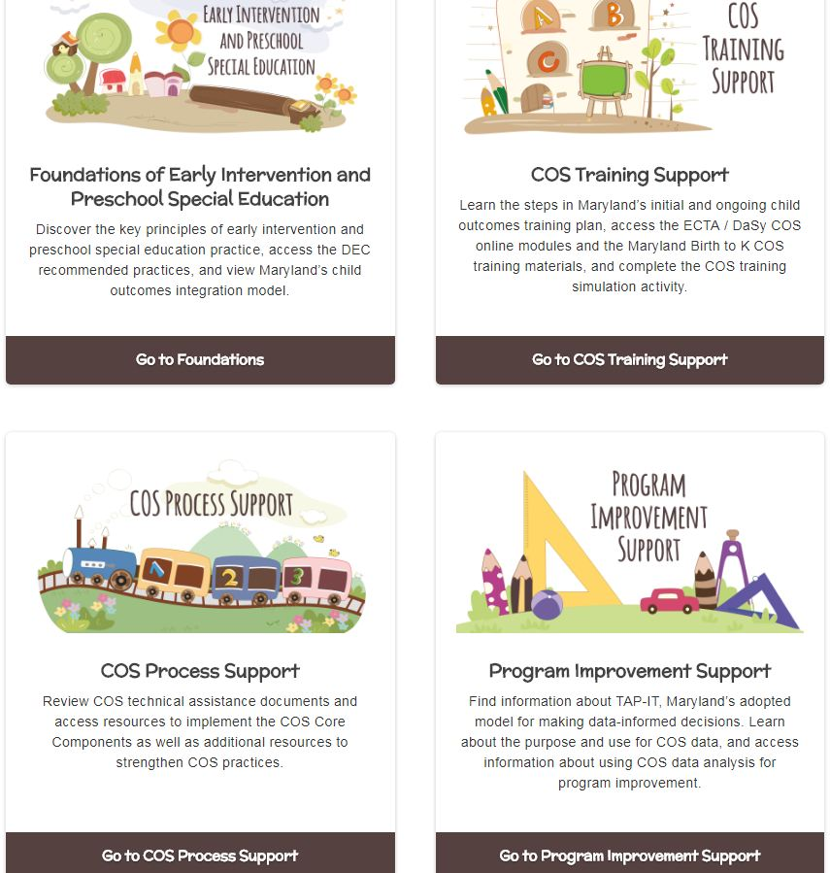
MD B-K Child Outcomes Gateway http://olms.cte.jhu.edu/mdcos-gateway
Guide to Birth to Kindergarten Child Outcomes and Child Outcomes Summary (COS) Process Training and Support

Slide 34
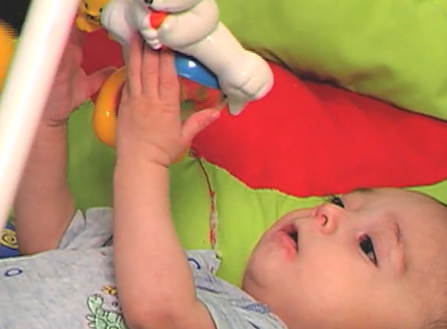
Key National Resource:
Child Outcomes Step-by-Step
Video
http://ectacenter.org/eco/pages/videos.asp

Slide 35
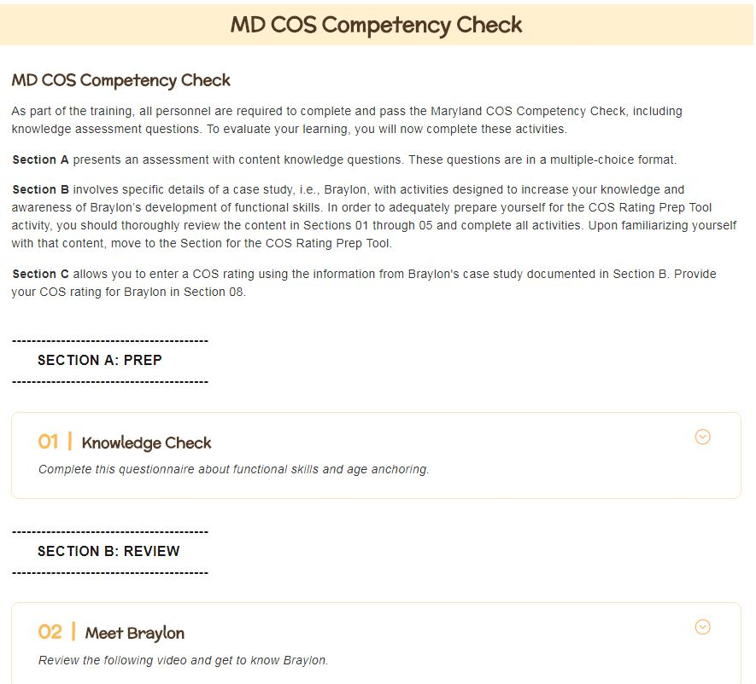
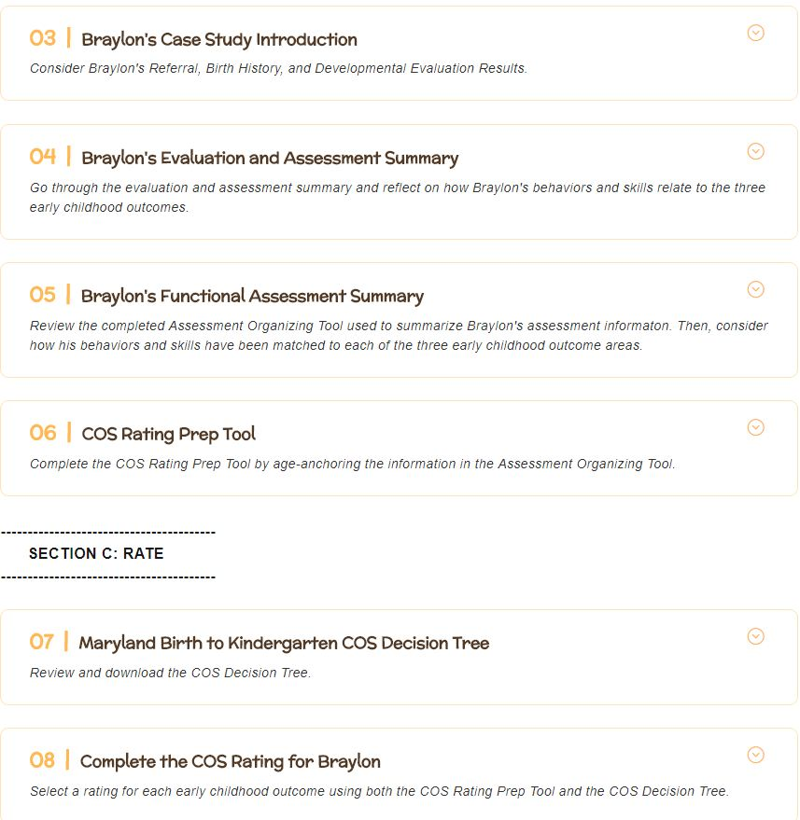
MD COS Competency Check http://olms.cte.jhu.edu/mdcos-gateway-training

Slide 36
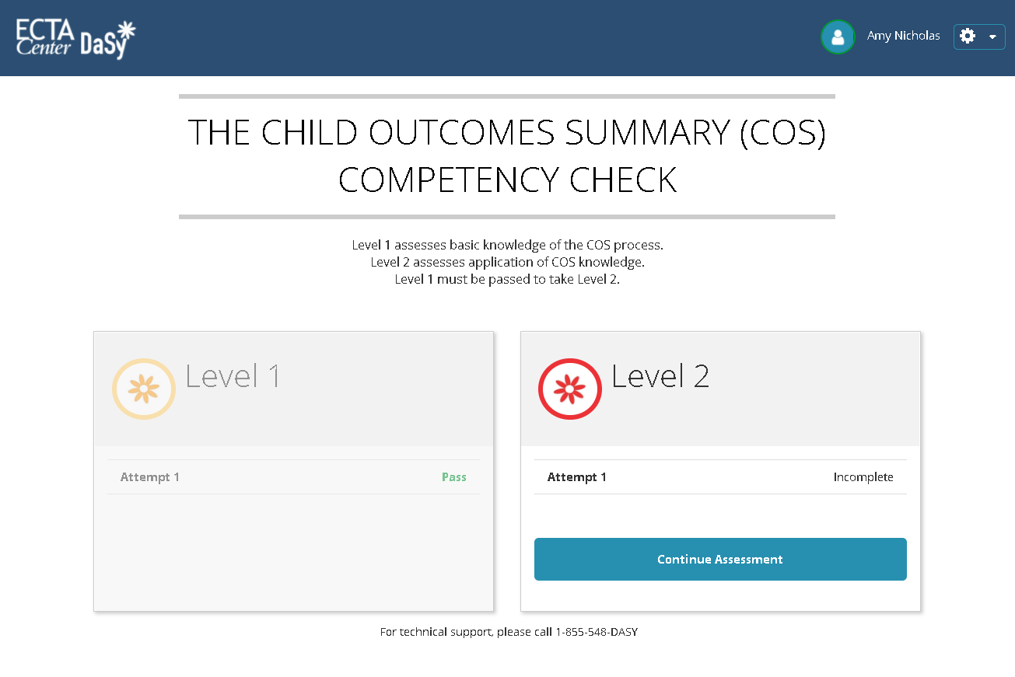


National COS Competency Check (COS-CC)
An online tool for assessing early intervention and early childhood special education practitioners’ understanding of the essential knowledge and skills needed to reach accurate COS ratings.
Level 1: ~10 multiple choice items designed to test basic knowledge of the COS process.
Level 2: ~15 items, including a case study with video, designed to test ability to apply knowledge
Developed by and

Slide 37
National COS-CC Field Test Results
 | Completed L1 | Completed L2 | % Both Completed | Pass L1 | % pass L1 | Pass L2 | % pass L2
Birth to Three | 117 (75%) | 94 (74%) | 80% | 105 | 90% | 32 | 34%
Three to Five | 40 (25%) | 33 (26%) | 83% | 36 | 90% | 25 | 76%
Total | 157 | 127 | 81% | 141 | 90% | 57 | 45%
Field test completed October 2018.

Slide 38

Let’s hear more from you!
Training Topics

Slide 39
Want to keep talking?
Join the DaSy/ECTA Centers’ COS Learning Community!
Meets quarterly via web conference. Next call is on Tues., Dec. 18th from 2-3 p.m. ET.
The goal of the Learning Community is to help participants promote and maintain quality COS practices that lead to high-quality data, and the ability to use those data in meaningful ways.
States and TA staff learn from one another, share tools and resources, and explore issues together in a collegial environment.
For more information and/or to join the Learning Community, contact Amy Nicholas at amy.nicholas@unc.edu

Slide 40
Find the DaSy and ECTA Centers Online
Center for IDEA Early Childhood Data Systems (DaSy Center)
http://dasycenter.org
Facebook and Twitter @DaSyCenter
Early Childhood Technical Assistance (ECTA) Center
http://ectacenter.org/
Facebook and Twitter @ECTACenter ‎

Slide 41

Thank You
The contents of this presentation were developed under grants from the U.S. Department of Education (#s H326P170001, H373Z120002). However, those contents do not necessarily represent the policy of the U.S. Department of Education, and you should not assume endorsement by the Federal Government. Project Officers: Meredith Miceli, Richelle Davis, and Julia Martin Eile.

