Slide 1
Cornelia Taylor, ECO at SRI Kathy Hebbeler, ECO at SRI
National Picture –Child Outcomes for Early Intervention and Preschool Special Education
October, 2013
Notes:
ECO analyzes the data states report every year to get a national picture of child and family outcomes.
(before data) At the beginning, reviewed APRs to understand state approaches to measurement.
In 2006, baseline data for family data.
In 2008, baseline data for child outcomes.

Slide 2
On Today’s Call
Brief review of the national data
Data quality
Completeness of data
State-to-state variation
Pattern checking with other variables
Change over time

Slide 3
State Approaches to Measuring Child Outcomes – 2011-12
Approach | Part C (N=56) | Preschool (N=59)
COS 7 pt. scale | 42/56 (75%) | 37/59 (63%)
One tool statewide | 8/56 (14%) | 9/59 (15%)
Publishers’ online analysis | 1/56 (2%) | 6/59 (10%)
Other | 5/56 (9%) | 7/59 (12%)
Notes:
Fairly steady over the last several years. Only a few changes as some states re-assess their approach and change.

Slide 4
3 Methods Methods for Calculating National Estimates
All states averaged (each state weighted as 1)
All states weighted by child count
States with the highest quality data weighted by child count to represent all states*
*The data we will be presenting for the national picture.
Notes:
Started 4 years ago with analyzing the data with just the highest quality data weighted by child count.

Slide 5
Identifying States with Quality Data
Criteria for high quality data:
Reporting data on enough children
Part C – 28% or more of exiters
Preschool – 12% or more of child count
Within expected patterns in the data
category ‘a’ not greater than 10%
category ‘e’ not greater than 65%
Notes:
Minimum expectations of quality at this point. Low amounts of missing data and within reasonably expected patterns for ‘a’ and ‘e’
Remember: Part C is all exiters, so we expect a higher %. 619 is of child count, so we expect a lower %. This is the national data we have to work from. Within a state, it is best to have the actual number of children exiting with at least 6 mo of service to calculate the actual % of missing data.

Slide 6
Number of States that Met Criteria for Inclusion in the National Analysis
 | 08-09 | 09-10 | 10-11 | 11-12
Part C | 19 | 29 | 39 | 33
Preschool | 15 | 33 | 36 | 39
Notes:
Minimum expectations of quality at this point. Low amounts of missing data and within reasonably expected patterns for ‘a’ and ‘e’

Slide 7
Part C – Reason States were Excluded from Analyses
Reason Part C state was excluded | 2010-11 | 2011-12
State is sampling | 3 | 2
No outcomes data reported | 0 | 0
Reported outcomes data on less than 28% of reported exiters | 3 | 6
Had at least one outcome with category a greater than 10% or category e greater than 65% | 4 | 5
Reported outcomes data on less than 28% of reported exiters AND Had at least one outcome with category a greater than 10% or category e greater than 65% | 1 | 4
Questionable data quality based on review of SPP/APR and knowledge gained through TA | 1 | 0
States included in the analysis | 39 | 33

Slide 8
Part B Preschool – Reason States were Excluded from Analyses
Reason Part B state was excluded | 2010-11 | 2011-12
State is sampling | 4 | 2
No progress category data reported | 1 | 2
No outcomes data reported | 1 | 0
Reported outcomes data on less than 12% of child count | 2 | 4
Had at least one outcome with category a greater than 10% or category e greater than 65% | 4 | 3
Reported outcomes data on less than 12% of child count AND Had at least one outcome with category a greater than 10% or category e greater than 65% | 0 | 0
Questionable data quality based on review of SPP/APR and knowledge gained through TA | 2 | 0
No child count data available | 1 | 0
States included in the analysis | 36 | 39

Slide 13
Good News!
Consistent data over time
Increasing number of children in the child outcomes data
Increasing number of states in the ‘quality’ data for child outcomes

Slide 14
Current Emphasis
Data Quality
Increasing the number of children/families in the data
Pattern checking to identify data quality issues
Training, guidance, supervision, etc.

Slide 15
Part C: Percent of States by completeness of child outcomes data*
* Completeness = (total with outcomes data/total exiters)

Slide 16
Part B 619 : Percent of States by completeness of child outcomes data*
* Completeness = (total with outcomes data/child count)

Slide 17
State Level Variation
Lots of variation across states in summary statement values
Variation is not a direct result of percent served

Slide 18
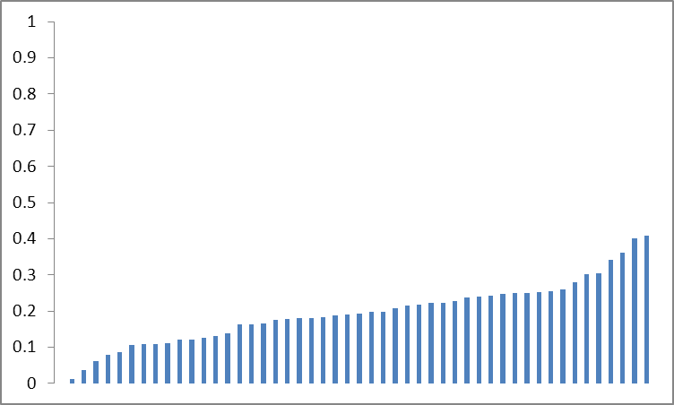
Part C: Positive Social Emotional Skills Progress Category ‘b’

Slide 19
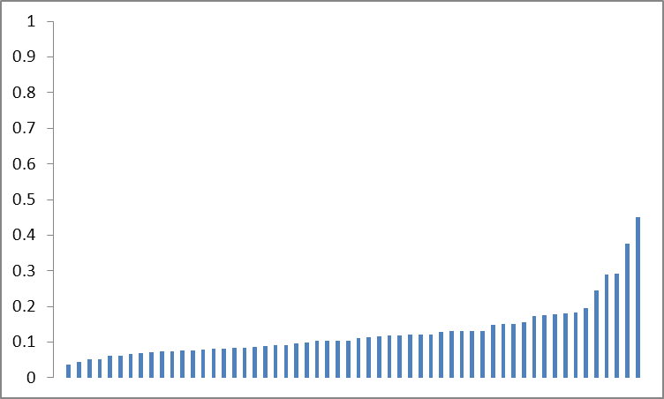
Part B Preschool: Positive Social Emotional Skills Progress Category ‘b’

Slide 20
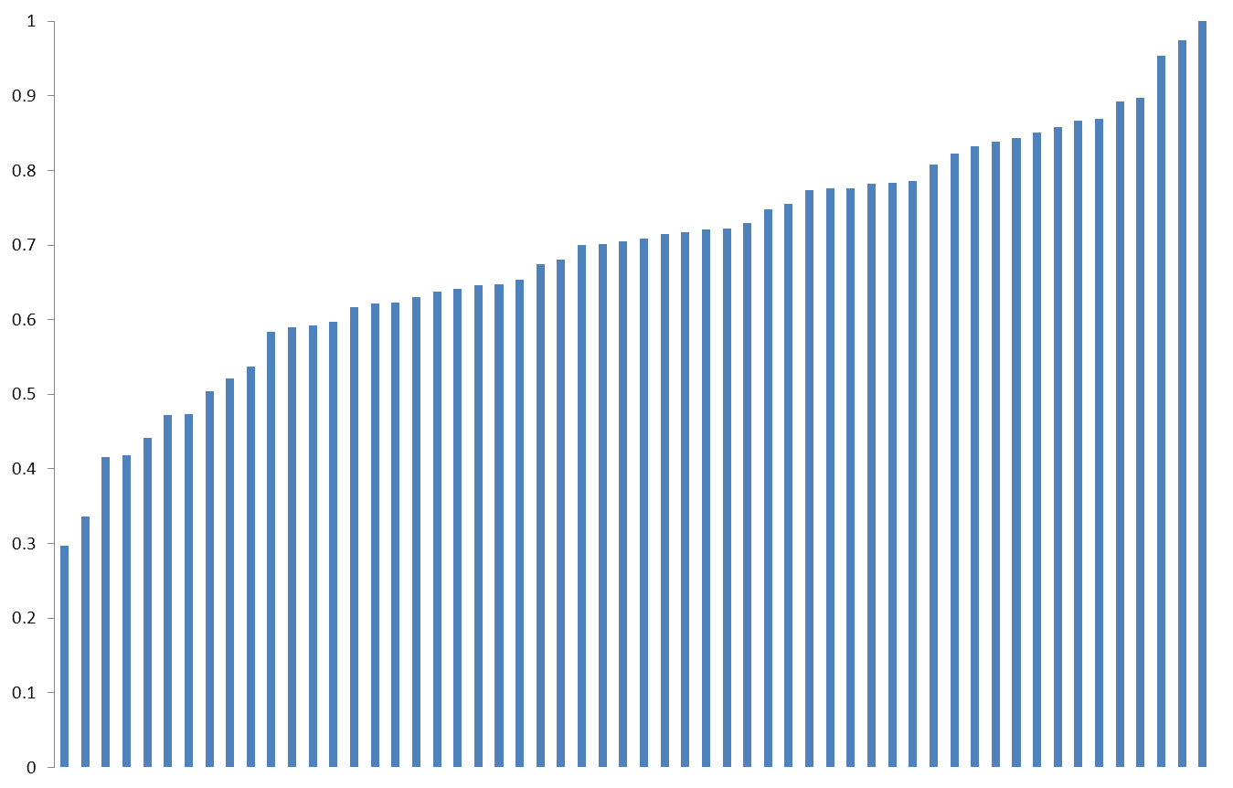
Part C – Knowledge and Skills, State Percentages for Increased Rate of Growth, 2011-12

Slide 21
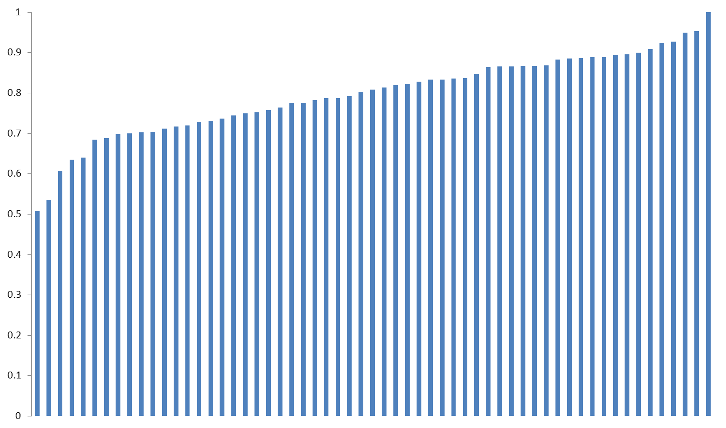
Part B Preschool – Meets Needs, State Percentages for Exited within Age Expectations, 2011-12

Slide 22
Pattern Checking

Slide 24
Part C, Average Percentage Who Exited Within Age Expectations by State Percent Served, 2011-12

Slide 26
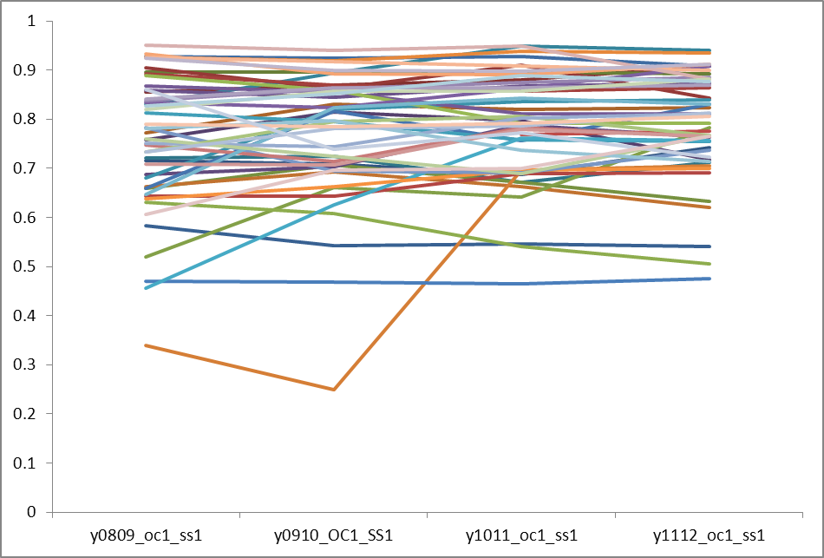
Part B 619 longitudinal patterns all states Outcome 1 Summary Statement 1

Slide 27
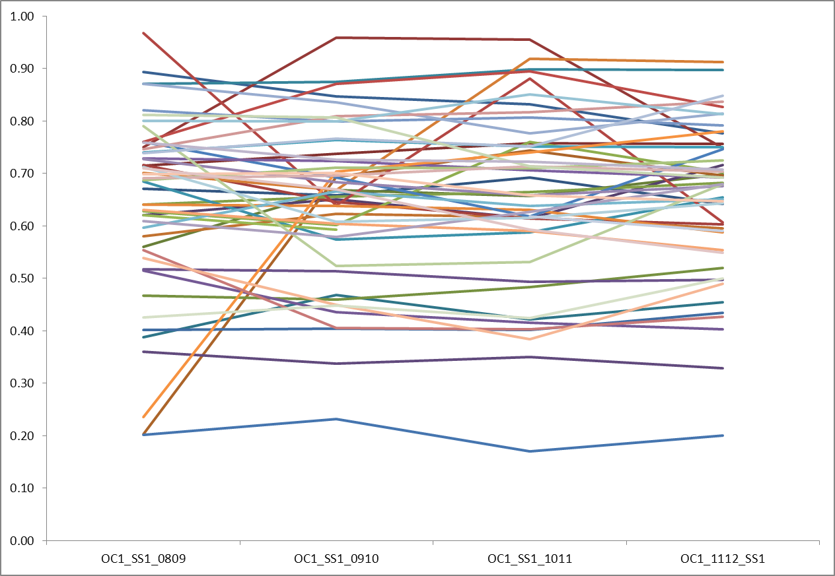
Part C longitudinal patterns all states Outcome 1 Summary Statement 1

Slide 28
Looking only at states that met the quality criteria for inclusion in the national analysis based on….
Missing data criteria
Patterning criteria
APR/SPP reviews

Slide 29
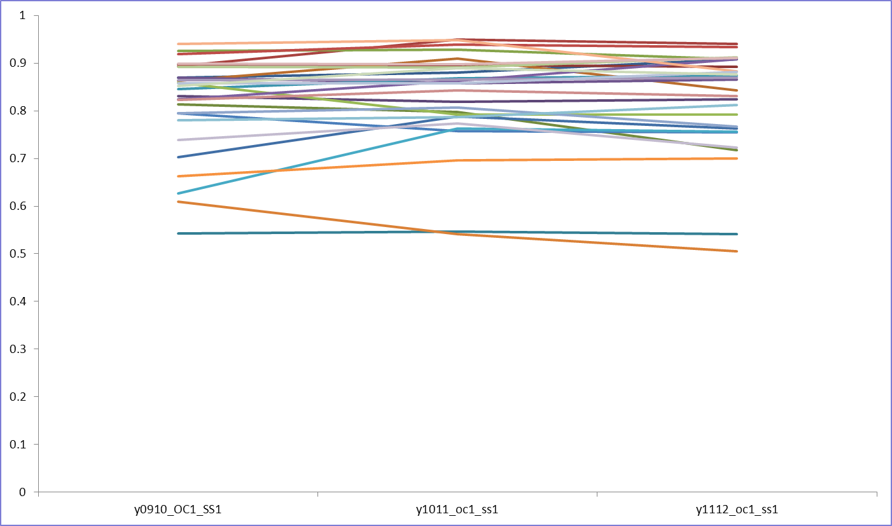
Part B 619 longitudinal patterns best states from last 3 years Outcome 1 Summary Statement 1 (n=28)

Slide 30
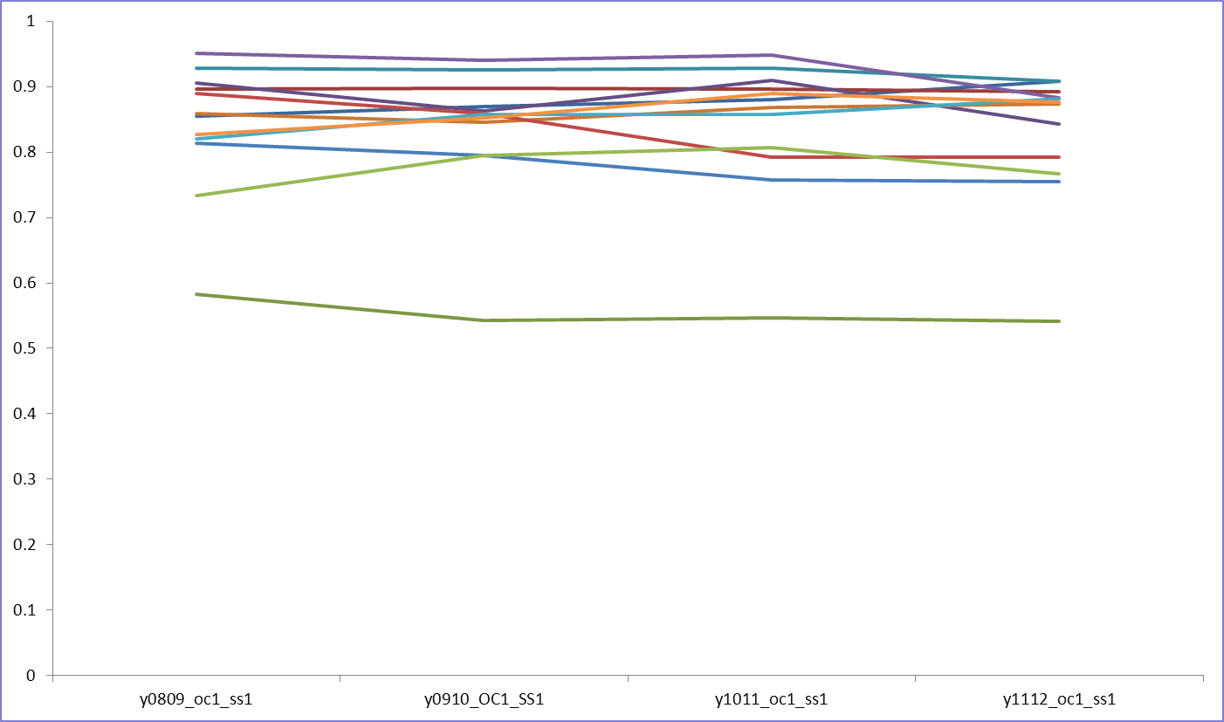
Part B 619 longitudinal patterns best states all 4 years Outcome 1 Summary Statement 1 (12 states)

Slide 31
Discussion
How should we interpret differences between state values?
What pieces of information already reported would predict summary statement values?

Slide 32
Interpreting Change over time

Slide 33
What types of change are important
Small variations from year to year are expected
Large consistent increases are good news particularly when linked to programmatic changes
Large consistent decreases require explanation (e.g. changing population)
Large up and down changes are an indicator of questionable data quality and require explanation

Slide 34
Part C: Change between 2010-11 and 2011-12
Statistically Significant Change | OC1-SS1 | OC2-SS1 | OC3-SS1 | OC1-SS2 | OC2-SS2 | OC3-SS2
Negative | 9 | 9 | 6 | 11 | 11 | 7
None | 32 | 31 | 36 | 30 | 34 | 33
Positive | 10 | 11 | 9 | 10 | 6 | 11
Average Positive change | 7.8 | 8.6 | 7.3 | 6.9 | 7.8 | 7.8
Min and Max | 2 – 15 | 2 – 15 | 3 – 13 | 2 – 18 | 3 – 15 | 3 – 22

Slide 35
Part B Preschool: Change between 2010-11 and 2011-12
Statistically Significant Change | OC1-SS1 | OC2-SS1 | OC3-SS1 | OC1-SS2 | OC2-SS2 | OC3-SS2
Negative | 8 | 6 | 7 | 13 | 10 | 10
None | 30 | 32 | 27 | 30 | 22 | 33
Positive | 11 | 11 | 15 | 6 | 17 | 6
Average Positive change | 5.4 | 4.5 | 8.3 | 4 | 5.6 | 5.2
Min and Max | 2 - 14 | 1 – 7 | 1 - 6 | 1 – 9 | 1 - 26 | 2 - 8

Slide 36
Conclusions
The data continue to be used by the federal government to justify funding
Results Driven Accountability is shining a spotlight on each state’s child outcomes data.
State’s can expect more scrutiny around data quality

Slide 37
How we can help!
Email Cornelia for a state profile of your data quality
cornelia.taylor@sri.com
Contact us for help with data quality analysis and quality assurance activities
Contact us for help with program improvement planning and data analysis.

Slide 38
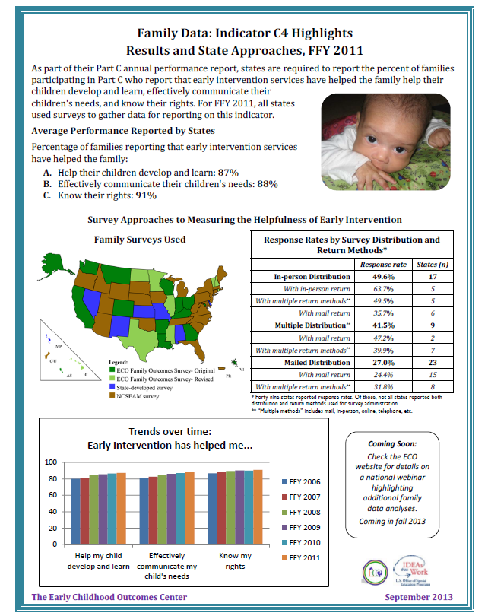
http://www.ectacenter.org/~pdfs/eco/OutcomesforChildren-FFY2011.pdf
http://www.ectacenter.org/~pdfs/eco/Family_fLYER_2013.pdf

Slide 39
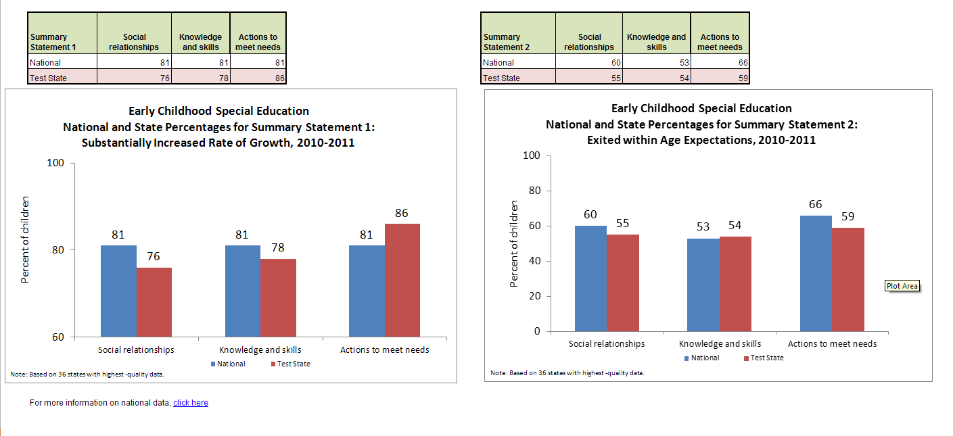
National Graphing Template

Slide 40
Other resources
National Graphing templates
http://www.ectacenter.org/eco/pages/summary.asp#summarygraph
Data quality TA resources
http://www.ectacenter.org/eco/pages/quality_assurance.asp
Data analysis for program improvement TA resources
http://www.ectacenter.org/eco/pages/usingdata.asp

Slide 41
Upcoming family data webinar
Stay tuned for an upcoming presentation of Family Data: Indicator C4 Highlights

Slide 42
Find more resources at:
http://www.the-eco-center.org

