Slide 1


Welcome to the Webinar Series: Recommended Practices for Engaging Families
Webinar 2: Resources and Materials That Support Family Use of the Recommended Practices
Tuesday, July 16, 2019, 3:00 - 4:00 PM EDT

Slide 2
Recap From Webinar 1
Purpose:
The Division for Early Childhood provides guidance on early intervention and early childhood special education practices related to better outcomes for young children with disabilities and/or delays, their families and the personnel who serve them.
Leadership (14)
Assessment (11)
Environment (6)
Family (10)
Instruction (13)
Interaction (5)
Teaming and Collaboration (5)
Transition (2)

Slide 3
Session Objectives
Participants will become familiar with the ECTA Center Suite of Resources that Support Family Use of RPs.
Participants will become familiar with how to access and use the resources to support families.

Slide 4
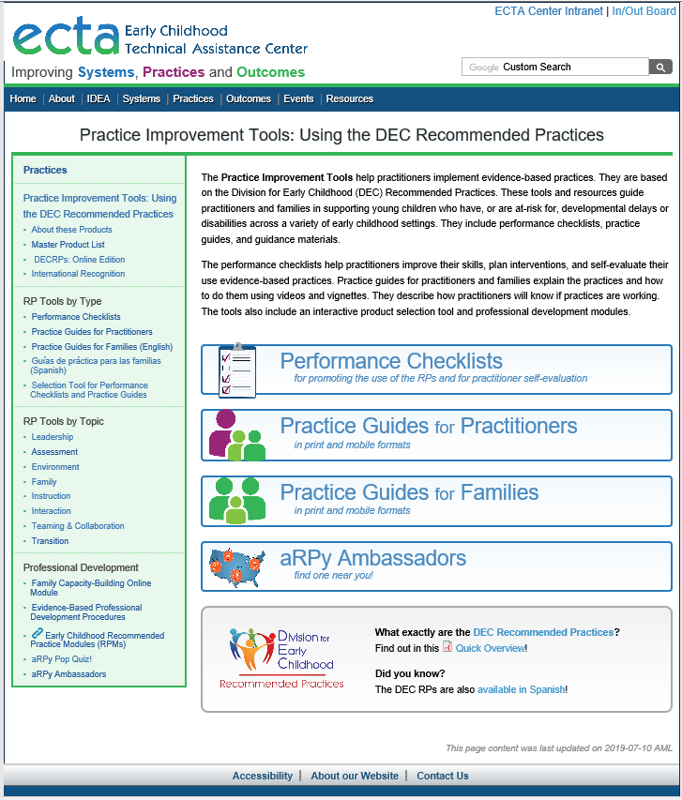
Spanish

Slide 6
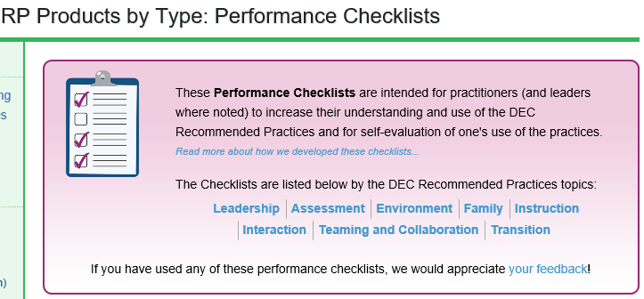

Slide 7
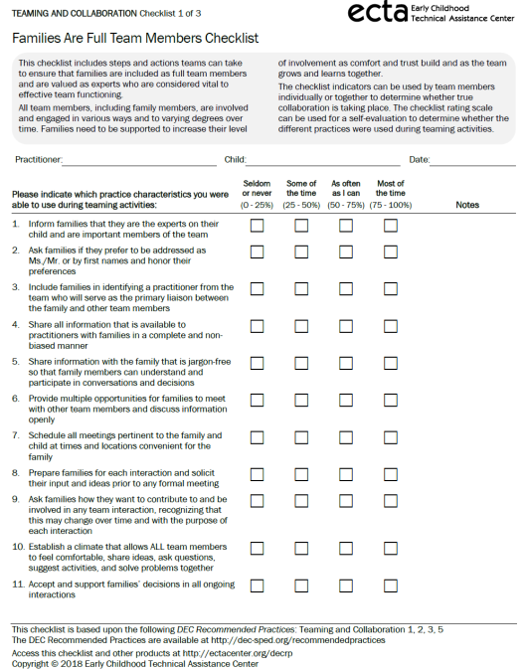

Example of a
Performance Checklist
Each checklist is formatted in the same way for consistency across topic areas

Slide 8
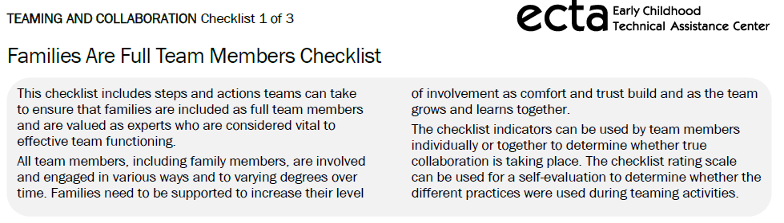
Checklist Instructions

Slide 9
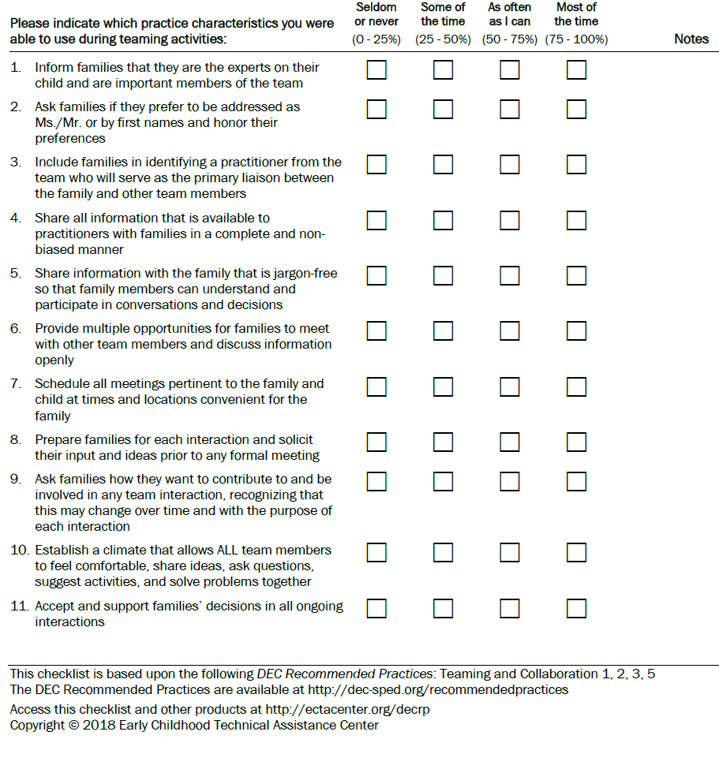

Slide 11
Practice Guide
Description of the Practice
Video example of the Practice
Performing the Practice
Illustrative vignette
Recognizing success

Slide 12
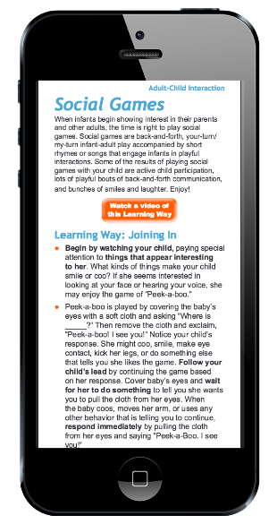
Mobile Access for Practice Guides

Slide 13

Practice Guides for Families

Slide 14
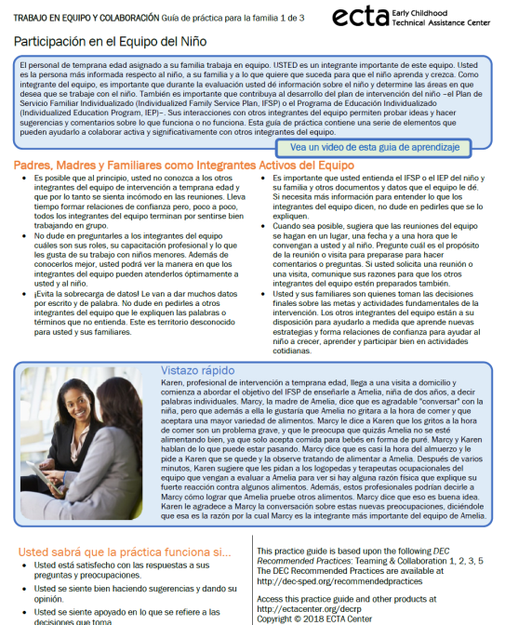
Practice Guides for Families in Spanish

Slide 15
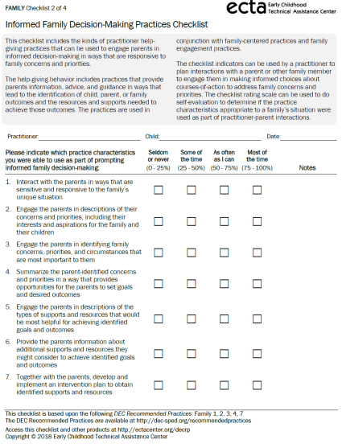
Let’s
See
It

Slide 16
Let’s See It: Practices and Resources That
Engage Families
F2. Practitioners provide the family with up-to-date, comprehensive and unbiased information in a way that the family can understand and use to make informed choices and decisions.

Slide 17
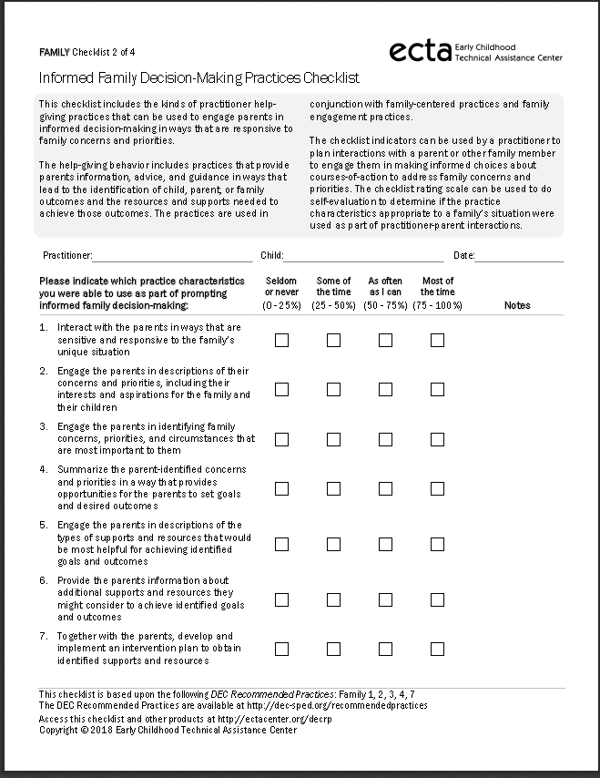
6. Provide the parents information about additional supports and resources they might consider to achieve identified goals and outcomes

Slide 18
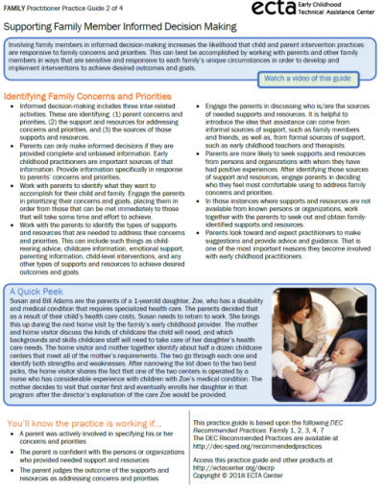
Providing family members with clear, understandable, and jargon-free information about the purposes of each and every interaction helps them to prepare for and participate in the assessment and intervention process.

Slide 19
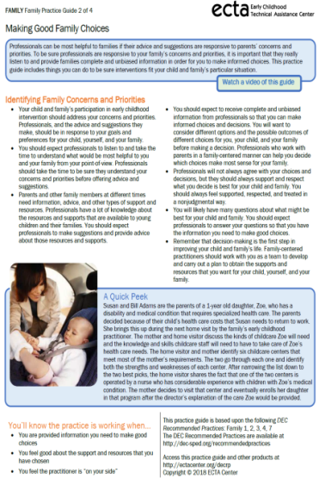
You should expect to receive complete and unbiased information from professionals so that you can make informed choices and decisions. You will want to consider different options and the possible outcomes of different choices for you, your child, and your family before making a decision. Professionals who work with parents in a family-centered manner can help you decide which choices make most sense for your family.

Slide 20
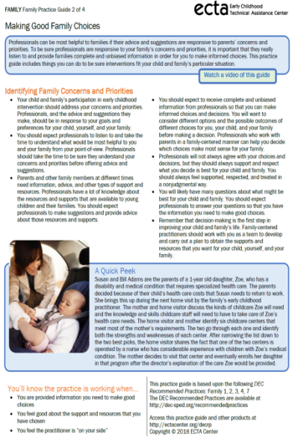
You are provided information you need to make good choices
You feel good about the support and resources that you have chosen
You feel the practitioner is “on your side”

Slide 21
Resource List
Webinar 1 Recording
http://ectacenter.org/events/webinars.asp
Practice Improvement Tools http://ectacenter.org/decrp/
Performance Checklists http://ectacenter.org/decrp/type-checklists.asp
Practice Guides for Practitioners http://ectacenter.org/decrp/type-pgpractitioner.asp
Practice Guides for Families (English) http://ectacenter.org/decrp/type-pgfamily.asp
Practice Guides for Families (Spanish) http://ectacenter.org/decrp/type-pgfamily-sp.asp

Slide 22
Discussion
Questions or comments
How do you see these resources enhancing the work you currently do with families?
Are there any challenges or barriers you see to using these resources with families?

Slide 23
What’s Next?
Evaluation Survey from this email:
Webinar 3 Wednesday, August 7, 2019 – Resources and Supports for PTACs/PTIs
Objectives:
Participants will become familiar with the ECTA Center Suite of Resources that Support the work of PTACs and PTIs
Participants will become familiar with how to access and use the resources

Slide 24
Thank You for Your Time and Participation
Contact Information
Betsy Ayankoya, ECTA Center: betsy.ayankoya@unc.edu
Peggy Kemp, Executive Director, Division for Early Childhood: peggy@dec-sped.org
Stephanie Moss, Region B PTAC and ECTA Center stephanie@p2pga.org
DEC: http://www.dec-sped.org/
The Early Childhood Technical Assistance Center: http://ectacenter.org
Region B Parent Technical Assistance Center at Parent to Parent of Georgia: www.p2pga.org

