Slide 1
Recommended Practices for Engaging Families
Introduction: DEC and the DEC Recommended Practices

Slide 2
Session Objectives
Provide an overview of the Division for Early Childhood of the Council for Exceptional Children
Describe the origin and purpose of DEC Recommended Practices
Share why DEC is important for families and
Share where you can locate the Recommended Practices

Slide 3
What is DEC?
The Division for Early Childhood (DEC) of the Council for Exceptional Children (CEC) is an international membership organization for those who work with or on behalf of young children (0-8) with disabilities and other special needs and their families. ​

Slide 4
What does DEC do for Families?
DEC promotes policies and practices that support families and enhance the optimal development of young children (0-8) who have or are at risk for developmental delays and disabilities.
Provides guidance on EI/ECSE practices related to better outcomes for young children with disabilities and/or delays, their families, and the personnel who serve them.

Slide 5
Who are the DEC Members?
DEC is the voice for early intervention and early childhood special education.
DEC members are representative of local, state and national levels. Members are practitioners, parent and family members, program administrators, higher education faculty, researchers, policy makers, professional development and technical assistance specialists as well as students.

Slide 6
What are the DEC Recommended Practices?
The primary goal of the Recommended Practices (RPs) is to inform and improve the quality of services provided to young children with or at risk of disabilities or delays and their families.
Practices represent the “essential”, “biggest bang” or highest leverage/impact practices
Practices should be viewed holistically

Slide 7
More Parameters……
Practices are observable
Practices are written in active voice
Practices are not disability specific
Practices can be delivered in all settings including natural/inclusive environments
Practices should build on, but not duplicate, standards for typical early childhood settings (e.g. Developmentally Appropriate Practices [DAP])

Slide 8
Why do we need the Practices?
The practices support young children, birth-5 (through kindergarten), who have or are at risk for developmental delays and disabilities; not limited to those eligible for IDEA services (e.g. children with severe challenging behavior).
The Recommended Practices support development and learning for all children.

Slide 9
Where did the DEC Recommended Practices come from?
1993: DEC produced the first set of Recommended Practices (RPs). This set of RPs was based on practices generated by focus groups and a field validation.
2000: The first set of DEC RPs was updated and revised with a grant from the Office of Special Education Programs from the US Dept of Education and included a thorough review of the research literature, new focus groups and a new field validation. Several products were produced.

Slide 10
History Cont’d
2012: DEC created a Recommended Practices Commission tasked with updating and revising the Recommended Practices. The members of the commission included representatives from families of children with special needs, university faculty, researchers, practitioners, professional development specialists and university graduate students.
ECTA Center was able to support DEC and its Commissioners to update the RPs through its OSEP funding, which included a provision on updating and helping the field to use the practices and in 2014, the newly revised DEC Recommended Practices were released.
As the field continues to evolve and new research emerges, the RPs will continue to be revisited and revised to remain current and relevant.

Slide 11
Eight Topic Areas
Leadership (14)
Assessment (11)
Environment (6)
Family (10)
Instruction (13)
Interaction (5)
Teaming & Collaboration (5)
Transition (2)

Slide 12
Three Themes of Family Practices
Family-centered practices
Family capacity-building practices
Family and professional collaboration

Slide 13
Family Practice Example
F6. Practitioners engage the family in opportunities that support and strengthen parenting knowledge and skills and parenting competence and confidence in ways that are flexible, individualized, and tailored to the family's preferences.

Slide 14
Family Practice Example
F4. Practitioners and the family work together to create outcomes or goals, develop individualized plans, and implement practices that address the family's priorities and concerns and the child's strengths and needs.

Slide 15
DEC Resources Available for Download

Slide 16
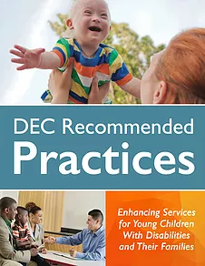
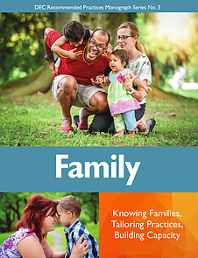
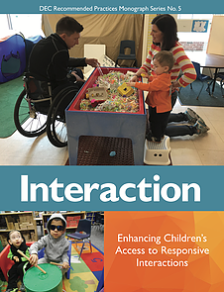
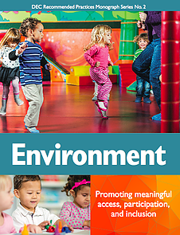
Other Recommended Practice Materials
https://www.dec-sped.org/dec-recommended-practices

Slide 17
WHAT QUESTIONS DO YOU HAVE?

Slide 18
Upcoming Webinars
July 16 - Resources and materials that support family use of the RPs
August 7- Resources and Supports for Parent Centers
September 11- aRPy Ambassador Initiative
http://ectacenter.org/events/webinars.asp

Slide 19
Contact Information
Betsy Ayankoya, ECTA Center: betsy.ayankoya@unc.edu
Peggy Kemp, Executive Director, Division for Early Childhood: peggy@dec-sped.org
Stephanie Moss, Region B PTAC and ECTA Center: stephanie@p2pga.org
DEC: http://www.dec-sped.org/
The Early Childhood Technical Assistance Center: http://ectacenter.org
Region B Parent Technical Assistance Center at Parent to Parent of Georgia: www.p2pga.org

