Slide 1

Using an Equity Mindset in the Data Life Cycle
Megan Vinh, ECTA
Grace Kelley, DaSy
Fred Edora, IDC
Leadership with an Equity Mindset: Using Preschool Special Education Data Series
April 26, 2023
Notes:
Megan

Slide 2
Building An Intentional Container*
Express Your Truth
Acknowledge Paradox
Focus on Learning and Responsibility, not perfection
Lean into Discomfort and Lean into Each Other
Commit to Non-Closure
“Creating an intentional ‘container’ is not a prelude to equity work,
but an essential step in the process.”
This work is licensed by OpenSource Leadership Strategies, Inc. under a Creative Commons Attribution-NonCommercial-NoDerivatives 4.0
Notes:
Adapted from Inclusion Institute*
2 minutes
A brief review of what these components are and how we are intentionally trying to disrupt white dominant “norms” through centering ourselves and our work in these
Building an Intentional Container, Suggestions for Facilitation Approach:
Communicate in the beginning (thank you for inviting us into your group, appreciate the wisdom you bring and glad for the opportunity to learn together… and facilitators consider ways these principles and others are integrated throughout)… consider concise framing context)
Lead with “confident humility” – the self-awareness that we all have wisdom and other gifts to contribute, and we always will have more to learn. With both confidence and humility, we can approach each challenge, including conflicts and failures, with courage and as an opportunity for creativity and positive change. (Counterpart Consulting Norm)
Foster a culture of appreciation “where the organization takes time to make sure that people’s work and efforts are appreciated; develop a learning organization, where it is expected that everyone will make mistakes and those mistakes offer opportunities for learning; create an environment where people can recognize that mistakes sometimes lead to positive results; separate the person from the mistake; when offering feedback, always speak to the things that went well before offering criticism…” (Tema Okun white supremacy culture characteristics antidotes to perfectionism)
Focus on learning and responsibility, not perfection (Counterpart Consulting Norms)
Embrace Paradox – “Either-or thinking can stymie dialogue, learning, and change. All of us, individually and collectively, embody paradox – identities, beliefs, and experiences that seem to contradict each other. Listen to your intuition and creativity, as well as to your critical thinking, to make sense of and hold ideas that are complex and appear contradictory. Welcome this in each other.” (Counterpart Consulting Norms)
“notice when people use ‘either/or’ language and push to come up with more than two alternatives; notice when people are simplifying complex issues, particularly when the stakes seem high or an urgent decision needs to be made; slow it down and encourage people to do a deeper analysis; people are faced with an urgent decision, take a break and give people some breathing room to think creatively; avoid (when possible) making decisions under extreme pressure” (Tema Okun white supremacy culture characteristics antidotes to either/or thinking)
Accept there are many ways to get to the same goal – “when working with communities from a different culture than yours or your organization’s, be clear that you have some learning to do about the communities’ ways of doing; never assume that you or your organization know what’s best for the community in isolation from meaningful relationships with that community (Tema Okun white supremacy culture characteristics antidotes to only one right way)
Example: The Envelope: The Envelope – For Curious Conversations To Evolve Family Practice (cuny.edu)
Possible resource: https://eclkc.ohs.acf.hhs.gov/sites/default/files/pdf/no-search/a-to-z-human-resources-guide-facilitating-dialogues.pdf

Slide 3
Opening Activity
How do you use data to make decisions?
How has data influenced your state?
Notes:
Shift from focus on the child to the system (example: 48% of Black boys are suspended at least once from preschool programs to programs will suspend 48% of Black boys)

Slide 4
What is a Racial Equity Mindset?

Slide 5
What does equity mean in early care and education systems?
“The state that would be achieved if individuals fared the same way in society regardless of race, gender, class, language, disability, or any other social or cultural characteristic. In practice, equity means all children and families receive necessary supports in a timely fashion so they can develop their full intellectual, social, and physical potential.”
Access
Experiences
Outcomes
https://www.naeyc.org/resources/position-statements/equity/definitions; Children’s Equity Project

Slide 6
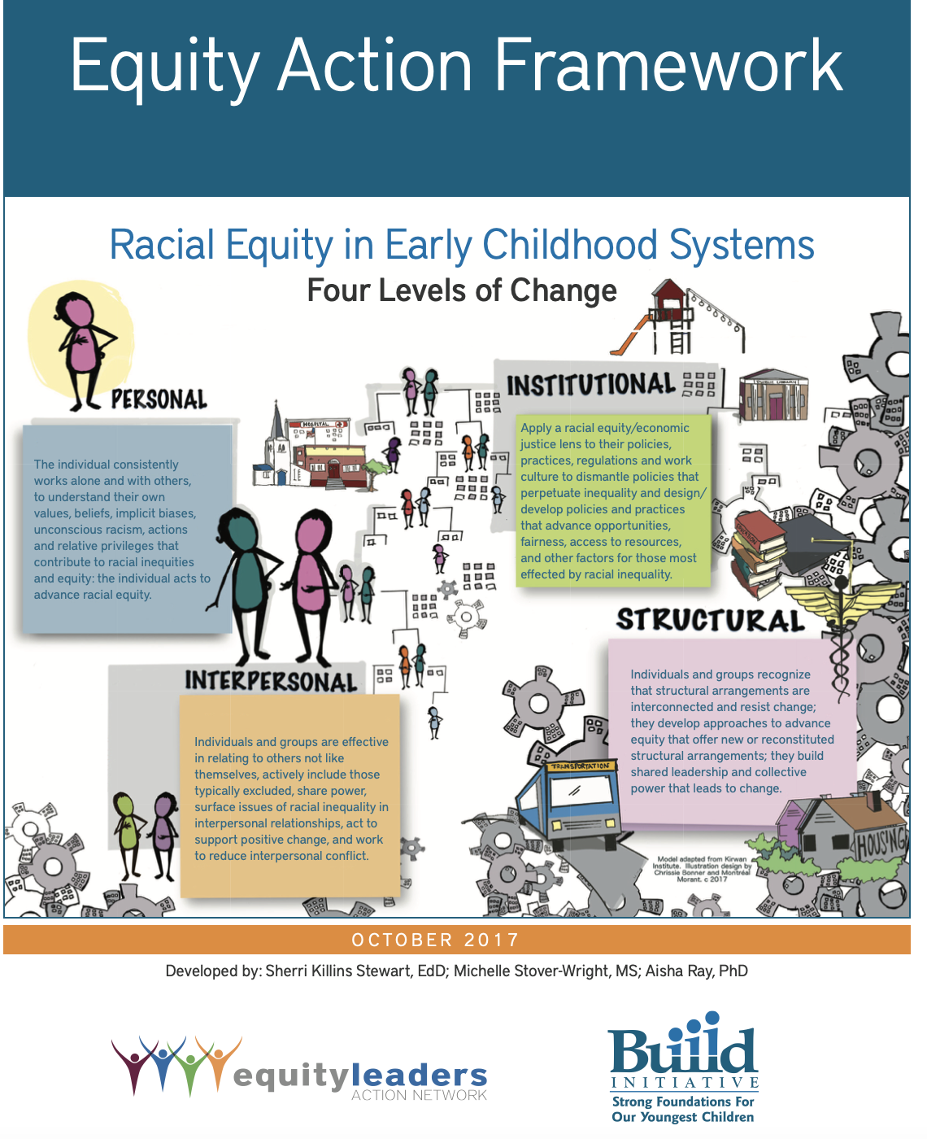
Equity Action Framework
INSTITUTIONAL: Apply a racial equity/economic justice lens to their policies, practices, regulations and work culture to dismantle policies that perpetuate inequality and design/ develop policies and practices that advance opportunities, fairness, access to resources, and other factors for those most effected by racial inequality.
PERSONAL: Individuals work alone and with others,
to understand their own
values, beliefs, implicit biases, unconscious racism, actions and relative privileges that contribute to racial inequities and equity: the individual acts to advance racial equity.
INTERPERSONAL: Individuals and groups are effective in relating to others not like themselves, actively include those typically excluded, share power, surface issues of racial inequality in interpersonal relationships, act to support positive change, and work to reduce interpersonal conflict.
STRUCTURAL: Individuals and groups recognize that structural arrangements are interconnected and resist change; they develop approaches to advance equity that offer new or reconstituted structural arrangements; they build shared leadership and collective power that leads to change.
Equity Action Framework by: Sherri Killins Stewart, EdD; Michelle Stover-Wright, MS; Aisha Ray, PhD, available at https://buildinitiative.org/wp-content/uploads/2017/10/EquityActionFramework.pdf

Slide 7
The Why?

Slide 8
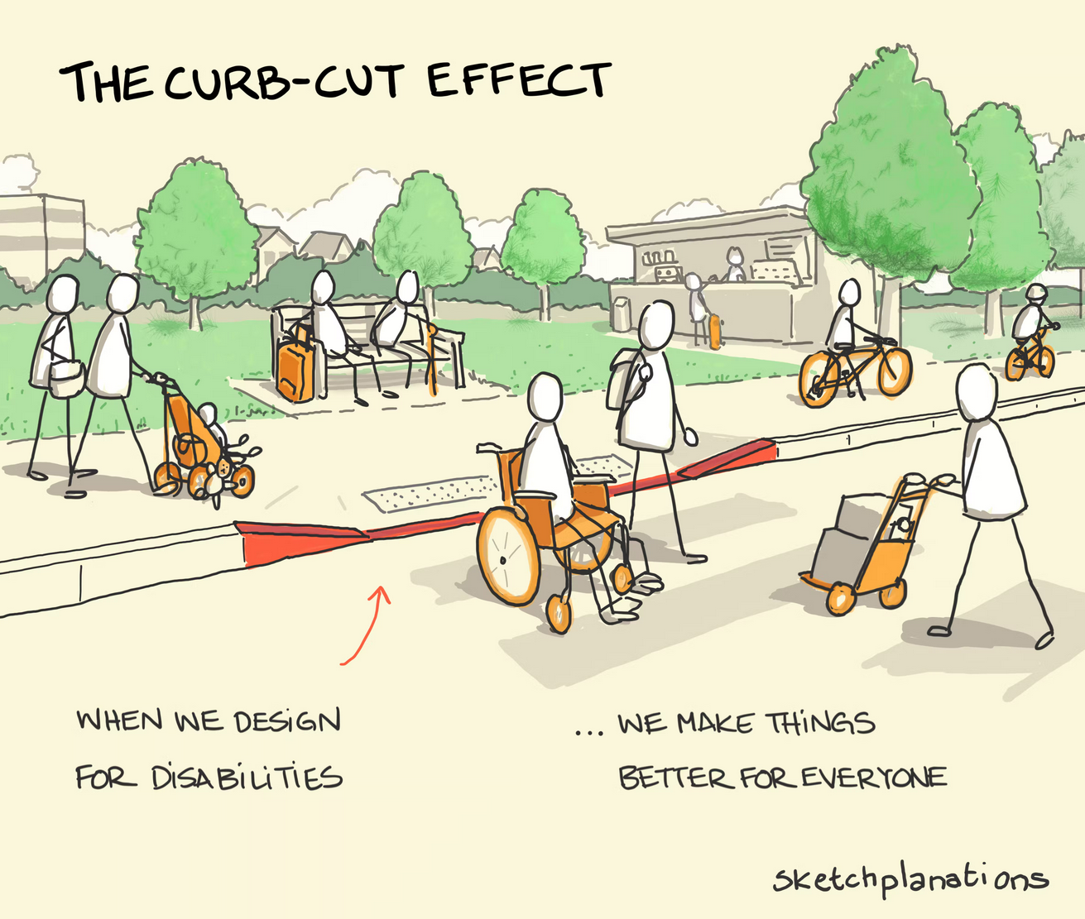
The ripple effect of centering children, families, and communities furthest from opportunity
Notes:
Take a moment to reflect/journal -- Who we are accountable to? Who are the children, families, and communities who are benefiting from the program, policy, or practice? Who is being harmed or not benefiting from the program, policy, or practice given the design and implementation?
Circle of Human Concern:
WA State Gov’s Office of the Education Ombuds – Oone out of Five Disability History and Pride Project Overview: https://www.oeo.wa.gov/sites/default/files/public/One-Out-of-Five-Project-Overview.pdf
Who is benefiting from the program, policy, or practice?
Who is being harmed?
Curb Cut Effect
Ripple effect – for children and families, for building networks of leaders
* build networks of leaders for equity, changing their practice as well as the practices of others.

Slide 9
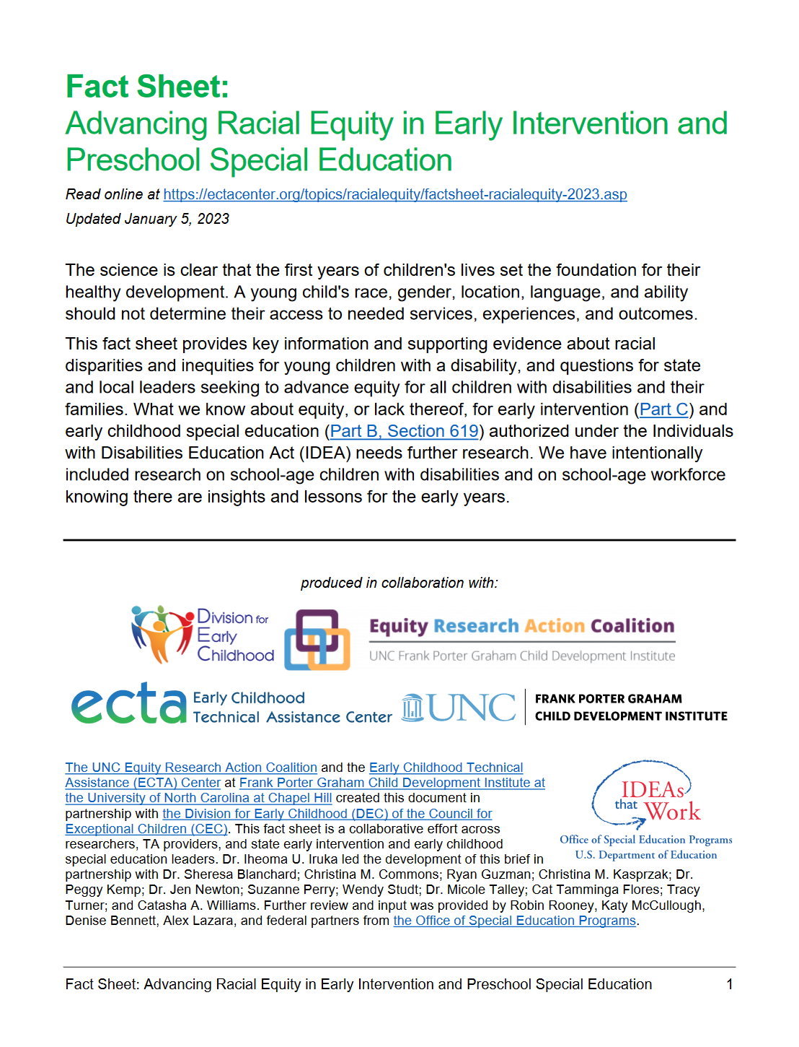
Why Should We Use a “Race and..” Approach?
Racial disparities in:
  Access to EI and ECSE screening, identification, and referral
  Reception of services for developmental delays
  Representation in disability categories, such as intellectual disability and emotional disturbance
  Outcomes for CWDs
https://ectacenter.org/topics/racialequity/factsheet-racialequity-2023.asp
Notes:
Black children are at least 2X as likely to be identified with intellectual disabilities or emotional disturbance than all other racial/ethnic groups combined.
Black children served under the ID + ED categories make up half of all Black school-aged CWD
For example, Black children are overrepresented in categories such as intellectual disability or emotional disturbance, but not in the categories that are based on a physical or medical condition or state such as hearing impairment or visual impairment. Scholars who study disability indicate there is a social stratification of disability where some categories are considered low-status and viewed as not valued by society and leading to fewer resources and supports compared to high-status categories.

Slide 10

The Why
Data may not be able to provide all the answers, but it can often illuminate important questions.
Reflective, probing questions help build the “data” story that identifies gaps in outcomes for children, points out the strengths and explores adult capacity around equity
We have to reframe our questions to challenge deficit assumptions of children and families
Notes:
Grace
Our question should not put the onus on children and families to change but for the system to change.
We have to reframe our questions to challenge deficit assumptions of children and families
Our question should not put the onus on children and families to change but for the system to change.
Our questions should be defined and detailed.
We should include partners in all aspect of our program evaluations, research projects and quality improvement activities.

Slide 11
Reasons to collect and use data:
Assess and improve quality of services that benefit children and families
Examine gaps in access to services and supports
Advocate for federal, state, and local policy change and investments
Increase public awareness and understanding
Build trust within and across communities and systems
Achieve positive and equitable outcomes for children and families
How are partners engaged and empowered in achieving these purposes of data use?
Notes:
Grace

Slide 12

“Data Don’t Drive”
It is collected, interpreted and acted upon by people
Dowd, 2005
Notes:
Grace

Slide 13
Behind Our Data are the People We Serve
How do we make sure that our data reflect the people we serve?
How do the people we serve engage with data?
Notes:
Grace
How we can ensure that our data reflect the real people we serve. Heather Krause says that “Collecting data can be an expression of respect” and we want to respect the families we serve by making sure they are all included both within our data and in our work with data.
So in addition to making sure the people we serve are represented in our data, we also want to make sure that they are engaging with data in meaningful ways. For DaSy’s work, that means giving families of children with disabilities access to data and opportunities to share their interpretations of the data.
Add the various type of ways of providing feedback…. Focus groups, committees, surveys task forces
Why is it important that families are involved in data discussions -
Convert the links to http links that can be copied and pasted into the chat easily
These needs Section 7: The Role of Families on Groups (approx. 17 min.) (servingongroups.org)
Authentic family involvement Diversity Inclusion - Authentic Stakeholder Engagement: Why, How and What (Purpose, Process and Results) | DaSy Center
Section 1: Opportunities to Get Involved (approx. 16 mins.) (servingongroups.org)
Introduction : DaSy Stakeholders Module 2014 (dasyonline.org)

Slide 14
Telling Your Story with Data
Quantitative and Qualitative Approaches
Notes:
Fred

Slide 15

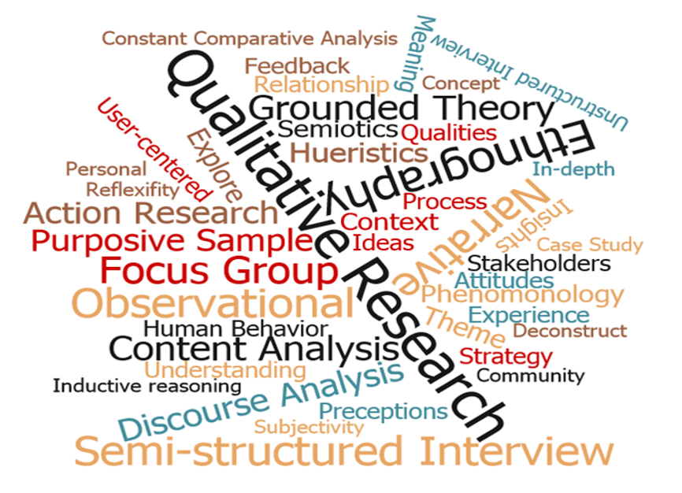
Two Main Types of Data
Quantitative data can either be counted or compared on a numeric scale. This type of data tends to answer questions focused on what or how many.
Qualitative data describe qualities or characteristics. This type of data tends to answer questions about the how and why of a phenomenon.
Notes:
Fred
Quantitative data is the value of data in the form of counts or numbers where each data set has a unique numerical value. This data is any quantifiable information that researchers can use for mathematical calculations and statistical analysis to make real-life decisions based on these mathematical derivations.

Slide 16

Quantitative Data
Are numerical
Represent things you can measure objectively:
  numbers of children served
  frequency of services delivered
  numbers of trainings
Answer these types of questions: ​
  Is there a problem?
  How many?”
  “How much?”
  “How often?”
Do not answer these types of questions
  Why?
  How?
Notes:
Fred

Slide 17

Why Use Quantitative Data?
Provides information that is concrete and specific
Efficient
  Allows for efficient collection of large amounts of data (e.g., national or statewide surveys)
  Can often be analyzed quickly using technology
  Allows for summarizing a lot of information concisely
Often required for accountability, reporting back to funders
Notes:
Fred

Slide 18





Sources of Quantitative Data
Close-ended survey items
Demographic information
Counts of things
Administrative information
Financial information
Notes:
Fred

Slide 19

Qualitative Data
Are not numerical
Provide Information that cannot be fully understood through numbers.
Can elevate the voices of stakeholders not well represented in quantitative data.
Can be time-consuming to collect and analyze
Answer why and how questions:
  Why is there a problem?
Do not answer these types of questions:
  How many?
  How much?
  How often?
Notes:
Fred

Slide 20

Why Use Qualitative Data?
Helps to explore, understand, and explain what is happening, especially that which cannot be easily or fully understood through numbers.
Brings numbers to life and help stakeholders relate to the findings.
Including qualitative data is a best practice for collecting, analyzing, and using data with an equity lens.
Notes:
Fred
To explore, understand, and explain what is happening, especially that which cannot be easily or fully understood through numbers.
To bring numbers to life and help stakeholders relate to the findings.
Including qualitative data is a best practice for collecting, analyzing, and using data with an equity lens.

Slide 21


Sources of Qualitative Data
Open-ended survey items
Interviews
Focus groups
Document reviews
(e.g., policy documents)
Other data not collected as part of a systematic inquiry
Notes:
Fred
Open-ended surveys
Interviews allow you to gain perspectives without influence of others
Focus groups draw on the synergy between members

Slide 22
What is the Data Life Cycle?
Notes:
Grace

Slide 23
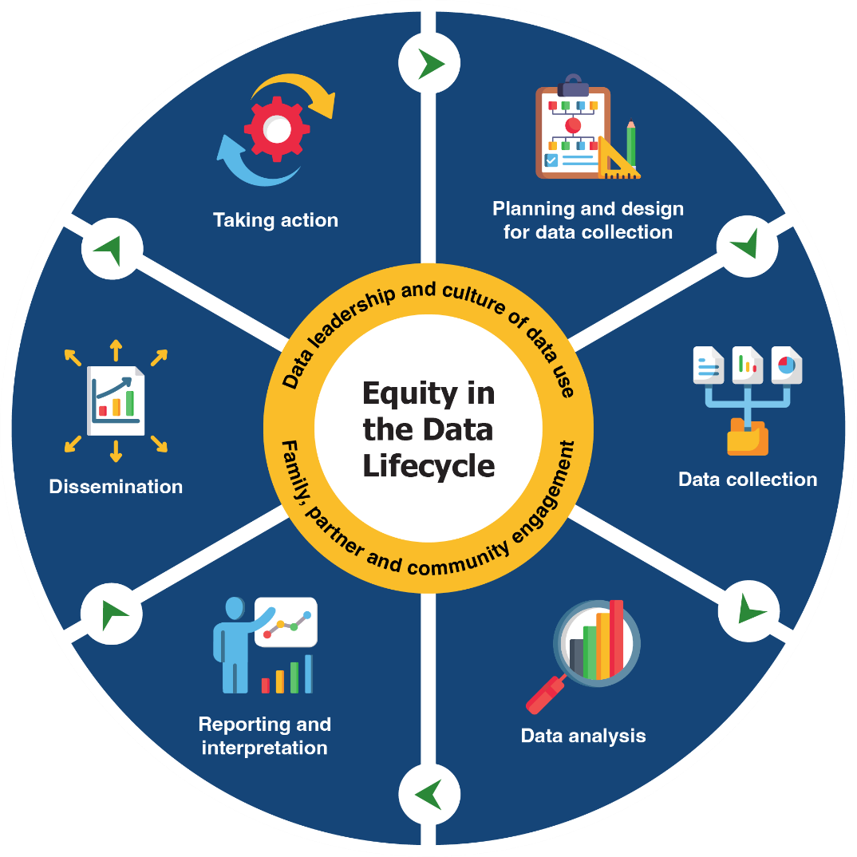
Engage in a Cycle of Inquiry
Inquiry is a cyclical process that takes time, and it’s important for data teams and communities to work together throughout.
Applying an equity-focused approach to inquiry prompts data teams to reexamine and assess power dynamics, policies, practices, mental models, and beliefs, that perpetuate systemic barriers and inequalities.
Draft representation of Embedding Equity in the Data Lifecycle. Will be available from dasycenter.org
Notes:
Grace

Slide 24

Ask the Right Questions
Plan and Design
Understand who is privileged by the data to be collected
Ensure the people defining the questions represent the people who will answer the question​s
​Engage those who are impacted by the data to define the questions that get asked. ​
Design questions that reflect the lived experiences for those impacted by the data
Consider questions about how the system/ program addresses the needs of children and families​
Notes:
Grace
We have to reframe our questions to challenge deficit assumptions of children and families​
Our question should not put the onus on children and families to change but for the system to change.​
Our questions should be defined and detailed.​
​
For instance: “How many instances of social conflict are experienced by boys with autism in program delivery area out side of school time?” Instances per what?​
​
​
​
​
​

Slide 25
Engage Partners to Collect Data
Gather Data
Be thoughtful about who collects data​
Use partners to collect data​
Train partners on how to ask questions​
Use quantitative and qualitative approaches​
Notes:
Grace
Collecting data can be an expression of respect” and we want to respect the families we serve by making sure they are all included both within our data and in our work with data.

Slide 26
Analyze Data Thoughtfully
Analyze Data
Provide training to ensure that partners are comfortable analyzing data​
Use data visualization techniques to make the data meaningful and interesting
Disaggregate your data to show who is represented and who is missing
​Include partners in discussions about what the data means to them
Notes:
Grace
Ensure that data and results are communicated in a way that stakeholders can use and understand is an important step toward equity​
Address barriers and discrepancies in equity and representativeness

Slide 27
Find Meaning in Your Data
Interpret Results
Value the different perspectives and contributions of all partners (lived experiences and qualitative data helps bring meaning to quantitative data)​
Encourage ideas and take all recommendations seriously ​
Define what the data can realistically tell you​
Expand a group of people who get to make meaningful decisions about the data
Involve partners in interpreting the findings​
Notes:
Grace

Slide 28
Share and Apply Data Findings
Report and Share Findings
Highlight and share achievements, big and small
Engage partners in how to apply the findings
Provide information on how partners can use the findings to improve outcomes
Ensure that those who provided the data receive the findings​ in an understandable format
Notes:
Grace
Remember Achievement would not be possible without partners (note for slide)​
Show appreciation for all stakeholders ​

Slide 29
DaSy Data Culture Toolkit: Building Equity in Data Leadership
Take Action
Data leaders:
Practice inclusive leadership
Support how people think, consider, speak and act around data—embed in the culture
Model commitment to using data by making data- informed decisions
Notes:
Grace

Slide 30
Discussion
Review critical questions: https://dasycenter.org/resources/critical-questions/
Identify 1-2 that you think would have an important impact on your program?
Identify what quantitative data do you have that may answer the questions.
How would you enhance the story using other data sources, including qualitative data?
Notes:
15 minutes (We will collect data and

Slide 31




Thank you
https://dasycenter.org/ Follow DaSy on Twitter: @DaSyCenter | ectacenter.org Follow ECTA on Twitter: @ECTACenter | https://ideadata.org/ Follow IDC on Twitter: @IDEAdatacenter
The contents of this presentation were developed under grants from the U.S. Department of Education, #H373Z190002 and #H326P170001. However, those contents do not necessarily represent the policy of the U.S. Department of Education, and you should not assume endorsement by the Federal Government. Project Officers: Meredith Miceli, Amy Bae, and Julia Martin Eile.

