Slide 1
More on Infusing Partnership Principles and Practices into Family Engagement Activities
Engaging Families and Creating Trusting Partnerships to Improve Child and Family Outcomes
June 21, 2017

Slide 2

Trusting Partnerships
Advocating
Meeting Basic Needs
Communication
Advocacy
Competence
Participating
and
Volunteering
Trusting
Partnerships
Referring
and
Evaluating
Commitment
Respect
Equality
Extending
Learning
Individualizing

Slide 3
Type 4: Extending Learning
Guiding families to teach child through everyday activities & routines
Making home visits
Advocating for preferred informational, emotional, & logistical support
Addressing behavioral challenges
Helping to connect children/families to neighborhood & community peers
Supporting children to be included in community recreational activities
Supporting children/families to attend community events
Building community partnerships

Slide 4
Type 5: Participating and Volunteering
Creating family friendly environments within the program
Encouraging families to attend program/community events & meetings related to child development
Guiding families in how to assist with learning as a volunteer
Guiding families in how to contribute to other program tasks
Guiding families to volunteer in community events that have school, student & family benefits

Slide 5

Available at: https://eclkc.ohs.acf.hhs.gov/hslc/tta-system/family/docs/ncpfce-markers-of-progress.pdf

Slide 6
Type 6: Advocating
Taking advantage of resources from Parent Training & Information Centers
Participating in advocacy & leadership training
Mentoring families & being mentored by families in advocacy activities
Informing families about program & community advocacy events & encouraging them to consider participating

Slide 7
Review of Types of Family Engagement
Meeting Basic Needs
Referring & Evaluating
Individualizing
Extending Learning
Participating & Volunteering
Advocating

Slide 8

High-quality systems support the implementation of effective practices to improve outcomes for children and families.
Governance
Result
Quality
Standards
Finance
Building
High-Quality
Systems
Implementation
of
Effective Practices
Good outcomes for children with disabilities and their families
Accountability & Quality Improvement
Personnel/Workforce
Data
System
ectacenter.org/sysframe

Slide 9

State Systemic Improvement:
A Focus on Family Outcomes
Kirsten Siegenthaler & Marie Ostoyich
NY Bureau of Early Intervention

Slide 10
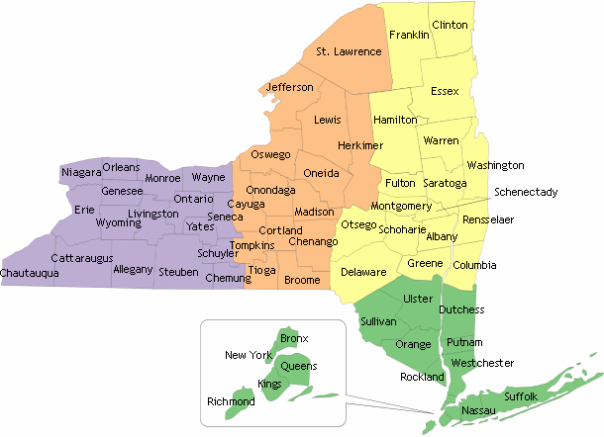
New York State’s
Early Intervention Program
Serves 68,000 children and their families each year
1,200 billing and 14,000 rendering providers
Across 57 Counties and New York City
Birth rate of almost 250,000

Slide 11
Family-Centered Services
Early intervention services are family-centered
Focus of NY’s State Systemic Improvement Plan (SSIP)
National Center for Special Education Accountability
Monitoring (NCSEAM) engaged families and other stakeholders to develop the Family-Centered Services Scale
  Statements about the family’s experience with early intervention (Strongly Agree to Strongly Disagree)
  Incorporated into a survey completed by families

Slide 12
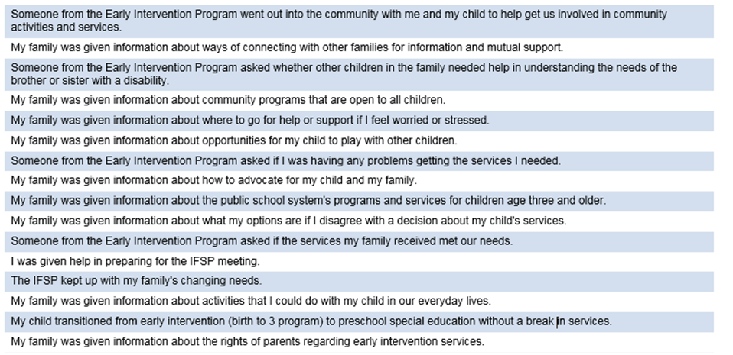
NCSEAM’s Family-Centered Services Scale

Slide 13
How will we improve?
Using The Breakthrough Series: IHI’s Collaborative Model for Achieving Breakthrough Improvement
Small changes implemented in daily routines and interactions
  Supported by outside experts and peers as coaches
  Cycle of continuous improvement
    Plan (look at data, identify an issue, review evidence-based strategies)
    Do (implement the change)
    Study (collect data and review routinely – daily, weekly, monthly)
    Act (adopt if it works, adapt if needed or abandon if it doesn’t)
*IHI: Institute for Healthcare Improvement

Slide 14
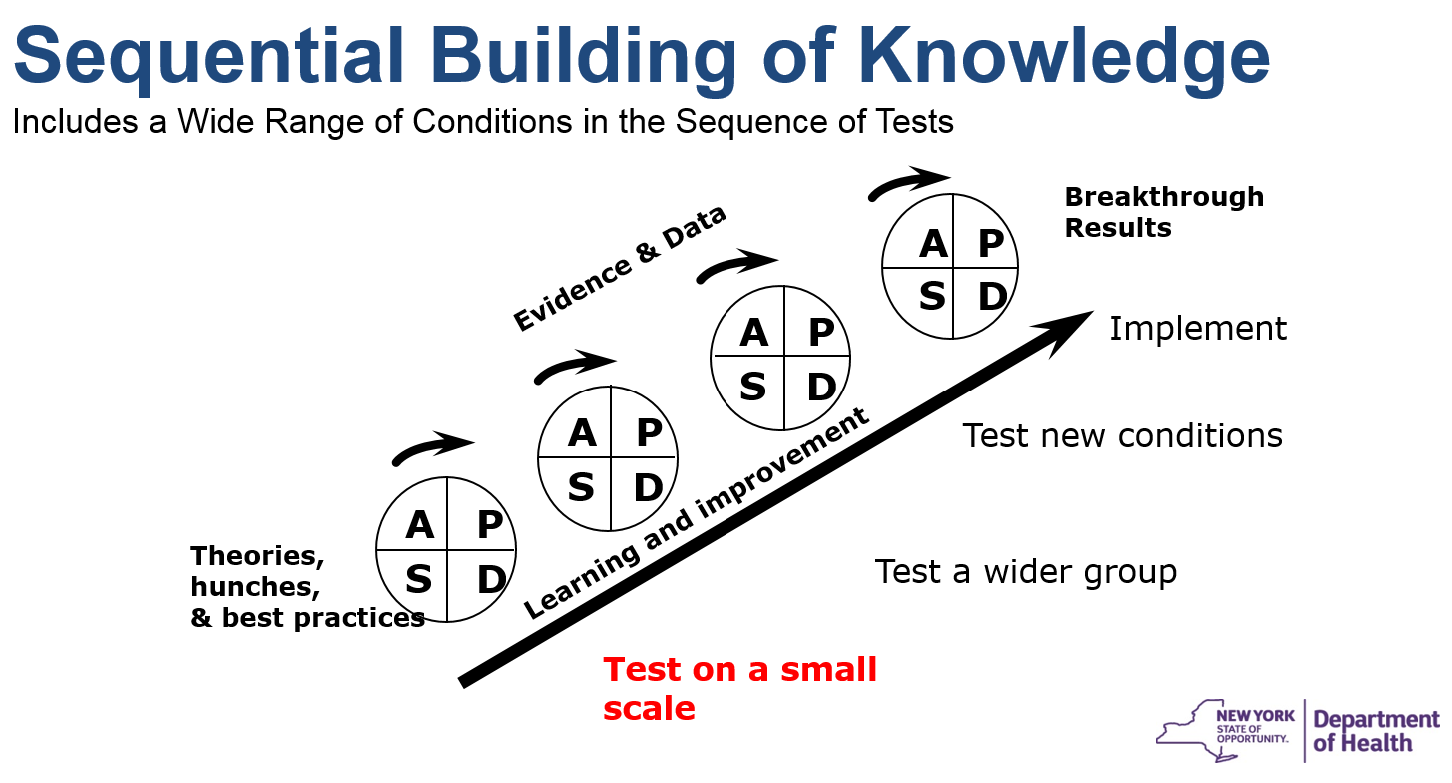
Sequential Building of Knowledge
Key: The changes will be embedded in every day interactions with families.

Slide 15

Local Implementation Teams
Participants:
Requirements:
Early Intervention Officials/Designees
Service Coordinators
Quality Assurance Officers
Early Intervention Providers/Therapists
Families
1-day In-Person Learning Sessions (start)
Monthly Coaching Webinars (11 months)
Conference Calls, Webinars, Email Contact

Slide 16
Trusting Partnerships
Advocating
Meeting Basic Needs
Communication
Advocacy
Competence
Participating
and
Volunteering
Trusting
Partnerships
Referring
and
Evaluating
Commitment
Respect
Equality
Extending
Learning
Individualizing

Slide 17
Key Ethical Principles
Key Ethical Principles
Family as Foundation
Family as core unit of society
Dignity
Dignity as an ascribed status, as a ‘regarded as’ standing within a community
Community
Community as more than a place or space
Family as principal shaper & provider of physical, emotional, fiscal, & other support for children
Family as source of life-long support
Dignity as a state of being worthy, honored, & esteemed, not for what one can do (or cannot do) but simply as a person with inherent worth
Membership & belonging to a greater societal whole
Having support in community programs

Slide 18
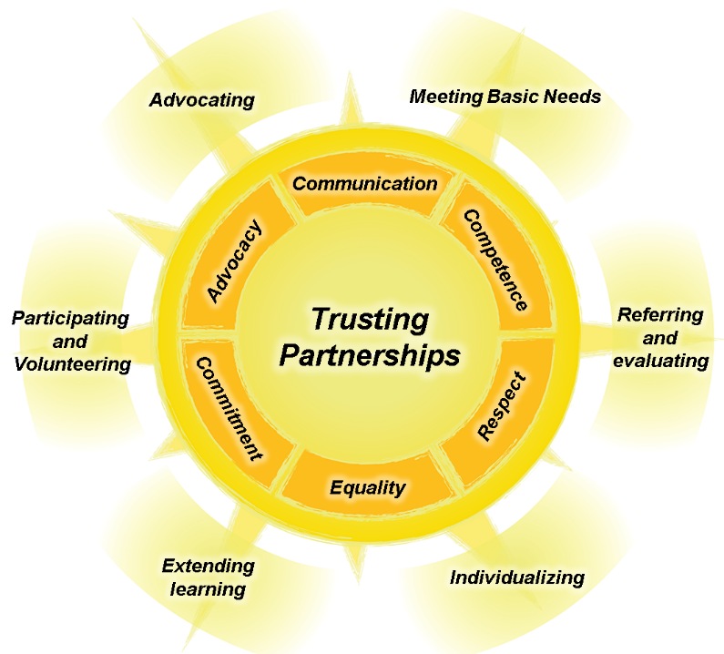
IDEA’s Long-Term Goals
“Improving educational results for children with disabilities is an essential element of our national policy of ensuring:
  Equality of opportunity
  Full participation
  Independent living
  Economic self-sufficiency.”

Slide 19
New York Presentation Resources and Presenter Contact Information
Resources:
NYS Early Intervention Program: http://www.health.ny.gov
Quality Improvement Breakthrough Series: http://www.ihi.org
Presenters:
Kirsten Siegenthaler: Kirsten.Siegenthaler@health.ny.gov
Marie Ostoyich: Marie.Ostoyich@health.ny.gov

Slide 20
Online Webinar Resources
http://ectacenter.org/~calls/2017/familyengagement.asp
PowerPoint
Handouts
Suggestions for Follow-up Reflection/Discussion
Resources and References

Slide 21
Tell Us What You Think!
Share your ideas for follow-up to this webinar series by emailing us at:
ectacenter-families@unc.edu

Slide 22

Acknowledgments
The contents of this tool and guidance were developed under grants from the U.S. Department of Education, #H326P120002 and #H373Z120002. However, those contents do not necessarily represent the policy of the U.S. Department of Education, and you should not assume endorsement by the Federal Government. Project Officers: Meredith Miceli, Richelle Davis, and Julia Martin Eile.

