Slide 1
Getting to the Bottom Line of Family Engagement
Engaging Families and Creating Trusting Partnerships to Improve Child and Family Outcomes
March 29, 2017

Slide 2
Today’s Presenters/Facilitators
Christina Kasprzak Early Childhood Technical Assistance Center/Center for IDEA Early Childhood Data Systems
Carmen Sanchez
U.S. Office of Special Education Programs
Josh Sparrow
National Center on Parent, Family, and Community Engagement
Ann Turnbull University of Kansas/ University of North Carolina
Rud Turnbull University of Kansas/ University of North Carolina

Slide 3
Today’s Discussion
Family Engagement and Outcomes for Children and Families
Synthesis of Policies, Frameworks, and DEC Recommended Practices on Family Engagement
Introduction to the How and What of Family Engagement in the Context of Early Intervention (EI)/ Early Childhood Special Education (ECSE)
Systems Supports for Quality Family Engagement Practices

Slide 4
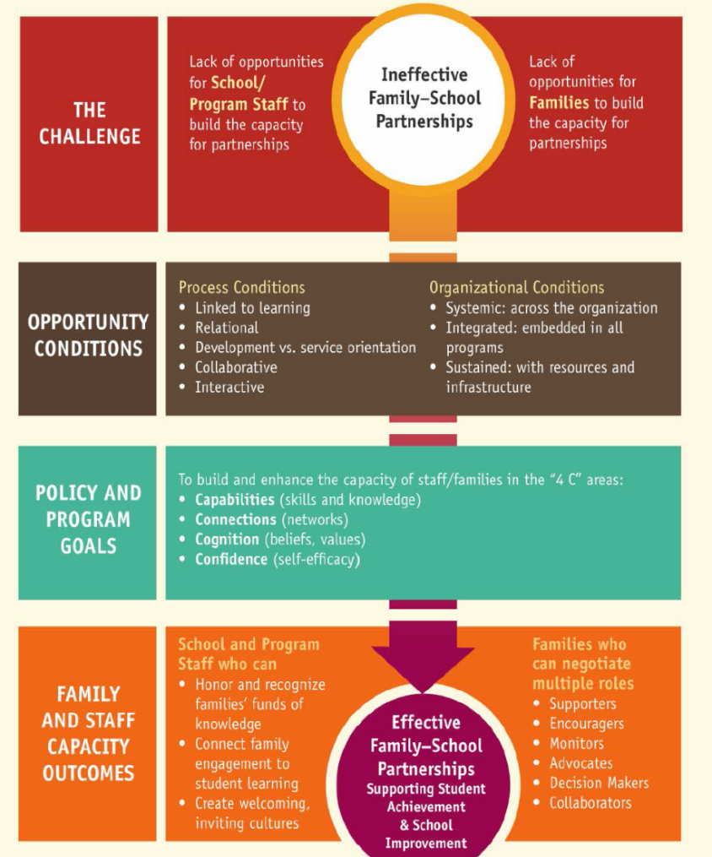
Policy Statement Purpose
Align the Frameworks with principles of effective family engagement

Slide 5
Policy Statement Purpose
Build a common language
Prioritize family engagement as an early childhood and
educational strategy.
Provide guidance to the field for implementing high-impact family engagement practices.
…have something
valuable to contribute.

Slide 6
Definition of Family Engagement
Family engagement refers to the systematic inclusion of families in activities and programs that promote children’s development, learning, and wellness, including in the planning, development, and evaluation of such activities, programs, and systems.

Slide 7
Carmen.Sanchez@ed.gov
202-245-6595
www.ed.gov/early-learning
http://www2.ed.gov/about/inits/ed/earlylearning/families.html#family-engagement-policy-statement

Slide 8
Family Engagement and Outcomes for Children and Families Josh Sparrow

Slide 9
Parent, Family, and Community Engagement (PFCE) Framework
Positive & Goal-Oriented Relationships
Family Well-being
Positive Parent-Child
Relationships
Families as Lifelong Educators
Families as Learners
Family Engagement in Transitions
Family Connections to Peers and Community
Families as Advocates and Leaders
Children are ready for school and sustain
Development and learning gains through third grade
Program Environment
Family Partnerships
Teaching and Learning
Community Partnerships
Program Leadership
Continuous Program Improvement
Professional Development
Program Foundations
Program Impact Areas
Family Outcomes
Child Outcomes

Slide 10
What is family engagement?
An interactive process: EC providers and other EC professionals, family members, and their children build positive and goal-oriented relationships.
A shared responsibility of families and professionals: mutual respect for the roles and strengths each has to offer.
At the program level: parents and providers work together toward the goals that families choose for themselves and their children.
At state-systems levels: EC leaders partner with parent leaders and programs to promote family well-being, positive parent-child relationships, and ongoing learning and development for providers and families.
EC professionals, parents and community partners work together to ensure equity, inclusiveness, and cultural and linguistic responsiveness.

Slide 11
Family Outcomes in PFCE Framework
Family Well-being
Positive Parent-Child Relationships
Families as Lifelong Educators
Families as Learners
Family Engagement in Transitions
Family Connections to Peers and Community
Families as Advocates and Leaders
PFCE Family Outcomes Research to Practice Series:
https://eclkc.ohs.acf.hhs.gov/hslc/tta-system/family/rtp-series.html

Slide 12
Family Well-being
Families are safe, healthy, have opportunities for educational advancement and economic mobility, and have access to physical and mental health services, housing and food assistance, and other family support services.

Slide 13
Positive Parent-Child Relationships
Beginning with transitions to parenthood, parents and families develop warm relationships that nurture their child’s health, development, and learning.

Slide 14
Families as Lifelong Educators
Parents and families observe, guide, promote, and participate in the everyday learning of their children at home, at school, and in their communities.

Slide 15
Families as Learners
Parents and families learn about their child’s personality, development, and learning style. They also advance their own learning interests through education, training, and other experiences that support their parenting, careers, and life goals.

Slide 16
Family Engagement in Transitions
Parents and families encourage and advocate for their child’s learning and development as they transition to new learning environments within and between EC services, early elementary grades, and beyond.

Slide 17
Parent Connections to Peers and Community
Parents and families form connections with peers, mentors, and other community members in formal or informal social networks. These social networks are supportive and educational, honor and are inclusive of families’ home language and culture, and enhance families’ social well- being and community life.

Slide 18
Families as Advocates and Leaders
Parents and families advocate for their children and play leadership roles in EC programs and systems. They participate in decision-making, policy development, and community and state organizing activities to improve children’s health, development, and learning experiences.

Slide 19
Takeaways
Family engagement promotes family and child outcomes.
PFCE family outcomes are for all families.
The two key ingredients of PFCE are:
Positive, goal-oriented relationships; and
Equity, diversity, and cultural and linguistic responsiveness.
The PFCE Framework is an organizational roadmap for implementing systemic, integrated and comprehensive PFCE engagement throughout programs.

Slide 20
Synthesis of Policies, Frameworks, and the DEC Recommended Practices Ann & Rud Turnbull

Slide 21
Facilitator prompt:
Increasing priority is being placed on family engagement within the early childhood field. As a disability policy leader, Rud, what is the ethical foundation of this policy initiative?

Slide 22
Ethical Principles
U.S. Constitution
Core Concepts of Disability Policy
Core Concepts of Disability-Related Supreme Court Decisions

Slide 23
Key Ethical Principles
Family as Foundation
Family as core unit of society
Dignity
Dignity as an ascribed status, as a ‘regarded as’ standing within a community
Community
Community as more than a place or space
Family as principal shaper & provider of physical, emotional, fiscal, & other support for children
Family as source of life-long support
Dignity as a state of being worthy, honored, & esteemed, not for what one can do (or cannot do) but simply as a person with inherent worth
Membership & belonging to a greater societal whole
Having support in community programs

Slide 24
Facilitator prompt:
Are these ethical principles reflected in the Code of Ethics of key professional organizations in the fields of early intervention and early childhood special education?

Slide 25
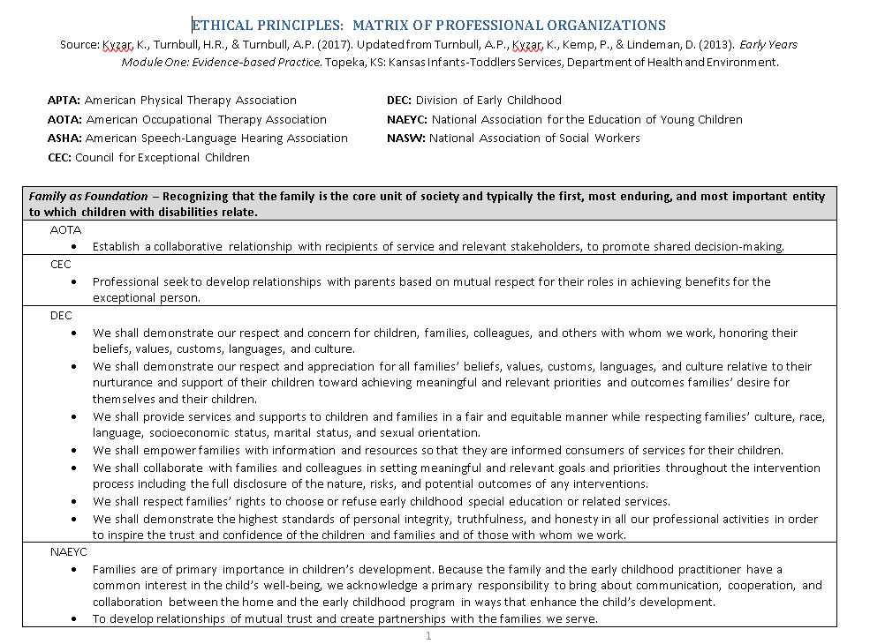
Handout—Ethical Principles: Matrix of Professional Organizations

Slide 26
Facilitator prompt:
In addition to an ethical foundation, the Individuals with Disabilities Education Act (IDEA) provides a policy foundation for family engagement. What are the relevant provisions of IDEA to which we must be attuned?

Slide 27
IDEA’s Requirements Pertaining to Family Participation/Involvement*
Principle: Family as Foundation
Purposes
Unit of focus
Individualized plans
Costs of services
Procedural safeguards
Family violence
Services
Service coordination services
Transition planning conferences
Data collection and use
*See handout: Relationship of Family as Foundation with IDEA Part C and Part B Requirements

Slide 28
Facilitator prompt:
What is the big picture behind IDEA’s requirements in terms of ultimate goals for individuals with disabilities over the full lifespan—long after early childhood services?

Slide 29
IDEA’s Preamble
Principle: Dignity
“Disability is a natural consequence of the human experience and in no way diminishes the right of individuals to participate in and contribute to society.”

Slide 30
IDEA’s Long-Term Goals
Principles: Community
Dignity
“Improving educational results for children with disabilities is an essential element of our national policy of ensuring:
Equality of opportunity
Full participation
Independent living
Economic self-sufficiency.”

Slide 31
Facilitator prompt:
With this foundation of ethical principles and IDEA goals and requirements, Ann, can you help us capture the essence of the joint Health and Human Services and Department of Education federal policy statement on family engagement?

Slide 32
HHS/ED Policy Statement on Family Engagement
“For family engagement to be integrated throughout early childhood systems and programs, providers and schools must engage families as essential partners when providing services that promote children’s learning and development, nurture positive relationships between families and staff, and support families” (p. 1).
“It is the goal of the Departments that all early childhood systems recognize and support families as essential partners in providing services that improve children’s development, learning, and wellness” (p. 2).
Notes:
ANN

Slide 33
Facilitator prompt:
How do the Council for Exceptional Children’s Division for Early Childhood (DEC) Recommended Practices align with the HHS/ED federal policy statement?

Slide 34
DEC Recommended Practices: Family Practices
F1: “Practitioners build trusting and respectful partnerships with the family through interactions that are sensitive and responsive to cultural, linguistic, and socioeconomic diversity.”
Notes:
ANN

Slide 35
DEC Recommended Practices: Family Practices (cont.)
“Family practices refer to ongoing activities that (1) promote the active participation of families in decision-making related to their child (e.g., assessment, planning, intervention); (2) lead to the development of a service plan (e.g., a set of goals for the family and child and the services and supports to achieve those goals); or (3) support families in achieving the goals they hold for their child and the other family members.”

Slide 36
Facilitator prompt:
Moving along from the DEC Recommended Practices, Ann, how do we get to the bottom line of the multiple family engagement frameworks that permeate the early childhood field?

Slide 37
Family Engagement Frameworks
Dept. of Education’s Dual Capacity-Building Framework for Family-School Partnerships
Head Start’s Parent, Family and Community Engagement Framework
Center for the Study of Social Policy’s (CSSP) Strengthening Families Approach and Protective Factors Framework
Epstein’s Framework on Parent Involvement

Slide 38
Dept. of Ed.’s Dual Capacity-Building Framework for Family-School Partnerships
“. . . Research shows that initiatives that take on a partnership orientation—in which student achievement and school improvement are seen as a shared responsibility, relationships of trust and respect are established between home and school, and families and school staff see each other as equal partners—create the conditions for family engagement to flourish.” (p.5)

Slide 39
Head Start’s Parent, Family and Community Engagement Framework
“Parent and family engagement in Head Start/Early Head Start (HS/EHS) is about building relationships with families that support family well-being, strong relationships between parents and their children, and ongoing learning and development for both parents and children. The Parent, Family, and Community Engagement (PFCE) Framework is a road map for progress in achieving the kinds of outcomes that lead to positive and enduring change for children and families” (p. 1).

Slide 40
CSSP’s Strengthening Families Approach and Protective Factors Framework
“Services should be coordinated, respectful, caring, strengths-based, and trauma-informed.” (p. 47)
In explicating principles of strengths-based practice with parents, the first is: “It is essential to forge a trusting relationship between parents and service providers” (p. 47).

Slide 41
Epstein’s Framework on Parent Involvement
“...productive connections of schools, families, and communities, and pertinent individual interactions of teachers, parents, and students are conducted in order to help students increase their academic skills, self-esteem, positive attitudes toward learning, independence, and other achievements, talents, accomplishments and other desired behaviors that are characteristic of successful students” (p. 42).

Slide 42
Facilitator prompt:
It is fascinating to note that these frameworks came from such different sources yet have such alignment on partnerships. What further detail is provided on the essence of trusting partnerships?

Slide 43
Bringing it All Together: Permeating Theme
The bottom line of family engagement is the development of a respectful and trusting partnership characterized by:
Cultural, linguistic, and socio-economic responsiveness
Strengths-based orientation
Individualization and flexibility
Alignment with family preferences/goals/aspirations
Alignment to child goals/outcomes
Equality of family and practitioner roles

Slide 44
Facilitator prompt:
We can turn to research to guide us in operationalizing partnerships. Ann, highlight for us your own research about the nature of trusting partnerships?

Slide 45
The HOW of Family Engagement: Trusting Partnerships
Communication
Respect
Professional competence
Commitment
Equality
Advocacy
Source: Turnbull, A.P., Turnbull, H.R., Erwin, E., & Soodak, L., & Shogren, K. (2015). Families, professionals, and exceptionality: Positive outcomes through partnerships and trust (7th ed.). Boston, MA: Merrill/Prentice Hall.

Slide 46
The WHAT of Family Engagement: Types of Activities
Meeting families’ basic needs
Referring and evaluating for services and supports
Individualizing in developing and providing services and supports
Extending child’s learning in home and community
Participating and volunteering with program/school
Advocating for systems improvement

Slide 47
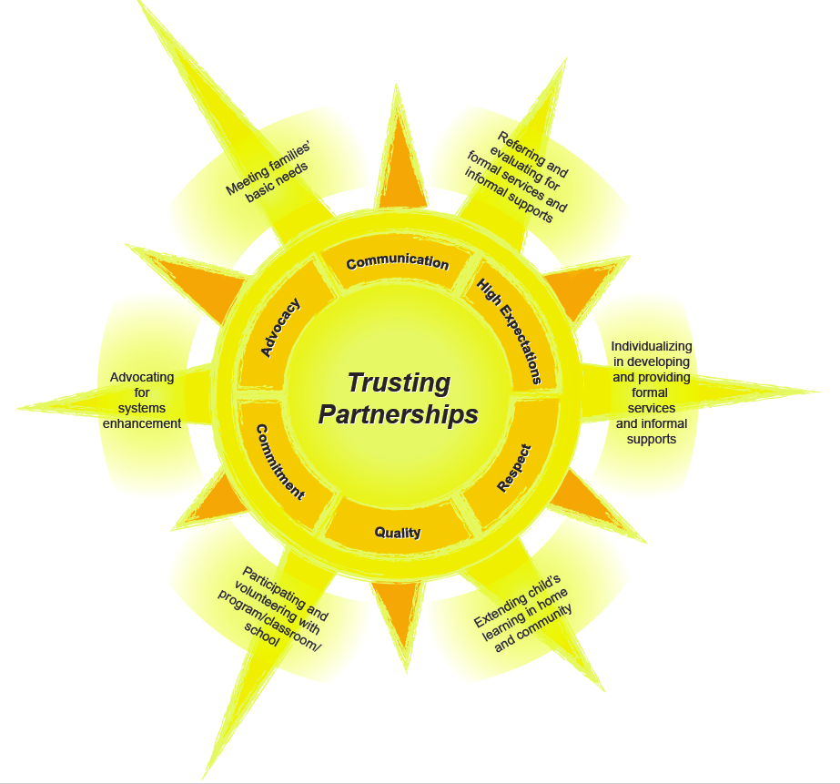

Slide 48
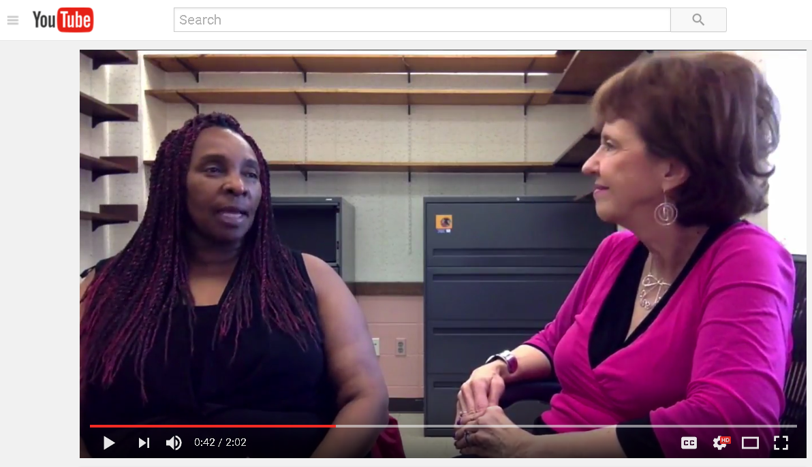
Sharilyn’s Story: Part 1

Slide 49
Facilitator prompt:
I like “seeing” the HOW of trusting partnerships, especially the potential power of partnerships. Now, please share with us a synthesis of the EI/ECSE-related partnership activities that are recommended in the various frameworks.

Slide 50
Meeting Families’ Basic Needs
Providing emotional support
Providing informational support, especially on parenting and child development
Promoting resilience
Promoting social connections
Addressing child care
Addressing health

Slide 51
Meeting Families’ Basic Needs (cont.)
Addressing safety (including child abuse and neglect)
Addressing financial subsistence
Addressing education and career planning for parents
Providing concrete support in times of need
Forging community partnerships to address needs

Slide 52
Referring and Evaluating for Services and Supports
Advocating for child, family, and teacher rights
Referring families to the state’s Parent Training and Information (PTI) Center
Coaching families in knowing and acting on child, family, and teacher rights
Implementing Child Find
Initiating and reviewing child referral
Collecting evaluation information on child
Documenting families’ resources, concerns, and priorities
Discussing evaluation results

Slide 53
Individualizing in Developing and Providing Services and Supports
Advocating for child, family, and teacher rights
Referring families to the state’s Parent Training and Information Center
Coaching families in knowing and acting on child, family, and teacher rights
Addressing the promotion of child competence across domains
Considering the effective incorporation of assistive technology

Slide 54
Individualizing in Developing and Providing Services and Supports (cont.)
Preparing for the Individualized Family Service Plan (IFSP)/Individualized Education Program (IEP) process
Conducting IFSP/IEP meeting
Finalizing IFSP/IEP document
Implementing IFSP/IEP
Planning for transitions

Slide 55
Extending Child’s Learning in Home and Community
Guiding families to teach child through everyday activities and routines
Making home visits
Advocating for preferred informational, emotional, and logistical support
Addressing behavioral challenges in home and community settings

Slide 56
Extending Child’s Learning in Home and Community (cont.)
Helping to connect children and families to neighborhood and community peers
Supporting children to be included in community recreational activities
Supporting children and families to attend community venues and events
Building community partnerships to address school, student, and family needs.

Slide 57
Families Participating and Volunteering with Program/School
Creating family friendly environments within the program
Encouraging families to attend program/community events and meetings related to child development
Guiding families in how to assist with learning as a volunteer
Guiding families in how to contribute to other program tasks
Guiding families to volunteer in community events that have school, student and family benefits

Slide 58
Families Advocating for Systems Improvement
Taking advantage of resources from Parent Training and Information Centers
Participating in advocacy and leadership training
Mentoring families and being mentored by families in advocacy activities
Informing families about program and community advocacy events and encouraging them to consider participating

Slide 59
Where do we go from here?
Today’s Webinar: March 29th (3-4 p.m. ET)
Next Webinar: April 20th (3-4 p.m. ET)
Getting to the Bottom Line of Family Engagement
Enhancing Trusting Partnerships at the Systems and Practice Levels: Reciprocal Opportunities for Professionals and Families

Slide 60
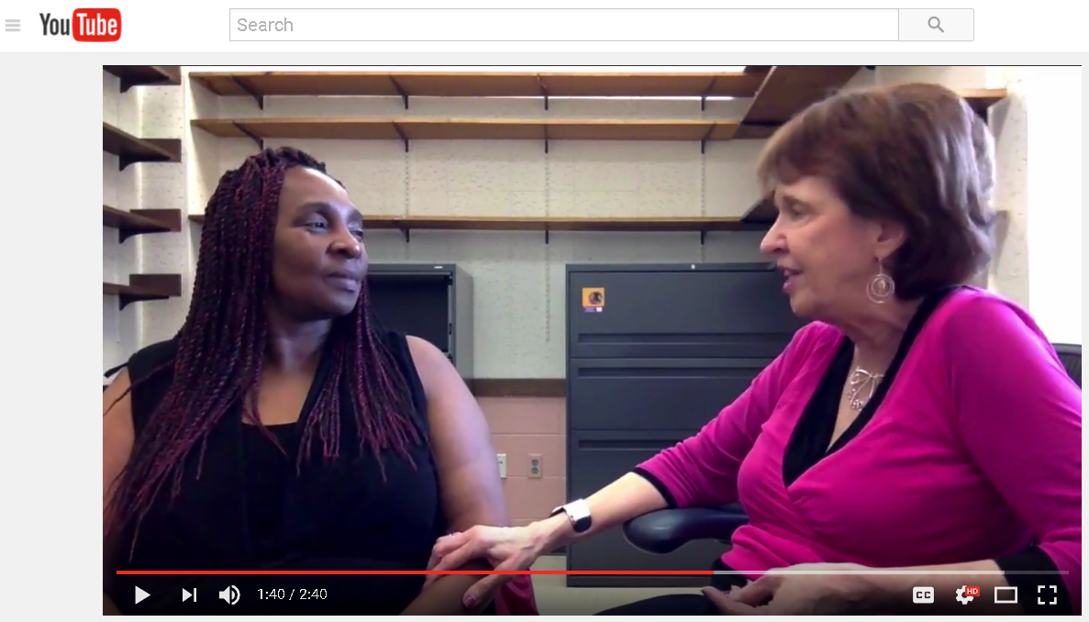
Sharilyn’s Story: Part 2

Slide 61
Systems Supports for Quality Family Engagement Practices Christina Kasprzak

Slide 62
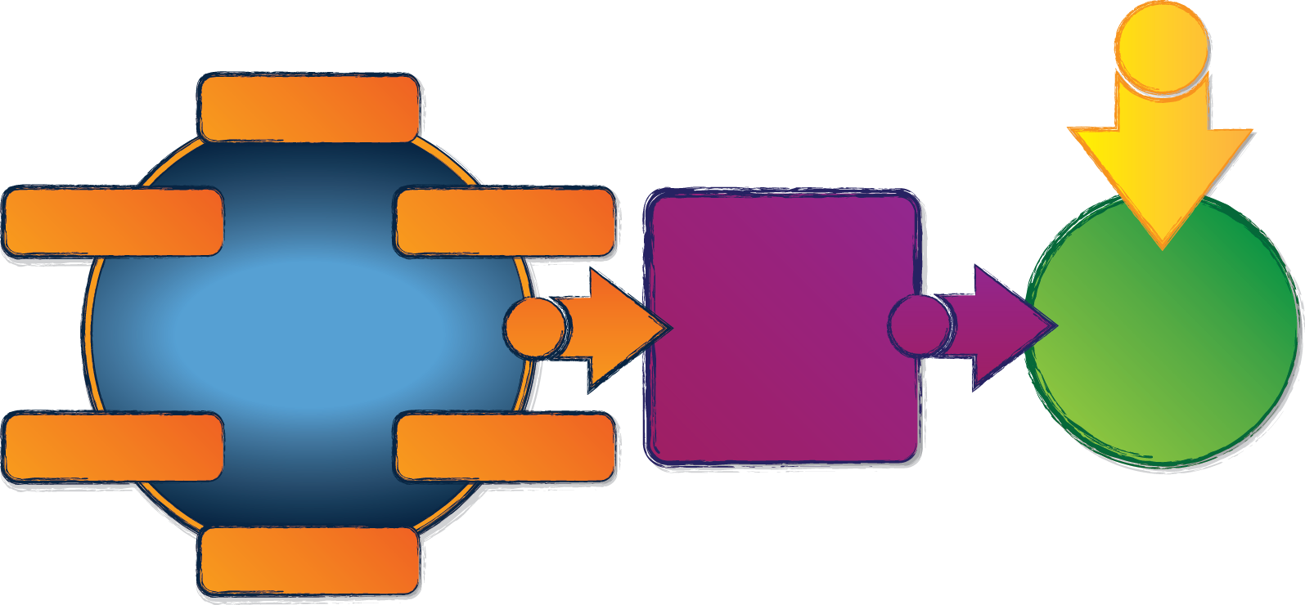
What does a state need to put into place to support implementation of effective practices?
Governance
Result
Quality
Standards
Finance
Implementation
of
Effective Practices
Good outcomes for children with disabilities and their families
Building
High-Quality
Systems
Accountability & Quality Improvement
Personnel / Workforce
Data
System
ectacenter.org/sysframe

Slide 63
Why do we need a System Framework?
Provides a common definition of a high quality system including components and elements
Aligns with and supports implementation of EBPs
Provides states with a framework for evaluating and improving their system
Through self-assessment it provides focus for program planning

Slide 64
Online Webinar Resources
http://ectacenter.org/~calls/2017/familyengagement.asp
PowerPoint
Handouts
Suggestions for Follow-up Reflection/Discussion
Resources and References

Slide 65
Register for the Next Webinar!
Enhancing Trusting Partnerships at the Systems and Practice Levels: Reciprocal Opportunities for Professionals and Families
Thurs., April 20, 2017
3-4 p.m. ET
Register at:
http://ectacenter.org/webinars.asp

Slide 66
The contents of this tool and guidance were developed under grants from the U.S. Department of Education, #H326P120002 and #H373Z120002. However, those contents do not necessarily represent the policy of the U.S. Department of Education, and you should not assume endorsement by the Federal Government. Project Officers: Meredith Miceli, Richelle Davis, and Julia Martin Eile.

