Slide 1


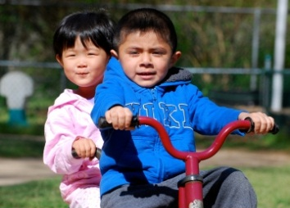

Webinar Series -
Supporting the Inclusion of Young Children with Disabilities
June 2, 2015
Session 3:
State Professional Development Strategies to
Support Inclusive Practices
Notes:
Kathy Whaley, ECTA Center and DaSy
This webinar is the third in a series of webinars planned for 2014 and 2015, jointly sponsored between ECTA and ELC-TA.

Slide 2
Webinar Presenters
  Kate Rogers, 619 Coordinator
  Vermont State Department of Education
  Janice Crow, Director
    Early Childhood Programs
    Windsor Southeast Supervisory Union
  Melissa A. Crist, Clinical Faculty
    Idaho STARS
    University of Idaho Center on Disabilities and Human Development

Slide 3
Objectives
Participants will:
Receive information on how Vermont has designed and is implementing professional development strategies for improving inclusive practices.
Receive information on state resources designed to improve personnel capacity to implement inclusive practices.

Slide 4

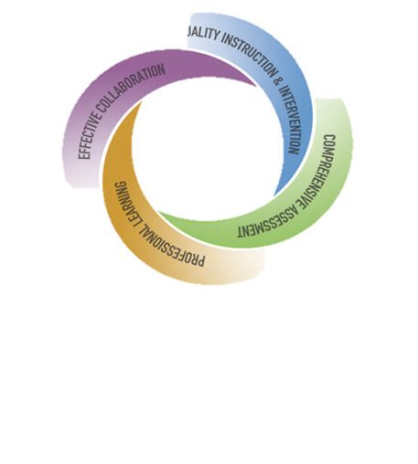
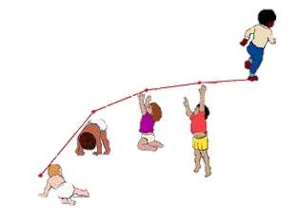

What’s is it?
What’s in it for You?
What’s in it for young children with
disabilities and their families?
Notes:
Thank you for including Jan and I in the webinar today. The VT Agency of Education has identified a multi-tiered system of support as a major component of its school improvement and effectiveness work. MTSS is a comprehensive and systematic approach for assessing and maximizing learning opportunities for all children age 3 thru 21. The focus of Early MTSS is birth to age 8. This framework supports our PD efforts to support high quality inclusive settings for young children with disabilities.

Slide 5



School Districts /LEA
Head Start
School Based
and
School Operated
Private Preschool and Childcare
Non-regulated/informal Childcare
Public PreK
Partnerships
Family
Childcare
Licensed Childcare Private and Non-profit
Home
Notes:
VT’s service delivery model varies greatly across LEAs. School districts provide spec ed and related services in school-based classrooms and school operated classrooms that may not be located within the school building. Some of these classrooms are separate classrooms but most are regular early ed settings.
Act 166 was passed in 2014 which provide public preK for all 3,4, and 5 year olds (not age eligible for K) public education for 10 hours per week for 35 weeks per year. These partnerships will allow LEAs to provide more options for children with d to participate in reg ed settings with their same age peers.
Children are also served in HS, private preschool and childcare programs, family childcare, licensed childcare as well as within their home.

Slide 6

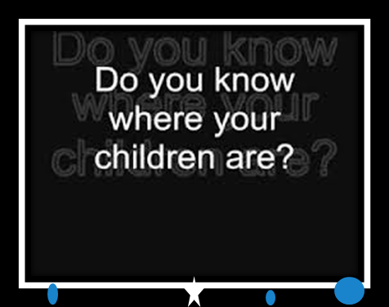
73.68%
% of children age 3,4 and 5
on IEPs who receive services
in regular ed setting
Notes:
The % of children with disabilities who participate in reg ed settings that I just highlighted in the previous slide is 73.68%. This % includes children who attend > 10 hours and < 10 hours.
This % seems wonderful doesn’t it? To

Slide 7

Early MulTi-Tiered System of Supports (MTSS) Inclusion Goals
To provide High Quality Inclusion for young Children with Disabilities
To enhance practitioner knowledge and use of EBPs & DEC Recommended Practices to support inclusion
To provide systems design to ensure program wide implementation and sustainability of EBPs
To increase LEAs capacity to offer a full continuum of educational placement options
To build a sustainable statewide system of high quality inclusive learning environments for each and every child

Slide 8

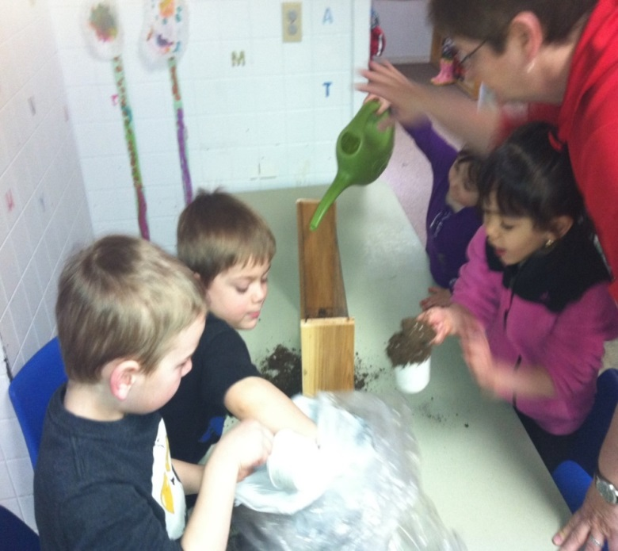
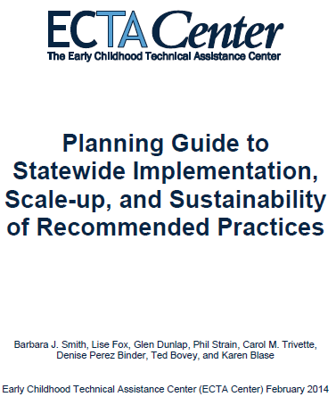


How do we really know if we are practicing high quality inclusion?
Notes:
The ICP focuses on EBPs in the classroom. Focus is on teacher/staff implementation of practices.
DEC RPs we all know and appreciate!
The scale up doc from ECTA is an excellent source to use as the framework to build capacity in states to implement and sustain RPs.
Also refer to →Fact Sheets: This collection of resources from Pyramid Plus can be used by state and local programs to raise awareness, support planning, offer strategies, and clarify IDEA data and regulatory requirements for improving and increasing inclusive practices. (posted October 22, 2014)
Fact Sheet of Research on Preschool Inclusion (2014): Dr. Erin Barton and Dr. Barbara Smith, this handout presents a list of 11 evidence-based facts that support inclusive practices in the preschool.
Brief Fact Sheet of Research on Preschool Inclusion: 1 page version of the above resource (4 pages with End Notes and References)
Inclusion for Preschool Children with Disabilities: What We Know and Should Be Doing (2014): Dr. Phil Strain
IDEA Provisions Supporting Preschool Inclusion (2014): Created by Dr. Barbara Smith, this handout briefly outlines provisions in IDEA that support inclusive practices in the preschool.

Slide 9




What is early MTSS?
Practice
Systems Building
Multi-Tiered System of Supports
Notes:
VT Early MTSS is a balanced approach. Lessons learned from previous pd efforts resulted in a huge gap in systemic support to support the practice. Early MTSS is now a two prong approach with focus on systems building and evidence based practices.

Slide 10


5 Key Components of Early MTSS
Systems Building
Strong System Support
  Functioning Leadership Team
  Staff Commitment
  Supportive Systems
Partnership & Collaboration
  Family Partnership
  Early Childhood Community Based Partners
  Transition (including K-3 transition)
Well-Designed Professional Development
  Identification of Staff need
  Provision of Professional Development Supports
  Assessment of Learning and Implementation
Provision of High Quality &
Responsive Learning Environments
  Social and Emotional Confidence and Competence
  Early Learning (Literacy) Confidence and Competence
  Early Learning (Numeracy) Confidence and Competence
Comprehensive & Functional
Assessment system
  Effective Problem Solving Process
  Data-Based Decision Making
  Promotes Ongoing Improvement
Notes:
As stated before, Early MTSS aligns with VT’s school age MTSS. The following 5 components of our Early MTSS framework has been adopted and adapted from our school age MTSS guidance document/work. The benchmark of qualities was also a primary document ‘Data Decision-Making and Program-Wide Implementation of the Pyramid Model Lise Fox, Myrna Veguilla,
and Denise Perez Binder
March, 2014 was adopted and adapted by VT to inform the design of our system.

Slide 11


Systems Inventory
Used by programs to assess progress so that Early MTSS initiatives are implemented with fidelity, sustainable and benefit children and families
Grounded in the science of implementation
Bridges gap between evidence based practices (EBP) and high fidelity implementation of practice
Goal Setting Tool for Professional Development
Notes:
The Early MTSS Systems Inventory was developed to support cohort site leadership teams build capacity to support implementation of EBPs in their programs. The inventory is sectioned by the 5 key components and critical elements are fleshed out to reveal program strengths and areas for improvement. This document includes a rating system and goal setting and action plan. The connect module 5 step Learning Cycle has been embedded into this process and is being utilized as a tool for teams to assist in EBP decision making.

Slide 12
Early MTSS Systems Inventory
Critical Element:
Well Designed Professional Development
Notes:
Critical Element: Well Designed Professional Development section of the Early MTSS Systems Inventory
Identification of Staff Need
Provision of Systemic Supports
Assessment of PD learning and implementation of practices learned

Slide 13
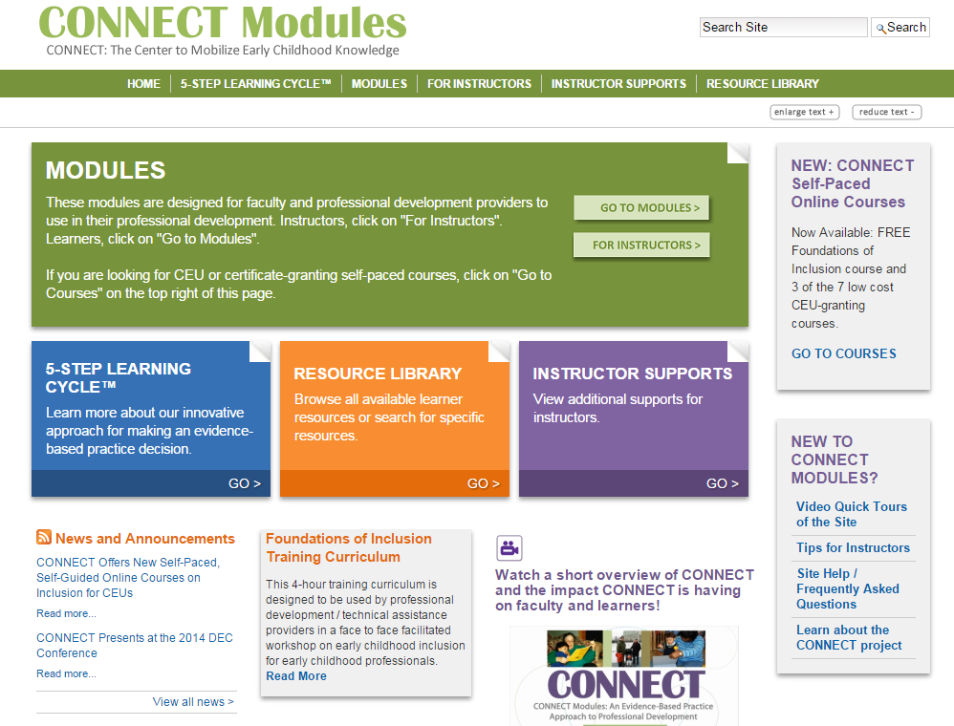
Early MTSS Goal Setting Tool includes
5 Step Learning
Cycle
http://community.fpg.unc.edu/
http://community.fpg.unc.edu/connect-modules/instructor-community/module-1/Training-Module-on-Early-Childhood-Inclusion

Slide 14


Vermont Multi-Tiered System of Supports
Early MTSS and K-12 MTSS Comparison
Notes:
This is a draft comparison btwn Vermont’s Early MTSS and K-12 MTSS framework that reflects the 5 key MTSS components and critical elements.

Slide 15

STATE Team
AOE/
RTT-ELC
Feedback Loops
Providing feedback and data on implementation
REGIONAL
Early Childhood Council
SU and /or
Local
Early Childhood Program
Leadership Team
Early Childhood
Classroom, Teachers,
Home- Visitors,
Children and
Families
Support Loops
Providing supports for effective
practices implemented with fidelity.

Slide 16





State
  Early MTSS Co-coordinators
  Cadre of Trainers, Coaches
  Contract with nat’l experts
  Data Analysis and Continuous Improvement
Feedback Loops
Providing feedback and data on implementation
Regional
BBF Council
Designates member as internal systems coach
Develops Regional Systems Inventory
Program
Leadership Team
Designates Internal coach
Receive Training
Receives external coach
Early MTSS Systems Inventory
Classroom
All staff receive training on EBPs
Coach supports practice
Coach conducts pre and post via TPOT & ICP
Support Loops
Providing supports for effective
practices implemented with fidelity.
Notes:
Did I mention that I love this!!!

Slide 17
Leadership Team
Administrator, teaching staff, parent, special educator
External Systems Coach
Practice-based
Coach
State Cadre of Practice Coaches receive intensive and ongoing training in Practice Based Coaching training and community of practice support
Cohort Site
All staff and admin (ownership)
Evaluation
Fidelity Measures
Program wide Systems Inventory
Internal coaches
TPOT
ICP
Supports completion of systems inventory
State Cadre of Systems Coaches receive intensive and ongoing training
Collects, analyzes and reports pre/post data
Supports development and follow through of systems implementation plan
Strategies to include families
Materials and resources to share with families
Supports teaching staff EBPs
Supports implementation of Pyramid Model EBP and ICP action plan
SSIS
Early MTSS Agreement *
Ensures sustainability of practice
Receive train-coach-train PD
Dialogue with admin and staff to develop action plan
Building family partnerships
Completes TPOT and Inclusive Classroom Profile as pre and post data
Notes:
Early MTSS INCLUSION PD Components
Cohort sites establish leadership team-systems inventory and goal setting tool is completed
Cohort sites receive a designated systems coach. Coach supports LT completion of inventory tool to identify strengths and areas for improvement
Cohort sites identify ‘internal’ systems coach to train with state level systems coach in order to build capacity and sustainability
Practice coach is designated per cohort site. PC supports classroom staff on identifying strengths and areas for improvement. PBC conducts observations of classroom practices on inclusion. The Inclusive Classroom Profile and Teaching Pyramid Observation tool is used for pre/post and on-going data collection on practice implementation.
All cohort site staff receive training on Pyramid Model practices and other EBPs to support knowledge and increase use of EBPs in classroom.
Training includes focus on family partnership and resources.
Evaluation is 3 pronged:
Building Systems-Systems Inventory (includes family partnerships)
Teacher Practice- TPOT, ICP, beginning to use CLASS
Child Progress Data- SSIS, IEP

Slide 18


“For every increment of performance I demand from you, I have an equal responsibility to provide you with the
capacity to meet that expectation.”
Elmore, 2002
Notes:
Some changes in early

Slide 19
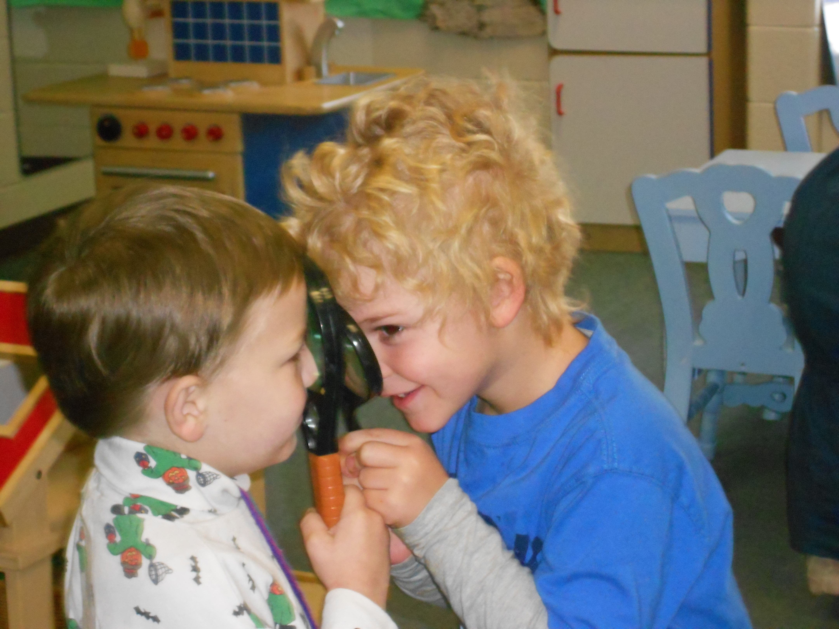
WHAT DOES HIGH QUALITY INCLUSION IN PRE-K LOOK LIKE AND HOW DO WE GET THERE ?
Notes:
The Windsor Southeast SU (WSESU) is comprised of 4 separate rural school districts in Vermont. The WSESU Early Childhood Program provides inclusive Pre-K for children ages 3-5 in one of the elementary schools and in community based settings such as Head Start, Child Care Programs or private preschools.
Special Educators and related service providers are part of the Early Childhood Team and provide support for children on IEP’s in all settings. Building a cohesive multidisciplinary Early Childhood Team has been on ongoing goal and for several years the WSESU Early Childhood staff has been asking questions around key factors for providing high quality inclusion and how to bring impact a larger system change within the Supervisory Union to support and sustain inclusive practices.
Using the NECTAC Quality Indicators of Inclusive Programs (Nylander, 2009) The WSESU Early Childhood Program has many of the pieces in place, but not all, especially in the areas of System Support, Professional Development, and Data based Decision making.

Slide 20

All children have access to high quality early learning environments and all providers support all children.
Service Providers, classroom teachers and support staff plan intentional interventions. Instruction is embedded in daily routines and the curriculum.
IEP services are provided
In classrooms. Service providers
are itinerant.
Children receive IEP services outside of their Preschool classroom. (hallway, therapy room, etc.)
Notes:
Creating high quality learning environments for all children and Implementing high quality inclusive practices is a journey and ours began over a decade ago. We started with children “attending” Pre-K but receiving most of their IEP services outside of the classroom with occasional in-class instruction and supports or consultation to the classroom teacher. Over the past several years we have been implementing practices to provide explicit and coordinated embedded instruction in every day routines and learning experiences for all children. But it hasn’t always been that way and we know we can and need to do more to include families in meaningful ways.
The next slide is an example of the shift in practice from in classroom IEP services provided in a quiet or separate of the classroom to embedded instruction within naturally occurring routines and learning activities.

Slide 21
Elements of quality inclusive teaching practices
All adults work collaboratively as a team.
All staff uses positive classroom management strategies.
All staff facilitate and support the development of social-emotional skills and encourages interactions among all children
Family involvement is encouraged in the classroom and at home.
Notes:
NECTAC’s “Quality Indicators of Inclusive Early Childhood Programs/Practices,” (September 2010) includes a variety of resources for defining and measuring indicators of quality in inclusive settings including one from The Florida Technical Assistance and Training System (TATS) eUpdates which identified the most important areas of a quality classroom: Physical environment, Curriculum, and Teaching Practices. In the area of Teaching Practices 4 elements were identified. Within each of these 4 elements are potential areas for Professional Development: Multi-disciplinary Team building, collaboration, Family engagement, Positive behavior supports.

Slide 22
Examples of Professional Development
Teaching Strategies Gold
Building Blocks for Early Literacy
CSEFEL Training Modules 1-3
7 Norms of Collaboration
Cara’s Kit
Theory of Mind/Social Stories
Eureka Math Pre-K
ASQ Screening
Each & Every Child
New Possibilities Conference
Notes:
These are some of the trainings some staff have attended in the past year. Other than annual Teacher generated Professional Development Goals, there is no cohesive or aligned plan to identify or prioritize the kind of training or content for Professional Development or way to measure the impact on teaching practices or child outcomes.

Slide 23
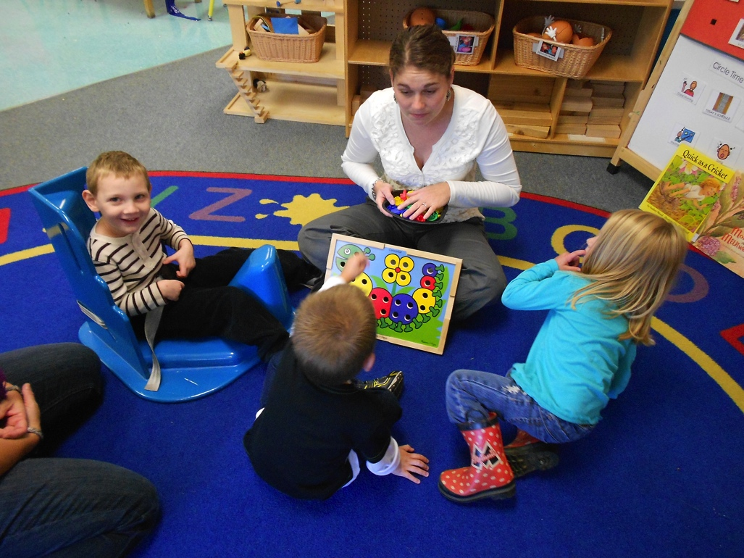
Notes:
In addition to the Quality Indicators, DEC/NAEYC published a Joint Position statement on inclusion that identified The defining features of inclusion to be access, participation, and supports. Supports are broadly defined as aspects of the system such as professional development, incentives for inclusion, and opportunities for communication and collaboration among families and professionals to assure high quality inclusion. The WSESU Early Childhood Program provides access and participation but there is no framework or system in place at the SU level to explicitly support and assure high quality inclusion. Current SU/District PD opportunities focus on curriculum and instructional practices for PK-12. As an Early MTSS site, we will have access to both onsite and state level training that will be support through the Administration.

Slide 24
Why Participate in Early MTSS?
We want to build a framework that supports system-wide change and is sustainable.
We believe we provide high quality inclusive learning opportunities for all children, but . . .
We need a Leadership Team that includes parent representation, to support and sustain a high quality program.

Slide 25
Why Participate in Early MTSS?
We need a well articulated implementation plan that is grounded in evidence based practices.
We want to insure Professional Development is ongoing, explicitly supports inclusion and is aligned with best practices.
We want to measure and assess growth, at all levels, over time.
Notes:
We currently monitor and measure individual and aggregate child progress and the classroom environment is assessed using the CLASS. In the fall the Inclusive Classroom Profile will be added. Using this information will help inform our plan for Professional Development.

Slide 26
VT Early MTSS Program Inventory:
Well Designed Professional Development
Training needs are determined based on knowledge, skills and competence in implementing Evidence based practices that support High Quality and Responsive Learning Environments.
All staff are supported in data based decision making.
Notes:
VT Early MTSS The Process- We are in the beginning stages of building our Action Plan. We have verbal commitment and a signed Early MTSS Pilot Site Agreement from the Supervisory Union Leadership Team which consists of the Superintendent, Director of Curriculum, Director of Student Support Services, Principals and the Director of the Early Childhood Program.
The Early Childhood Director has received training in Practice Based Coaching, The Inclusive Classroom Profile, and is a trainer for the CSEFEL modules.
Next steps will be to identify and build the Leadership Team and develop an Action Plan based on the Program Inventory, The Inventory of Practices for Promoting Social Emotional Competence, Environment, Child and staff data. The Action Plan and inventories will help identify priorities for Professional Development and ensure we are building a shared knowledge and skill base across all staff to improve the use of evidence based practice. Using data we will have evidence of measurable positive outcomes for staff and most importantly for all children.

Slide 27
“Programs not children have to be ready for inclusion . . .the most successful programs view inclusion as the starting point for all children.”
Ilene Swartz, Samuel E. Odom, Susan R. Sandall,

Slide 28
High Quality Inclusion is a Journey
and
a Destination

Slide 29

Questions for Janice or Kate?

Slide 30
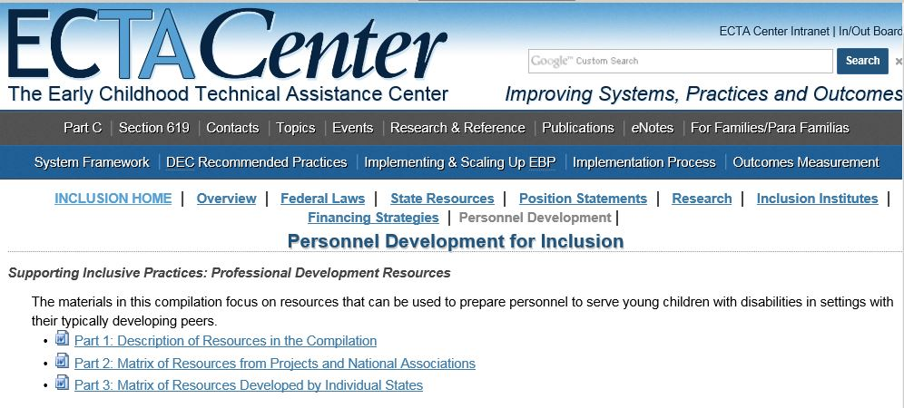
Personnel Development for Inclusion
http://ectacenter.org/topics/inclusion/personnel/personnel.asp

Slide 31
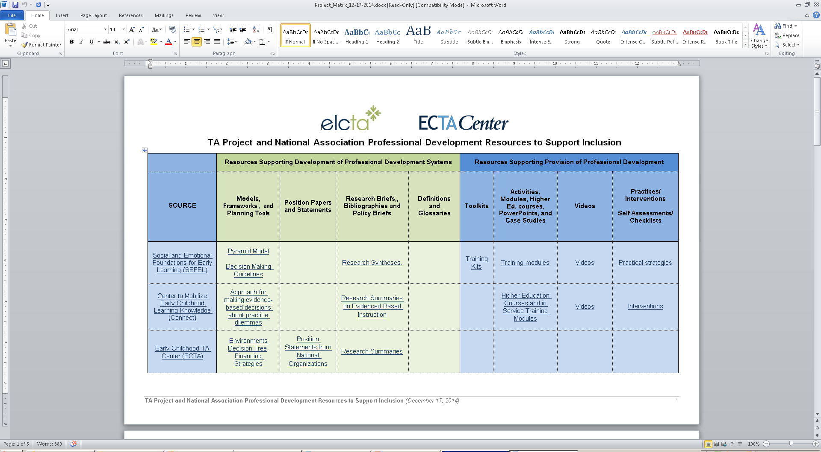
TA Projects and National Organizations

Slide 32

Specialized Initiatives and Projects
Toolkits
Activities/Modules/Webinars & Podcasts
Videos
Communities of Practice & Peer to Peer Networking
Coaching/Mentoring & Site-based Consultation Strategies
Self-assessments & Checklists
Incentives
Specialized Certification, Endorsements & Competencies

Slide 33
A Web Tour: Looking at the Idaho Stars Professional Development Resources

Slide 34
Questions for Melissa?

Slide 35
Have you come up with one new idea from today’s call that you would like to explore further?
If so, what is it?
Notes:
Megan
Either share on the line (press *6 to unmute) or via the chat.
Q: Do you have strategies you use in your state? List in chat.

Slide 36


Thank you for joining us!
Resources related to this webinar and other presentations are available at the following URL:
http://ectacenter.org/webinars.asp
Notes:
Megan
Resources related to this webinar and other presentations are available at the following URL: http://ectacenter.org/webinars.asp

