Slide 1
Integrating Learn the Signs. Act Early. in an Aligned System for Screening and Assessment
Gail Chodron, MA, PhD (expected Dec 2014)
CDC’s Act Early Ambassador to Wisconsin
Waisman Center UCEDD, UW-Madison
Notes:
Thank you so much for inviting me to share our Wisconsin experiences of using “Learn the Signs. Act Early.” in our early childhood cross-sector and Child Find work.
My name is Gail Chodron, and I’m the CDC’s Act Early Ambassador to Wisconsin, and I’ll be reporting today on the behalf of our team, which really includes a number of people, most of whom have been doing this work for many dedicated years. So I hope that I can do an adequate job of representing our collective work, which is obviously quite diverse. I’m a parent of a young boy who had some significant delays that were not caught early because he wasn’t screened, so I’m pretty passionate about this work. I work at our state UCEDD, or University Center of Excellence on Developmental Disabilities, at the Waisman Center.

Slide 2
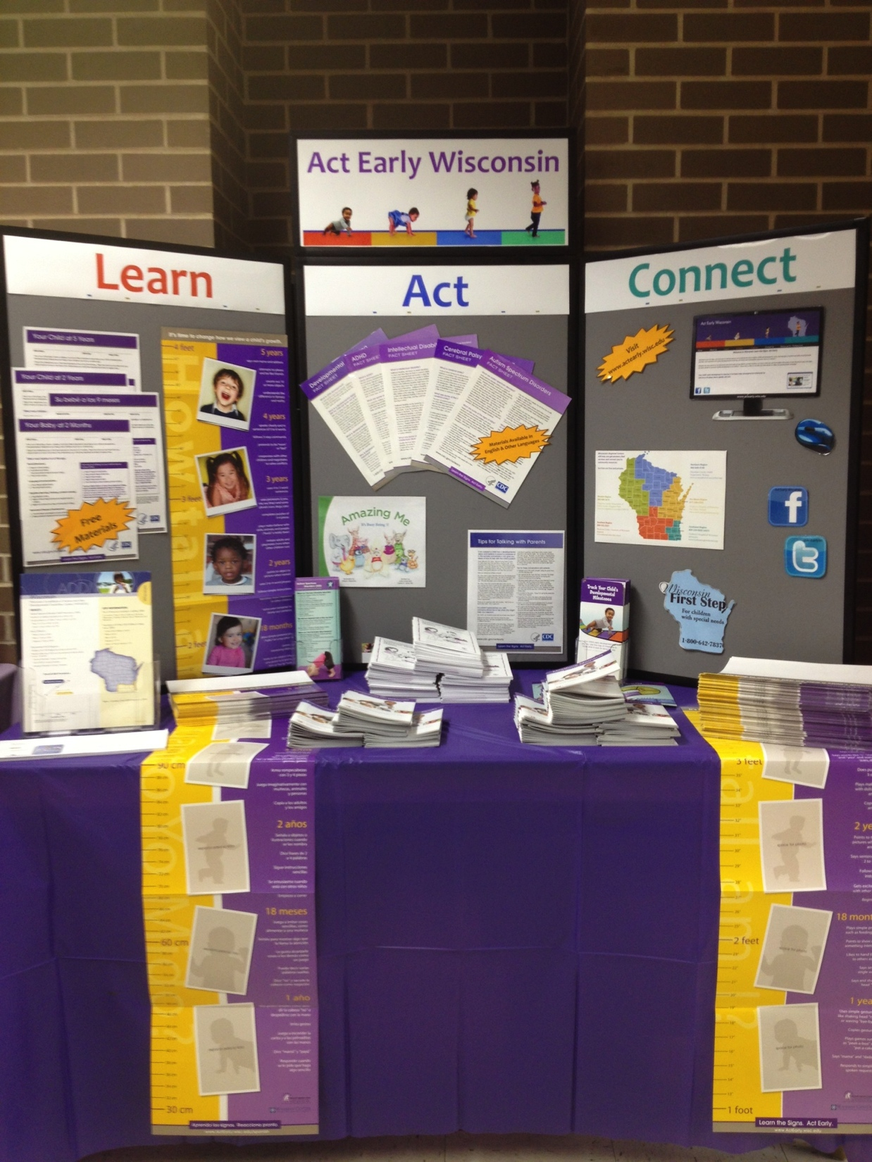
Focus of Presentation
Three factors leading to meaningful and successful integration of Learn the Signs. Act Early.
Foundation of aligned messaging
Focus on integration and sustainability
Customization and localization of materials
Notes:
The focus of this part of the presentation is on integrating “Learn the Signs. Act Early.” messaging and materials into a coordinated, cross-sector system for developmental monitoring, screening, and referral.
I’d like to focus on three key aspects of this work that our team thought were really important to making integration of “Learn the Signs. Act Early.” meaningful and successful in our state:
Aligned messaging,
Integrated and sustainable use of materials, and
Customization and localization of materials

Slide 3
Context
Wisconsin Early Childhood Collaborating Partners
Notes:
Before I tell you about these three aspects, I’d like to tell you a little bit about our cross-sector work, so you have a context for the rest of what I’m going to say. Our cross-sector developmental monitoring and screening efforts are coordinated through our Healthy Children Committee, which is part of the Wisconsin Early Childhood Collaborating Partners. The Healthy Children Committee includes representatives from the Department of Public Instruction, Part C Early Intervention, Part B Childhood Special Education, Head Start, Maternal and Child Health and the Children and Youth with Special Health Care Needs Program, Department of Children and Families, home visiting, the Wisconsin Chapter of the American Academy of Pediatrics, and other programs.

Slide 4
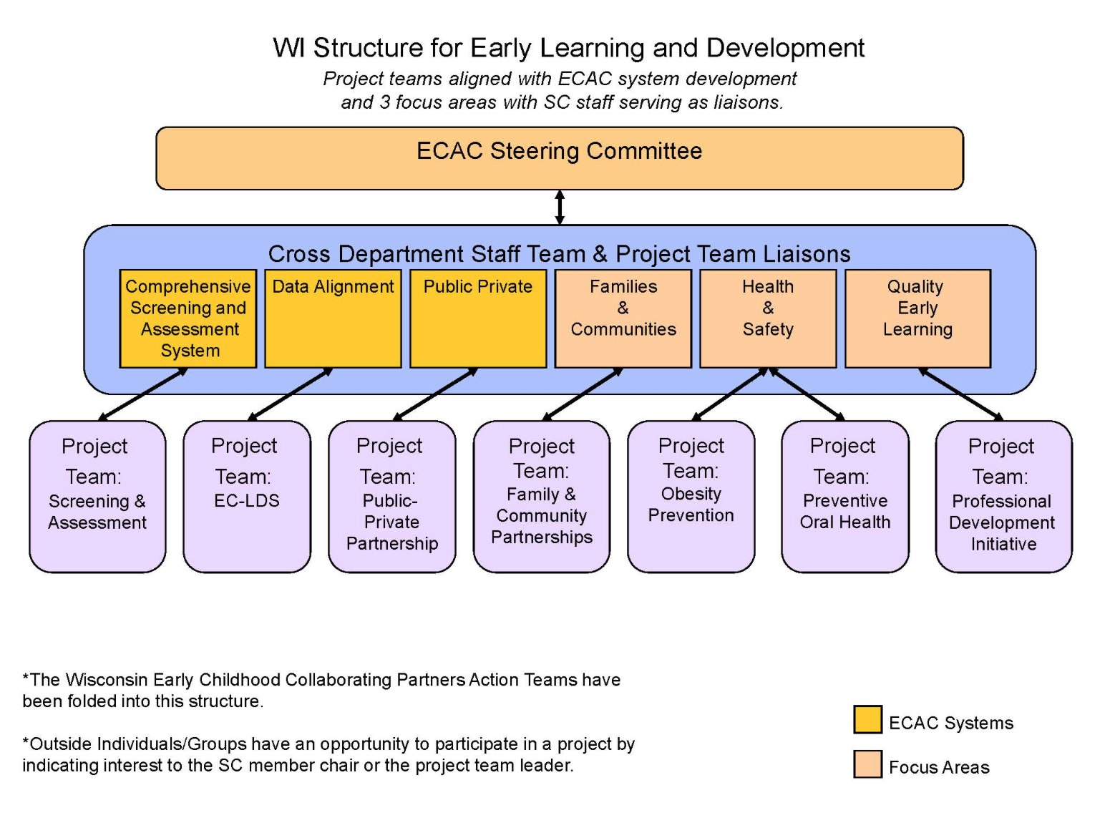
Context
Screening and Assessment Practice Group of Governor’s Early Childhood Advisory Council
Notes:
Early in 2011, this committee was also designated to serve as the “Screening and Assessment Practice Group” for the new Governor’s Early Childhood Advisory Council. There are also Practice Groups on Professional Development, Family and Community partnership, and other topics. So our role is really specific to screening and assessment.

Slide 5
Blueprint 2012
Notes:
In recent years, the primary goal of this committee has been to build and implement a comprehensive and aligned system for screening and assessment of young children. In 2012, we released our first State Blueprint outlining the characteristics of such a system. This Blueprint is available online, and I the website link will be posted on the Early Childhood Technical Assistance website. We are currently finalizing updates to a new, 2014 release.

Slide 6
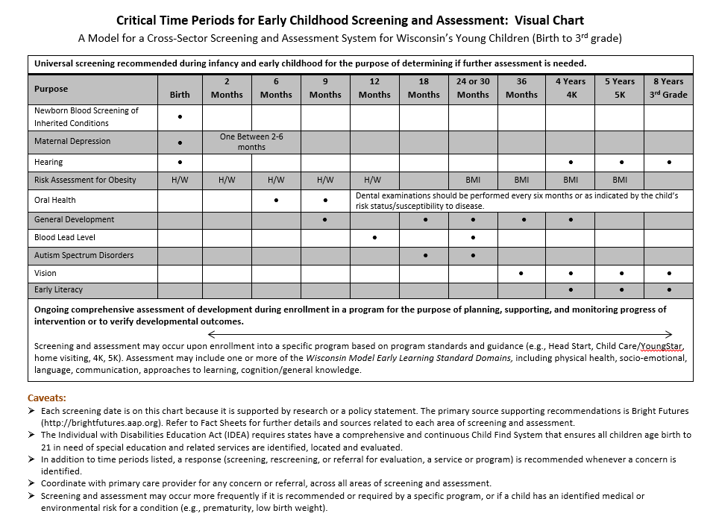
Critical Time Periods
Notes:
The image on this slide is from the updated 2014 version. The table you see is the Critical Time Periods Chart that we developed. It integrates recommendations for Critical Time Periods for screening and assessment across multiple areas. So this shows you the range of areas of screening and assessment that we focus on. The purpose of the Blueprint is to communicate screening and assessment guidance to professionals across health care, early childhood, home visiting, child welfare and all the programs that are working with young children and their families.

Slide 7
Blueprint 2012
Notes:
In addition to working on guidance for a comprehensive and aligned cross-sector system for screening and assessment, we’ve worked a good bit on training and outreach. On this slide you can see some of the professional and community resources that our team has developed over the past several years, which are available on the Early Childhood Collaborating Partners website.

Slide 8
Three factors for success
Foundation of aligned messaging
Focus on integration and sustainability
Customization and localization of materials
Notes:
Now that I’ve given you a little bit of background and context, I’d like to talk about three aspects of how we’ve integrated “Learn the Signs. Act Early.” into our work. I think there are helpful takeaways from each of these three points, whether you yourself are involved in building the cross-sector systems in a leadership capacity, or you are primarily working within one or two programs.
The three aspects I’m going to talk about are how we approached
Aligned messaging,
Integrated and sustainable use of materials, and
Customization and localization of materials

Slide 9
Three factors for success
Foundation of aligned messaging
Tracking Milestones = Developmental monitoring → Development Screening → Developmental Assessment
Developmental Monitoring = Surveillance → Developmental Screening → Diagnostic Assessment
? ? ? ? ?
Notes:
First, aligned messaging. As Camille pointed out, “Learn the Signs. Act Early.” is about developmental monitoring. This is a step that families can be involved in as they track how their children are developing. It’s a step that can come before developmental screening, and it can also continue after and between screenings. But the other day I was talking to one of our team members, who is a physician, about developmental monitoring, and she pointed out that to a physician “developmental monitoring” means the entire, ongoing process of surveillance, screening and follow up. When we refer to “developmental monitoring” in “Learn the Signs. Act Early.”, what we are referring to is actually equivalent to what physicians refer to as “surveillance.” A cross-sector group of early childhood professionals is going to have different terms for similar activities. This is true for the terms screening and assessment, as well.

Slide 10
Three factors for success
Foundation of aligned messaging
Clear cross-sector understanding to share with leadership and staff
Clear distinction made between developmental monitoring and developmental screening
Clear and consistent messaging to share with families and community members
Notes:
So, the first aspect that allowed us to integrate “Learn the Signs. Act Early.” into our cross-sector system was aligned messaging. In order to write the 2012 Blueprint as well as develop materials for the community, we had to be able to agree on common language to use in it. In order to agree on language, we needed to work together to develop that common language and consistent messaging. Once we had this shared understanding, we could work to select common tools to use.
We worked for a long time on aligning our language in about 2011. If you are interested in seeing the messaging we chose, you can take a look at the Blueprint. Aligning our messaging helped us integrate “Learn the Signs. Act Early.” in several ways.
First, it helped everyone clearly understand where these materials fit into the process of monitoring and screening. This helped us work with programs to identify ways to use the materials in their processes.
Second, it gave us the language we needed to clearly distinguish the function of developmental monitoring or surveillance from screening with a validated screening tool when we were sharing these materials with professionals. This helped us provide a clear message that this is not a screening tool, for instance. One of the earliest, big hurdles I personally encountered in using the campaign was that people thought it was a screening tool, or thought their staff would think so. In addition, they wondered how to use it if their program was already using doing developmental screening. So developing this shared understanding was important for all of us.
Third, it also gave us the language we needed to talk to parents clearly and accurately.

Slide 11
Three factors for success
Focus on integration and sustainability
Sustainable, affordable supply of materials
Group purchase through fiscal agent
Targeted, intentional program integration
Prenatal care coordination
Home visiting (MIECHV)
Training integration
To enable practice integration
Notes:
So that is the first aspect. The second of the three aspects I want to share is integration and sustainability. I can’t imagine that there is anyone listening to this webinar today who doesn’t realize how hard everyone works in the early childhood and pediatric fields. It has been really important to us to accomplish something worthwhile by using these materials, but also to make certain it fit into our programs well, and was sustainable without constantly jumping through hoops. So we did several things to accomplish integration and sustainability.
One thing that was important for sustainability was finding a way to get the supply of materials we needed. From what I’ve heard, it sounds like Act Early Ambassadors and Act Early State Teams in different states are finding various ways to do this. I will share what we did, but it might not work in your state. The basic point, though, is to find a way to secure the materials you need before you work too hard to integrate their use into a program. In Wisconsin, our UCEDD serves as the fiscal agent to print Milestone Moments booklets, growth charts, and brochures. Community partners who have any funding for parent education materials chip in what they can, and we make a group purchase. This reduces our costs significantly, so we can purchase tens of thousands of materials per year. We are on our third large scale printing, I think.
Next, we have really focused on integration into one or two programs at a time. This sounds slow, but it has actually led to rapid widespread outreach for us. Others have had success with starting at the grassroots, but this systems approach has worked for us in Wisconsin. In addition, the first programs we targeted were chosen because statewide integration could be accomplished readily. We chose prenatal care coordination and the Maternal Infant and Early Childhood Home Visiting (MIECHV) programs. Each program had one statewide coordinator who was on board to integrate “Learn the Signs. Act Early.” Home visiting reaches between 1 to 2 thousand families per year, and could add “Learn the Signs. Act Early.” into programs’ contracts, so all programs use the materials as a research-based tool in their evidence-based home visiting programs. Prenatal care coordination reaches about 10,000 families a year, and offered the campaign materials to providers to use with their families if they wanted to.
Finally, when we were working on integrating into home visiting and prenatal care coordination, we also developed curriculum to integrate into all of the major training programs used by home visitors and other early childhood professionals in our state. For each of these, our trainers, Pence Revington and Kate Gillespie, were able to explain when and how to talk to parents about child development, and how to use the materials to support this conversation. They really did a wonderful job on this, and if anyone is interested in learning more, we’re really very happy to share whatever we use here.

Slide 12
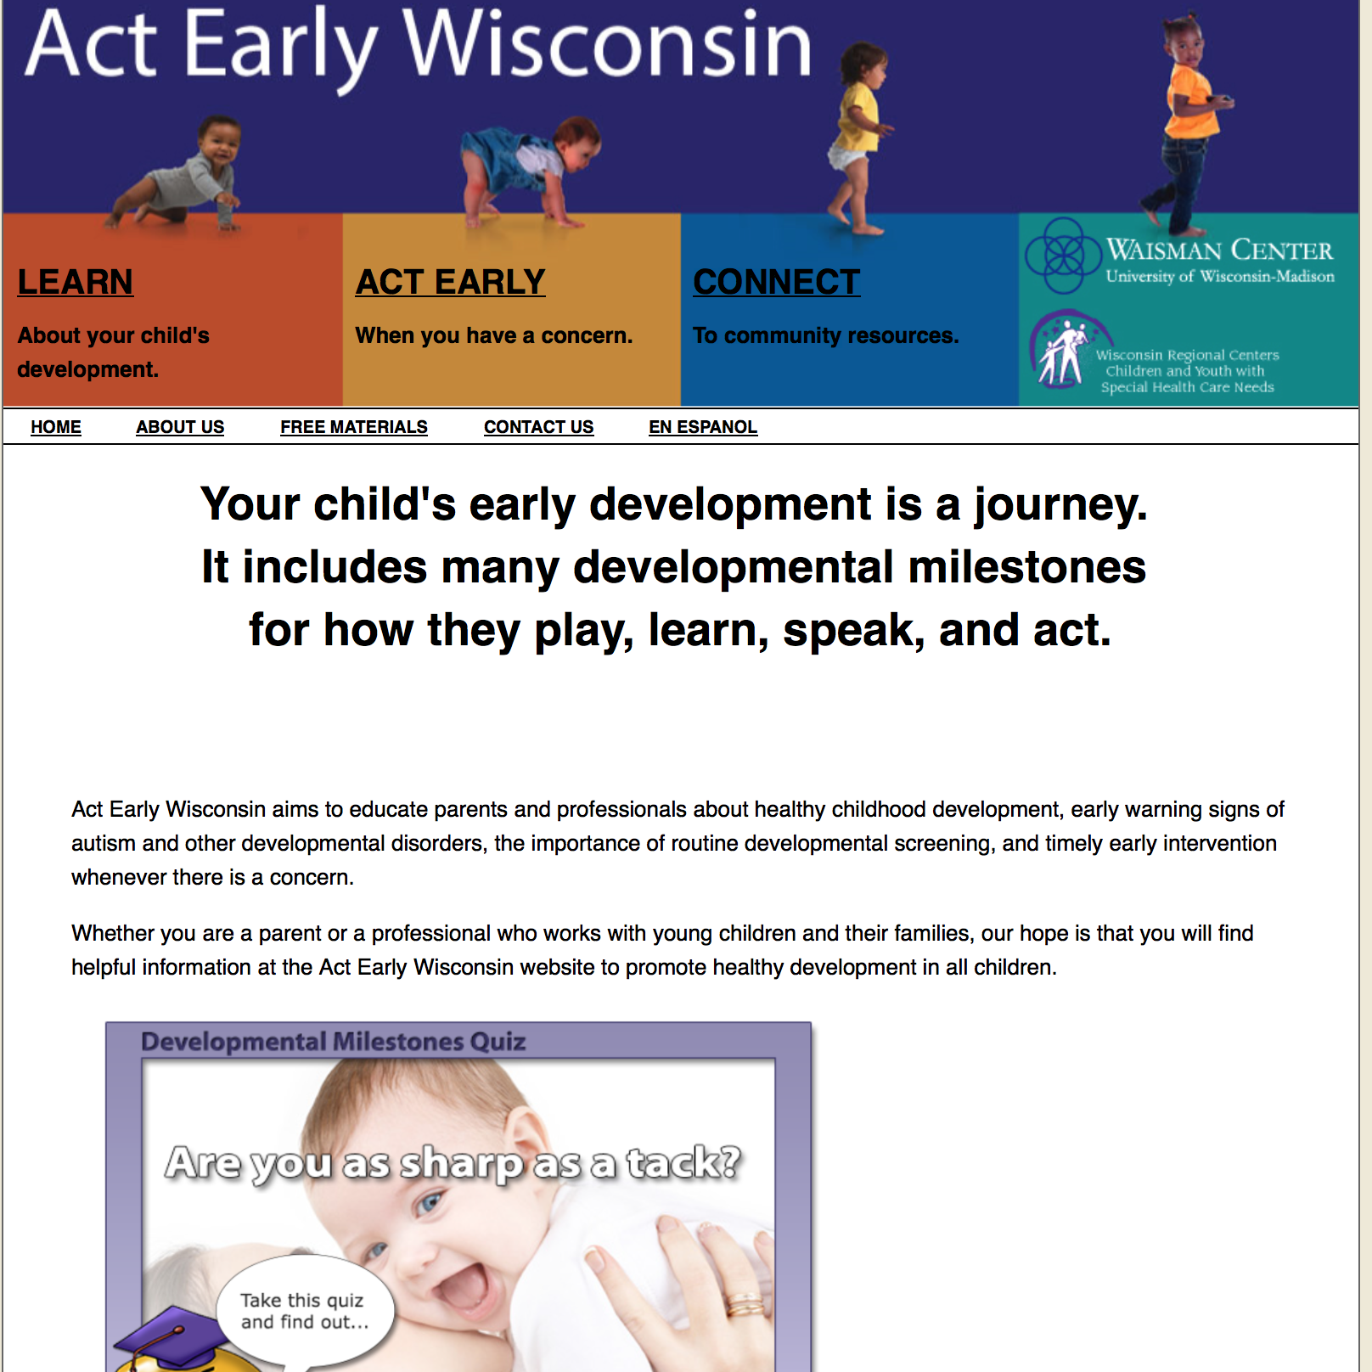
Three factors for success
Customization and localization
Local: Feels like it belongs to us
Website, branding
Notes:
So a focus on integration and sustainability was the second aspect of what supported our success. The third and final aspect is customized and localized use of materials.
I think many of our program partners preferred feeling like the materials belong to Wisconsin, so it was good to customize with our own logos and website. This slide shows our website, which we link to from our Collaborating Partners site and other sites as well.

Slide 13
Three factors for success
Customization and localization
Contact info: For Wisconsin resources
Phone number, website
Notes:
And of course, customizing gave us an opportunity to list our own phone number and website, which means that when parents read this booklet and do have a question or concern, they are being directed to their own community resources. I know as a parent I’m not going to call the CDC directly if I have a concern! So this felt right to me, as a parent, too. You’ll notice on the inside pages of our Milestone Moments booklets we replaced the CDC website and phone number with our Act Early Wisconsin website and the one phone number that links to our state resource system.

Slide 14
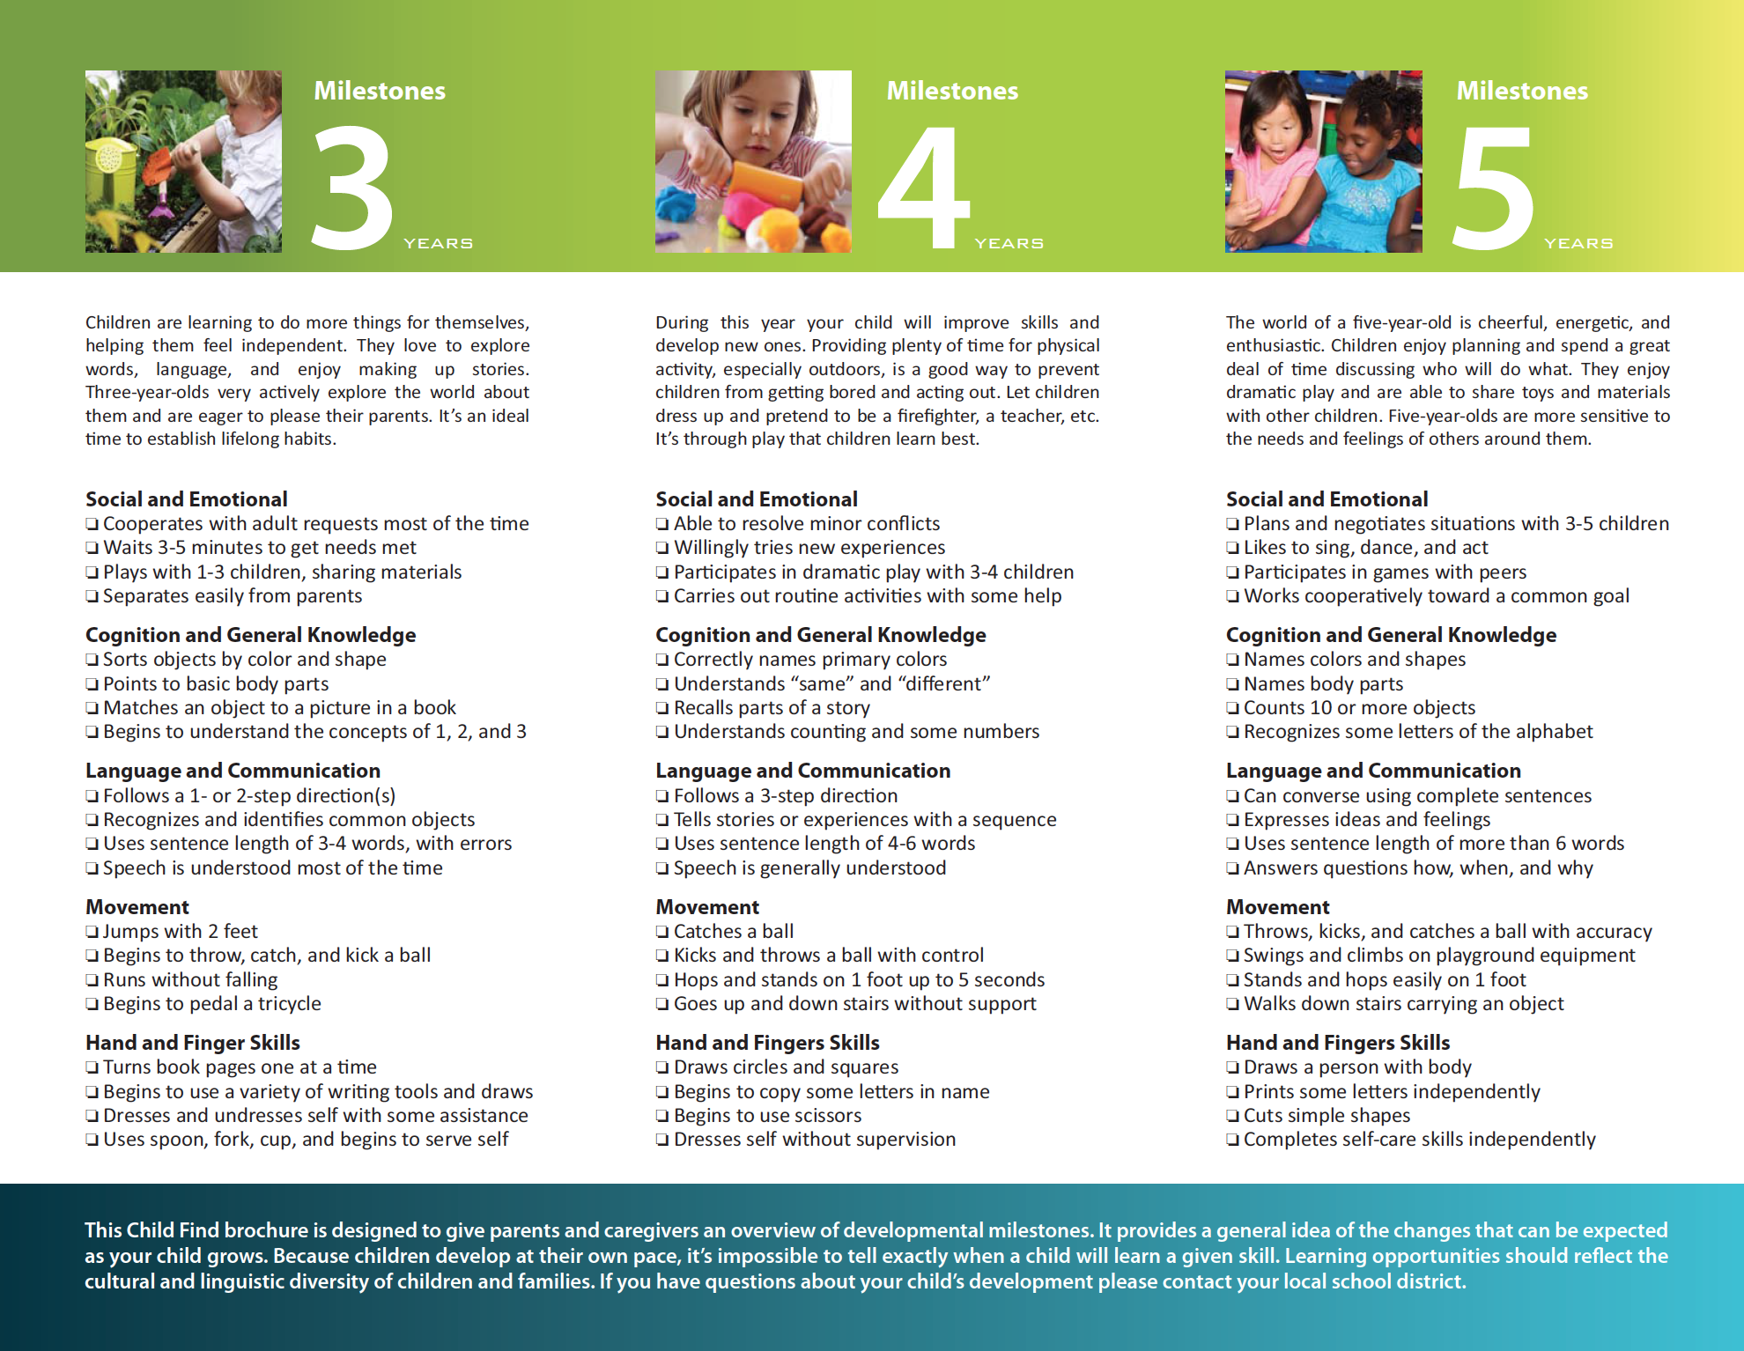
Three factors for success
Customization and localization
Child Find: Using parts of LTSAE messaging
Milestones used in Child Find parent brochure
Notes:
Child Find did something else unique with customization. Gail Cismoski is our Child Find materials coordinator, and she really appreciated the milestones messaging. So she was able to use that in the newest Child Find brochure for families. This reflects customization, and it also brings us right back to the beginning – aligned messaging.

Slide 15
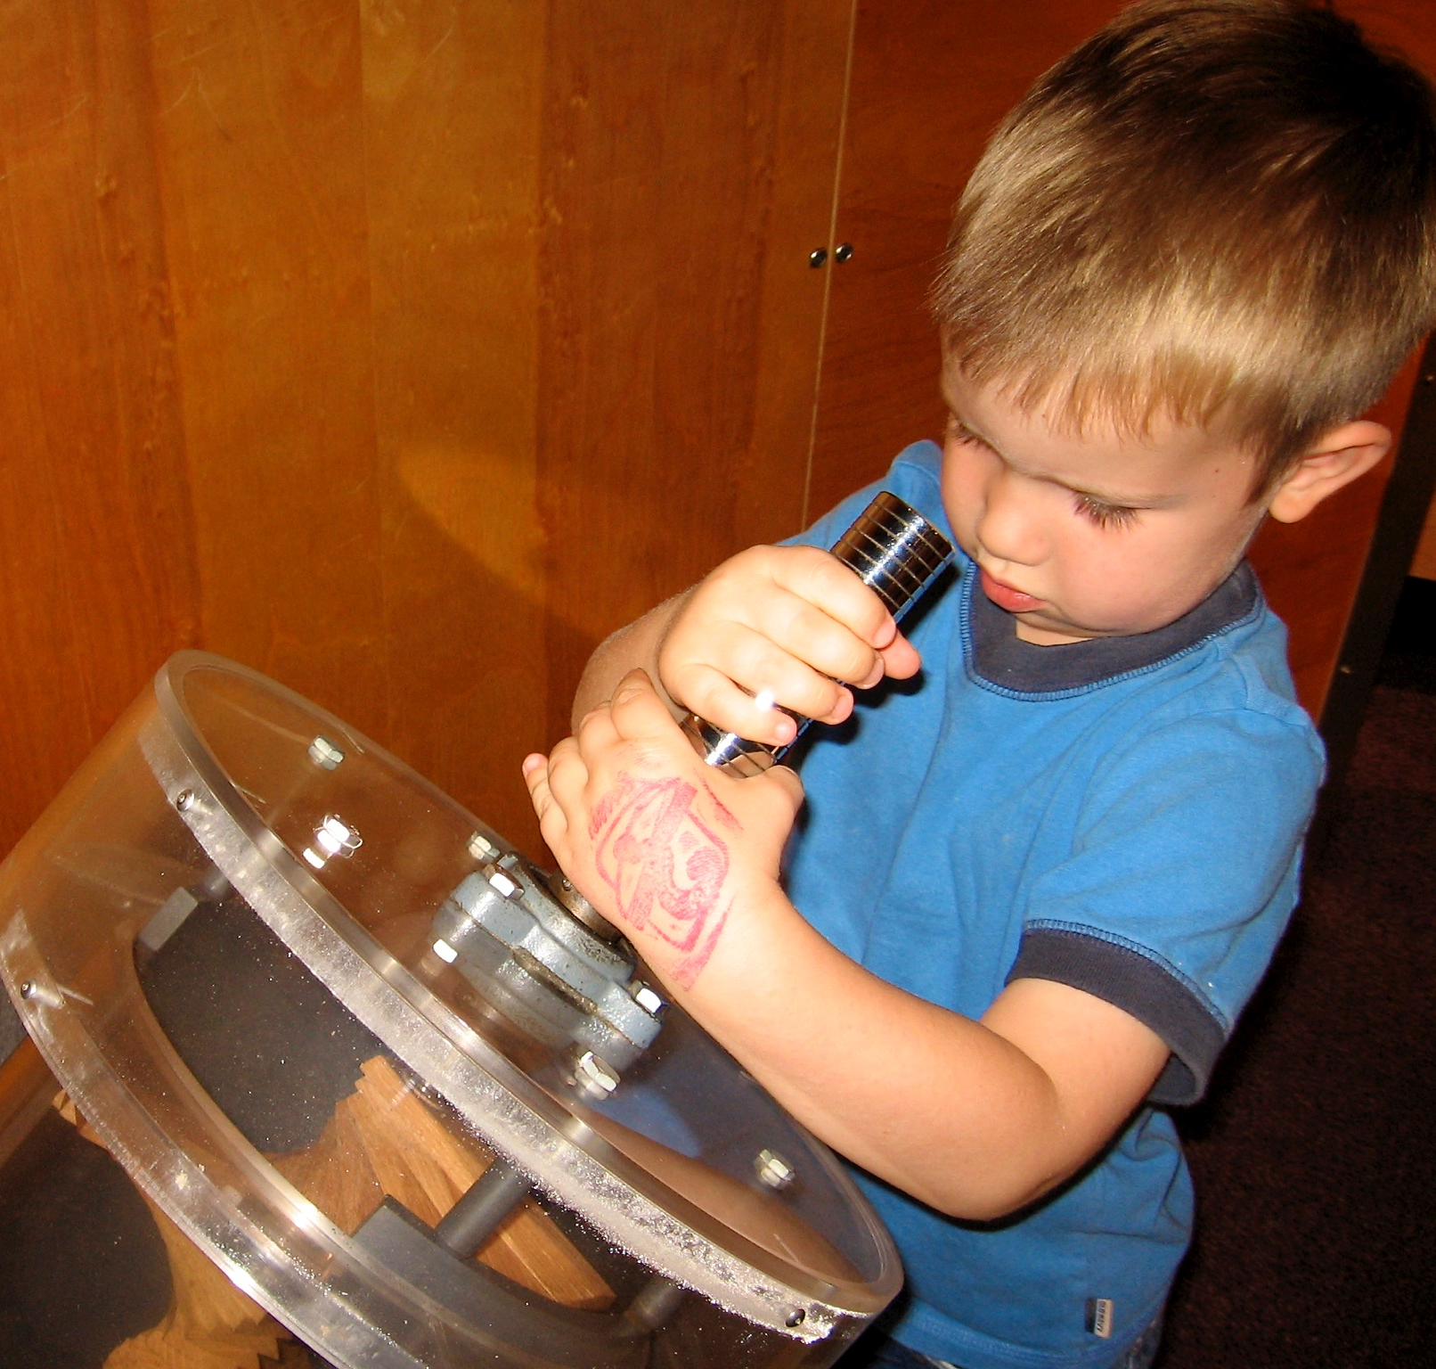
Thank you!
Gail Chodron, Waisman Center UCEDD, UW-Madison
chodron@wisc.edu, 608-890-0145
WECCP: www.collaboratingpartners.com
ECAC: http://dcf.wi.gov/ecac
Blueprint 2012: www.collaboratingpartners.com/documents/22112_blueprint.pdf
Act Early Wisconsin: www.actearly.wisc.edu
Notes:
So that is a brief overview of three aspects of our work that I think were the most important to our meaningful and successful use of “Learn the Signs. Act Early.”, and I really hope this is helpful to you in your work with families. Thank you.

