Slide 1
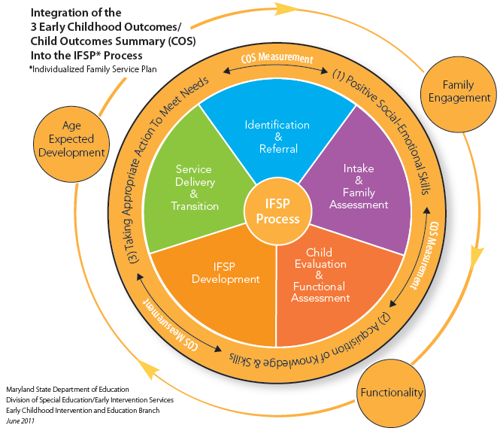
Pulling it All Together Meeting William & His Family Naomi Younggren, Ph.D.
Maryland Dept. of Ed.
Early Intervention
Mini Conference
November
2011

Slide 2
Objectives
Apply your knowledge of the COS process
Use materials important to the COS process
Simulate sharing information with parents
Learn from each other

Slide 3
Outline – Small Groups
Get Organized (5 minutes)
Observe typical 30 month old child (5 minutes)
Review information about William and Family (10 minutes)
Assign someone to “play” William’s Mother
Meet William and his family (10 minutes)
Conduct authentic assessment
Compile available information using COS tools (15 minutes)
Apply additional information (AE-IF-F coded materials)
Complete S & N Summary - Generate COS Rating (15 minutes)
Role play the conversation with William’s Mother
Share Observations and Ahah’s (15 minutes)

Slide 4
1. Get Organized (5 minutes)
Organize into small groups (5 or so in each group)
4

Slide 5
2. Observe typical 30 month old children (5 minutes)
30 Month old clips typical development
Watch and make note of 30 month old skills
5

Slide 6
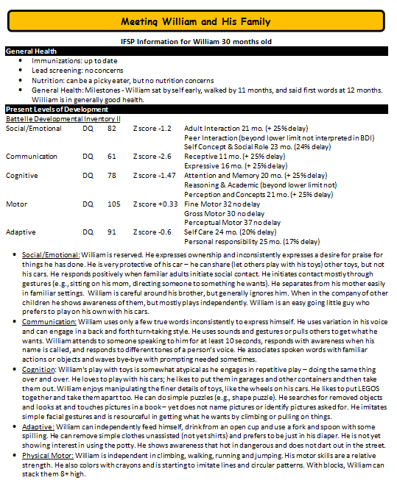
3. Review information about William and His Family (10 minutes)
Assign someone to play William’s Mother - Bee
Review IFSP Information
Make note of functional abilities
6

Slide 7
4. Meet William and his family (10 minutes)
Observe Video
Conduct authentic assessment
Take notes
Organize skills by outcome area and AE-IF-F
7
Notes:
William is 30 months old he lives at home with his mom Bee and his younger brother. William’s father is deployed. More information will follow.

Slide 9
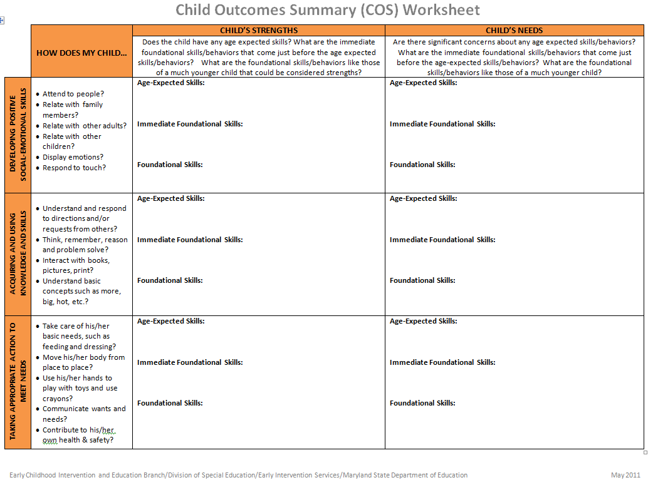
5. Compile available information using COS tools (15 minutes)
Use documentation tools
Use all the information available to complete
Apply additional information (AE-IF-F coded materials)
Bee complete Family Worksheet
9

Slide 10
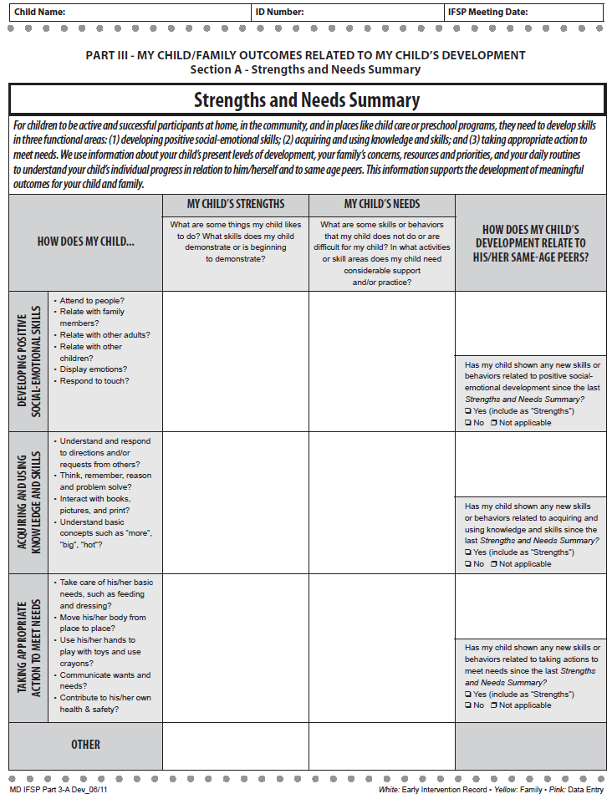
6. Complete Strengths & Needs Summary - Generate COS Rating (15 minutes)
Role play the conversation with Bee
Complete the COS

Slide 11
7. Share Observations & Ahah’s (15 minutes)

Slide 12
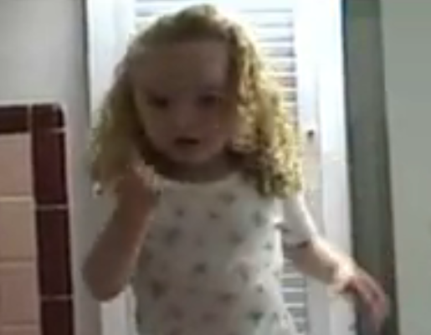
Applaud your work… some pointers from Jessica

