Slide 1






Measuring Child Outcomes with the Summary of Functional Performance: An Introduction
Kathy Hebbeler
The Early Childhood Outcome Center (ECO)
SRI International
December, 2011

Slide 2
Intended audiences
For those new to the Summary of Functional Performance (SFP) process related to child outcomes
Those already familiar with the Child Outcomes Summary Form (COSF) used with the earlier IFSP but still need more information
Notes:
The information presented should be useful for new staff who have not received training in the outcomes summary process. Staff who have participated in Child Outcomes Rating may also benefit from hearing the information.

Slide 3
What will be covered
Why gather child outcomes information
General information about the rating scale embedded in the Summary of Functional Performance (SFP)
The 3 child outcomes
The 7 points of the rating scale and descriptor statements
Guidance for completing the SFP section
The team process to decide a rating
Notes:
In this training, we’ll provide some general information about using the outcomes summary rating scale – as well as details about the three outcomes, the points on the rating scale, and how the team decides the rating.

Slide 4
Getting this information to your colleagues
Nearly all of the content in this training is from a webinar that ECO developed for the Washington State Early Support for Infants and Toddlers (ESIT).
This webinar will be posted on the ESIT website in the near future.

Slide 5
Additional information
Washington-specific information is available on the ESIT Website
  Child and Family Outcomes heading at: http://www.del.wa.gov/publications/esit/
For additional TA or questions, contact:
ESIT Program Consultants
Notes:
First, some resources. Please use ESIT’s website for information about how the outcomes summary process works in Washington

Slide 6
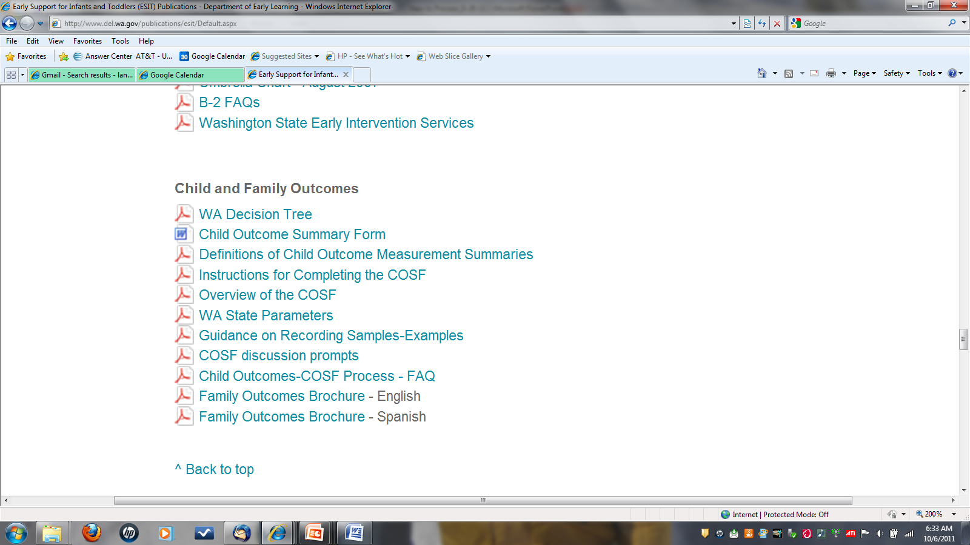
This is the old material and will be updated
Notes:
Here’s a screen shot to give you an idea of what you will find on the website now.

Slide 7
What will not be covered (but might help you make sense of this material)
What information states are required to report
Meaning of summary formats for data in database reports (progress categories and summary statements)
For more information, go to the ECO website at www.the-eco-center.org
Notes:
Although we won’t cover details on the federal requirement for child outcomes data, that information does help to understand the history, background, and rationale for this work. Please go to the Early Childhood Outcomes Center website to learn more.

Slide 8

Why Gather
Child Outcomes Information?

Slide 9
ESIT is required to report data on child outcomes to the federal government
State reports data to U.S. Dept of Ed
You report data on a child
State aggregates data on all children
Notes:
But this is the what, not the why….

Slide 10
Why does the federal government want data on child outcomes?
Government Performance and Results Act (GPRA)
Program Assessment Rating Tool (PART)
Individuals with Disabilities Education Act (IDEA)
4

Slide 11

Government Performance and Results Act (GPRA) passed in 1993
Requires goals and indicators be established for federal programs, including IDEA
Indicators and data collection for school age population included data on outcomes
Previously, for early childhood data had been reported on:
  Number of children served (Part C)
  Settings (both Part C and 619

Slide 12
OSEP: PART evaluation results (2002)
130 programs examined in 2002; 50% programs had no performance data
Programs looking at inputs, not results
Findings for Part C and Section 619
  “ Not Performing: Results Not Demonstrated”
Department of Education needs to develop a strategy to collect annual performance data in a timely manner
Notes:
During the 2003 budget period, the Administration rated approximately 130 federal programs on their effectiveness using part
50% of the these programs had no performance data
Programs tend to use inputs or process data, rather than results or outcome data
Specifically for Part C and Section 619: did not do well in the area of accountability/results because there were no long-term child outcome goals; no child outcome data. The recommendation from the PART is that OSEP needs to develop a strategy to collect annual performance data (child and family outcomes) in a timely manner

Slide 13
IDEA 2004
SEC. 616. <<NOTE: 20 USC 1416.>> MONITORING, TECHNICAL ASSISTANCE, AND ENFORCEMENT. ``(a) Federal and State Monitoring.…..
(2) Focused monitoring.--The primary focus of Federal and State monitoring activities described in paragraph (1) shall be on-- (A) improving educational results and functional outcomes for all children with disabilities;
The word “results” appears 65 times in the legislation.

Slide 14
$9,682,875
$489,427,000
Notes:
What are these numbers? The Washington state and national allocation for Part C for FY 2012.

Slide 15
State and Local Uses
Accountability
  Justifying the investment in EI and ECSE
Program Improvement
  Using data to identify program strengths and share them
  Using data to identify program weaknesses and address them

Slide 16
ESIT Mission
“ To build upon family strengths by providing coordination, supports, resources, and services to enhance the development of children with developmental delays and disabilities through everyday learning opportunities.”
Notes:
Child outcomes data helps us know if we are accomplishing the piece of our mission associated with enhancing the development of children.
Outcomes data are one piece of information our system needs to help us achieve overarching goals for children and families.

Slide 17




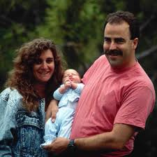


Another take on Accountability
Who should programs be accountable to?
Children and families

Slide 18
The data for
2009-10 are impressive
Notes:
Available at http://www.fpg.unc.edu/~eco/assets/pdfs/outcomesforchildrenfinal.pdf

Slide 19
Does anyone care about these numbers?

Slide 20
…..on behalf of the President and the White House…
We know that state collection of data is very complicated and can be very difficult related to infants and toddlers with disabilities. But the rewards far outweigh any complications because that data, that information that we gain, demonstrates that early intervention works and that Part C program can be a model for state coordination of statewide services.
And so what we know from these data, what we know from the data that everybody is collecting under the Part C program, which is vital, is that 74% of infants and toddlers with disabilities who receive Part C services show increases in their rate of development. And we also know that 60% of infants and toddlers with disabilities who receive the Part C services exit the program at the age of three or earlier with the skills expected, or that are expected, for their age. These are good numbers but we all know that we need to and we must do better and these percentages must go up.
These Part C regulations that we are releasing today support the development of high-quality state and local data so that we can collect the valid and reliable information that we need related to Part C Early Intervention, including data on early childhood outcomes.
Kareem Dale,
Special Assistant to the President for Disability Policy
Part C Final Regulations Conference Call, September 6, 2011
Notes:
Seven years ago when we started talking about what the outcomes should be, who would have thought that someone would have been citing these data on behalf of the President.

Slide 21
How You provide data on child outcomes
Notes:
How many of you could explain to a new colleague why you are collecting child outcomes data?

Slide 22
Outcomes
A benefit children or families experience as a result of services
Global vs. Individualized
Three Child Outcomes
What you write on IFSPs
Notes:
Today, we will be talking about outcomes. The word outcomes can mean lots of different things to different people. When we use the word, we mean “a benefit children or families experience as a result of services”. We are talking about what people get, the difference produced, as a result of the services, not the number or type of services themselves or people’s satisfaction with the services they got.
It is also important to distinguish between the kinds of outcomes that we expect all children who receive ESIT services to get and those that are specifically individualized for each child. The global set of benefits we expect for all children served by ESIT are global outcomes that help us understand how well the program is producing the intended effects for all children served. We periodically summarize where each child is with regard to 3 global outcomes. We also identify more individualized outcomes, or benefits, we think the services will produce for each individual child. These individualized outcomes are those outlined in the IFSP.

Slide 23
3 global outcomes
Children have positive social relationships
Children acquire and use knowledge and skills
Children take appropriate action to meet their needs
            (more on these later)
Notes:
These are the 3 global outcomes we’re talking about measuring. Later, we’ll provide more detail about what we mean by each of these. But, you can see that they are very global and reflect things we want all children to show progress in as a result of services. They also cut across domains. For instance, the outcome isn’t that children will show improved language skills.

Slide 24
Summary of Functional Performance
Note:
with the previous IFSP, this was a separate process called the
Child Outcomes
Summary Form (COSF)
Notes:
The section of the IFSP where you will be recording the rating and the evidence is called the "Summary of Functional Performance."

Slide 25
Completing the Summary of Functional Performance
Describe the child’s current functioning in each outcome
  across settings and with different people
  relative to age-expectations
Select the appropriate “descriptor statement.”
  These correspond to a 7-point scale
  These provide the data on child outcomes
Notes:
The summary of functional performance is the section of the IFSP that focuses on these global outcomes. In it, teams provide a snapshot of the child’s current functioning across settings, relative to age-expectations in each of the 3 global outcome areas. Teams also select one from among a list of statements that best describes the child’s functioning; each statement corresponds to a number on a 1-7 rating scale.

Slide 26
Example of a descriptor statement
“Relative to same age peers, Maria shows many age-expected skills, but continues to show some functioning that might be described like that of a slightly younger child in the area of social relationships.”

Slide 27
Thinking about children’s functioning
Early Childhood Outcomes Center
27
Notes:
This figure represents the range of skills and behavior that can be observed in all children in the general population.
The yellow circle represents those with age-expected behavior. That includes quite a range of skills. By definition, most children in the general population fall into the yellow circle. There are some children at the fringe of the yellow circle (just beyond the dotted line, still in yellow) who show age-expected skills now, but for whom providers and parents have concerns that if they continue on this developmental course, then in future years they might no longer show age-expected skills. (Perhaps they have the skills now but don’t appear to be gaining new skills at a rate or in quality that parallels other children their age.) Then there are children who right now do not show age-expected skills and behaviors. Some are pretty close, but not quite at age-expected levels (like the red ring, where you might see a mix of age-expected and not age-expected skills in different situations or at different times). Others are farther from age-expected levels—like the blue ring, where a child might show skills that are the immediate foundation for age-expected skills (not displaying age-expected skills yet, but a step just before that in the sequence of development). Still other children are farthest from age-expected levels. Those in the outermost pink ring also show skills, but they don’t show those expected for their age or even those that are the close precursors to those skills. Over time, children might move away from having age expected (that is, as the bar for age-expected behavior gets higher with age—a child’s behavior might look more age expected as a baby but fall farther away with increasing age) or move from the outside of the circle in (for example, a child exhibiting delays gets needed services or accommodations and begins to catch up in functioning to the skills shown by same-age peers). The goal of early intervention and preschool special education is to help children move closer to the yellow circle. Not all will reach it, but in the work that we do, we hope to either minimize children’s movement away from yellow (for example, for children with Down Syndrome, where this typically does happen) or to help children move from an outer circle as close into yellow as possible.

Slide 28
Key Points
Assumption: Children can be described with regard to how close they are to age-expected functioning
By definition, most children in the general population demonstrate the outcome in an age-expected way
Over time, some children will move farther away from age-expected functioning (skills at older ages are more demanding)
By providing services and supports, programs are trying to move children closer to age-expected functioning
Some children will never achieve this
Notes:
Not all children will develop according to age expectations. The children we work with are likely to show functioning that is below what is expected for their age in at least one of the outcome areas. The outcomes summary process operates on an assumption that the services we provide are designed to help the child move closer to expectations. The Summary of Functional Performance helps measure the progress children make having received early intervention services. The data are reported to the state, the state aggregates the data, and submits the results to the US Department of Education. The data help show the extent to which the work we are doing improves children’s growth and development.

Slide 29
Why do we compare to age-expected functioning?
Part of federal requirement
Stronger evidence of program’s effects
Set high expectations (and many do attain them), but also celebrate different kinds of progress
Want to promote active and successful participation now and in the future (including school readiness)
Families are entitled to know both individual progress and relative to age-expected (avoid being surprised later)
Notes:
Sometimes people ask why compare the child’s functioning to age expected behavior, why not only focus on the child’s functioning now compared to some time in the past…?
One reason is that the federal government requires information about child outcomes in that format. But, there are other good reasons too. As we use child outcomes information to justify our program’s effectiveness, it is stronger to show that children receiving services make progress relative in how close they are to age-expected functioning rather than only that they make progress. This is because most children birth to three will make some progress even without intervention….it is simply a time of growth and change for all children. Also, having high expectations challenges us to help children achieve as much as possible. Studies show too that many children will reach an age-expected level of functioning. For instance, a national study of early intervention (NEILS) showed that about half of children who enrolled in early intervention services no longer needed special education services by the time they reached kindergarten. That said, the way in which states actually report child outcomes data to the federal government isn’t just achieved age-expected functioning/did not achieve it. States report 5 different kinds of progress that children make as a result of services. We don’t go into a full explanation of all of those different progress categories in this presentation, but it is important to know that we use the information to think about the pattern of progress for each child. Comparing children’s functioning to age-expected behavior also provides important information about how the child may be able to successfully participate in a variety of settings, including community and eventually school settings that are designed with the assumption of age-expected skills. Finally, as many stakeholders weighed in on what the federal requirement should be, many family members said they wished there had been a clearer discussion about where their child stood relative to age expectations all along the way. Some indicated that throughout early intervention they kept hearing about all the individual progress their child was making as time passed and were later surprised as their child started school to find out that their child continued to be behind his peers. They hadn’t realize the pace at which other children were making progress during the same time.

Slide 30
Steps in the process for an initial IFSP
Conduct assessment (Collect information about the child’s functioning across settings and situations in the 3 outcomes).
Meet as a team to review the information.
Develop a summary of the child’s functioning reflecting how child uses skills relative to age-expectations.
Consider decision tree and agree on a descriptor statement (rating) for Outcome 1.
Repeat for Outcomes 2 and 3
Complete information about assessment team members, their roles, and how the family was involved.

Slide 31
Notes:
As you can see in the handout (See “At a glance” handout”), the descriptor statements are arrayed in seven sections with each section corresponding to one of the seven points on the scale.

Slide 32
Essential knowledge for selecting an appropriate descriptor statement
Among them, team members must:
Understand the content of the three child outcomes
Know about the child’s functioning across settings and situations
Understand age-expected child development
Understand age expectations for child functioning within the child’s culture
Know how to use the rating scale
Notes:
For successful participation in this process, team members need to be knowledgeable about the three outcomes and the child’s functioning. They also need to understand age-expected child development an understanding of the cultural differences that may affect expectations for a child’s development. Finally, they need to understand the criteria for each of the points on the rating scale.

Slide 33
Core Team
FRC
Early intervention specialist
Parent(s)
Other therapists or related service providers?
Other caregivers (child care, extended family, etc.)?
Selecting the descriptor statement is intended to be a team process

Slide 34

Important point
It is not necessary that all team members be knowledgeable in all 5 areas
Especially, there is no expectation that parents understand the rating scale or typical child development
But the professionals have to!
Notes:
Together, at least one member of the team has to be knowledgeable in each of the 5 areas. Together, team members should be able to describe the child’s functioning as compared to age expectations. The child’s parent is a key team member and critical to understanding how his or her child functions in every day life. We don’t expect parents to be able to compare their child’s development to other children. That’s the role of the professional. It is essential that the professionals understand age-expected child development!

Slide 35

Parent participation in the process
Be prepared to explain to parents why child outcomes data are being collected
Remember parents are your best source of information the child’s functioning across situations throughout the day
There is no reason to mention the numbers on the scale during the discussion (more on this later)
Notes:
It’s the families who see their children’s skills and behaviors in every day life – at home and in the community. Parents contribute in the process by contributing what they know about their child. Their participation is essential to the process. We can prepare parents for the process by letting them know that we’ll be asking them to describe their child’s skills and behaviors for us as part of the assessment process, and that we’ll be using that information to report to the federal government. But we need to reassure families that information about their child will not be reported on the individual child level. We need not ask the families to come up with a number on the rating scale.

Slide 36

Essential knowledge for completing the Summary of Functional Performance
1. Understand the content of the three child outcomes
Notes:
For effective participation in the summary of functional performance process, we need to understand the content of the three child outcomes we’re measuring.

Slide 37
Outcomes: Step by Step video
http://www.fpg.unc.edu/~eco/pages/videos.cfm
Notes:
This video will provide an overview of what we mean by the outcomes and show example of children’s functioning you might observe related to those outcomes.

Slide 38
The three outcomes provide a lens or a framework….
…for how you see children
…for gathering and reporting assessment information
…for how you think about individualized outcomes on the IFSP
…for how you think about children’s progress at review and transition
…for collecting data.

Slide 39
Functional child outcomes
Functional:
Refer to things that are meaningful to the child in the context of everyday living
Refer to an integrated series of behaviors or skills that allows the child to achieve the important everyday goals
Meaningful behaviors in meaningful context – what child usually does in situations (crosses domains)
NOT – unusual, isolated circumstances, only in structured, specific standardized, elicited situations
See http://www.fpg.unc.edu/~ECO/assets/pdfs/Functional_outcomesHO.pdf
Notes:
The outcomes are intended to focus on the child’s functional skills, that is how the child integrates his/her skills across domains to accomplish tasks that are meaningful to the child. Instead of looking for discrete skills out of context ,for instance, says 10 words - the focus is instead on how the child uses words in the service of taking appropriate actions to meet needs, such as to tell a caregiver she wants milk or food.

Slide 40
Outcomes Jeopardy
Pointing to the cabinet for cereal | Reading the letter “S” on the Stop sign | Washes hands before lunch
Biting | Plays by himself in the classroom | Plays with rhyming words
Building a castle from blocks with a friend | Problems sleeping | Sharing a cookie at lunchtime
$100
$100
$100
$200
$200
$200
$300
$300
$300
Notes:
You must be in slide show mode to be able to move the “cover” off the answer.

Slide 41
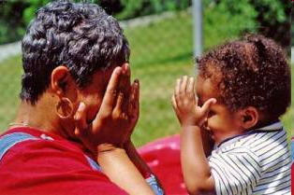
Children have positive social relationships
Involves:
  Relating with adults
  Relating with other children
  For older children, following rules related to groups or interacting with others
Includes:
  Attachment/separation/autonomy
  Expressing emotions and feelings
  Learning rules and expectations
  Social interactions and social play
Notes:
The first child outcome is that ‘children will have positive social relationships.’ This refers to how children interact with adults and also with peers, and for older infants and toddlers, how well children can participate in a group setting. When assessing the child’s skills and behaviors in this area, we’ll also look at his or her ability to express emotions and feelings, and participate in social play.

Slide 42

Children acquire and use knowledge and skills
  Thinking
  Reasoning
  Remembering
  Problem solving
  Using symbols and language
  Understanding physical and social worlds
  Early concepts
    symbols
    pictures
    numbers
  Imitation
  Acquiring vocabulary
  Early literacy
Notes:
The second child outcome is that children will ‘acquire and use knowledge and skills.’ Included in this outcome area are thinking, reasoning, problem solving and the use of symbols, such as words, to represent objects and actions. Assessment in this area will also include the child’s early literacy and numeracy skills.

Slide 43

Children take appropriate action to meet their needs
Involves:
  Taking care of basic needs
  Getting from place to place
  Using tools (e.g., fork, toothbrush, crayon)
  In older children, contributing to their own health and safety
Includes:
  Integrating motor skills to complete tasks
  Self-help skills (e.g., dressing, feeding, grooming, toileting, household responsibility)
  Acting on the world to get what one wants
Notes:
The third outcome, that children will take appropriate action to meet their needs, addresses how the child takes care of basic needs, such of feeding, toileting, and dressing. It includes the ability to express their needs, and to move from place to place to get needs met. Especially for preschoolers, your assessment of this outcome area will include the child’s awareness of health and safety issues, for example, not running into the street or touching a hot stove.

Slide 44

Essential knowledge for completing the Summary of Functional Performance
2. Know about the child’s functioning across settings and situations
Notes:
How do you collect information about the child’s functioning across settings and situations to inform the rating on the 7 point scale?

Slide 45

How we learn about the child’s functioning across settings and situations
Good Assessment
Notes:
We learn about the child’s everyday functioning through good assessment practices.

Slide 46
The key question:
Where is this child developmentally on each of the outcomes?
Not just a question for the ratings

Slide 47
DEC* recommended practices for assessment
Involve multiple sources
  Examples: family members, professional team members, service providers, caregivers
Involve multiple measures
  Examples: observations, criterion- or curriculum-based instruments, interviews, norm-referenced scales, informed clinical opinion, work samples
*Division for Early Childhood of the Council for Exceptional Children
Notes:
Our professional organization for early childhood special education – the Division for Early Childhood of the Council for Exceptional Children – defines good assessment practices as those that use multiple sources of information, and multiple measures.

Slide 48
Assessment practices appropriate for outcomes measurement: ASHA*
ASHA recommended practices:
  Gather information from families, teachers, other service providers
  Collect child-centered, contextualized, descriptive, functional information
*American Speech-Language-Hearing Association
Notes:
The professional association for Speech-Language Pathologists, AHSA, says that a balanced assessment includes information from families, teachers, other service providers, and information that is child-centered, contextualized, descriptive and functional.

Slide 49
A score in a domain on an assessment tool does not necessarily translate directly into a descriptor statement
Descriptor statements (ratings) require:
  Looking at functional behaviors
  Collecting and synthesizing input from many sources familiar with how what the child does in across different settings and situations
Notes:
A provider of early intervention services should never make decisions about a child based on one assessment source, such as the scores from one tool. The rating on the Summary of Functional Performance should reflect all the information we can learn about a child to understand not only the skills he has acquired, but also how he uses them in everyday life.

Slide 50
Listening and learning from parents is good assessment
See the discussion prompts on the ESIT website for possible questions to ask families
The Routines-Based Interview offers lots of information
Use information from parents to learn about the child’s functioning and incorporate this information into the SFP process
Notes:
The discussion prompts file provides some questions you can ask families about their child’s skills and behaviors in everyday life. These are possible questions; it is not expected that you would ask all of the questions to the same family. This ‘real life’ information provided by family’s answers helps determine the child’s level of functioning across different aspects of the global outcomes, and helps identify the most appropriate rating.

Slide 51
Involving families in a conversation about their child’s functioning
Avoid jargon
Ask questions that allow parents to tell you what they have seen
  “Tell me how Anthony eats”
Avoid questions that can be answered with a yes or no
  “Does Anthony finger feed himself?”
  “Is that what you see at home?”
Notes:
Information about the family is critical to a summary rating that reflects all the settings and situations that make up the child’s natural environment

Slide 52

Resource: Discussion Prompts
http://www.del.wa.gov/publications/esit/default.aspx
Notes:
Also available at the ECO web site:
http://www.fpg.unc.edu/~eco/assets/pdfs/COSF_discussion_prompts_4-4-07.pdf

Slide 53
Descriptor statement is based on…
Types of Information
  Curriculum-based assessments (e.g., AEPS)
  Norm-referenced assessments (e.g., BDI-2)
  Developmental screenings (e.g., Ages & Stages)
  Structured interviews (e.g., Routines Based Interview, Vineland-II)
  Observation and report
Sources of Information
  Parents and family members
  Service providers
  Therapists
  Physicians
  Child care providers
  Teachers
  People familiar with the child in all of the settings and situations that s/he is in
Notes:
Here is a summary of the various assessment data sources that can be used in the rating process.

Slide 54
Activity: What are functional skills and behaviors?
Handouts:
ECO COSF 101: What is a functional outcome?
Exercise: What are functional skills and behaviors?
Notes:
Available at the ECO web site:
www.fpg.unc.edu/~eco/assets/pdfs/Functional_outcomesHO.pdf
http://www.fpg.unc.edu/~eco/assets/pdfs/Functional_skills_exercise.pdf
Answer key:
http://www.fpg.unc.edu/~eco/pages/training_activities.cfm#func_outcomes

Slide 55

Essential knowledge for completing Summary of Functional Performance
3. Understand age-expected child development
Notes:
Another key ingredient of the Summary of Functional Performance process is knowledge of age-expected child development.

Slide 56
Why do we intervene?
Development in young children follows a predictable course
Children who acquire new skills at a slower rate get further and further behind
Notes:
Comparing the child’s skills and behaviors to those expected for his age helps us document whether our services are making a difference. This is based on an assumption that intervention helps children with special needs move closer to the age expectations. Age expected development follows a predictable course. If children with special needs are not keeping up with age expectations, we provide services to help move their development along.

Slide 57
Notes:
(This slide includes animation in the slide show mode. Each click brings in a line on the graph.)
The pink line on this graph represents typical development. The graph title says ‘language’ but it could just as easily say social interaction or problem solving or independence. Development follows a predictable course that involves acquiring more skills and more complex behaviors as children get older. We also know there is variation in development and no child’s development follows this kind of a line. We can, however, describe what we expect of 4 year olds and that differs from what we expect of 3 year olds. If children are developing new skills a little slower than other children, the aqua line after 21 months, these children will be a little bit behind when they arrive at kindergarten. Other children are acquiring new skills so slowly that they are substantially behind other children and we say these children have a developmental delay (red line). We intervene to change their trajectories (blue line). Without intervention, we assume that these children will continue on their same course. The goal is to do everything we can to help them achieve and stay on a higher trajectory.

Slide 58
Resources can…
Help you identify the time period when skills often emerge in the general population
Remind you about the sequences in which the skills develop

Slide 59
Resources for understanding age-expected child development
Nearly all are by domain rather than outcome, looking for more resources
Website list: http://www.fpg.unc.edu/~eco/assets/pdfs/Age-expected_Resources.pdf
CDC milestone lists by age
MEISR-COSF – routines by outcomes with approximate age levels
ND state compiled milestone lists in each outcome area by age

Slide 60
http://www.fpg.unc.edu/~eco/assets/pdfs/4_MEISR-COSFToolJuly2010.pdf

Slide 61
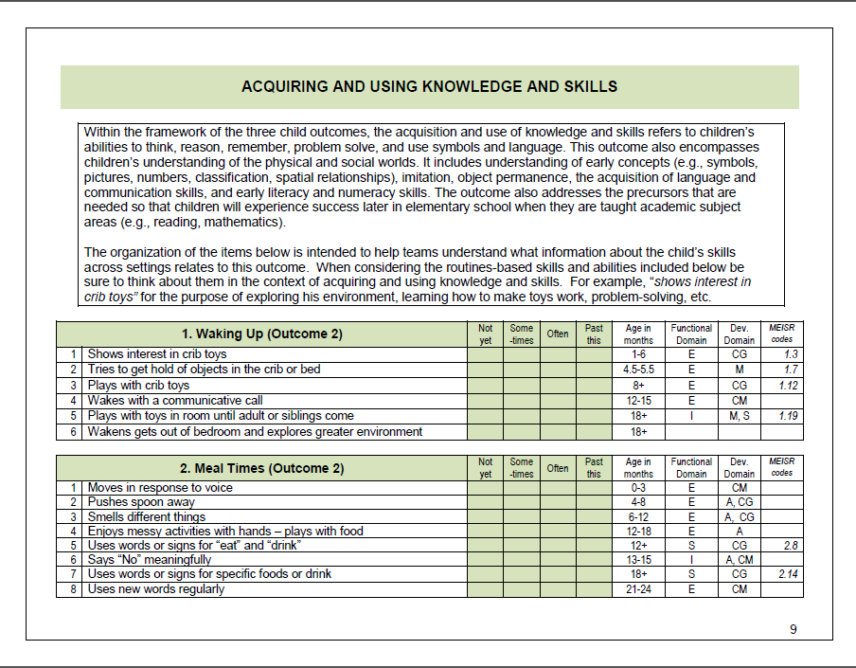

Slide 62

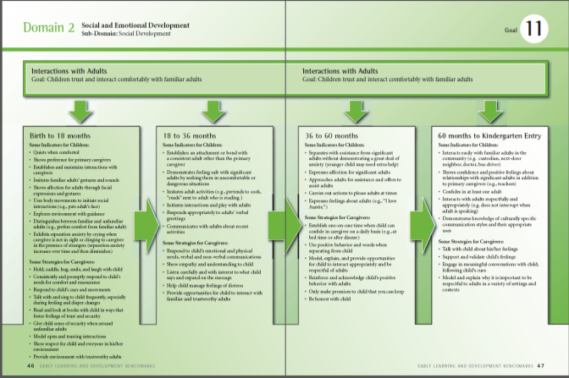
Washington Benchmarks
Notes:
Washington has benchmarks for infants and toddlers (which are being revised) which can be a source of information on typical development.

Slide 63
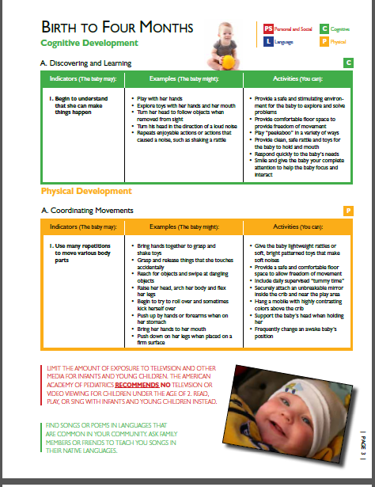

Maryland
Notes:
You can also look to other states early learning guidelines.

Slide 64
What age to use for comparisons?
For these ratings, use actual chronological age.
Do NOT correct for prematurity.
This way we can show the progress preemies make as their skills become closer to those of full-term children born at the same time

Slide 65
Caution: Interpreting age-expected skills
Just because a child developing typically with the same chronological age often demonstrates a skill or behavior does not mean it is age-expected.
Children continue to use the skills that developed at younger ages…
Example: Making eye contact

Slide 66

Essential Knowledge for Completing Summary of Functional Performance
3. Understand age expectations for child functioning within the child’s culture
Notes:
Another consideration for teams in deriving a rating is the influence of culture on a child’s development.

Slide 67
Age appropriateness and culture
The age appropriateness of some behaviors varies across cultures
  Especially those related to independence and self care
Important for working with the child and for completing the Summary of Functional Performance to understand expectations within the child’s culture
Notes:
As you know from working with families of different cultures, expectations for development may vary -- especially with regard to independence and self care skills. It’s important for the team to learn from the family about their culture’s expectations for their child’s development and learning. If a child’s skills are not at the same level as same age peers of our mainstream culture, it may be that there is a different expectation within that child’s culture. Teams must be aware and sensitive to these differences. The rating is to reflect age expected functioning within the child’s culture-- so the team needs to understand those expectations.

Slide 68

Essential Knowledge for Completing the Summary of Functional Performance
5. Know how to use the rating scale
Notes:
Participants in the Summary of Functional Performance process – most notably, the professionals on the team, must understand how to use the 7-point rating scale. That means understanding the definition of each of those 7 points and how descriptor statements correspond to those points. This knowledge helps team members and programs all use the scale the same way. Let’s review what descriptor statements are and the definitions for each of the scale points.

Slide 69
Descriptor Statements
There are 7 categories of ratings
Instead of identifying a rating by a number, the team selects a descriptor statement which corresponds to a rating
Notes:
Instead of selecting a rating number to describe the child’s functioning, the team selects from a list of statements that summarize how the child is functioning in that outcome. Each of the 7 points on the scale has one or more statements that describe a child functioning at that level. When the information is entered into the data system, the screen with show the set of possible statements and the person entering the data will select the appropriate statement. Let 's look at some examples.

Slide 70
Descriptor Statements
For each of the 7 rating categories, there are several “descriptor statements” that describe and summarize how the child is functioning in the outcome area
Descriptor statements are selected verbatim in the data system. The data system inserts the child’s name in the statement and associates the statement with a rating for later reports
Notes:
Instead of selecting a rating number to describe the child’s functioning, the team selects from a list of statements that summarize how the child is functioning in that outcome. Each of the 7 points on the scale has one or more statements that describe a child functioning at that level. When the information is entered into the data system, the screen with show the set of possible statements and the person entering the data will select the appropriate statement. Let's look at some examples.

Slide 71
Notes:
See “At a glance” handout.

Slide 72
7
Child shows functioning expected for his or her age in all or almost all everyday situations that are part of the child’s life
Functioning is considered appropriate for his or her age
No one has any concerns about the child’s functioning in this outcome area
Notes:
Let’s start at the top of the scale. The team would consider a rating of ‘7’ in an outcome area for a child who is ‘completely age appropriate’ in just about all of the settings that make up his or her life – and for whom there are no concerns in this particular outcome.

Slide 73
7 Descriptor Statements
For a child whose functioning in the outcome is completely age appropriate, choose one of the following descriptor statements:
Relative to other children [CHILD’S NAME]’s age, he has all of the skills that we would expect of a child his age in the area of (outcome [e.g., taking action to meet needs]).
[CHILD’s NAME] has a good mix of age expected skills in the area of (outcome).
Notes:
In this first example, the team has reviewed the information about the child' s functioning in the outcome, they used the decision tree -- more on the decision tree in a minute -- and have decided that the child is functioning like same age peers in this outcome. They will select one of the two descriptor statements that can be used to convey that the child is at the highest point on the rating scale. They can pick whichever of the two they like the best. In the data system, the child's name will appear automatically in the descriptor statement as well the outcome related information.

Slide 74
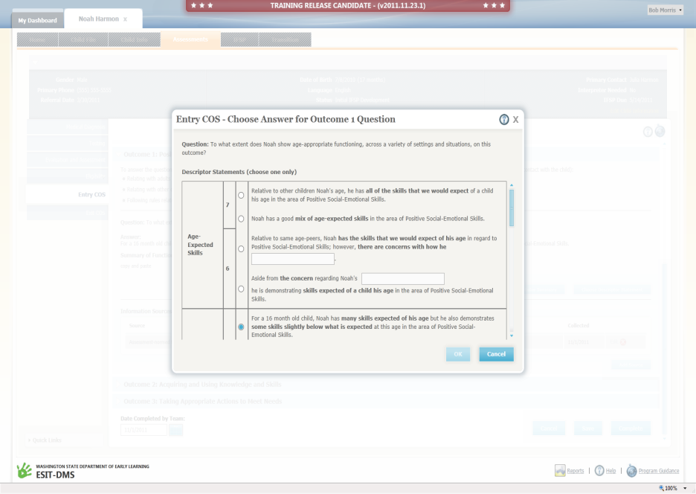
Note: The child’s name is filled in.

Slide 75
6
Child’s functioning generally is considered appropriate for his or her age but there are some significant concerns about the child’s functioning in this outcome area
These concerns are substantial enough to suggest monitoring or possible additional support
Although age-appropriate, the child’s functioning may border on not keeping pace with age expectations
Notes:
You would consider a rating of ‘6’ if the child’s functioning is overall age appropriate in the outcome you’re measuring, but the team does have some concerns about the child’s development in this area. Concerns are not simply target areas for improvement. Concerns should be serious enough that one would want to keep an eye on the child’s development because you suspect, although the child is functioning at an age-expected level right now, unless concerns area addressed, the child will not be able to keep up with those peers who are developing according to age expectations.

Slide 76
6 Descriptor Statements
For a child whose functioning is currently age-appropriate, but where there are substantial concerns that may interfere with maintaining age-expected functioning:
Relative to same-age peers, [CHILD] has the skills that we would expect of her age in regard to (outcome); however, there are concerns with how she [insert functional area of concern].
Aside from the concern regarding, [CHILD] is demonstrating skills expected of a child her age in the area of (outcome).
Notes:
Here the two descriptor statements that can be selected both indicate some type of substantial concern as well as acknowledge functioning that is currently age-expected.

Slide 77
5
Child shows functioning expected for his or her age some of the time and/or in some settings and situations
Child’s functioning is a mix of age-appropriate and not age-appropriate behaviors and skills
Child’s functioning might be described as like that of a slightly younger child
Notes:
A rating of ‘5’ means that the child does show age-expected skills and behaviors, but not in all of the settings or all the situations that make up his or her everyday life. The child’s functioning may appear to be more like that of a slightly younger child.

Slide 78
5 Descriptor Statements
[For a child whose functioning show a mix of age-appropriate and not age-appropriate skills:
For a # month old child, [CHILD] has many skills expected of his age, but he also demonstrates some skills slightly below that expected at the age in the area of (outcome).
Relative to same age peers, [CHILD] shows many age-expected skills, but continues to show some functioning that might be described like that of a slightly younger child in the area of (outcome).
[CHILD] is somewhat where we would expect him to be at this age. This means that [CHILD] has many skills we would expect at his age in regard to (outcome), but he does not yet have all of the age-expected skills.
Notes:
The mix of skills consistent with a rating of 5 can look somewhat different depending on the combinations of skills. The three different descriptor statements allow teams to choose which statement sounds most like the child’s current functioning. Any of these three statements also will register a “5” as a rating associated with the child’s summary of functional performance.

Slide 79
4
Child shows occasional age-appropriate functioning across settings and situations
More functioning is not age-appropriate than age-appropriate.
Notes:
The team would consider a rating of ‘4’ if a child occasionally shows skills and behaviors that are at age level, but most of the time appears more like a younger child in an outcome area.

Slide 80
4 Descriptor Statements
For a child whose functioning show a mix of age-appropriate and not age-appropriate skills where more of the skills are not yet age-appropriate:
At # months, [CHILD] shows occasional use of some age-expected skills, but more of his skills are not yet age-expected in the area of (outcome).
At # months, [CHILD] shows occasional use of some age-expected skills, but has more skills that are younger than those expected for a child his age in the area of (outcome).
[CHILD] has a few of the skills we would expect in regard to (outcome), but he shows more skills that are not age-appropriate.

Slide 81
3
Child does not yet show functioning expected of a child of his or her age in any situation
Child uses immediate foundational skills, most or all of the time across settings and situations
Immediate foundational skills are the skills upon which to build age-appropriate functioning
Functioning might be described as like that of a younger child
Notes:
A rating of ‘3’ means that the child is not showing age-expected skills and behaviors in an outcome area. The child’s functioning is close to, but not at, age level. The skills that are close to, but not at, age expectations, we call ‘immediate foundational skills.’ These are the skills that practitioners will build on to help move the child to age expected functioning.

Slide 82
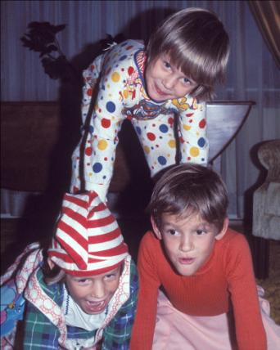
Thinking about development in sequences
Skills build on each other to allow more complex behavior
Need to understand what skills are expected at a given age
Where is each child in the progression of skills
Notes:
Part of understanding age-expected development is being familiar with the sequences of skills that build on each other over time.

Slide 83
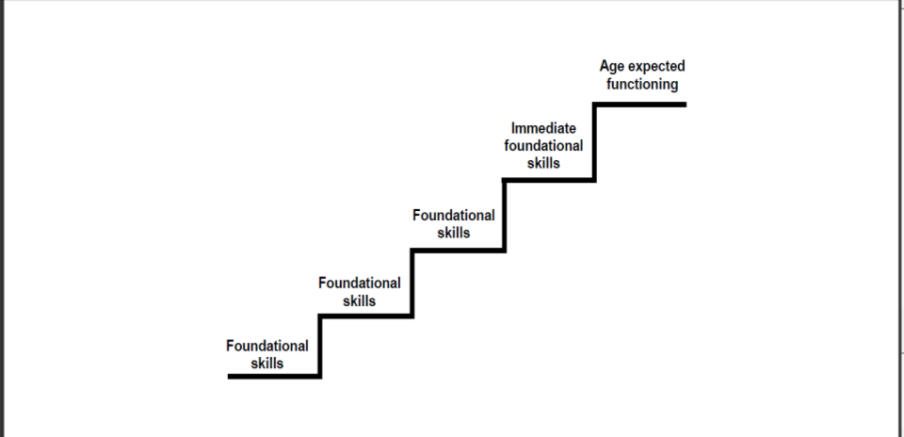
How foundational skills lead to
age-expected functioning
How foundational skills lead
to age-expected functioning
From handout on immediate foundational skills…….
Notes:
One way to think about development is like stair steps, with the skills that emerge first forming the foundation for later skills.
It is especially important to understand which skills come right-before the age-expected skills. We call these immediate foundational skills.

Slide 84
What are foundational skills?
Foundational skills are….
Skills and behaviors that occur earlier in development and serve as the foundation for later skill development
Teachers and interventionists often use foundational skills to help children move to the next level developmentally

Slide 85

Immediate foundational skills
The set of skills and behavior that occur developmentally just prior to age-expected functioning
Are the basis on which to build age-expected functioning
Functioning looks like a younger child
Notes:
The focus is on functionally meaningful actions. Many assessment tools have items that measure discrete skills that aren’t meaningful to the child, especially as isolated skills. The skills are meaningful only when they are integrated with other things so that the child can accomplish something.

Slide 86
Activity:
Age-expected, Immediate Foundational and Foundational Skills
Notes:
Available at the ECO web site:
http://www.fpg.unc.edu/~eco/assets/pdfs/AE-IF-F_activity_30_month_old.pdf
Answer key:
http://www.fpg.unc.edu/~eco/assets/pdfs/AE-IF-F_activity-ANSWER_KEY.pdf

Slide 87
3 Descriptor Statements
For a child whose functioning is not yet showing age-appropriate skills and most or all of the time includes immediate foundational skills:
Relative to same age peers, [CHILD’S NAME] is not yet using skills expected of his age. He does however use many important immediate foundational skills to build upon in the area of (outcome).
In the area of (outcome), [CHILD’S NAME] is nearly displaying age-expected skills. This means that he does not yet have the skills we would expect of a child his age. He has the immediate foundational skills that are the building blocks to achieve age-appropriate skills.
Notes:
There are two different statements to choose from to describe children who mostly use immediate foundational skills, but not yet age-expected functioning across everyday situations.

Slide 88
Clarification: “Emerging”
If team members use “emerging” language to talk about age-expected skills.
  Are they using emerging as a euphemism and really mean nearly there, but not yet?
  Or, do they mean they are just starting to see them occasionally in certain situations?
This is a critical distinction between summary ratings of 3 versus 4

Slide 89
2
Child occasionally uses immediate foundational skills across settings and situations
More functioning reflects skills that are not immediate foundational than are immediate foundational
Notes:
The rating of ‘2’ means the child occasionally uses immediate foundational skills, but most of the time his or her functioning uses skills that would be considered foundational rather than immediate foundational.

Slide 90
2 Descriptor Statements
For a child whose functioning is not yet showing age-appropriate skills and occasionally uses immediate foundational skills:
At # months, [CHILD] shows occasional use of some immediate foundational skills that will help him move toward age-appropriate skills. More of his functioning displays earlier skills in the area of (outcome).
Relative to same age peers, [CHILD] is showing some immediate foundational skills, but has more skills that developmentally come in earlier in the area of (outcome).
For a # month old, [CHILD] occasionally uses immediate foundational skills, but has a greater mix of earlier skills that he uses in the area of (outcome).
Overall in the outcome area, [CHILD] is just beginning to show some immediate foundational skills which will help him work toward age appropriate skills.
Notes:
Children in this category often show a rich array of foundational skills and occasionally exhibit immediate foundational skills. There are 4 descriptor statements to choose from that correspond to a rating of “2”.

Slide 91
1
Child does not yet show functioning expected of a child his or her age in any situation
Child’s functioning does not yet include immediate foundational skills upon which to build age-appropriate functioning
Child functioning reflects skills that developmentally come before immediate foundational skills
Child’s functioning might be described as like that of a much younger child
Notes:
The team would consider a rating of ‘1’ for a child who is not showing age-expected functioning or immediate foundational sills. A rating of ‘1’ does not mean that the child has no skills. It means the child has not yet acquired the skills considered immediate foundational skills for a child of his or her age. It does mean that his or her functioning probably looks like more like a much younger child.

Slide 92
1 Descriptor Statements
For a child whose functioning includes foundational, but not yet age-appropriate or immediate foundational skills:
Relative to same age peers, [CHILD] has very early skills in the area of (outcome). This means that [CHILD] has the skills we should expect of a much younger child in this outcome area.
For a # month old, [CHILD] shows early skills in the outcome area. She does not yet show age-expected skills or the skills that come right before those.

Slide 93
Clarification: Skills and 1
Children with descriptor statements equivalent to 1 still display many skills
Skills are below the immediate foundational level
Notes:
It is important to note that children with descriptor statements corresponding to a rating of 1 will show skills, and by exit, might even have made major progress from the skills used at program entry. A rating of “1” means that all of the skills are at a foundational level. They are not the skills that come just before what would be expected of a child that age.

Slide 94
General points
Summary Rating ≠ Eligibility
Ratings do NOT correct for prematurity – use actual chronological age
Ratings ARE based on functioning with whatever assistive technology is typically available in everyday settings
Notes:
Just a reminder that the summary rating at entry is completely independent of the eligibility determination. There is no reason to be concerned that the ratings might lead someone to question the child's eligibility. Children receiving services may be functioning at age-expected levels on one or more outcomes. Some children receiving services may be functioning at age-expected levels on all three outcomes, for example if the child has a diagnosed condition or a sensory impairment where services are preventing developmental decline and the child is functioning effectively. Another example is if assistive technology or supports are helping the child to function at a high level.
Note that the ratings are based on the child's functioning with the use of assistive technology if the child makes regular use of some kind of assistive technology. Ratings are to reflect the child 's current functioning relative to age-expected functioning. Do not correct for prematurity.

Slide 95
Where to focus in deciding the rating
Focus on the child’s overall functioning across settings and situations
  Functioning that is displayed rarely and/or when the child is provided with a lot of unusual support or prompts is of little significance for the rating.
  Ratings reflect child’s FUNCTIONAL use of skills across settings now, not discrete skills a child has shown but doesn’t use in everyday situations.

Slide 96
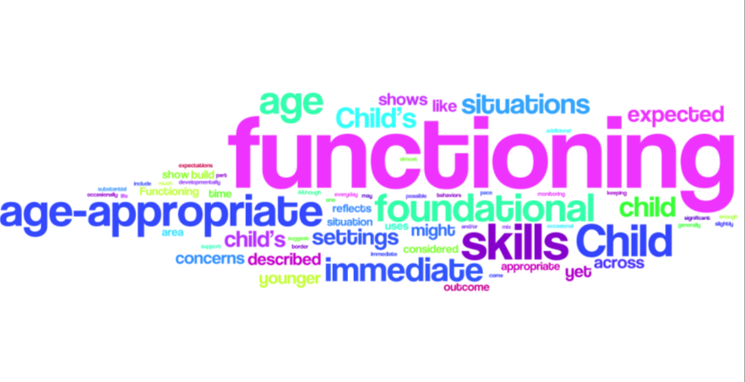
Summary of Functional Performance Ratings
Notes:
If you think you have read and heard the word ‘functioning’ many times in this presentation, you are right!! Measuring child outcomes focuses on how a child functions in everyday life – not the presence or absence of certain skills, but how the child integrates skills to make friends, learn, and get his or her own needs met. This ‘word cloud’ shows other ‘themes’ in the words that are in the criteria for the ratings with the largest words being the words used most often.

Slide 97
Notes:
(See “At a glance” handout.) In the handout showing all the descriptor statements, there is a decision tree to help you continue to distinguish between the different summary ratings. It is a tool that helps teams thinking about the critical distinctions in the criteria for each rating. After discussing the child’s functioning, teams can consider the extent to which age-expected behavior, immediate foundational skills, or foundational skills were described and see how the mix of these skills in each outcome area relates to ratings.

Slide 98
Resource: Decision Tree
http://www.del.wa.gov/publications/esit/default.aspx

Slide 99
Rating Scale Jeopardy
Age appropriate functioning – no concerns | Mix of age appropriate and not age appropriate functioning | No age appropriate functioning – not yet showing immediate foundational skills
Some age appropriate functioning but very little | No age appropriate functioning – lots of immediate foundational skills | Age appropriate functioning – some concerns
Rarely shows age appropriate functioning | No age appropriate functioning – some immediate foundational skills | Age appropriate functioning
$100
$100
$100
$200
$200
$200
$300
$300
$300
Notes:
You must be in slide show mode to be able to move the “cover” off the answer.

Slide 100
Activity: Connecting the ratings and descriptor statements
Notes:
Available at the ECO web site:
http://www.fpg.unc.edu/~eco/assets/pdfs/Matching_COSF_Ratings_with_statements.pdf
Answer key:
http://www.fpg.unc.edu/~eco/assets/pdfs/AE-IF-F_activity-ANSWER_KEY.pdf

Slide 101
Completing the Summary of Functional Performance

Slide 102
Summary of Functional Performance
For each outcome, you will
  Provide a descriptive summary of the child’s functioning in that outcome area.
  Select a “descriptor statement” that best summarizes the child’s functioning relative to age expectations
Notes:
In the Summary of Functional Performance, you will find sections for each of the three outcomes. In each section, you will see a space to record a narrative description of the child's functioning and also a space for the descriptor statement.

Slide 103
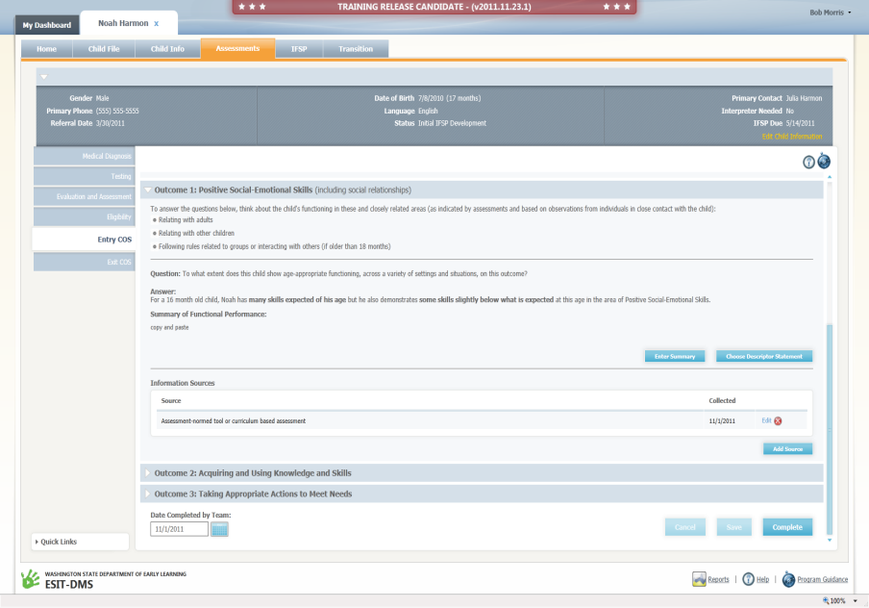

Slide 104
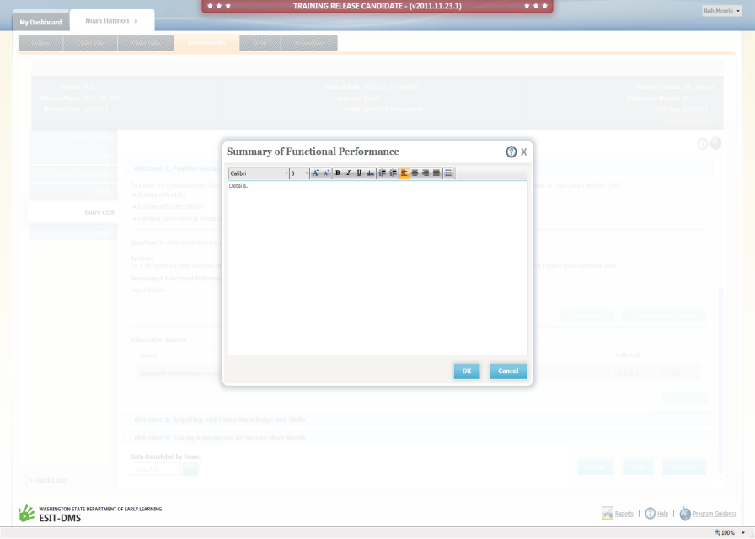

Slide 105
Write a Summary of the Child’s Functional Performance for Each Outcome
Do NOT simply repeat PLOD statements
Include information from multiple sources and observations across settings
Include information from one or more assessment tools
Include specific examples of the child’s functioning related to the breadth of content for each outcome
Describe how the child uses his/her skills across domains in meaningful ways related to the outcome
Notes:
Teams will first complete the narrative that describes that child's level of functioning. In this section, you will want to describe the child's functioning in this outcome across settings and situations based on information from multiple sources. Include examples of what the child can do as well as areas where the child is struggling. Don't simply repeat the information in the PLOD. Rather try to paint a picture of what the child is like in his or her everyday life with regard to this outcome.

Slide 106
Write a Summary of the Child’s Functional Performance for Each Outcome
Include examples of things the child does and does not yet do and a sense of the mix of skills observed
  Note: If the summary only addresses what the child is doing that is at the child’s highest level when the child has a mix of age-expected, immediate foundational, or foundational skills, there will not be enough evidence to support the rating.

Slide 107
Summary of Functional Performance for Each Outcome (Continued)
Describe functioning with respect to age-expected functioning, immediate foundational skills, and/or foundational skills as appropriate to provide support for the descriptor statement
Describe functioning at the current point in time (that is, do not compare functioning to a previous time point)
Notes:
You will want to include information from assessment tools that is relevant to the outcome. To the extent possible, try to describe the child's functioning using terms like "age-expected," "immediate foundational skills," and "foundational skills" so that someone else who reads the narrative will be able to understand why a particular descriptor statement was selected.

Slide 108
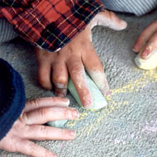
How much to write?
Write enough to provide a rich (but not overly long) description of how the child is doing in the outcome. The writing should provide evidence to support the descriptor statement that the team selects.
Notes:
A question you might be asking is "how much should we be writing?". We all know there is a lot we could write about with regard to a child and each of the outcomes. The narrative describing the child's functioning should provide the team including the family with a rich description of how the child is doing in the outcome without being overly long. The narrative also should provide enough information that an independent reviewer could read the narrative and understand the rationale for the rating.

Slide 109
Example 1: Alex, 23 months
Summary of Functional Performance
Alex engages in simple pretend play with his Dad when playing with trains and animals, making the animals eat or fight. He will search for objects that have been taken away, often looking for specific trains, but is not able to tell others which item he is looking for with words. Alex can turn toys on and off independently and make the toys function in a variety of ways. He has taken apart several of his trains recently, and has tried putting them back together, often fitting a piece or two before starting a different activity. Alex also puts together puzzles appropriate for children his age and takes apart and puts together train tracks. He likes to turn the remote control on and off, and likes to explore the drawers in his dresser. When asked to put away toys, Alex will put different toys in the appropriate place when asked.
Alex can say 3 words, however, these can be difficult for others outside the family to understand and are rarely heard other than during quiet times with his parents at home and during play with Dad, with the exception of the word, “No.” He does not yet use words other than “no,” “Mama,” and “Da” regularly across settings and situations. He points to items that he wants, and understands familiar, recurring 2-step directions like going to get his shoes and bringing them to his Mom when he is getting ready for school. (Continued)
Notes:
Here is one example of a completed narrative for Alex, a 23 month old boy. What outcome is described? Take a few minutes to read this example to get a sense of the kind of information you will be summarizing in the new IFSP.

Slide 110
Example 1: Alex, 23 months
Summary of Functional Performance (Cont.)
Alex uses gestures effectively to communicate when calm, but often gets overwhelmed in social situations with peers or in loud settings and may cry, scream, hit, or kick when he is frustrated rather than using gestures or words. He will listen to a short story, but usually loses interest after about two minutes. He can point to pictures in a book and sometimes jabbers along with the adult reading the book, imitating the adult’s voice and some of the sounds in the words they use. Alex responds to his own name and recognizes lots of objects, showing his understanding of named objects by pointing to them from pictures or picking them out of a group. Alex’s talking includes lots of jabbering that sounds like sentences.
Assessment tools indicate that receptive communication and cognitive functioning were within normal limits for children Alex’s age. Although parental concerns are present related to Alex’s communication, he scored within typical range (within 1.0 standard deviations) in the communication domain using the BDI-2.
Notes:
Here is the rest of the example.

Slide 111
Example 2: Kim, 17 months
Summary of Functional Performance
Kim plays by reaching for and batting toys, patting pictures and banging toys. She holds objects when placed in her hand (toys, spoon).
Kim has very early skills with regard to using appropriate behaviors to meet her needs (AEPS shows less than 6 months for adaptive behavior and 4-6 months for motor skills). Kim knows what she wants, but several times a day Kim cries and fusses when she is not understood and cannot yet convey those wishes using words or actions. When toys are placed near her, Kim is beginning to reach for and bat at toys, and sometimes is successful at hitting things or banging them into other objects. She has not yet begun to use toys as tools to get other toys or interact with toys in sequences of exploratory actions like other children the same age. She holds objects placed in her hand (toys, spoon), but is still working on picking them up herself. (Continued on next slide)
Notes:
Here is a second example for a child, Kim, who is 17 months old. Does this description give you a sense of the child relative to this outcome? Do you have enough information to predict what rating the team selected?

Slide 112
Example 2: Kim, 17 months
Summary of Functional Performance (Cont.)
Kim eats mostly baby food, taking between 5-10 spoonfuls of food that is fed to her per meal, seated in an adapted high chair. She is able to move food around in her mouth with her tongue, has good lip closure, and is starting to make munching motions. Kim eats small meals every 3-4 hours. She is tube fed twice a day and is on a feeding tube at night. Gagging reduces as Kim adjusts to new foods.
Kim is not yet able to assist in dressing or bathing due to her motor challenges. Her limited movement also challenges her ability to explore and play. She is able to move short distances forward (twisting her body to inch along) and is motivated to attempt to get her toys, with occasional success at touching a toy, but not yet picking it up. Kim is continuing to work on the skills that are the building blocks to skills other children her age are using to meet their needs.

Slide 113
The Team Process

Slide 114
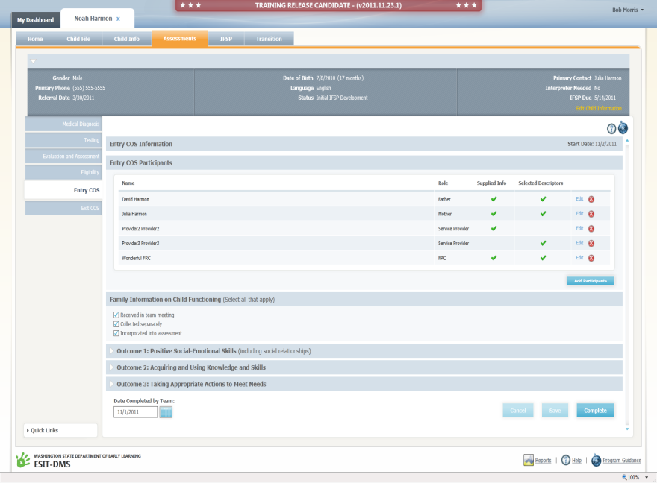

Slide 115
The team discussion process
The team describes the child’s functioning (not just test scores or ratings)
The team considers the child’s current functioning is relative to same-age peers
Discussion includes the child’s full range of functioning (describing skills that are immediate foundational or foundational)
The summary of functional performance written by the team describes the child’s functioning and serves as the rationale for the descriptor statement
The team decides which descriptor statement best describes the child’s current functioning

Slide 116
In a high-quality team discussion…
All team members participate
Parent input is respectfully elicited and considered
Multiple sources of assessment information are considered (observation, family report, formal ‘testing’)
Discussion focuses on the outcomes and includes the full breadth of the outcome
Group reaches consensus on rating

Slide 117
Tools
Using the decision tree as a guide and language of descriptor statements will:
  Help make the process family friendly
  Produce more valid, consistent ratings
  Focus examples shared to more efficiently fit discussion into time available/meeting flow
Family outcomes brochure on ESIT website will help introduce the outcomes and summary process to families

Slide 118
Reaching consensus
Re-visit process – describe functioning first, not #
Focus on outcome content – considering breadth of outcome content, does the skill fit, is it functional?
Share examples – settings, situations, supports, and describe if view as AE, IF, F (do not correct for prematurity)
AE= Age expected
IF = Immediate foundational
F= Foundational
Does the team agree on AE, IF, F?

Slide 119
Reaching consensus
Include more discussion about skills that would see in child with typical developmental pattern as common ground for comparison
Have a Policy – what to do in rare case of disagreement (majority, supervisor, additional info, etc.)
See http://www.fpg.unc.edu/~eco/assets/pdfs/Consensus.pdf

Slide 120
Example probe in team discussion
Tell me about the kinds of evidence that suggest to you this child has [AE, IF, F] functioning in this outcome?
When have you observed those skills? In what situations?
How frequently does that occur?
Were the accommodations/supports available in that setting? What were they?
Are there other steps in the sequence of development that need to occur between developing this skill and the skills same-aged peers display (AE) in this area? (when an IF skill is identified)
Is there other information we need to be better equipped to make this decision?

Slide 121
Is the rating subjective?
What is subjective?
  “relating to the mind of the thinking subject and not the nature of the object being considered”
The summary of functional performance ratings involve clinical decision making from the team
  much like that used in deciding on goals and intervention strategies
Notes:
A question that sometimes arises in the context of the summary of functional performance process is whether or not rating a child’s functioning on the 7-point scale is ‘subjective.’ Subjectivity is defined as related to the ‘mind’ of the rater, rather than the nature of the subject being rated. If your team determines a rating based on what is in their minds, rather on the what the child demonstrates and the rating criteria, the rating will be subjective. If the rating is based on the child’s demonstrated functioning, as compared to age-expected functioning and the criteria for each of the 7 points, it is an evidence-based decision – not unlike the decisions the team makes when designing an appropriate program for a child.

Slide 122
Informed Decisions
Conditions:
Operational definitions of the observed attributes
Structured rating format to record informed opinion
Gather data from multiple sources
Establish consensus-decision making process
Provide training to facilitate reliable ratings
Research on clinical judgment shows that professionals can reach reliable conclusions under certain conditions
The ratings process meets all of these conditions.
Notes:
Rating a child’s functioning based on multiple sources draws upon the clinical judgment that professionals develop as part of their experience and training. Research shows that practitioners will reach the same conclusions when certain conditions are in place.

Slide 123
Activity: Review of a Completed Summary
Teresa Harris, Age 24 Months

Slide 124
Completing the SFP at Exit

Slide 125

When to complete ratings
ESIT requires selection of descriptor statement (rating) at entry and exit
  Optional at intervening times, such as at the annual IFSP review
  Benefits of interim use:
  - Consistency in team actions – familiar
  each time to caregivers/team
  - Promotes good discussions about
  child’s functioning with caregivers
  - Will have a more recent rating if family
  exits suddenly
Notes:
If your program opts to complete the Summary of Functional Performance more frequently than at entry and exit, you will have a richer record of how the child has changed in each outcome area. You also will have more recent information available for the exit rating, if a family leaves unexpectedly.

Slide 126
Completing the 2nd, 3rd, etc., rating
Process is identical to entry with the addition of one question, the “progress” question.
Do NOT look at the previous rating. Each rating is independent and is to be based on where the child functioning is now.
  Looking at the previous rating can introduce bias into the rating process.

Slide 127
Completing the 2nd, 3rd, etc., rating
Do NOT look at the previous rating. Each rating is independent and is to be based on where the child functioning is now.
  Looking at the previous rating can introduce bias into the rating process.
(if needed) Complete the progress question
Notes:
For children who stay in your program 6 months or more, you will complete a second and possibly a third outcomes rating. It is important that the new ratings are determined independently of the previous ratings. At the second and subsequent ratings, you will answer a question about the child’s progress. We complete each ECOSF independently so that one rating does not influence the other. In other words, if you know a child has made progress since the last rating, the team should not simply look at the last rating and bump it up. The rating should be based on the child’s current status relative to the criteria for each of the 7 points. The yes/no progress question, however, DOES address how the child’s development has changed over time.

Slide 128
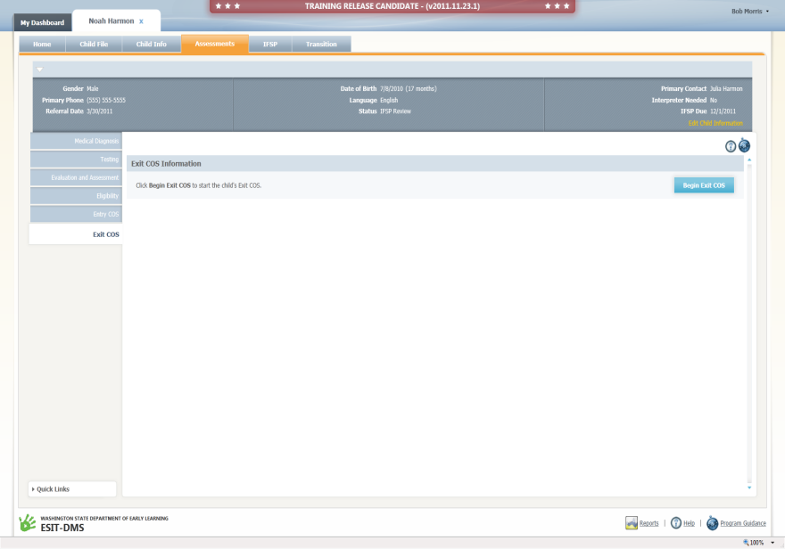
Notes:
The data system will automatically bring up the appropriate information for the exit rating and progress question.

Slide 129
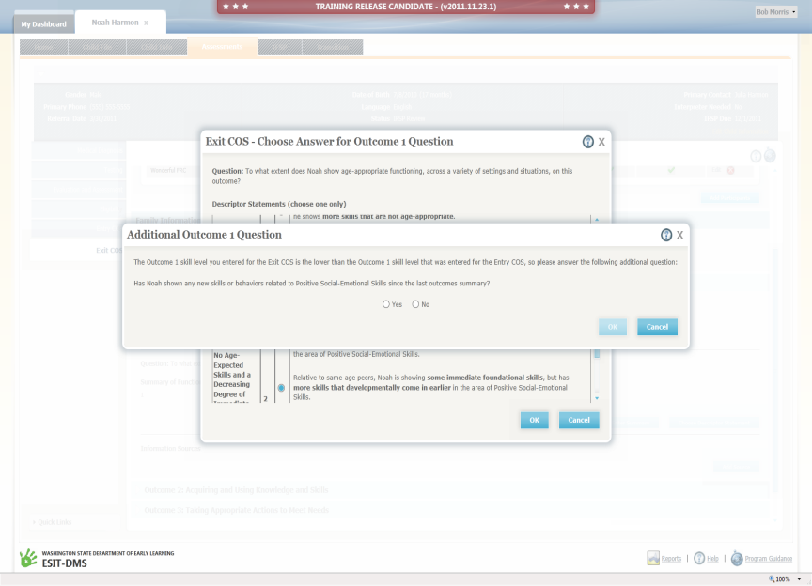

Slide 130
The “progress” question
b. Has the child shown any new skills or behaviors related to [this outcome] since the last outcomes summary?
This question is answered “yes” if the child has acquired ANY new skill or shown any improvement related to this outcome since the last summary of functional performance, e.g.,
  Using one new word
  Using one new gesture
Notes:
Unlike the determination of the rating on the 7-point scale which is a comparison of the child’s functioning with age-expected development, the yes/no progress documents the child’s acquisition of any new skill since the last rating. Some of our children may not move up the scale when compared to their same-age peers, however, they are still making progress compared to their own previous level of functioning. Just one new word or one new gesture warrants a ‘yes’ to the question, ‘has this child shown any new skills in this outcome since the last outcomes summary?’ If the child has not acquired any new skills or has regressed in the outcome area, the answer to the question should be “no.”

Slide 131
Children can show two kinds of growth
Acquisition of new skills
  Which almost all children do over time
Change in rate of growth or developmental trajectory
  The goal of intervention for many children is to change their developmental trajectory so they are functioning like or closer to same aged peers.
Notes:
The rating scale and the yes/no progress question reflects two kinds of growth. The yes/no progress question allows us to document the acquisition of any new skill. The rating scale documents the extent to which the child has moved closer or even caught up to age expectations.

Slide 132
Functioning
132
Notes:
132
On the graph displayed, the vertical axis shows the child’s level of functioning. Each of the trajectories on the graph corresponds to one of the points on the 7 points rating scale. The dotted line separates overall age appropriate (6-7) from less than age appropriate (1-5). The horizontal axis corresponds to the child’s age in months. We can plot entry and exit ratings on this kind of a graph to illustrate the various kinds of change in trajectory that children might display.

Slide 133
Entry
Exit
133
Notes:
133
The entry and exit ratings plotted on this graph shows the child entered services with an summary of functional performance rating of 4 and left with a rating of 6. This child showed substantial growth in this outcome area and the change in trajectory was significant enough that by the time the child exited the program, she was functioning like same aged peers.

Slide 134
Checking your understanding
Anthony began early intervention when he was 18 month olds and exited the program when he was 36 months.
His entry rating was 5.
His exit rating was 4.
The team answered “no” to the progress question.
Do you think this is the correct answer?
Notes:
(Answer: Almost certainly not. The child is 18 months older at the time of the exit rating and showing a few age appropriate skills for a 36 month old (thus, the rating of “4” ). It is highly unlikely that the child was showing these same skills when he entered the program. If the child has acquired any new skills, the answer to the “progress” question is “yes.”)

Slide 135
Entry
Exit
135
Notes:
135
The entry and exit ratings plotted on this graph show a who child entered services with a rating of 5 and left with a rating of 5. When you plot the trajectory, note the slope - the line is not flat. The child has learned new skills and improved functioning even though the trajectory did not change. For the rating to stay the same from entry to exit, a child has to make progress…(other than for a rating of 1).
- The answer to the “any progress” question at exit has to be yes when the child acquires new skills.
- Having the same rating number from entry to exit can be celebrated because it means the child has not dropped to a lower trajectory.

Slide 136
Entry
Exit
136
Notes:
136
Finally, we have an example of a child who received a rating of “1” at entry and at exit and for whom the progress question was answered “no.” This child did not make any progress during his time in program. Note that the trajectory is flat.
There are very few children who will make no progress between entry and exit.

Slide 137
Find out more
Learn more about how the summary of functional performance translates into progress categories
See how those categories are summarized in different ways on reports you can retrieve from the database
Contact: ESIT Program Consultants

Slide 138
Conclusion
This training provided an overview of the summary of functional performance process.
This information alone is not sufficient to ensure that an individual could reliably complete an SFP rating.
Staff members responsible for the ratings must continue to receive feedback and support
Those who are new to the process are encouraged to discuss the process with supervisors and experienced colleagues.
District supervisors can provide refresher trainings for staff.
Notes:
Keep in mind that this is just one piece of the professional development needed for effective participation in the summary of functional process.

Slide 139

Notes:
You can go to the ECO web site to find more information about the how states are integrating the rating process into the development of the IFSP.

Slide 140
Additional Resources
ESIT Resources –
Child and Family Outcomes heading and IFSP Process and Resource Guide at: http://www.del.wa.gov/publications/esit/
Contact: ESIT Program Consultants
Early Childhood Outcomes Center –
www.the-eco-center.org
IFSP-Outcomes Integration page:
http://www.fpg.unc.edu/~eco/pages/integration.cfm
Notes:
We hope you feel prepared to complete the Summary of Functional Performance and select the appropriate descriptor statement in the new IFSP. Additional information about the new process will be available at the ESIT website. Additional information about how other states are integrating the three outcomes and the rating decision into the IFSP process is available at the ECO website. If you have additional questions, please contact ESIT Program Consultants.

Slide 141
Thank you for all you do.
Please continue
to pursue your learning.

