Slide 1
State Strategies for Seamless Birth to Five Services:
Strategies for Summer Birthdays and Local Infrastructure Supports
January 14, 2019

Slide 2

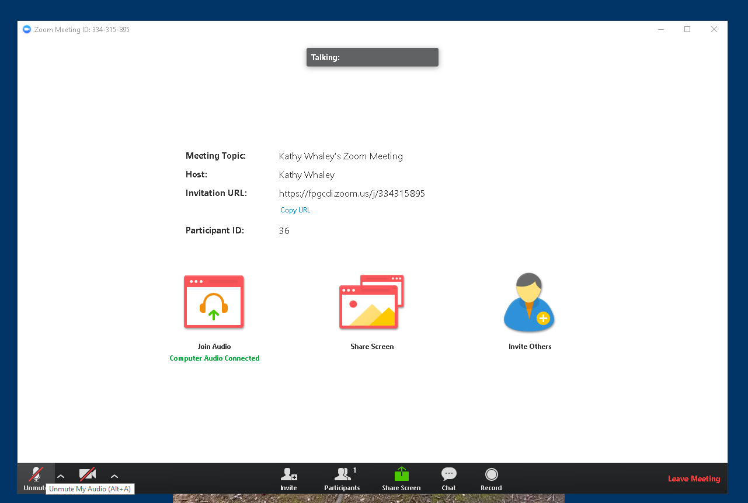
ZOOM: Tips & Tricks
Mute/unmute your mic
Toggle participant list & chat windows

Slide 3
Overview and Goals
To learn about federal and state resources on the transition from Part C to Part B Section 619.
To learn about transition strategies used by Missouri and New Mexico that address policy, coordination, TA and infrastructure supports.
To ask questions and engage in discussion with peers.

Slide 4
Presenters
Pam Thomas, Part C Coordinator
Missouri First Steps Early Intervention Services
Department of Elementary and Secondary Education
Sandy Drangmeister, Education & DVMPT Manager, ECLN
University of New Mexico Center for Development & Disability
Kathy Whaley, TA Specialist, ECTA Center
Evelyn Shaw, TA Specialist, ECTA

Slide 5
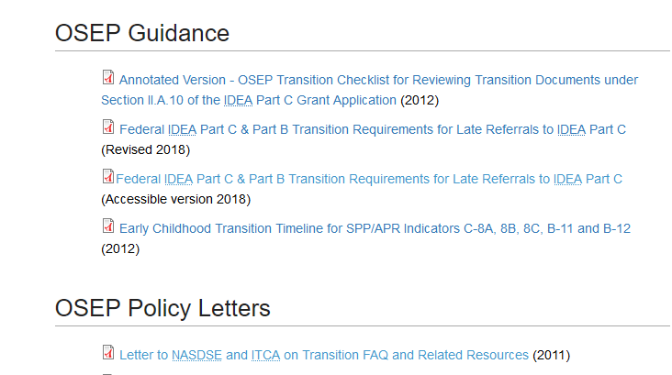
Transition Resources From Part C to Preschool
Notes:
The ECTA Center has a web page with a variety of resources on the transition from Part C to Preschool special Education and other services. This part of the page shows links to resources developed in collaboration with OSEP and resources from OSEP directly.

Slide 6
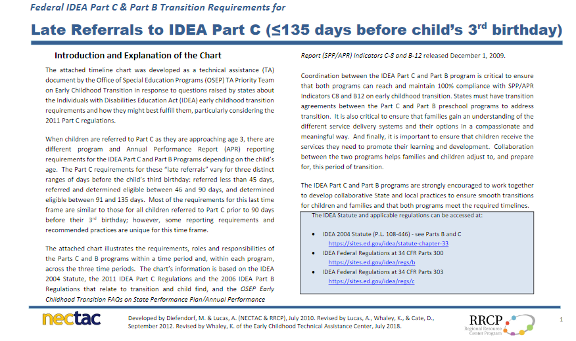
Notes:
This is a resource developed by NECTAC and the RRCP, two centers no longer actively funded, with the approval of OSEP. It provides information for Part C and Part B, 619 on what requirements must be implemented under the IDEA by each agency depending on the timing of the referral.

Slide 7
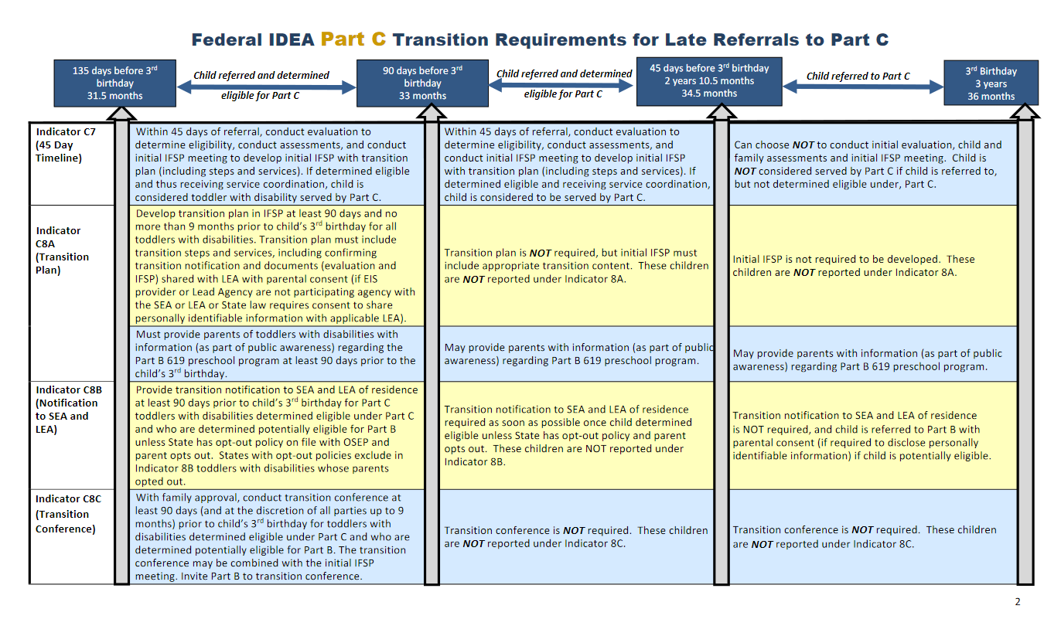
Notes:
This is the second page showing the Part C requirements. Another rpage not pictured in this presentation shows the Part B requirements.

Slide 8
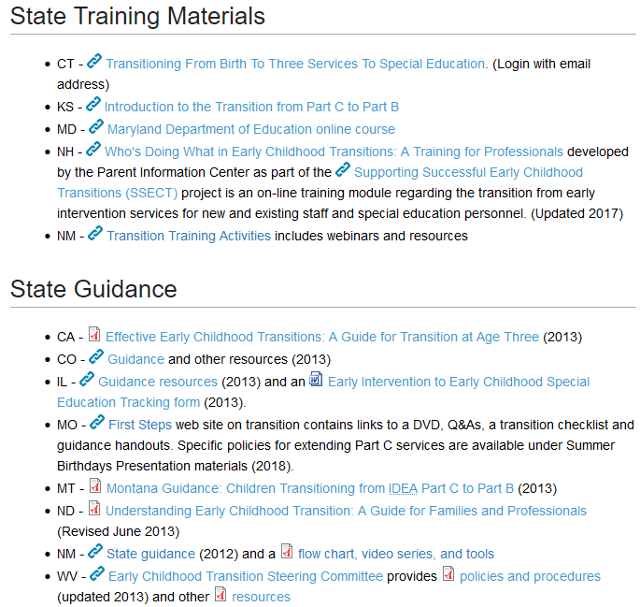
Notes:
The web site also provides state developed resources and documents such as inter/intra agency agreements, training materials, guidance, policies and forms.

Slide 9
The Missouri Process
Pam Thomas

Slide 10


Missouri First Steps (Part C) Program
Notes:
Missouri Part C First Steps Early Intervention Program
Pam Thomas, Part C Coordinator

Slide 11
Missouri Part C Infrastructure
Lead Agency: Education
Service Coordinators: Regional contractors
Providers: Independent/agency vendors
Eligibility Criteria for Developmental Delay:
  Part C is half-age delay in one or more areas
  Part B/619 is two standard deviations in one area
  or 1.5 in two areas.
Notes:
Part C is unique to each state’s program, and I want to tell you a little bit about Missouri Part C before sharing information about our Part C Extension Plan.

Slide 12

Missouri Part C Transition
Transition Data: Approximately 70% of three-year-olds in Part C are eligible
for Part B/619.
Policy: Extend the Part C program for
children with summer third birthdays.
Purpose: Prevent a gap in services and
promote a seamless transition from Part C
to Part B/619 for children with
summer birthdays.

Slide 13

State Options
34 CFR § 303.211(a)(2)
From age three until the beginning of the school year following … the child’s third birthday
…the child’s fourth birthday
…the child’s fifth birthday
Option 1
Option 2
Option 3
Missouri Part C Extension
Definition: Parents of children with summer third birthdays may choose to continue in Part C over the summer months, or transition to Part B/619 on the child’s third birthday.
Notes:
With the 2011 federal regulations for Part C Extension, Missouri but had to develop a Part C Extension policy to align procedures for summer services with the new regulations.
The regulations indicate 3 options (explain).
Missouri’s plan extended services for Summer Third Birthdays, falls under Option 1, but Missouri was not fully implementing Option 1, because we are not serving all children over age three until the following school year. Even so, Missouri has written an Extension Plan as part of our state regulations and follows all procedures for an Extension as if doing Option 1, and may one day be able to fully fund Option 1.
I’ll talk more about that in a little bit.

Slide 14

Missouri Part C Extension Criteria
Definition: A summer third birthday is a birthdate of
April 1 through August 15.
Opt-out: Missouri has an opt-out policy.
If the parent opts out of sending directory
information to Part B/619, then the
Part C extension program is not available.
Notes:
At this time, Missouri’s Part C Extension criteria is a summer third birthday between April 1 – August 15

Slide 15

Additional Extension Criteria
If the parent chooses to transition to ECSE at age three, the Part C program ends the day before the child turns three years old.
If the parent chooses to continue in Part C after age three, the child must meet the following additional criteria:
  The child is determined eligible for Part B/619 before
  age three, or
  The child’s eligibility determination is in process before
  age three (i.e., the Part C service coordinator confirmed
  the school district received the referral).
The child continues in Part C Extension program
until the day before school begins in the fall
following the child’s third birthday.

Slide 16

Missouri Part C Extension Data
Calendar Year 2017
Children with IFSPs: 10,861
  Children with IFSPs with Third Birthdays between 4/1/17 – 8/15/17: 1,814 (approx. 17% of total)
  Children utilizing Part C Extension: 857 (approx. 50% of the children eligible for extension)
Total Program Annual Costs: $45.9 million
  Total Costs Per Child Per Year: $3,114*
  Services Costs Per Child Per Year: $2,305
Additional Expansion Considerations
  Funds: To serve all three year olds: approx. $5.3 million
  Capacity: Child count doubled in size from 2008 – 2018
  *includes administration, direct services, testing/protocols, training, etc.
Notes:
Note about additional expansion – if Missouri Part C was going to fully implement the extension plan for all three year olds…..

Slide 17
The New Mexico Strategies
Sandra Drangmeister

Slide 18
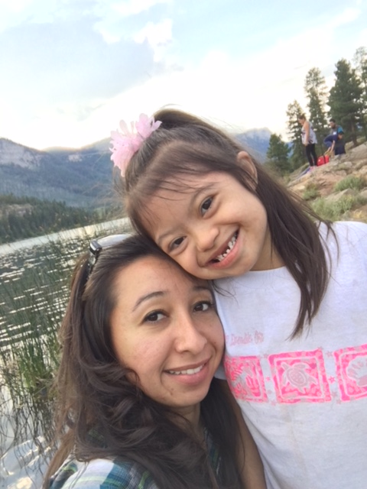
Vision
All children and families will experience a smooth and
effective transition as a result
of collaborative intentional community planning.
Notes:
The transition process requires collaboration of all parties involved in a child’s transition. NM has found that bringing community partners together in collaboration around transition has helped ensure that families are fully informed of the process and that Part B and Part C are better able to meet their timelines and indicators related to transition as a result of this collaboration.

Slide 19
NM Part C Infrastructure
Lead Agency: Department of Health, Family Infant Toddler Program (DOH FIT)
Service Coordinators: Early Intervention Agency staff/contractors
Providers: DOH FIT contracted Early Intervention Agencies, NM State Supported Schools (New Mexico School for the Blind and Visually Impaired, New Mexico School for the Deaf)
Eligibility Criteria
  Part C – evaluated discrepancy between chronological age & developmental age of 25%, after correction for prematurity, in one or more areas of development
  Part B - delay of 30% or more in one or more areas of development may be eligible
Notes:
Lead Agency: Department of Health, Family Infant Toddler Program (DOH FIT)
Service Coordinators: Early Intervention Agency staff/contractors
Providers: DOH FIT contracted Early Intervention Agencies, NM State Supported Schools (New Mexico School for the Blind and Visually Impaired, New Mexico School for the Deaf)
Eligibility Criteria for Developmental Delay:
Part C – evaluated discrepancy between chronological age and developmental age of 25%, after correction for prematurity, in one or more of the following areas of development: cognitive, communication, physical/motor, social or emotional, and adaptive.

Slide 20
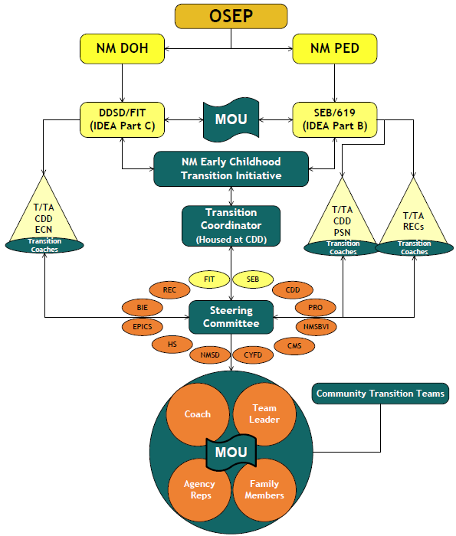
NM Transition Initiative
“The strength of the team is each individual member. The strength of each member is the team” - Phil Jackson
Notes:
Since 1999 the NM Early Childhood Transition Initiative has worked to improve systems across NM in order to foster smooth, effective transitions for children and families as they exit IDEA Part C, Early Intervention services and move into other services and supports.
NM’s Transition Initiative supported the formation of statewide transition teams and 31 teams continue to meet in regions of the state. Here is a diagram of the NM Transition Initiative.

Slide 21
Community Transition Teams
Coach
Team Leader
Family
Members
Agency Reps
Improve transition from Part C to Part B
Develop MOU
Ongoing meetings
Coach, parent & other partner involvement
Early Intervention agencies, Part C
School Districts, Part B
MOU
Notes:
Each teams’ members vary based on the local partners in that region. School districts & EI agencies are part of a transition team as well as other partners with whom they share responsibilities in the transitioning of children. Some EI agencies, State supported schools (NM School for the Blind and Visually Impaired and NM School for the Deaf, home visiting programs and other partners may be part of more than one team but most schools only participate in one.
The purpose of the team is to provide a place for members to address transition procedures at the local level because each community agency may have internal procedures that are unique to them.
Each team meets based on an agreed upon schedule outlined in their MOU. In some cases this is monthly and in others it is 2 times a year. However, it is the RESPONSIBILITY of the members of EACH team to attend!
Teams support parent involvement at team meetings which is helpful for all to hear a parent perspective on their experience in the transition process.
Each team develops a community MOU and reviews the MOU, at a minimum annually, and refers regularly to the MOU to clarify transition roles and processes.

Slide 22
Transition Coaches
UNM CDD ECLN Contracts
  DOH FIT Program
      14 Transition Teams
  NM PED – SEB
      7 Transition Teams
  NM Regional Education Cooperatives
      6 Transition Teams
Notes:
Coaches for transition teams are assigned by the state Transition Coordinator and based on availability of funding from the Department of Health Family Infant Toddler Program and the Public Education – Special Education Bureau. Over the years our funding has decreased and to support coaching coverage, we reached out to the Regional Education Cooperative in NM and they have stepped up and support 6 transition teams around the state.
Through ECLN we have Training and Development Consultants who support the EI agencies and school districts and they are also Transition coaches in the region of the state where they provide TA and support. ECN, PSN, RECs
The coaches come together three times a year to share transition team celebrations as well as concerns. Utilizing the experiences of other coaches and the transition coordinator, they work to problem solve and discuss strategies that might be working in other areas of the state that they can use with their teams.
The Transition Coordinator works closely with the DoH FIT Lead and PED-SEB lead to provide additional support to teams & coaches facing challenges with transition processes. These concerns are shared with the Steering Committee who determines if guidance needs to be revised.

Slide 23
Transition Coach Role
Foster collaboration
Assist in working through barriers
Address technical assistance needs
Encourage parent involvement
Serve as a resource
Foster sustainability
Identify issues and keep NM Early Childhood Transition Coordinator informed
Promote continuous improvement
Notes:
The coaches’ role is to support the team in achieving smooth and effective transitions for children and families in their region.
Ensure team members understand the Vision & Mission of the NM Early Childhood Transition Initiative and facilitate an understanding of the transition process among and between systems
Foster collaboration and relationship building
Facilitate the interagency process and partnership and assist teams in working through barriers
Address technical assistance needs; secure appropriate resource(s).
Encourage parent involvement and foster a family focus
Serve as a resource in the development of interagency agreements
Assist teams in recognizing and celebrating accomplishments
Foster sustainability
Identify issues relevant to the system and keep the NM Early Childhood Transition Coordinator informed
Promote continuous improvement
The coach acts as a resource person for the team and may also play the role of facilitator when problem solving or disruptive issues occur between agencies. The coach may also be a person to call upon when there are questions outside of meetings.

Slide 24
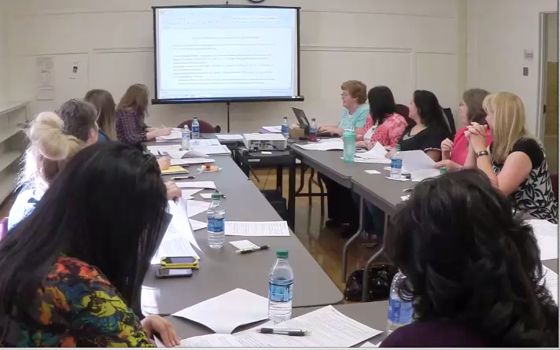
Memorandum of Understanding MOU
Promote smooth transitions for young children
Tied to funding at the LEA level
Agreed upon transition processes
Clarification of roles
Defined timelines
Notes:
Each Transition Team develops a Memorandum of Understanding (MOU). It is a shared responsibility to create it and to get signatures from agency and district personnel who have the role of signing such documents.
Once it is signed, it is a legally binding document.
Mandatory signees include all EI agencies, school districts and state supported schools, NMSD and NMSBVI. Partners such as Head Start, Early Care, Home Visiting, etc. are not required signees but are encouraged to sign.
The MOU outlines procedures for promoting a smooth and effective transition for children and their families. It is reviewed annually in most teams (this is recommended and revised (as needed, required by the state usually because of regulation/policy changes or every 4 years.)
Along with the timeline for transition, the MOU is a document that is made available for each staff member participating in the process. This, as well as the guidance document, are to be referred to regularly to make sure everyone is following regulations (both state and federal) and the procedures agreed to by all partners.
Districts must attach a copy of the signed MOU with their applications for IDEA Part B funding in the spring and are submitted to the Special Education Bureau, Public Education Department.

Slide 25
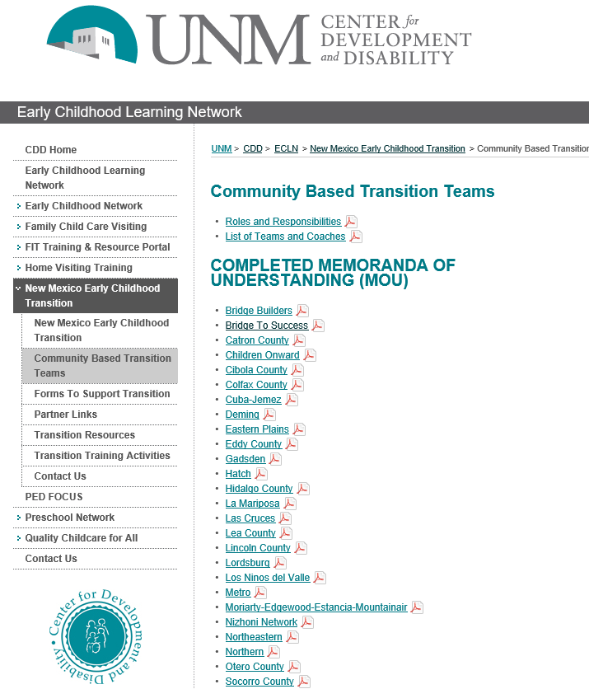
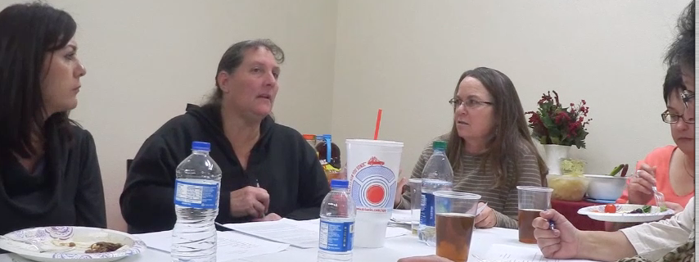
Transition MOU Library
http://www.cdd.unm.edu/ecln/Transition/index.html
Notes:
To find a copy of each Transition Team’s MOU, visit the NM Early Childhood Transition MOU Library website.
The Statewide Transition Coordinator keeps a repository of al the MOUs, both in PDF and Word so that if school and EI personnel move away, we always have a working document that each team can work from as they review their MOU annually.

Slide 26
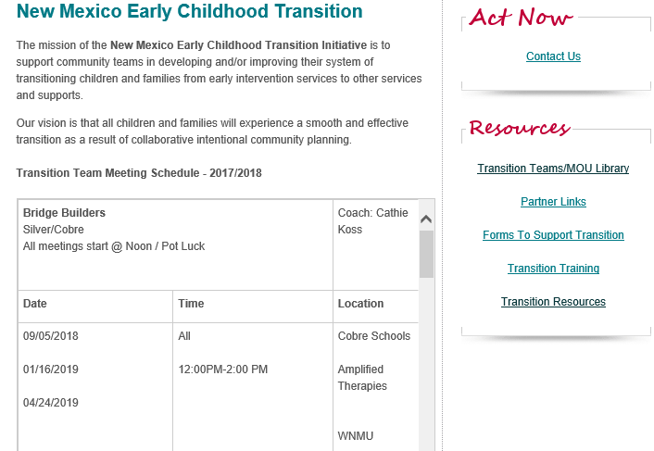
NM Early Childhood Transition Website
http://cdd.unm.edu/ecln/Transition/index.html
Notes:
Here is a screenshot of the NM Early Childhood Transition website. This illustrates the calendar of meetings for the 31 regional transition team’s.
We created this calendar to support districts in having a central location for finding information about upcoming meetings.

Slide 27
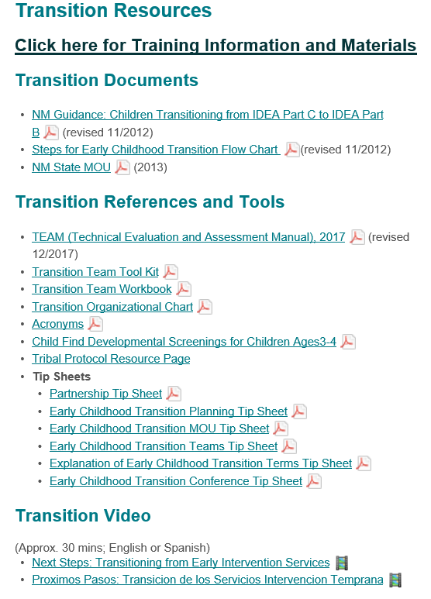
Transition Resources
Team Toolkit
Team Workbook
Tip Sheets
Tribal Protocol
Video
http://cdd.unm.edu/ecln/Transition/transitionResources.html
Notes:
Support for new staff and team members has been an ongoing concern and so we developed a team toolkit that is utilized by the coach and team lead to support new team members in understanding early childhood transition and their role on the team.
We also have tip sheets that support common questions like how long is our MOU good for…whose signatures are required on the MOU, who is responsible for facilitating the Transition Conference, etc.

Slide 28

NM Early Childhood Initiative Transition Website
http://www.cdd.unm.edu/ecln/Transition/index.html
NM DOH FIT Website
https://nmhealth.org/about/ddsd/pgsv/fit/
NM PED SEB Website
https://webnew.ped.state.nm.us/bureaus/special-education
Resources
Notes:
If you have any questions, or would like to know more about NM Early Childhood Transition Teams or processes, please contact me at sdrangmeister@salud.unm.edu or 505-917-6044.
Thank you.

Slide 29
Questions
What questions do you have?
What clarifications would be helpful?
Do you have a strategy or policy you would like to share?
Notes:
Kathy

Slide 30
Find out more at ectacenter.org
The ECTA Center is a program of the FPG Child Development Institute of the University of North Carolina at Chapel Hill, funded through cooperative agreement number H326P170001 from the Office of Special Education Programs, U.S. Department of Education. Opinions expressed herein do not necessarily represent the Department of Education's position or policy.

