Slide 1
State Strategies for Seamless Service Delivery and Transition Implementing the Extended Part C Option
December 19, 2018

Slide 2
Presenters
Jennifer Barrett-Zitkus, OSEP
Kathleen Heck, OSEP
Marcella Franczkowski & Pam Miller, Maryland
Allan Phillips and Carlene Reid, District of Columbia
Kathy Whaley, ECTA Center

Slide 3
FY 2019 Omnibus spending bill, signed by the President, included a $470 million appropriation for Part C
Under IDEA section 643(e), in any fiscal year where the appropriation exceeds $460 million, the Secretary shall reserve 15% of the appropriated amount to provide incentive grants to States that elect to offer Part C services beyond age three under IDEA sections 632(5)(B)(ii) and 635(c). (See also 34 CFR §303.211.)

Slide 4
IDEA- Part C Extended Option: Age 3 to Kindergarten Age
Allows flexibility to make Part C services available to children from age 3 until eligible to enter kindergarten or elementary school [635 (c)(1)]
Adds requirements in implementing this option [635 (c)(1)]
Adds a reporting requirement [637(b)(4)(A)
Requires identification of funding sources in the state’s policy
[635(c)(4)
Allows the use of funds for the Part C option [638(4)]
Notes:
Statute

Slide 5
IDEA- Part C Extended Option: Age 3 to Kindergarten Age
34 CFR §303.211 allows each State to develop and implement a policy under which parents of children who are receiving early intervention services and who are eligible to receive services under section 619 of Part B of the Act can choose for these children to continue receiving early intervention services under Part C of the Act
Children whose parents elect to continue to receive Part C services beyond age three must have an individualized family service plan developed that includes an educational component that promotes school readiness and incorporates pre-literacy, language, and numeracy skills consistent with the requirements in 34 CFR §303.344(d)(4). 34 CFR 303.211(b)(2)
Notes:
Regulations:

Slide 6
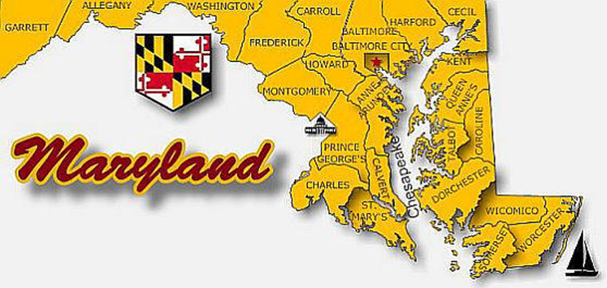
December 19, 2018
Strategies for Seamless Service Delivery and Transition:
Implementing The Extended Part C Option
In
Marcella Franczkowski, Assistant State Superintendent Pam Miller, Director, Maryland Infants and Toddlers Program
Maryland State Department of Education
Division of Early Intervention and Special Education Services

Slide 7
The Division of Early Intervention/Special Education Services STRATEGIC PLAN
Moving Maryland Forward
EARLY CHILDHOOD: Implementing a seamless and comprehensive statewide system of coordinated services for children with disabilities– birth to kindergarten– and their families in home, community, and early childhood settings to narrow the school readiness gap.
Maryland State Department of Education DIVISION OF EARLY INTERVENTION/SPECIAL EDUCATION SERVICES | Marcella E. Franczkowski, Assistant State Superintendent | December 2018

Slide 8
Maryland Snapshot – Who We Serve
Total Children/Students Receiving Early Intervention and Special Education Services – 2017
Total Children
Birth to 3
8,484*
Receiving Early
Intervention Services through an IFSP
Total Children
3 through 5
13,006*
Receiving Preschool Special Education and Related Services
through an IEP
Total Students
3 through 21
107,189*
Receiving Special Education and Related Services through an IEP
Total Children
Ages 3–4
1,306*
on an IFSP
Includes 94,191* Students Ages 6 through 21 on an IEP
Source: Maryland *Snapshot Date: October 1, 2017
Special Education/Early Intervention Services Census Data and Related Tables – 2016 Resident Population Data and U.S. Department of Justice, Office of Juvenile Justice Website (http://www.ojjdp.gov)
Maryland State Department of Education DIVISION OF EARLY INTERVENTION/SPECIAL EDUCATION SERVICES | Marcella E. Franczkowski, Assistant State Superintendent | December 2018

Slide 9
Maryland’s Unique Background Information
Maryland is one of five Birth Mandate states.
The Department of Education is the Lead Agency for the Maryland Infants and Toddlers Program.
Maryland has a broad eligibility criteria (Category A) – 25% delay in one or more area of development, atypical development, high probability condition.
Maryland State Department of Education DIVISION OF EARLY INTERVENTION/SPECIAL EDUCATION SERVICES | Marcella E. Franczkowski, Assistant State Superintendent | December 2018

Slide 10
The Extended Part C Option in Maryland
As of February 1, 2010, children who are were eligible for preschool services under Part B of IDEA may choose the continuation of early intervention services under Part C of IDEA.
The Code of Maryland Regulations Applicable to Infants and Toddlers with Disabilities and Their Families (including the Extended IFSP Option) in effect on 4/2/13 and currently receiving services in Part C.
The Extended IFSP Option extends to the beginning of the school year following the child’s fourth birthday.
Maryland State Department of Education DIVISION OF EARLY INTERVENTION/SPECIAL EDUCATION SERVICES | Marcella E. Franczkowski, Assistant State Superintendent | December 2018

Slide 11
Extended Part C Option in Maryland
Year | MITP Part C Child Count |  | Extended IFSP Option | Total October 1 Count | Extended Option %
 | October 1 Count | Annual Count | Age 3 and over
2009 | 7,178 | 14,301 | NA | 7,178 | NA
2010 | 7,697 | 14,636 | 1,005 | 8,702 | 11.55%
2011 | 7,380 | 16,038 | 1,312 | 8,692 | 15.09%
2012 | 7,478 | 16,296 | 927 | 8,405 | 11.03%
2013 | 7,773 | 16,547 | 1,086 | 8,859 | 12.26%
2014 | 7,729 | 17,105 | 1,125 | 8,854 | 12.71%
2015 | 7,798 | 17,445 | 1,178 | 8,976 | 13.12%
2016 | 8,094 | 17,697 | 1,031 | 9,125 | 11.30%
2017 | 8,484 | 18,251 | 1,306 | 9,790 | 13.34%
Maryland State Department of Education DIVISION OF EARLY INTERVENTION/SPECIAL EDUCATION SERVICES | Marcella E. Franczkowski, Assistant State Superintendent | December 2018

Slide 12
Family Choice at Age 3: IFSP vs IEP
Source: MD Online IFSP October 1, 2017
Maryland State Department of Education DIVISION OF EARLY INTERVENTION/SPECIAL EDUCATION SERVICES | Marcella E. Franczkowski, Assistant State Superintendent | December 2018

Slide 13
The Extended Part C Option in Maryland: LESSONS LEARNED
Despite variability between local programs, the ratio of families that choose the Extended IFSP Option versus an IEP remains relatively consistent, around 2/3.
Families report service coordination and continuous year round services as the major reasons for choosing the Extended IFSP.
Providers have reported difficulty staying neutral regarding family decision making (IEP vs. IFSP). MSDE issued a Technical Assistance Bulletin on Effective Transition Practices.
Necessary to provide continued messaging about school readiness and children on an Extended IFSP receiving services in community settings.
Broad stakeholder input was critical prior to, during, and following implementation of the Extended IFSP Option.
Maryland State Department of Education DIVISION OF EARLY INTERVENTION/SPECIAL EDUCATION SERVICES | Marcella E. Franczkowski, Assistant State Superintendent | December 2018

Slide 14
The Extended Part C Option in Maryland: Finance CONSIDERATIONS
Extended Option is funded by both federal & State funds through a Birth–4 funding formula and by local funds.
As a birth mandate state there are no family fees and Medical Assistance billing covers children on an Extended IFSP Option (no difference from a child Birth to Age 3).
Maryland State Department of Education DIVISION OF EARLY INTERVENTION/SPECIAL EDUCATION SERVICES | Marcella E. Franczkowski, Assistant State Superintendent | December 2018

Slide 15
The Extended Part C Option in Maryland: Service Provision and Personnel Development CONSIDERATIONS
Collaborative partnerships Birth to Kindergarten between Part C and Part B 619 staff at State and local level
Early Learning Standards Birth to Age 8 (MD Healthy Beginnings - Birth through Three already in place when started Extended Option)
Specific guidance and training provided around the educational component
Various models of service provision – IFSP services in Community Programs, Schools, and Home
Maryland State Department of Education DIVISION OF EARLY INTERVENTION/SPECIAL EDUCATION SERVICES | Marcella E. Franczkowski, Assistant State Superintendent | December 2018

Slide 16
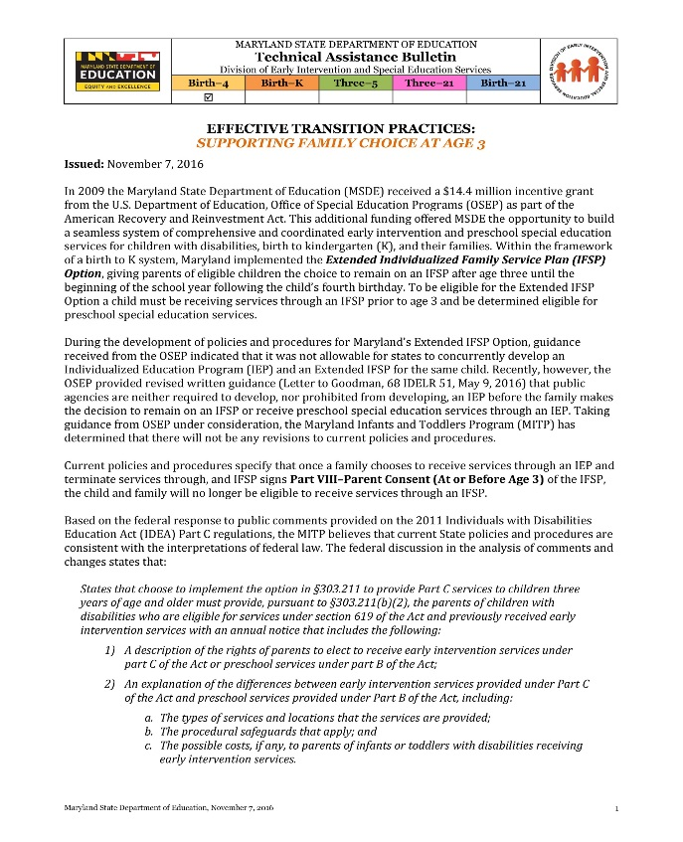
The Extended Part C Option in Maryland: Family Impact CONSIDERATIONS
Clear information for families to be fully informed
Clear information about effective transition practices
Maryland State Department of Education DIVISION OF EARLY INTERVENTION/SPECIAL EDUCATION SERVICES | Marcella E. Franczkowski, Assistant State Superintendent | December 2018

Slide 17
Transition at Age 3: Extended IFSP
Maryland State Department of Education DIVISION OF EARLY INTERVENTION/SPECIAL EDUCATION SERVICES | Marcella E. Franczkowski, Assistant State Superintendent | December 2018

Slide 18
The Extended Part C Option in Maryland: Data System and Monitoring CONSIDERATIONS
Data system changes are necessary to capture all data elements (Part C, Extended Option, Part B 619), including SPP/APR indicators.
Added the required educational component to the Child and Family Outcomes page of IFSP – Language, Numeracy, Literacy. A part of the Birth – 21 monitoring tool.
Added “Transition After Age Three” to the IFSP.
Maryland State Department of Education DIVISION OF EARLY INTERVENTION/SPECIAL EDUCATION SERVICES | Marcella E. Franczkowski, Assistant State Superintendent | December 2018

Slide 19
Birth to Kindergarten System of Services Points of Transition
Maryland State Department of Education DIVISION OF EARLY INTERVENTION/SPECIAL EDUCATION SERVICES | Marcella E. Franczkowski, Assistant State Superintendent | December 2018

Slide 20
Individuals with Disabilities Education Act (IDEA) Part C Extended Option in the District of Columbia (DC)
Dec. 19, 2018
Allan Phillips, Special Assistant (IDEA Part C)
Carlene Reid, Supervisory Coordinator for Special Education (IDEA Part B, 619)
20
Notes:
20

Slide 21
Background on the District of Columbia
The total population in the District is 693,972.
More than 9,000 children are born in the District of each year.
Approximately 26,000 children birth through age 3 are currently living in DC.
Source: US Census July 1 2017

Slide 22
Background on the District of Columbia
DC has universal pre-K for 3- and 4-year-olds.
Seventy-two percent of all 3-year-olds and 86 percent of all 4-year-olds were enrolled in pre-K in the 2017-18 school year.
Effective July 1, 2018, eligibility for early intervention services expanded from 50 percent delay in one area or 25 percent delay in two areas of development to 25 percent delay in any one area of development.

Slide 23
Extended Option in DC
As of July 1, 2014, children who are eligible for preschool services under Part B of IDEA may choose the continuation of early intervention services under Part C of IDEA (5-A DCMR §3110).
DC’s Extended Individualized Family Service Plan (IFSP) option extends up to the first day of school following child’s fourth birthday.

Slide 24
Extended Option in DC
District of Columbia IDEA Part C Statistics from 2012-2017
Year | DC Part C Child Count |  | Extended Option Part C | Total Dec. 1 Count | Extended %
 | Dec. 1 Count | Annualized | Children age 3 and older by year
2012 | 482 | NA | NA | NA | NA
2013 | 510 | NA | NA | NA | NA
2014 | 635 | NA | 65 | 700 | 9.29%
2015 | 784 | 1,375 | 137 | 921 | 14.87%
2016 | 794 | 1,434 | 109 | 903 | 12.07%
2017 | 823 | 1,600 | 118 | 941 | 12.54%

Slide 25
Considerations for Extended Option
Finances
Personnel
development
Early childhood infrastructure
Data systems/
monitoring

Slide 26
Finances
DC’s Medicaid plan will cover early intervention services for children eligible for IDEA Part C up until they enter school.
Extended option is primarily locally-funded in DC.
DC does not charge families any fees.
Notes:
For example, The Dec. 1 count for extended option ranged between 65-137 since inception in 2014. States would need to be able to secure funding that covers services for families that elect extended option.

Slide 27
Personnel Development
There needs to be a strong working relationship between Part C and Part B to ensure that service coordination is timely and effective.
The process has to be well-communicated to families including the differences in the IDEA Part B and IDEA Part C options, parents’ rights, accessing free appropriate public education (FAPE) and transition process.

Slide 28
Early Childhood Infrastructure
The DC Municipal Regulations (DCMR) include extended option.
The Strong Start, DC’s early intervention program, constantly does outreach and provides training to early childhood workforce on Part C service delivery model and screening.
Notes:
There is a challenge with balancing implementation of NLEP and implementation of educational goals. Challenge for therapists is the need to do more one on one rather than using coaching interaction style.
Describe constant outreach during talk (i.e. training with child care staff, meetings with key agencies, etc.) Reiterate - Our universal preK infrastructure requires us to do this type of outreach with stakeholders

Slide 29
Data Systems/Monitoring
The data system should be able to collect all the elements needed for Part C Annual Performance Reports (APR) reporting and Part B indicator reporting.
The data system should be able to disaggregate Part C data from extended Part C.

Slide 30
OSSE Contacts
1050 First St. NE, Sixth Floor
Washington, DC 20002
Allan Phillips, Special Assistant (IDEA Part C)
Allan.Phillips@dc.gov
Carlene Reid, Supervisory Coordinator for Special Education (IDEA Part B, 619)
Carlene.Reid@dc.gov

Slide 32
Questions
What questions do you have?
What clarifications would be helpful?
Notes:
Kathy

