Slide 1
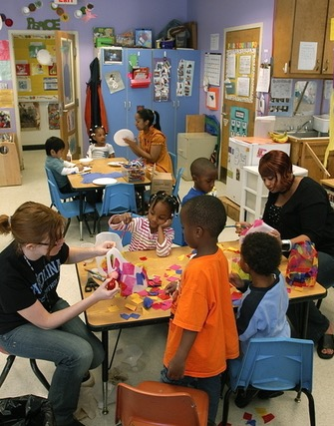
Strengthening Collaboration
Between IDEA Agencies and
Head Start Programs
December 15, 2022
Notes:
Strengthening Collaboration between IDEA agencies and Head Start Programs
During this webinar the Office of Special Education Programs and the Office of Head Start, joined by the Early Childhood Technical Assistance (ECTA) Center and the National Center on Development, Teaching and Learning, will be highlighting the newly released Guidance on Creating an Effective Memorandum of Understanding to Support High-Quality Inclusive Early Childhood Systems and the Dear Colleague Letter on IDEA Services in Head Start. Join us to learn about collaborative opportunities to support children with disabilities and their families. Together we will explore strategies and resources that can help to foster collaboration across programs and services and promote inclusion in early care and education.

Slide 2
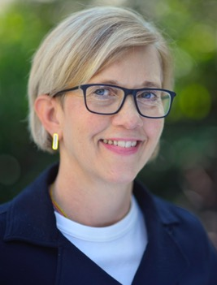
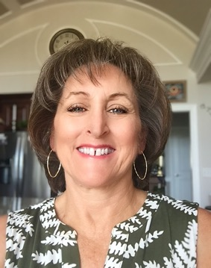




Introductions: Federal Presenters
Julia Martin Eile
Office of Special Education Programs
US Department of Education
Janette Guerra
Office of Special Education Programs
US Department of Education
Dayana Garcia
Office of Head Start
US Department of Health and Human Services

Slide 3


Technical Assistance Center
Presenters
Jani Kozlowski
Early Childhood Technical Assistance Center (ECTA)
Jen Fung
National Center on Early Childhood Development, Teaching and Learning (NCECDTL)

Slide 4

Today’s Agenda
Welcome/Introductions
What does the data show?
OSEP and OHS Joint Resources
MOUs: What, when, who and why
State and local collaboration examples
Question/Answer opportunity
Announcements/Upcoming Events
Closing

Slide 5

Setting the Stage:
What does the data show?

Slide 6
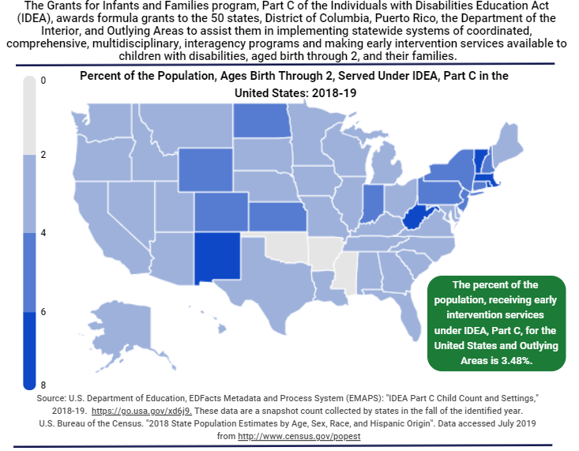
Part C – Infants and Toddlers Served

Slide 7
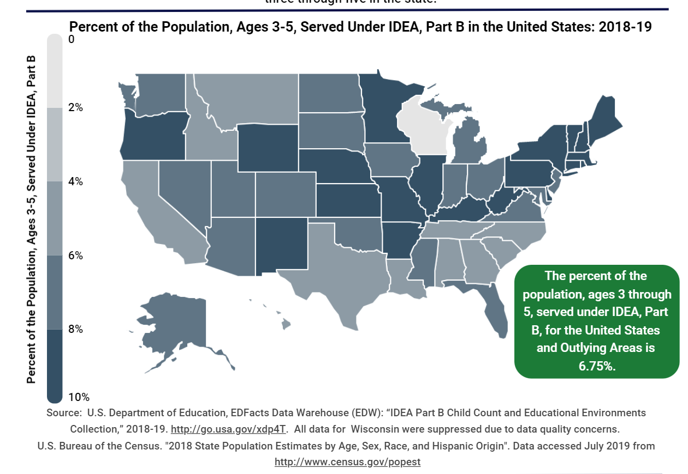
Percent of Population Served under IDEA
Notes:
In 2019, there were 806,319 children ages 3 through 5 served under Part B in the 49 States for which data were available, the District of Columbia, Bureau of Indian Education schools, Puerto Rico, the four outlying areas, and the three freely associated states. This number represented 6.7 percent of the resident population ages 3 through 5 (Exhibit 12).
https://sites.ed.gov/idea/osep-fast-facts-children-3-5-20

Slide 8
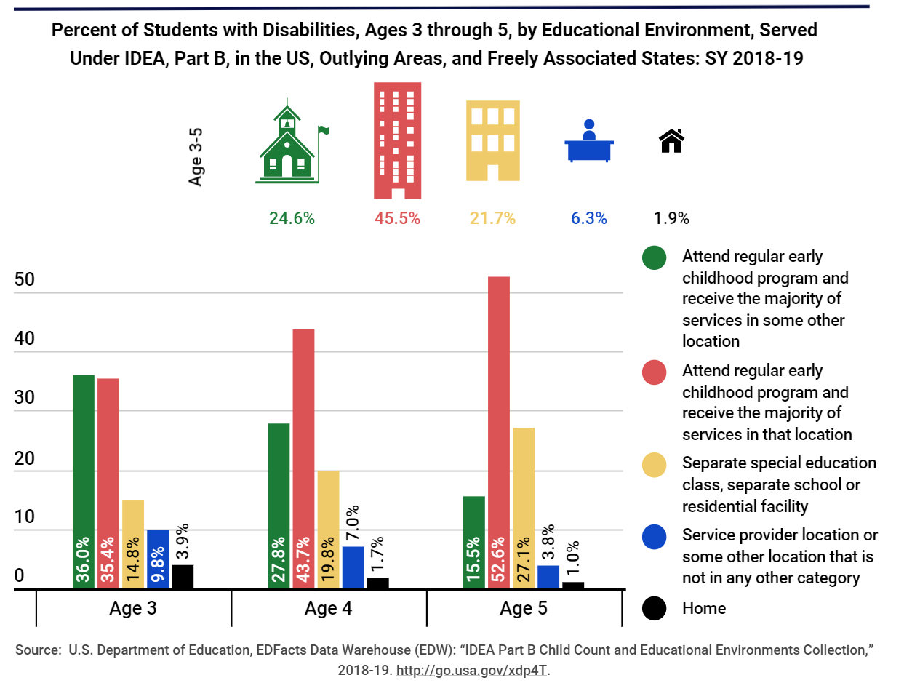
Pre-pandemic Data for Students with Disabilities
Notes:
Pre pandemic data
5 year olds – in this data it includes children in kindergarten – so it looks like more 5 yr olds are included in preschool than there really are (for the current data collection system, the kindergarteners are not included and the inclusive placement numbers for 5 yr olds dropped in many states.
https://sites.ed.gov/idea/osep-fast-facts-children-3-5-20

Slide 9
In the US: Least Restrictive Environment Data Over Time
yellow
6A Children attending a regular EC program and receiving services there
6B Children attending a special education class, separate school or residential facility
Note: 20-21 data does not include kindergartners who are 5 on the state collection date
Notes:
Data collected as part of state reports to the US Department of Education. These are data for preschool (children ages 3-4). Although note that in the 2020-2021 data, children who are 5 and in kindergarten are now reported under the school age data. The data in this figure also do not include entities – for example children who might attend
Home added as a reporting category
Indicator data taken from 619 Data Collection - point in time
Data in this presentation does not include entities
Data is from US DOE Static Table12: https://www2.ed.gov/programs/osepidea/618-data/static-tables/index.html, percentages are rounded

Slide 10
2021 PIR Data: Children Enrolled: 797,578
Children with an IEP: 74,135

Slide 11

OSEP & OHS Joint Resources
Notes:
Two new guidance documents that we jointly developed with the Office of Head Start Programs were released Oct 5th.

Slide 12
Joint Letter
Dear Colleague Letter on Individuals with Disabilities Education Act (IDEA) Services in Head Start
  IDEA Requirements of FAPE in LRE
  Collaboration
  Resources
Notes:
The first is a Dear Colleague letter that addresses providing IDEA services in Head Start classes. The letter has a three-fold purpose: first, we want to remind State and Local education agencies (SEAs/LEAs) of the requirements under IDEA to provide special education and related services to eligible preschool-aged children with disabilities in the least restrictive environment. Second, we want to emphasize the importance of ongoing collaboration between the SEA, LEAs, and their Head Start program partners to effectively meet IDEA requirements and ensure the provision of a free appropriate public education (FAPE) to children with disabilities. Lastly, the letter provides resources to assist in implementing high-quality early childhood programing for all children.
However, particularly since the pandemic, both OSEP
and OHS have quantitative data and other information that indicate—
Initial evaluations to determine eligibility of children suspected of having a disability are being delayed;
Special education and related services included in IEPs are not being provided timely, or IEPs are not being fully implemented; and
Educational placement decisions for children with disabilities are not being made in accordance with IDEA’s LRE requirements.
Page 3
SEAs, LEAs, and Head Start programs all have responsibilities for implementing IDEA:
SEAs are responsible for establishing and enforcing policies and procedures to ensure full implementation of child find and other IDEA requirements to ensure that FAPE is made available to all eligible children with disabilities in the State;
LEAs are responsible for identifying, locating, and evaluating children suspected of having disabilities in a timely fashion and developing and implementing IEPs for eligible children with disabilities in accordance with the applicable IDEA requirements; and
Head Start programs are responsible for referring children and families for IDEA evaluations as well as supporting implementation of children’s IEPs.
Understanding the roles and responsibilities of each of these partners is imperative to successfully implement IDEA and ensure FAPE in the LRE is made available for all children with disabilities in the State.⁴
IDEA Requirements, Including Ensuring a Free Appropriate Public Education in the Least Restrictive Environment
Child Find
Initial Evaluation and Eligibility Determination
Development of the IEP
Determination of the Placement in the LRE for the Child
Collaboration with Head Start to Support Implementation of IEPs
Resolving Disagreements
Collaboration Between Partners
TTA Resources

Slide 13

MOU Guidance
NEW
Guidance on Creating an Effective Memorandum of Understanding to Support High Quality Inclusive Early Childhood Systems
  Vision: A seamless system of early care and education with a coordinated approach to service delivery for infants, toddlers, and preschool children (young children) with disabilities and their families.
  IDEA Part C/Part B619 programs and Head Start
    concepts apply to any early childhood partnership
  Examples of effective MOU components
  Resources
  Table A examples
Notes:
The second document is guidance on developing effective MOUs to formalize those early childhood partnerships that are necessary to build a seamless system of early care and education with a coordinated approach to serve all children in meaningful inclusive programs. It uses IDEA programs and Head Start programs as the example but the concepts can be applied to all early childhood partners. We expect that all states have MOUs in place with at least their Head Start partners. This resource can be used at the state and local levels to operationalize collaborative roles and responsibilities.
The Office of Special Education Programs (OSEP) and the Office of Head Start (OHS) envision a seamless system of early care and education with a coordinated approach to service delivery for infants, toddlers, and preschool children (young children) with disabilities and their families. This requires heightened and sustained levels of ongoing collaboration between the Individuals with Disabilities Education Act, (IDEA) Part C early intervention and Part B, Section 619 preschool special education programs and Head Start programs. This also includes other early childhood programs such as child care and State preschool programs.

Slide 14
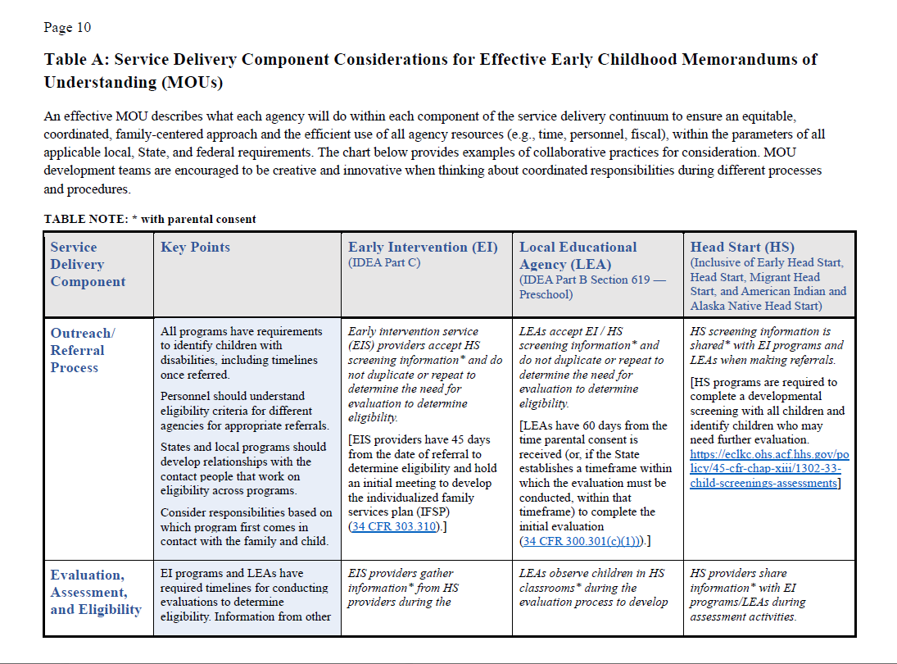
Table A: Examples
Service Delivery Component
Outreach/Referral Process
Evaluation, Assessment, Eligibility
IFSP/IEP Development
Child Outcome Ratings
Service Delivery
IFSP/IEP Reviews
Transition Planning
Training and TA

Slide 15
Memorandum Of Understanding (MOU):
Who, why, what and where

Slide 16
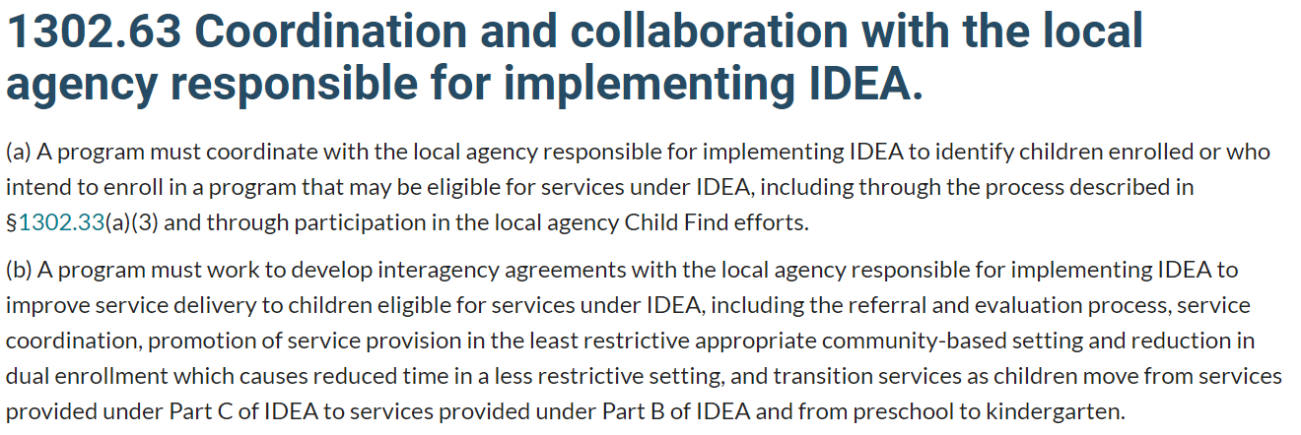
But first…. The regulations
Head Start:
Source: https://eclkc.ohs.acf.hhs.gov/policy/45-cfr-chap-xiii/1302-63-coordination-collaboration-local-agency-responsible-implementing-idea
Notes:
As mentioned, in Table A within the guidance document, there is a crosswalk of the different components of an MOU and the applicable federal requirements for Head Start, Part C and Part B, 619.
It’s clear from our federal requirements that these agencies should work together, and if we zoom out a bit, we can see this clearly as part of the overarching expectations for each.
Head Start is a clear example here, in that this regulation refers to the specific requirement around the development of an interagency agreement or MOU.
For reference….
Table A: Service Delivery Component Considerations for Effective Early Childhood Memorandums of Understanding (MOUs)
An effective MOU describes what each agency will do within each component of the service delivery continuum to ensure an equitable, coordinated, family-centered approach and the efficient use of all agency resources (e.g., time, personnel, fiscal), within the parameters of all applicable local, State, and federal requirements. The chart below provides examples of collaborative practices for consideration. MOU development teams are encouraged to be creative and innovative when thinking about coordinated responsibilities during different processes and procedures.

Slide 17
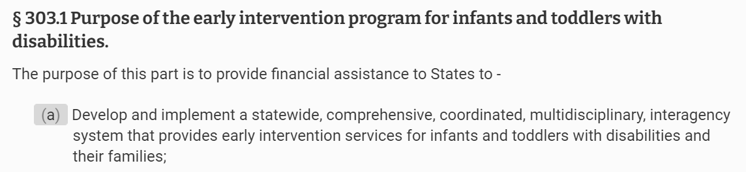
But first…. The regulations page 2
IDEA Part C:
Source: https://www.ecfr.gov/current/title-34/subtitle-B/chapter-III/part-303
Notes:
Part C also includes an overarching statement around collaboration at the start of the regulations. You can see it here in the purpose statement.

Slide 18
But first…. The regulations page 3
IDEA Part B, Section 619:
Regulations are specific to the components of an MOU, including:
Screening and evaluation: 34 CFR 300.301(c)(1)
IEP development and review: 34 CFR 300.320 and 34 CFR 300.324(b)(1)(i)).]
Service delivery: 34 CFR 300.114(a)
Transition planning: 34 CFR 300.124
Source: https://www.ecfr.gov/current/title-34/subtitle-B/chapter-III/part-303
Notes:
And as mentioned, the specific components related to the IDEA/Head Start collaboration can be found in IDEA Part B, Section 619 as well.
For reference from Table A:
LEAs accept EI/ HS screening information* and do not duplicate or repeat to determine the need for evaluation to determine eligibility. [LEAs have 60 days from the time parental consent is received (or, if the State establishes a timeframe within which the evaluation must be conducted, within that timeframe) to complete the initial evaluation (34 CFR 300.301(c)(1))).]
LEAs observe children in HS classrooms* during the evaluation process to develop functional individualized education programs (IEPs). [LEAs must conduct a meeting to develop an IEP for a child within 30 days of a determination that the child needs special education and related services; and, as soon as possible following development of the IEP, special education and related services must be made available to the child in accordance with the IEP (34 CFR 300.323(c)).]
IEP services are planned with HS teachers and provided within HS classroom routines and activities. [IEP services must be provided in the least restrictive environment to the maximum extent appropriate (34 CFR 300.114(a).]
IEP Teams provide information to families transitioning from Part C to Part B services, including how IEP services might be provided in HS classrooms. [LEA personnel must participate in transition planning conferences (34 CFR 300.124).]

Slide 19

Who?
To support productive agreements:
Ensure representation across agencies
Consider diverse perspectives and experiences
Include people with decision-making authority
Notes:
Who: The first step in developing an MOU or revising an existing MOU, at any level, is to identify members of a leadership team across agencies to work on the document and to then oversee its implementation. It is important to ensure membership includes representation from diverse perspectives, areas of expertise, and responsibilities (e.g., director, provider, family member, fiscal manager) as well as those with the authority to make decisions. This supports agreements that are well-informed and have a greater chance of successful implementation. For example, at the State level, the team would, at a minimum, include the: Head Start Collaboration Director, IDEA Part C and Part B Section 619 coordinators, monitoring, and legal personnel from both the State educational agency and State lead agency, local program leaders and service providers, other partner agencies, family members, and pertinent stakeholders from the State and regional levels.

Slide 20
Why?
Collaborate to create a shared understanding:
Benefits of formalized agreement
Shared values
Collective purpose
Meet requirements
Notes:
Why:
When developing relationships to establish an MOU, it is critical to review the benefits of having a formalized agreement and have shared values and understanding of the collective purpose, for example, to:
Create an equitable and coordinated early childhood system. Equity in early childhood education is providing all children high-quality equitable services that allow them to grow and succeed. The provision of early care and education that meets the unique needs of each and every young child requires coordination among multiple State systems. When State agencies that serve young children come together and define each other’s roles in providing services to young children who are at risk for or have a developmental delay or disability and their families, they are better able to create a more coordinated system.
Improve relationships across agencies and staff. IDEA programs, Head Start and other early care and education agencies, and their respective staff should connect regularly and intentionally about serving young children who are at risk for or have a developmental delay or disability and their families. Outlining how often agencies will regularly meet and what collaborative efforts they are working to improve (e.g., child find, delivery of services, resource allocations, and MOU development and revisions) will help them build their partnerships.
Maximize resources, including fiscal resources. IDEA programs, Head Start and other early care and education agencies should share resources to promote a coordinated approach to delivering services to young children who are at risk for or have a developmental delay or disability and their families. Fiscal resources may be blended, braided, and layered to the extent allowable under applicable laws. Agencies can more efficiently use their resources by outlining relevant resources each agency can share, including space, staff time, data, professional development, and funding.
Improve child and family outcomes. IDEA programs require that State agencies report child and family outcomes data. Head Start is encouraged to share data from the Program Information Report (PIR) at the State and local levels to complement data collected from IDEA partners. A cohesive approach to improving services for young children who are at risk for or have a developmental delay or disability and families, requires that agencies outline child and family outcome data points collected by each agency and include steps each agency will take toward supporting the improvement of those data.
Identify young children with disabilities as early as possible. Many early care and education agencies have requirements for screening and identifying children with suspected developmental delays or disabilities. Outlining their child find processes in the MOU may help agencies identify ways in which they could improve their child find efforts.
Increase IDEA services in the natural environment and in inclusive settings. IDEA programs require that eligible young children are provided services in a natural setting where a child would be educated if they were not identified with a disability. Head Start programs must ensure enrolled children with disabilities, including but not limited to those who are eligible for services under IDEA, and their families receive all applicable program services delivered in inclusive environments and that they fully participate in all program activities. Agencies can review the range of settings that services are currently being provided in to identify areas that do not have inclusive settings and develop steps to expand the number of inclusive settings.
Increase cross-fertilization of ideas among interagency members. IDEA programs, Head Start and early care and education agencies should share and consider how they can support one another in implementing innovative solutions or approaches to providing services to young children who are at risk for or have a developmental delay or disability and their families.
Increase understanding and implementation of transdisciplinary practices. IDEA programs, Head Start and early care and education agencies should promote practices that include coaching and the implementation of cross-disciplinary team support that improves service delivery of early childhood services. Being clear on the services each agency provides will allow the agencies to identify gaps in services and plan for increasing transdisciplinary practices to improve child and family outcomes.
Increase staff collaboration skills. IDEA programs, Head Start and early care and education agency staff members require an understanding of each other’s work to support young children who are at risk for or have a developmental delay or disability and their families. Identifying strategies to bring staff together and ensuring time where they can work together can help them build their collaboration skills.
Increase cross-sector professional development opportunities. IDEA programs, Head Start and early care and education agencies can provide professional development and technical assistance that staff from other agencies can access. Establishing areas for joint professional development and trainings can support the mission and shared values of the MOU.
Define roles and share responsibilities across agencies. The roles of IDEA programs, Head Start, and early care and education agencies in serving young children with disabilities and their families should be clearly stated. In instances where service areas overlap, the expectations for collaboration and oversight should be described. An MOU can help each agency clearly define its role, which will assist with maintaining the group’s focus on improving child and family outcomes.
Share data and information to strengthen services to young children with disabilities and their families. IDEA programs, Head Start, and early care and education agencies collect data that can enhance service delivery for young children with disabilities and their families. Data sharing may be done in the aggregate (on a deidentified basis) or individually (with parental consent where required and/or through an MOU that utilizes a specific exception Page 7 under the IDEA privacy regulations in 34 CFR 300.622 and 303.414). It is critical to include legal review to ensure that the IDEA Part C and Part B confidentiality and privacy requirements are met.5 The development of the MOU may reveal additional areas for data collection and analysis across systems.
Meet requirements of IDEA and Head Start. Under IDEA Part C, to the maximum extent appropriate, infants and toddlers with disabilities must receive early intervention services in the natural environment. Under IDEA Part B, to the maximum extent appropriate, children with disabilities must be educated with children without disabilities. Under Head Start program requirements, HS programs must ensure enrolled children with disabilities, including but not limited to those who are eligible for services under IDEA, and their families receive all applicable program services delivered in the least restrictive possible environment and that they fully participate in all program activities. An MOU that ensures services across programs supports implementation of these and other requirements of the applicable laws and regulations and should improve outcomes for young children with disabilities and their families.

Slide 21
What?
Describe each agency’s role to address key IDEA activities:
Child find
Eligibility evaluation
IFSP or IEP process
Child and family outcomes
Placement
Service delivery
Collaboration
Transitions
Notes:
What:
In order to effect system changes, States need time to consider factors across the implementation components (leadership, organization, and capacity-personnel & program) that make up their infrastructure. For example, MOUs might address leadership components through agreed upon commitments and community awareness strategies. Organization components include policies, procedures, data, funding, quality assurance, early learning and program standards, family engagement, and the systems to support and sustain these organization components.
Capacity components include looking across programs to align early childhood personnel standards, preservice preparation, credential and licensing requirements, and ongoing cross-sector professional development, teaming, and coaching. The Early Childhood Indicators of High Quality Inclusion offer specific focus areas at each system level for States to consider including in their MOUs. At the State and local levels, discussions should also consider each agency’s role and responsibilities to address the successful implementation of IDEA requirements within Head Start programs at each major point of the service delivery continuum:
• Child find and referral;
• Evaluation and eligibility;
• Individualized Family Service Plan (IFSP)/Individualized Education Program (IEP) development and reviews• Child and family outcomes;
• Placement decisions;
• IFSP/IEP implementation;
• Ongoing service delivery;
• Collaborative teaming, coaching, communication;
• Transition from IDEA Part C to IDEA Part B, Section 619 programs, and to kindergarten; and
• Contingency plans for national, State, or local emergencies.
The Head Start Disabilities Services Coordinator Orientation Guide Appendix A: Building an Interagency MOU provides additional details to consider in developing State and local level agreements. Also, the Service Delivery Component Considerations for Effective Early Childhood Memorandums of Understanding (attached Table A) offers examples of collaborative practices throughout service delivery to stimulate thoughts and discussions as MOUs are developed and reviewed. An MOU should be written so that it is clearly understood. The language of an MOU should be simple and straightforward. A good approach is to use language that makes all parties feel important and vital to the relationship, keeping in mind that the written document should reflect what has been negotiated and agreed upon. There is no standard MOU format. A common-sense approach should guide both the development of the instrument and the decisions regarding inclusions and exclusions.

Slide 22

Common MOU Components
Purpose
Program Overviews
Shared Philosophy
Areas of collaboration
Agency Roles/Responsibilities
Confidentiality
Dispute Resolution
Review and Amendments
Definitions
Signatures
Appendices

Slide 23
When?
Ongoing activities should demonstrate dedication to keeping partnership strong:
Ongoing, open dialogue
Intentional collaboration
Regular discussion of MOU implementation
Conflict resolution
Specific timelines for MOU review, revisions, and updates
Notes:
When:
Specify an annual review schedule for the agreement to ensure that it is of high quality. Once the MOU has been written and signed by the agencies involved, the next steps are to implement and sustain the agreement. There are several strategies to help successfully implement and sustain the MOU:
• Maintain an open dialogue between the agencies involved as this will facilitate the ongoing development and evolution of the agreement;
• Establish a regular (e.g., quarterly, semi-annually, annually) schedule of formal meetings or workgroups to discuss the progress of the implementation of the MOU and potential areas of change to consider;
• Address potential conflicts and resolve in a respectful and professional manner;
• Maintain intentional and purposeful collaboration;
• Provide training and orientation on the collaboration for all new staff at each agency involved;
• Provide a centralized file location or repository for MOU documentation and meeting notes to be accessible by all involved; and
• Determine timelines for revisions, updates and overall schedules of MOU reoccurring activities, including revisions based on needs, leadership and staff changes, natural disasters, or health emergencies. These strategies may serve as the foundation for successful collaborative work and to increase partnerships and joint activities to strengthen inclusive services for young children with disabilities and their families

Slide 24

Innovations:
State and Local Examples of Collaboration
State-level MOUs
Shared data gathering initiatives
State-level crosswalk
Collaborative professional development opportunities
Transition activities
Staffing models
  Co-visits
  Head Start family engagement staff at LEA preschool
  LEA specialists at Head Start center
  Co-licensed center
Notes:
state-level collaboration
State-level development of an MOU that serves as guidance and support for local-level MOUs
Shared data gathering to identify areas of need across sectors of Head Start, Early Intervention and Early Childhood Special Education
State-level crosswalk developed for clarification around state-specific regulations and guidance
Collaborative model for leadership development and the creation of an innovative state-level Early Childhood Inclusive Leadership Fellowship
local HS collaboration
Expand on collaborative PD – local level examples of PD, often around teaching practices, several Pyramid Model
Collaborate on transition activities – transition fair, open house, school playground nights, backpack dropoff/distribution
Staffing models

Slide 25



Questions/Answers
Share your questions in the chat box!
Notes:
.

Slide 26

Save the Date for the Inclusion Institute
Save the Date!
May 16-18, 2023
The Friday Center in Chapel Hill, NC
Details will be coming soon!
Find out more at: https://inclusioninstitute.fpg.unc.edu/
Notes:
The International Early Childhood Inclusion Institute has become one of the premier educational opportunities for anyone involved in the care and education of young children with disabilities in inclusive settings.
For more than 21 years, the Institute has drawn people from across the nation and around the world to Chapel Hill to:
learn about the latest research findings, models, and resources that guide inclusive policy, professional development, and practice;
to develop collaborative relationships and cross-agency systems that support early childhood inclusion; and
to have the opportunity to meet, learn from, and problem-solve with peers.

Slide 27

Thank you for joining us!

Slide 28
Find out more at ectacenter.org
The ECTA Center is a program of the FPG Child Development Institute of the University of North Carolina at Chapel Hill, funded through cooperative agreement number H326P170001 from the Office of Special Education Programs, U.S. Department of Education. Opinions expressed herein do not necessarily represent the Department of Education's position or policy.

