Slide 1
Bringing Inclusion to Life in a Virtual World
A webinar sponsored by the Early Childhood Technical Assistance Center (ECTA) and the National Center for Pyramid Model Innovations (NCPMI)

Slide 2
What changed under COVID?
Shift from in person services to virtual services
Alter the very basics of early intervention and preschool special education
Services delivered through tele-intervention/teletherapy increasing the reliance on virtual platforms and requiring greater parent or guardian involvement
Additional unexpected costs to states, locales and families
The needs of families and children have changed!!!

Slide 3
What did not change under COVID
FAPE requirements
LRE requirements
Data requirements

Slide 4
Inclusion in COVID
When LRE cannot be measured (time and place) because of online AND
When high quality inclusion (characteristics and desired outcomes) are difficult to plan
THEN we turn to the use of inclusive practices because of their operationalized nature because they can be used regardless of instructional modality- online, hybrid or in person with health and social distancing requirements.

Slide 5
Key Early Childhood Education Environment (ECEE) Indicators to Support Inclusion (regardless of instructional modality)

Slide 6
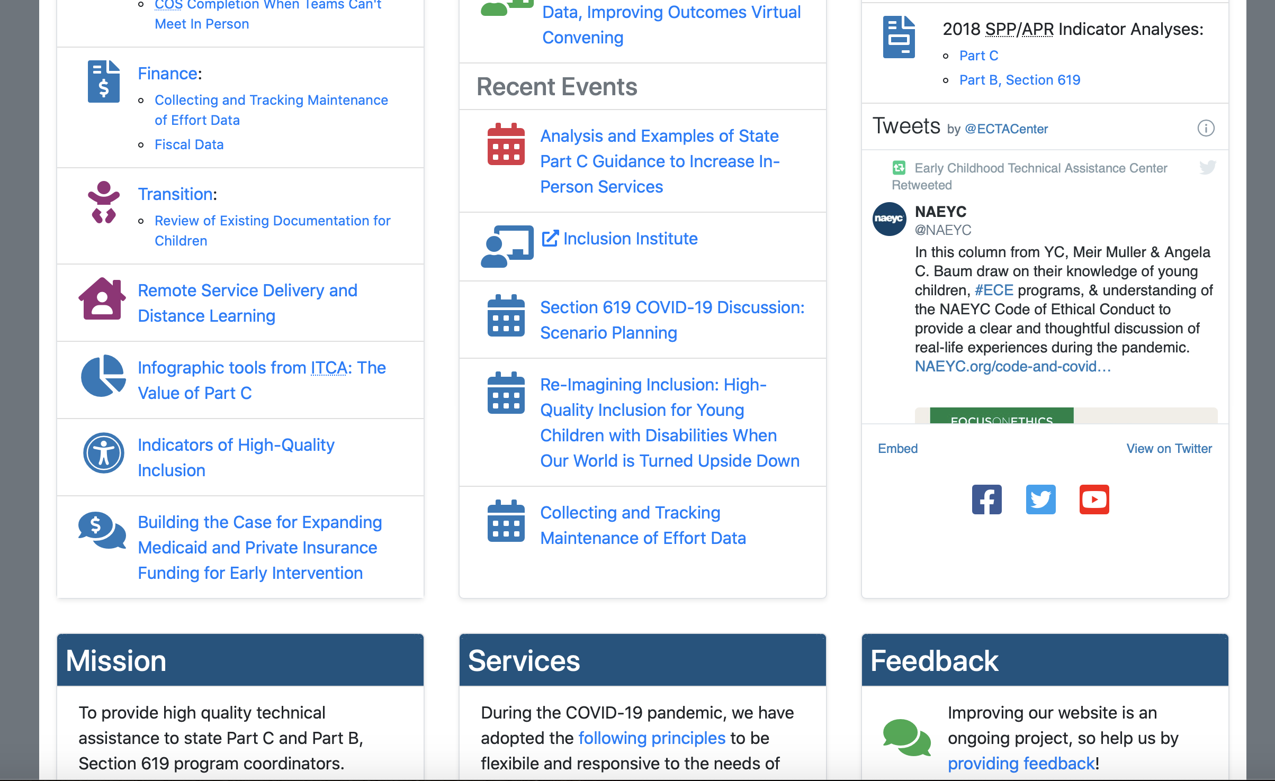
From the ECTA Homepage

Slide 7
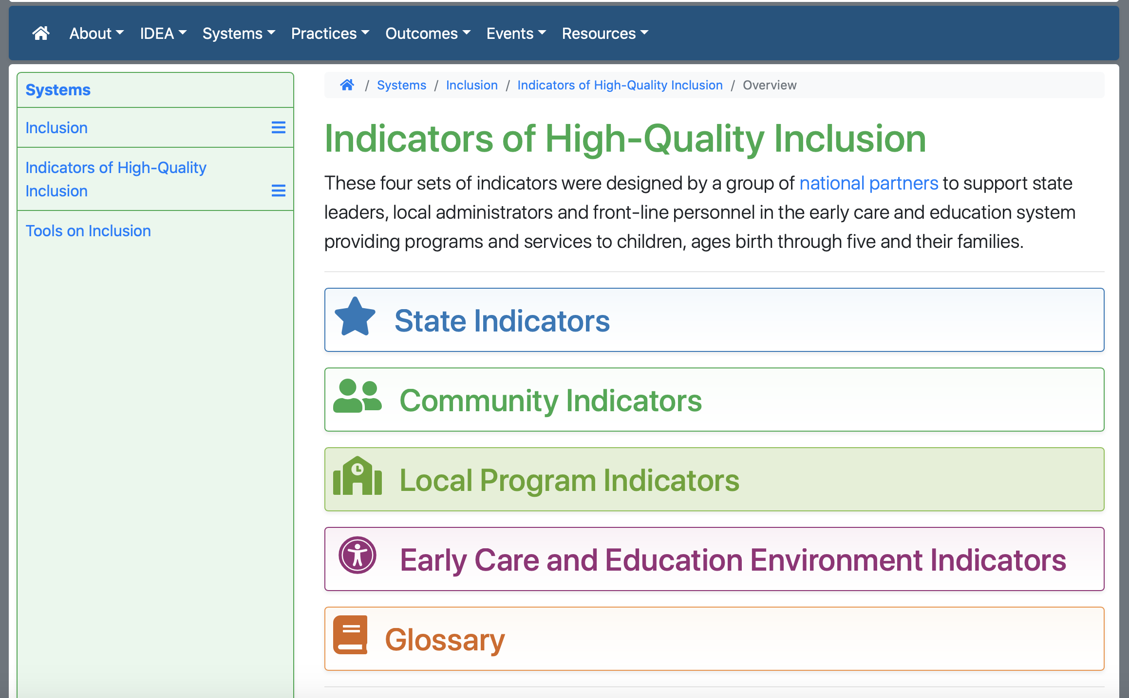

Slide 8
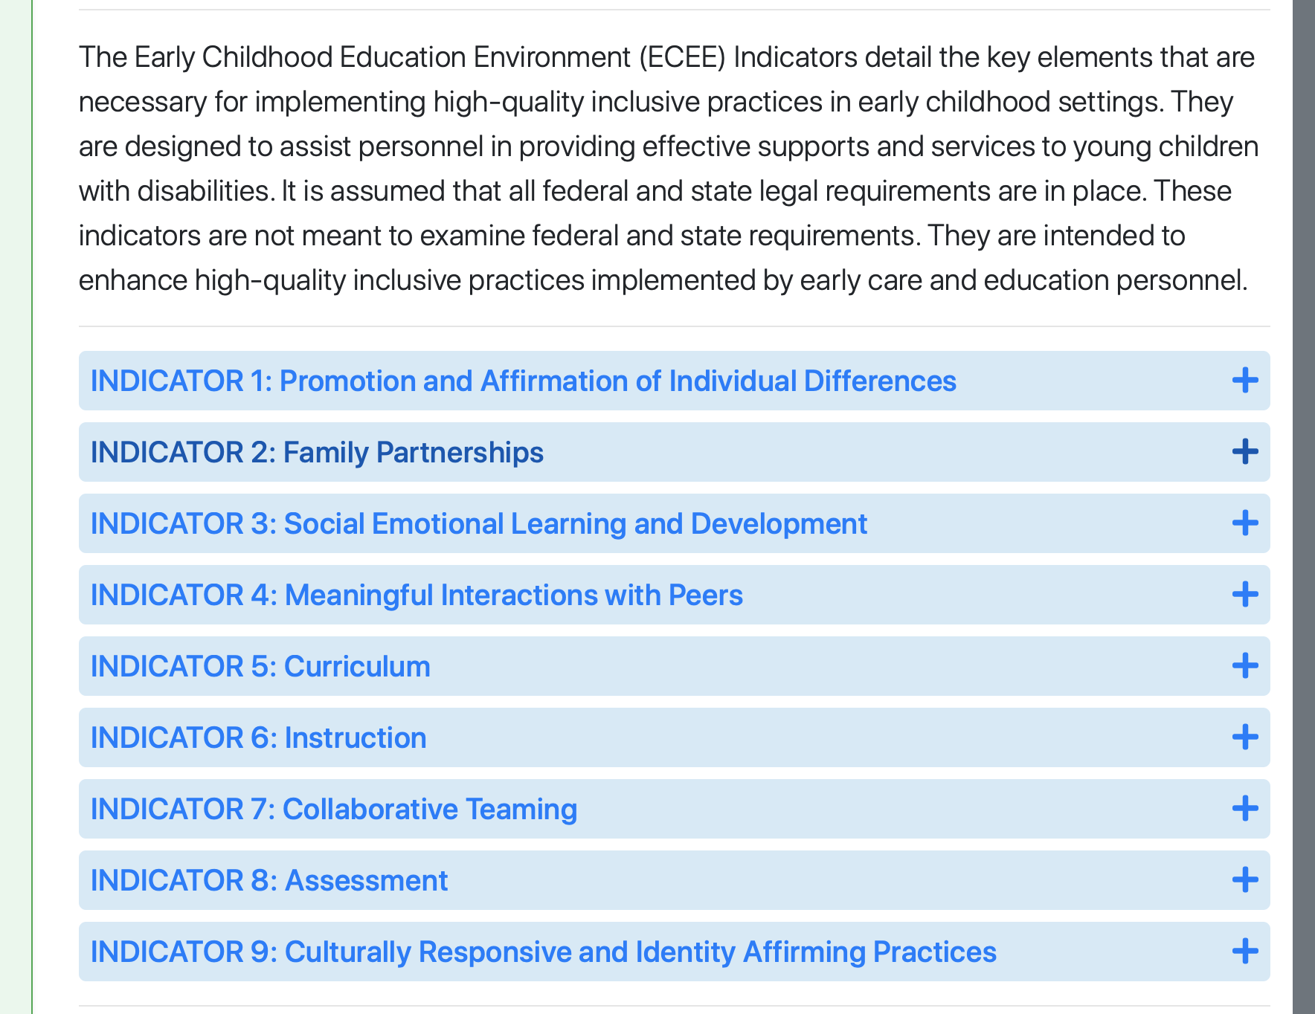

Slide 10
Early Childhood Education Environment Indicator #2-
Family Partnerships
Element #5
Include and involve families in early care and education environment activities to the extent to which families want to and are able to be involved. Providers offer a multitude of ways for families to be involved, such as observing, volunteering, and developing materials outside of the early care and education environment. Opportunities for involvement are culturally and linguistically affirming.

Slide 11
Online Family Partnership Opportunities
Ask families what they need and how they want to engage- this can be through a phone call, email or needs checklist.
Establish new “home-based” goals and intervention plans to meet those goals. Check in with families and make sure that goals that are listed are indeed their priorities.

Slide 13
Hybrid- Guiding Questions
How can bi-directional communication with families be encouraged to drive in-person learning experiences?
Apps
Communication books
Regular emails, phone calls or Zoom meetings
AND… a combination of all of these
AND… can change day to day.
Remember, this experience is unique to each person and family and their individual responses need grace!

Slide 14
In-Person Learning (with health and social distancing restrictions)
Curbside drop off and pick up with use of the app (BrightWheel) for check-in, payment AND bidirectional sharing with families.
When a family is not ready for this, what accomodations can be made that everyone can live with?

Slide 15
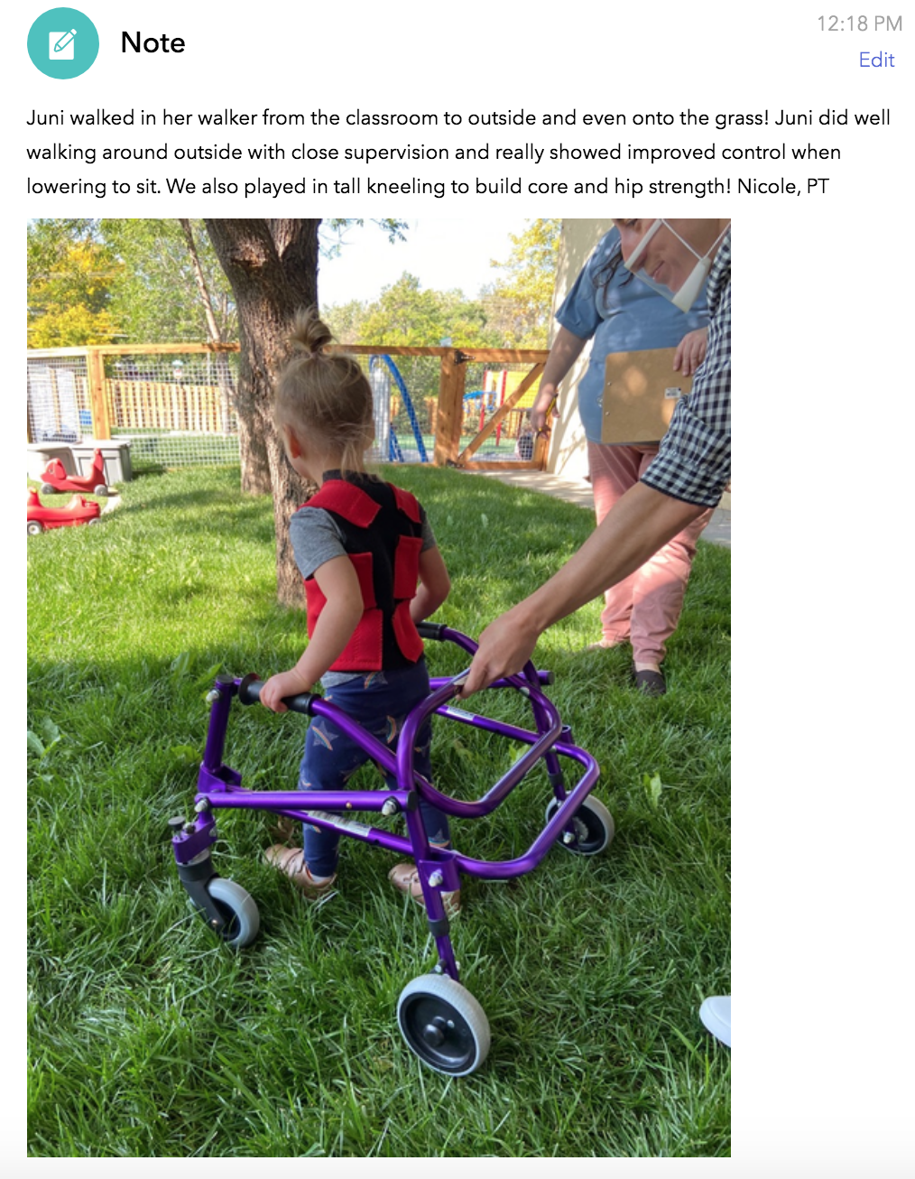
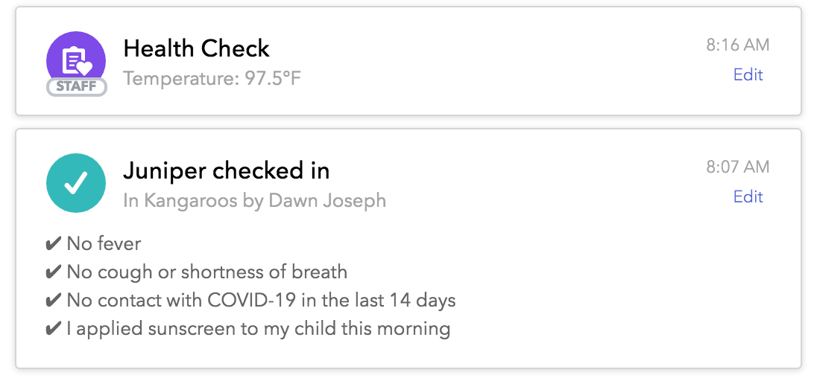
BrightWheel Examples

Slide 16
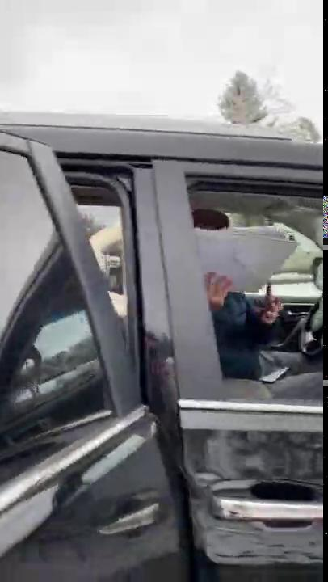
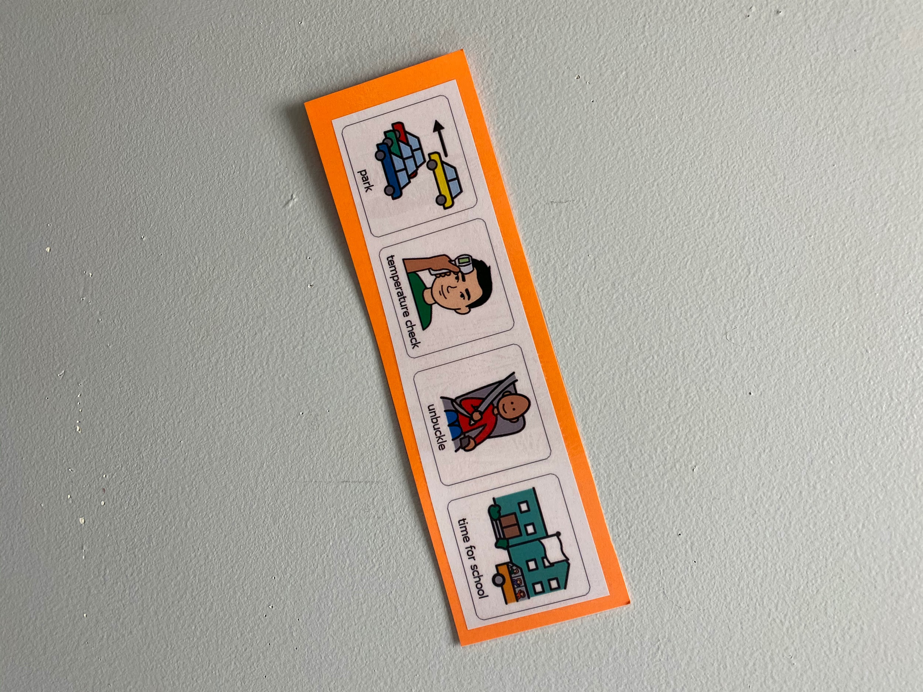

Slide 17
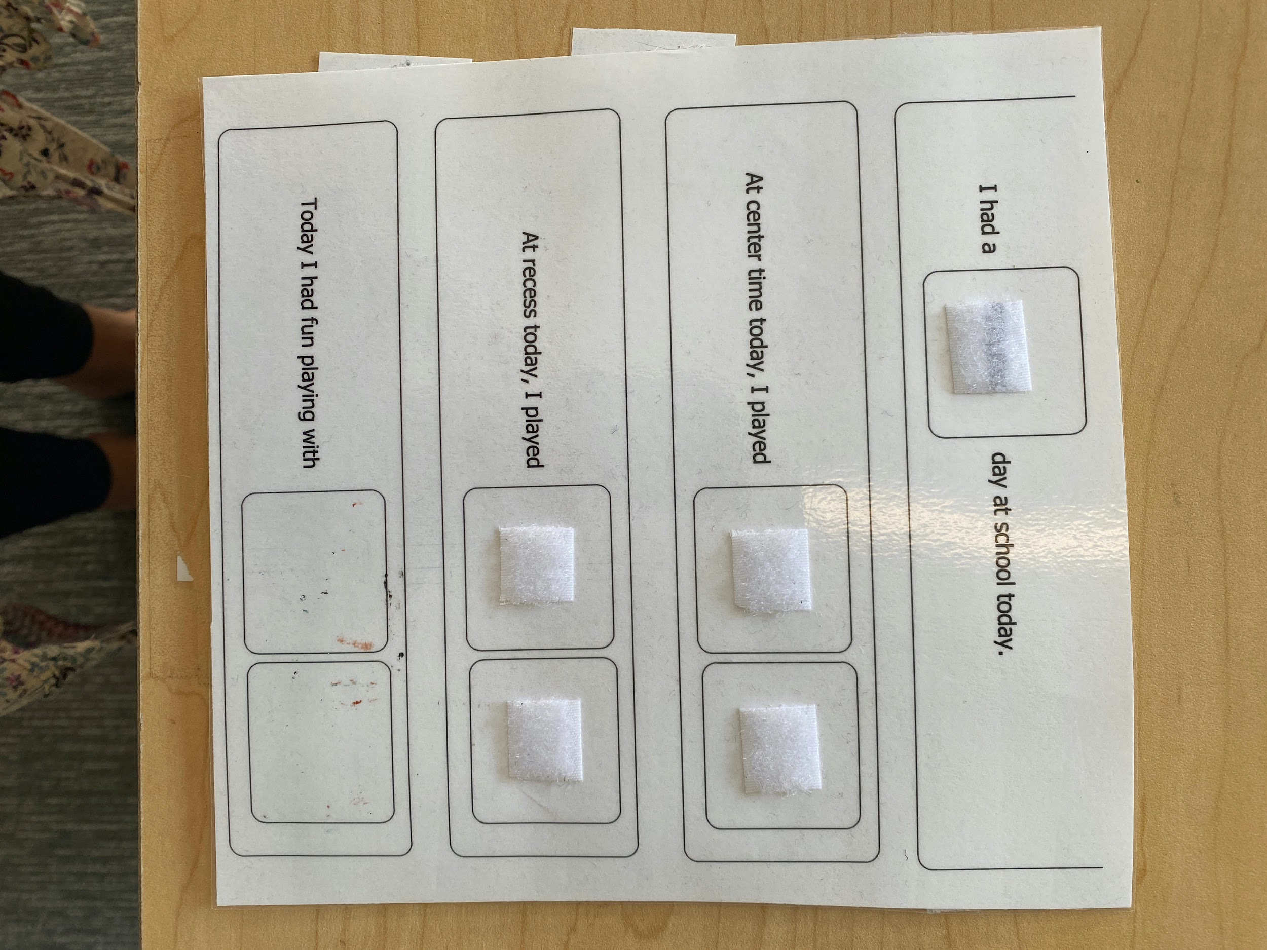

Slide 18
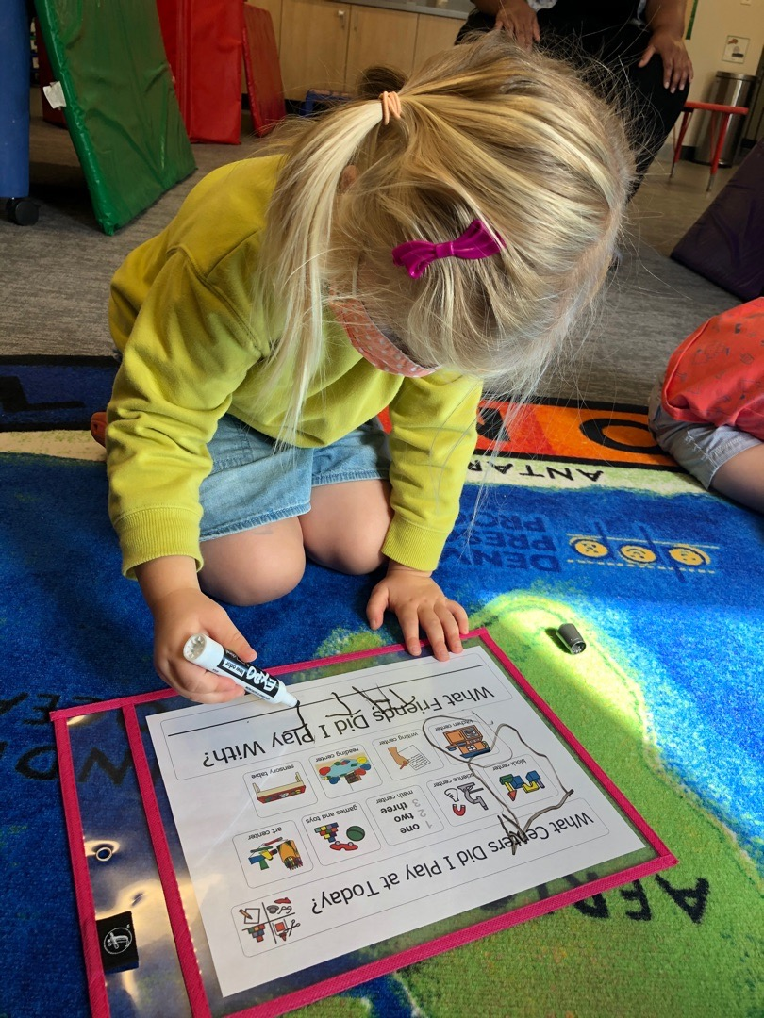

Slide 19
Early Childhood Education Environment Indicator #4: Meaningful Peer Interactions
Element #2
Teach appropriate peer social skills through large and small group lessons and role-playing opportunities for all children

Slide 20
Online: Note: Inclusion does not just happen with children in public schools settings- peer interactions can include siblings, neighborhood friends, community members such as worship centers- so think outside of the box!
Lunch Bunch for a child with peer-mediated intervention for feeding.
Peers would log onto Zoom and do his feeding therapy with him virtually.

Slide 21
Arrange for children to work with or talk to each other outside of “school”. Have guiding questions (e.g., what is your favorite animal?).
Resource: Barton Lab https://lab.vanderbilt.edu/barton-lab/

Slide 24
Resource: Barton Lab https://lab.vanderbilt.edu/barton-lab/

Slide 25
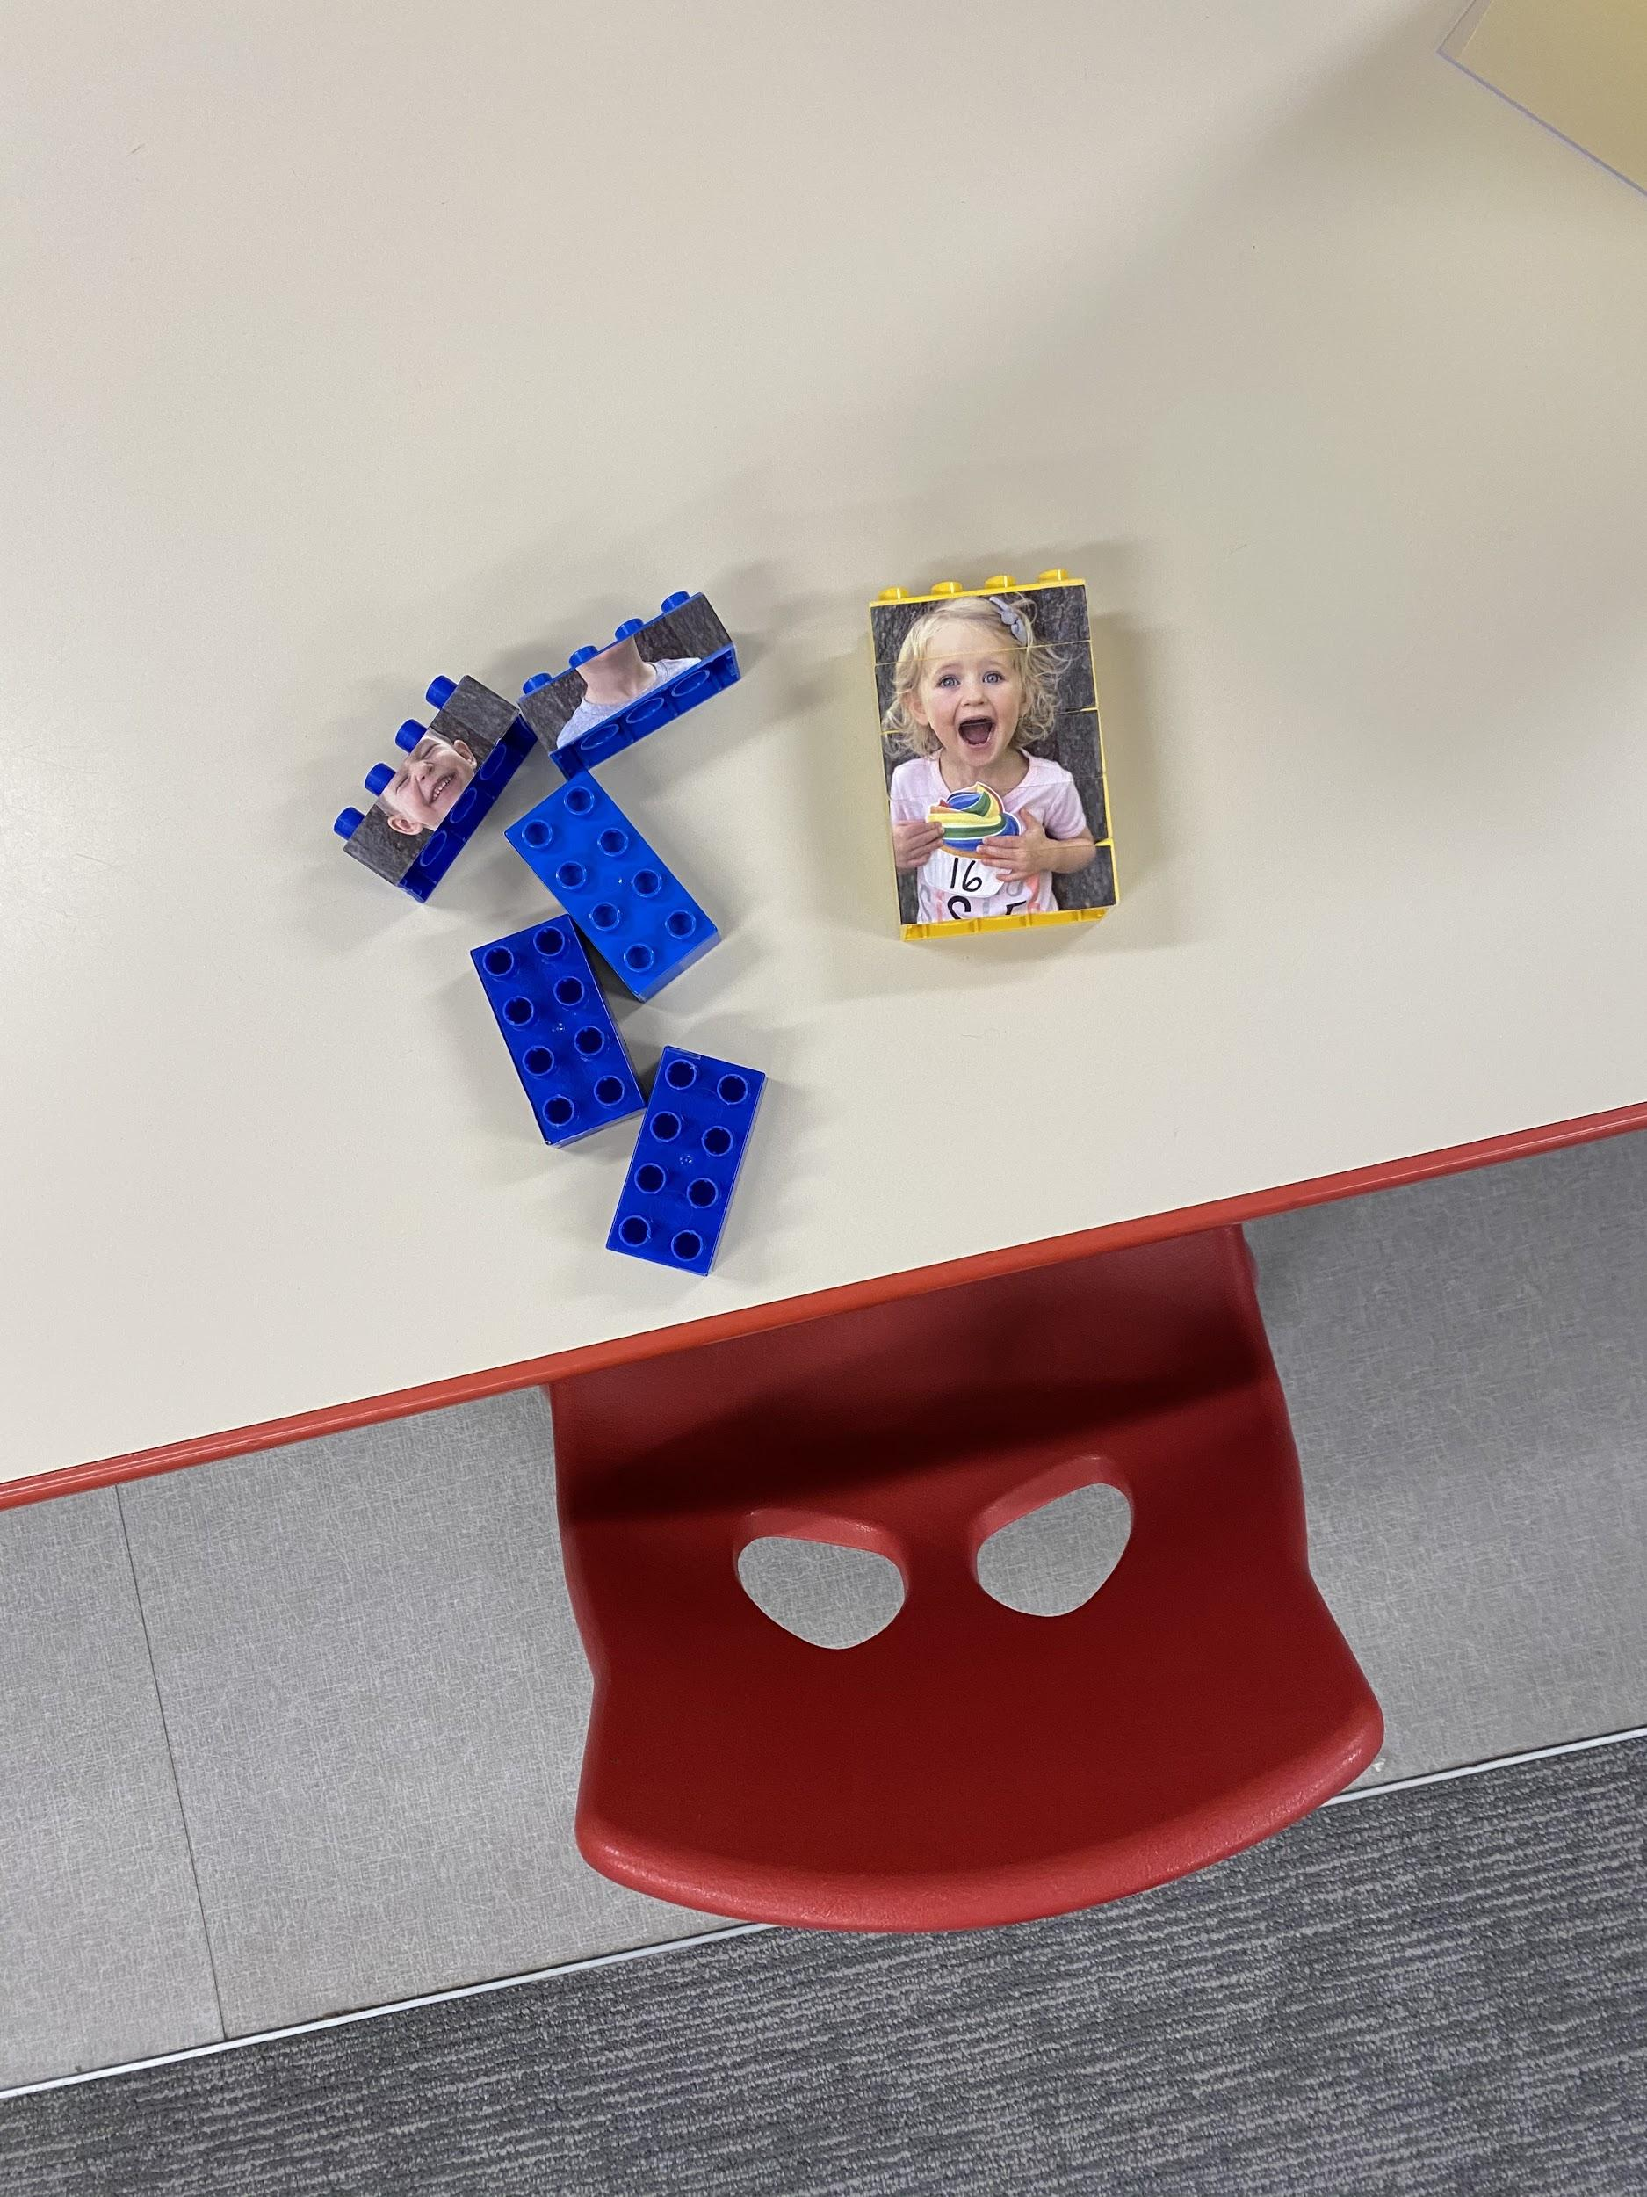
Create peer statues where children can “build” their peers and send them home for children to play with and learn their peers’ names and faces.

Slide 26
Hybrid- Guiding Questions
When time is limited, how do you use the time that you have to practice peer related social skills?
How can you build opportunities for large and small group to teach social skills in-person?
How can you build opportunities to teach social skills synchronously or asynchronously?

Slide 27
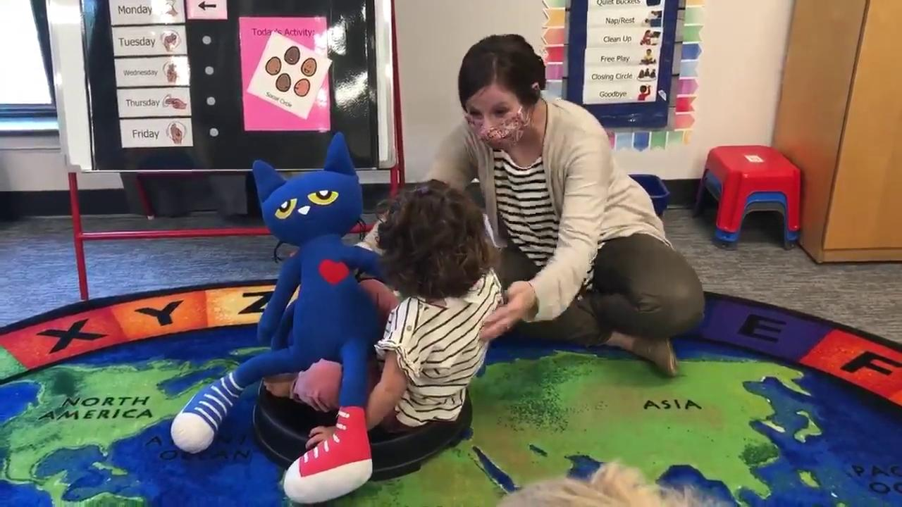
In-Person Learning (with health and social distancing restrictions)
Children practice social skills with puppets rather than with each other.

Slide 28
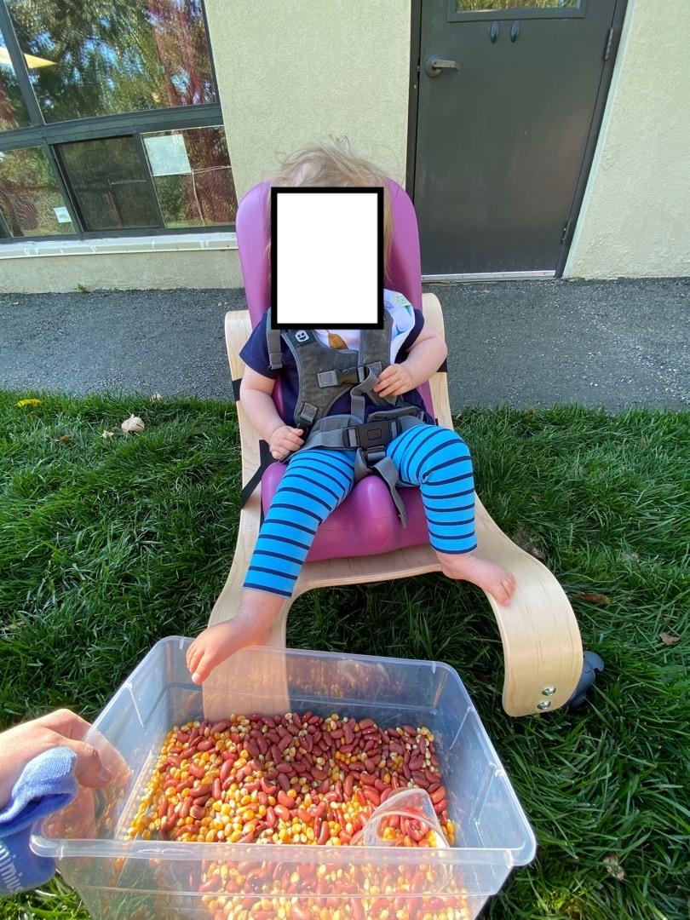
Provide lots of outside time when possible. Adapt games and activities to include social distancing.

Slide 29
Early Childhood Education Environment Indicator #6- Instruction
Element #2
Develop or modify the environment, materials, and instruction to ensure children can engage in curricular activities and achieve their individualized goals
COVID NOTE: Consider all goals and which are most critical right now and how to create opportunities throughout the day for children to practice these!

Slide 30
Online Instruction
Families as implementers! Use a family coaching model with siblings and relatives as intervention agents.
AND
Remember: Families are families and not teachers… they cannot be everything all of the time. It is our job to help them to navigate this.
Notes:
ERIN???

Slide 31
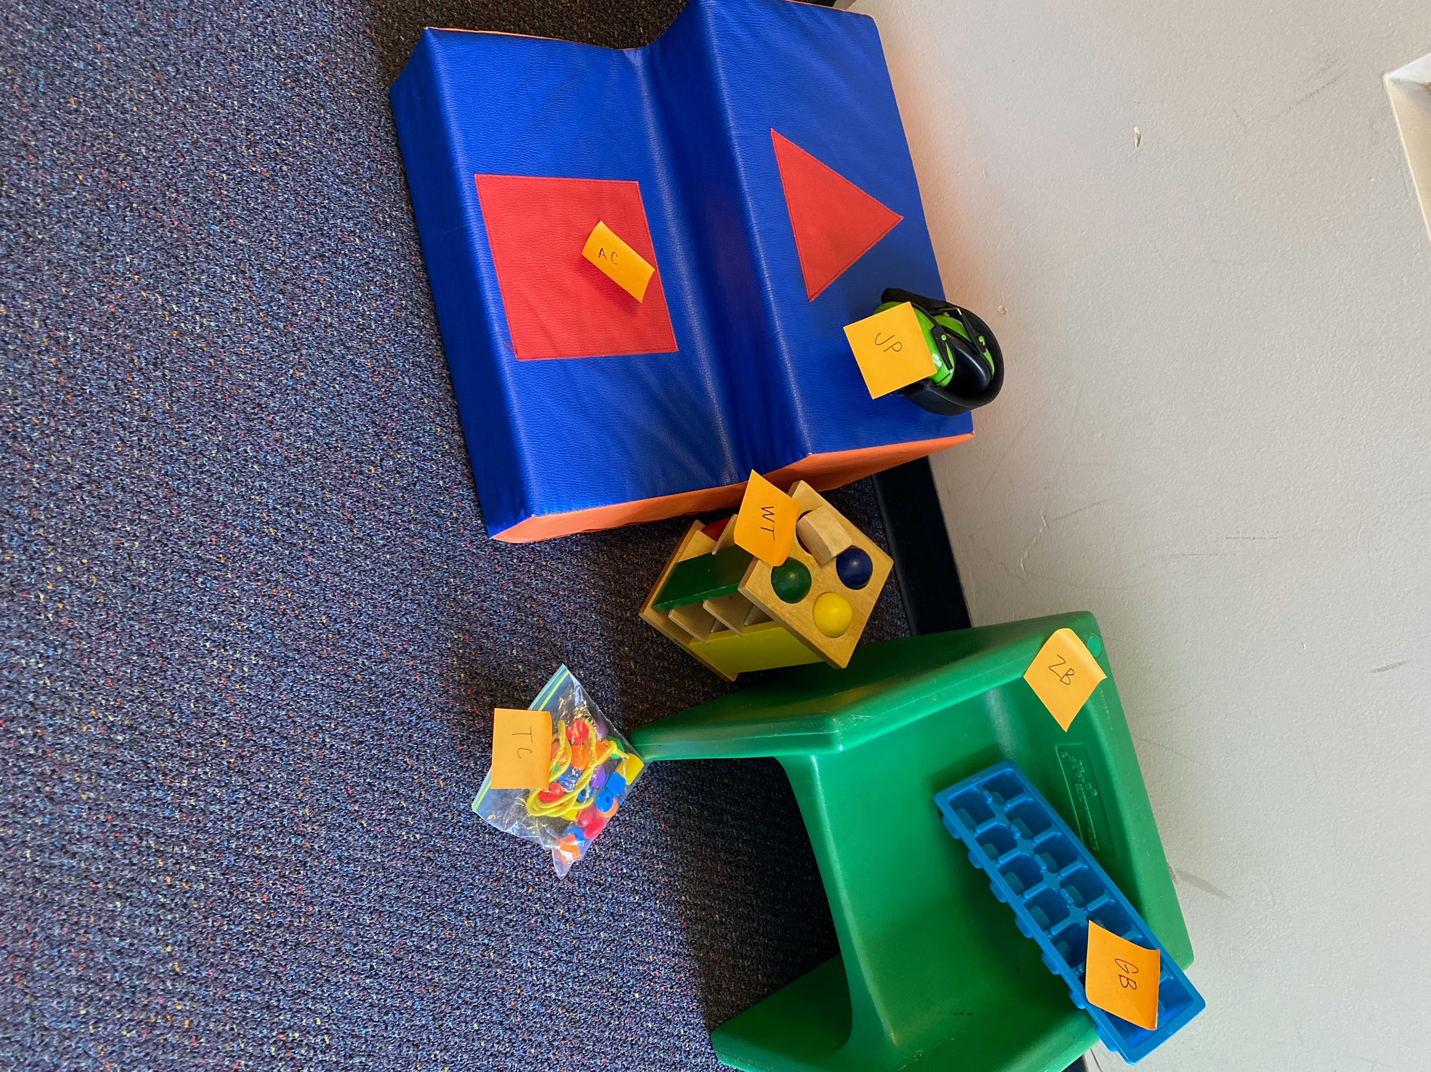
Online Instruction
Consider:
Look for therapy materials rental programs- balls, tricycles, cube chairs, tables.
Use screenless speech consults with “bug in the ear” to coach families.
What time of day is best for engagement?
What can happen in between sessions?

Slide 32
Hybrid Instruction
Guiding Questions
How are you structuring in-person time and partnering with families to use the entire learning cycle- acquisition, fluency, maintenance, and generalization?
How can resources be intentionally used to provide children opportunities to learn AND practice skills across settings (school, home, neighborhood, worship centers)?

Slide 33
In-Person Instruction (with health and social distancing restrictions)
Prioritize goals and provide sufficient learning opportunities
Move learning outside when possible and focus on goals you might not typically teaching outdoors
Use smaller groups in bigger spaces :)
Remember the ratio, and give lots of lots of noncontingent reinforcement

Slide 34
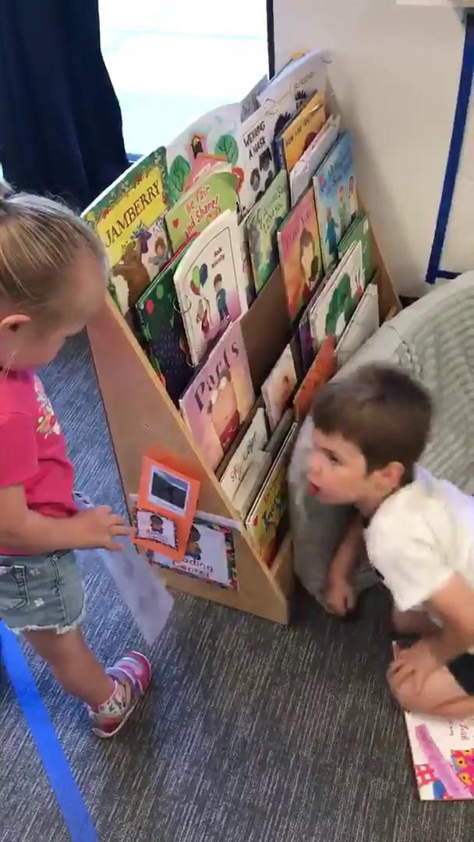
In-Person Instruction (with health and social distancing restrictions)

Slide 36
Early Childhood Education Environment Indicator #9-
Culturally Responsive and Identity Affirming Practices
Element #1
Interactions with family members and children demonstrate personal knowledge of and appreciation for the values, beliefs, and cultural norms represented by the children and families in their care.

Slide 37
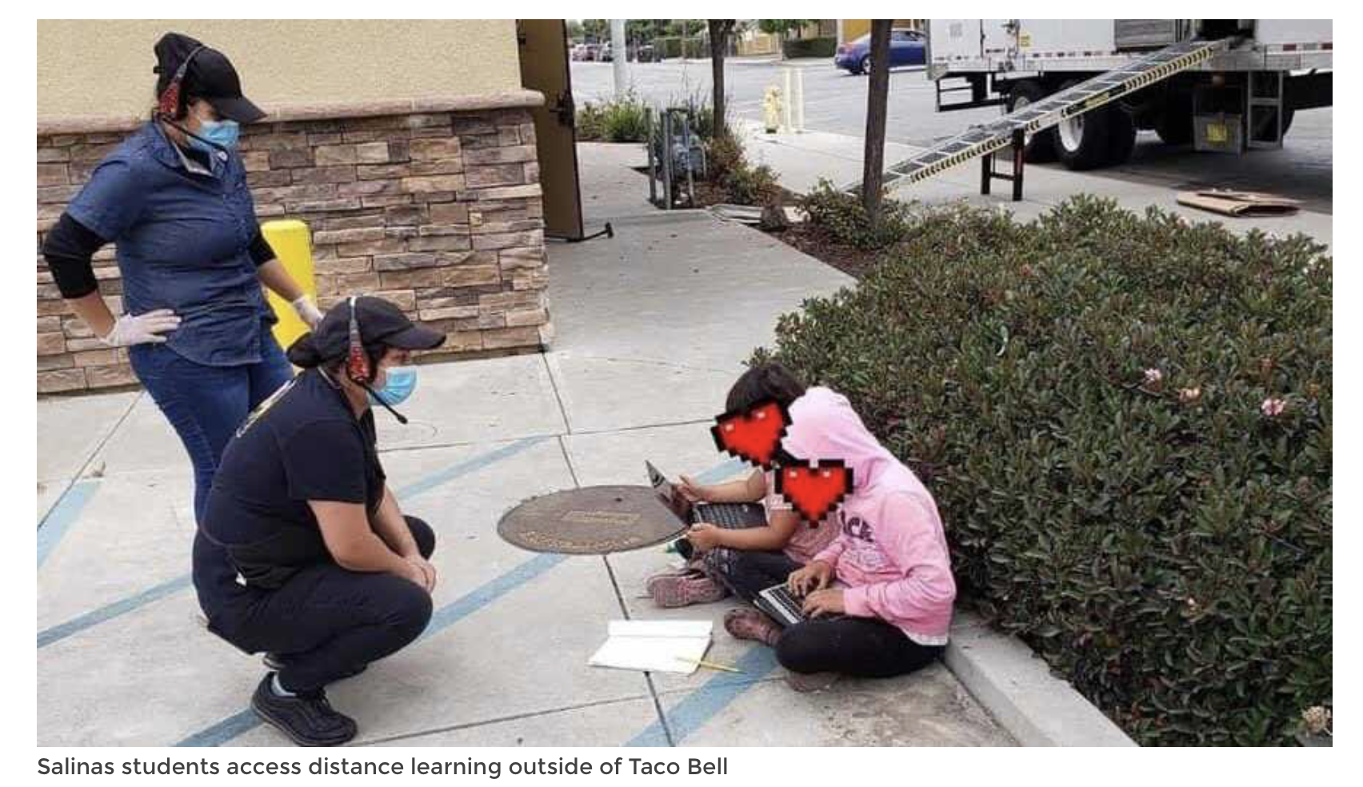
Culturally Responsive and Identity Affirming Practices
Providers learn about families, withhold judgements about family circumstances and affirm their decisions such as use of video or not, level of family engagement, etc.
Providers make accommodations to work with family choices regarding goals, expectations, participation and supports.
Photo credit: https://www.ksbw.com/article/photo-showing-2-salinas-girls-doing-homework-outside-taco-bell-goes-viral/33834659#

Slide 38
Culturally Responsive and Identity Affirming Practices
Adapted from ”I Am From” Activity from Don’t Look Away: Embracing Anti-Bias Classrooms page 82.
1. Read the poem, “Where I’m From” by George Ella Lyon. Create picture board for children to follow along.
2. Ask children and families to write their own poem with three characteristics that represent their family with food, family names, favorite books, shows, movies, and favorite activities, etc.
3. Celebrate all the things that make children and families different. Do this all year long.

Slide 39
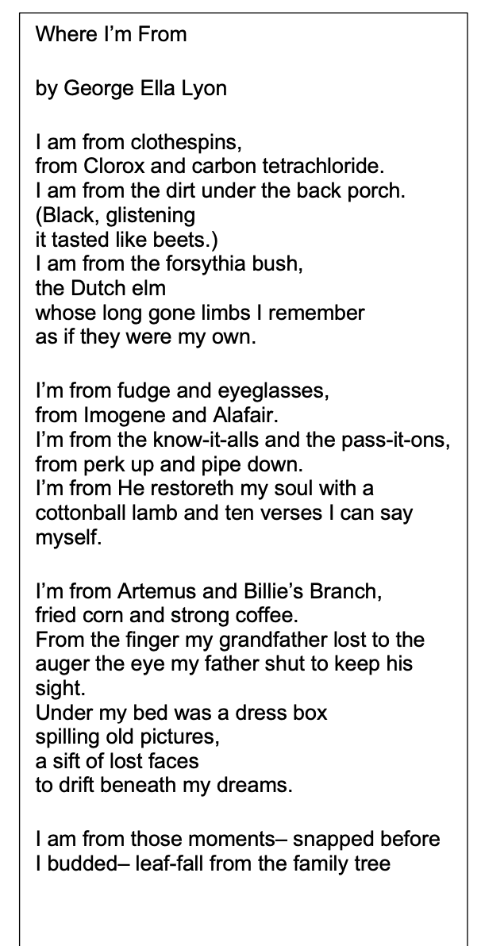
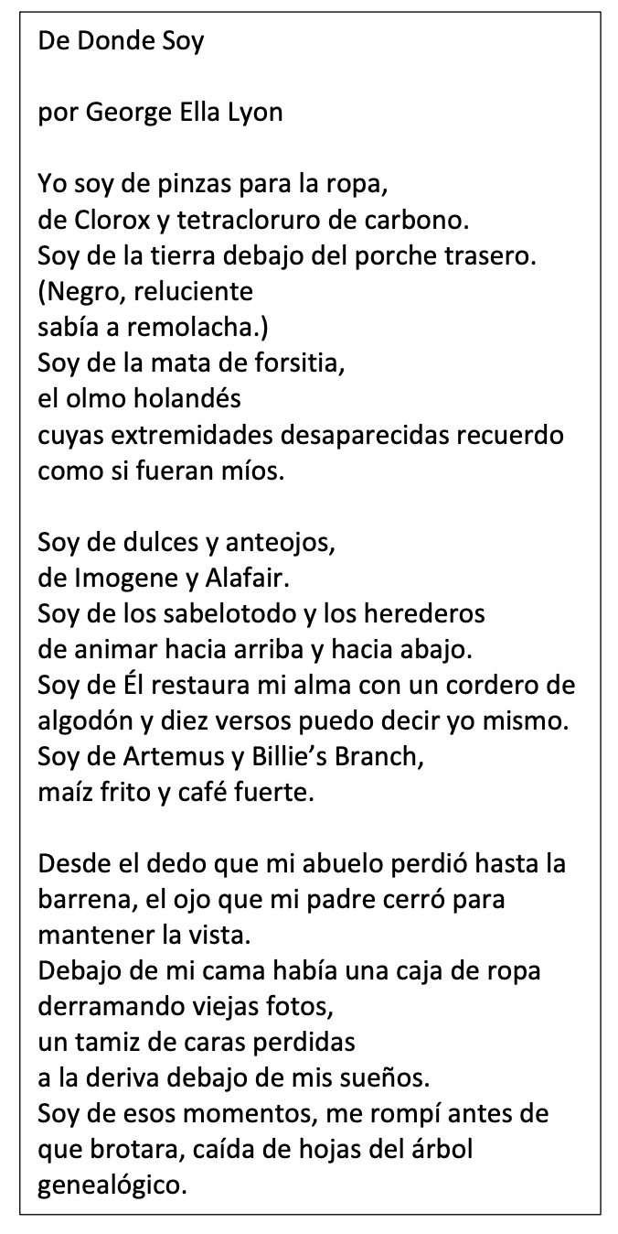

Slide 40
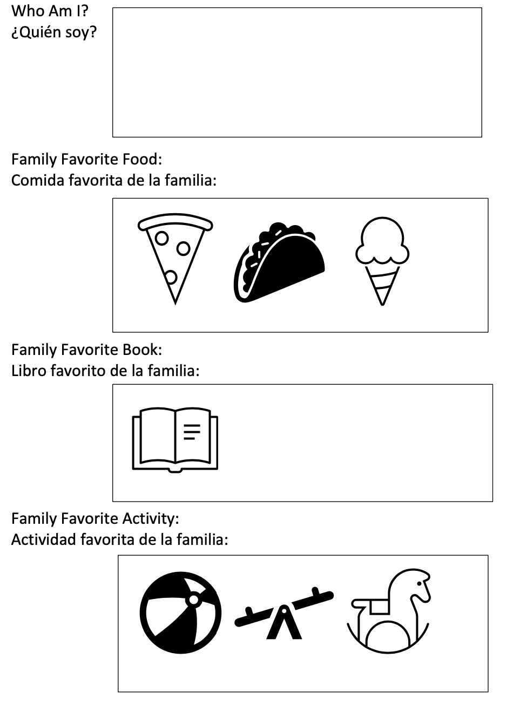
child inserts pictures or draws pictures
child inserts pictures or draws pictures
child inserts pictures or draws pictures
child inserts pictures or draws pictures

Slide 41
Culturally Responsive and Identity Affirming Practices
Adapted from Don’t Look Away: Embracing Anti-Bias Classrooms page 102.
Evaluate:
classroom learning spaces
curricular activities and routines
communication with families
program activities
etc. ...

Slide 42
Do learning activities, materials, and policies reflect white culture or anti-Blackness?
How so? If not, why not?
Be flexible. Allow for multiple types of responses.
Recognize that the ways you might have operated are not anti-racist.
Use multiple modes of communication with families.
Assume competence of families.
Accurately represent cultures of children with toys, books, visuals, etc.
Use continuous non-contingent reinforcement all day, every day in a way that is equitable. Monitor and make changes.

Slide 43
Inclusion
It is not a place, it is everywhere.
It begins with families in a reciprocal belonging place with providers.
It demands responsiveness to family diversity in all of its manifestations.
It demands quality implementation at the classroom, program, community and state level.
Go to ECTA.org https://ectacenter.org/topics/inclusion/indicators.asp

Slide 44
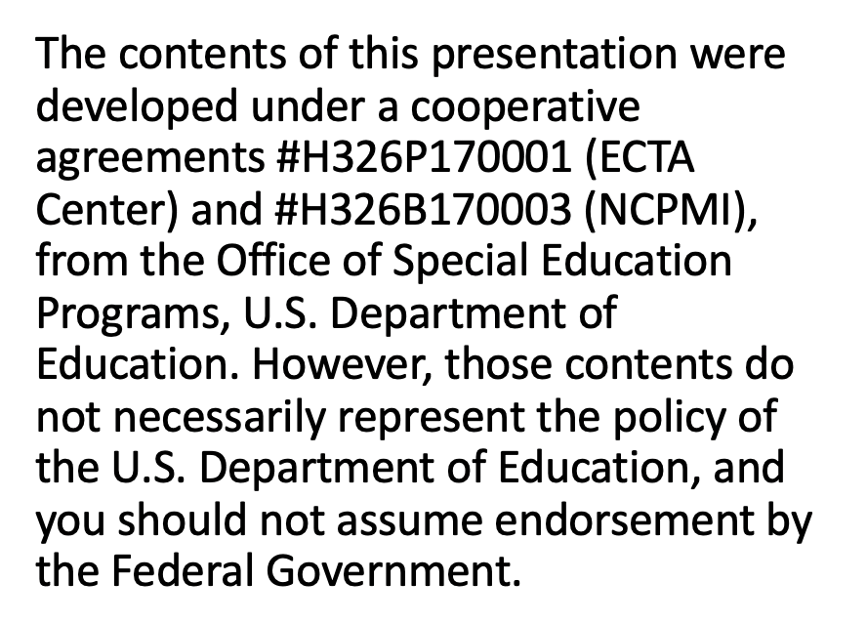
Thank You

