Slide 1
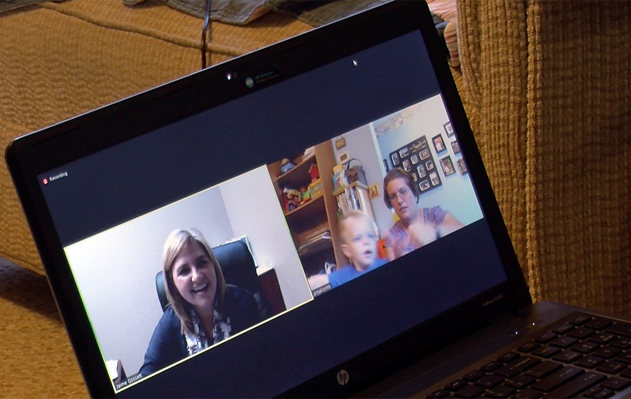
Use of Tele-intervention in Early Intervention (IDEA Part C) – Strategies for providing services under the COVID-19 public health emergency March 24, 2020
Christina Kasprzak
Larry Edelman
Andy Gomm

Slide 2
Agenda
Welcome and Housekeeping
What is “Tele-Intervention”?
Policy and Regulations- HIPAA, FERPA, and IDEA
Chat Box: questions, examples, and resources
Funding Strategies - Medicaid and Private Insurance
Chat Box: questions, examples, and resources
Video Conferencing - Technology and Considerations
Chat Box: questions, examples, and resources
Future webinars
Photos in this presentation by Larry Edelman
Courtesy of the Ohio Developmental Disabilities Council © 2016

Slide 3
Housekeeping
All participants are on mute
When you use the "Chat" box – please select "panelists and all attendees"
Participant list is not visible to all – we ask you to write in the chat:
Your Name
State
Age Focus (e.g. 0-3)
Role (e.g. State Part C Coordinator)
Use the "Chat" box throughout the webinar today – to share questions, comments, strategies, resources
The webinar will be recorded and key content including resources from the chat will be summarized and shared

Slide 4
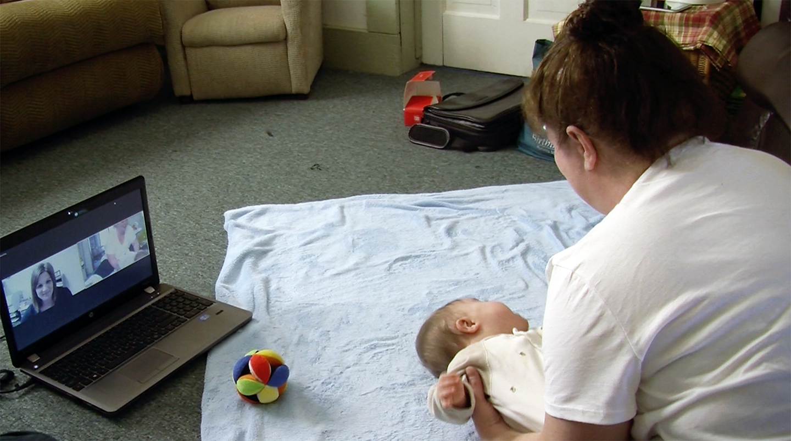
What is “Tele-Intervention”?

Slide 5
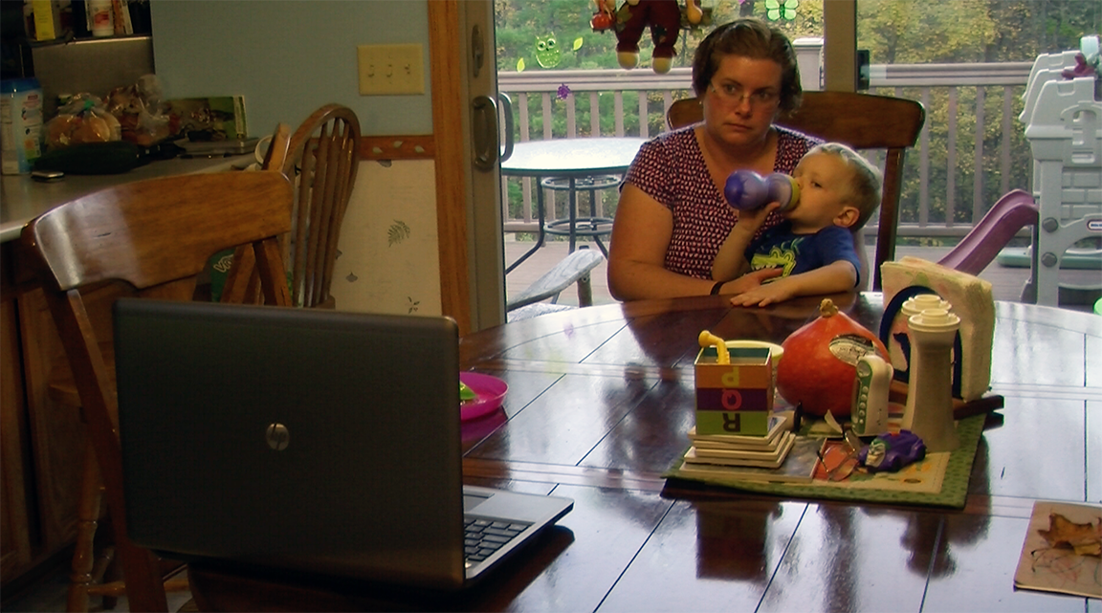
Using video conferencing for early intervention home visits is not new!
Shortage of personnel
Challenges to delivering services in vast rural areas
Children with compromised immunity
Increase frequency of contact
Supportive models
Enabling regulations

Slide 6
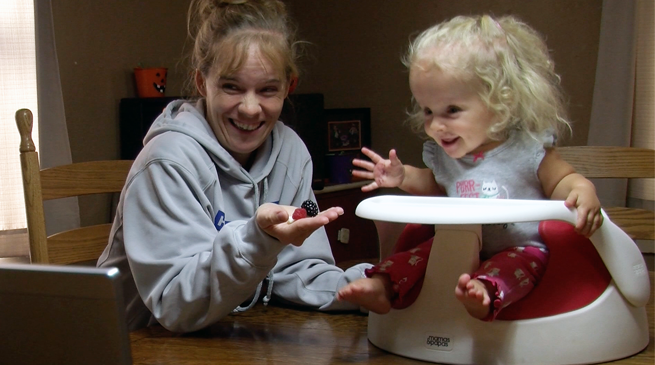
What’s in a name?
Many terms are used to describe similar, but not always identical services (with and without hyphenation!):
tele-intervention
tele-health
tele-medicine
tele-practice
tele-therapy
tele-EI

Slide 7
There are variety of conceptual ways to describe it
American Occupational Therapy Association (AOTA): Advisory Opinion for the Ethics Commission - Telehealth (2017)
https://www.aota.org/~/media/Corporate/Files/Practice/Ethics/Advisory/telehealth-advisory.pdf
American Physical Therapy Association (APTA): Telehealth Position Statement (09/20/2019)
http://www.apta.org/uploadedFiles/APTAorg/About_Us/Policies/Practice/TelehealthHODPolicy.pdf
American Speech-Language-Hearing Association (ASHA): Telepractice webpage
https://www.asha.org/PRPSpecificTopic.aspx?folderid=8589934956&section=Overview

Slide 8
Telehealth and Medicaid Reimbursement
No two states are alike in how telehealth is defined and regulated.
States alternate between using the term “telemedicine” or “telehealth.”
Reference:
The Center for Connected Health Policy’s (CCHP) Fall 2019 release of the “State Telehealth Laws and Reimbursement Policies”
https://www.cchpca.org/sites/default/files/2019-10/50%20State%20Telehalth%20Laws%20and%20Reibmursement%20Policies%20Report%20Fall%202019%20FINAL.pdf

Slide 9
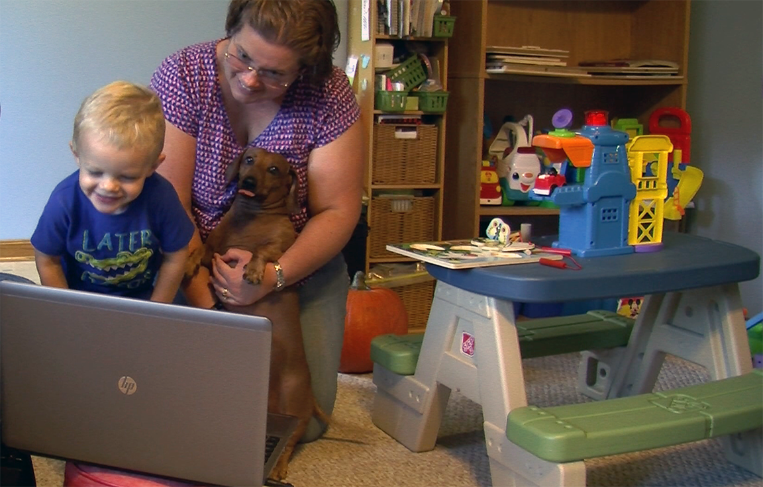
Any term or definition is only as useful as the needs of whoever produces and/or uses the definition
There is no one universally understood and accepted definition of early intervention home visits delivered via video conferencing.
Regardless of the term we each prefer, let’s simply focus on:
“Using video conferencing to deliver IDEA Part C early intervention home visits.”

Slide 10
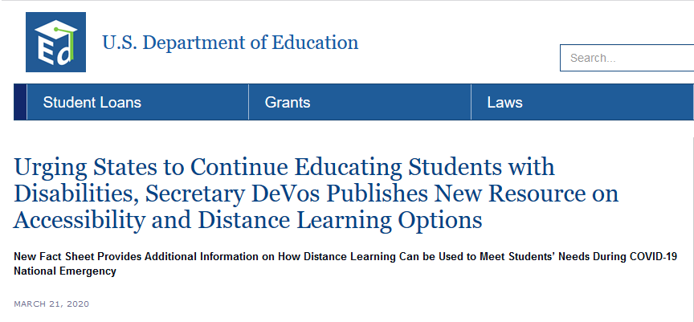
Recent Headline

Slide 11
Policy and Regulations- HIPAA, FERPA, and IDEA

Slide 12
Office of Special Education and Rehabilitation Services (OSERS) – Supplemental Fact Sheet (March 21, 2020)
As school districts nationwide take necessary steps to protect the health and safety of their students, many are moving to virtual or online education (distance instruction). Some educators, however, have been reluctant to provide any distance instruction because they believe that federal disability law presents insurmountable barriers to remote education. This is simply not true. We remind schools they should not opt to close or decline to provide distance instruction, at the expense of students, to address matters pertaining to services for students with disabilities.
To be clear: ensuring compliance with the Individuals with Disabilities Education Act (IDEA), Section 504 of the Rehabilitation Act (Section 504), and Title II of the Americans with Disabilities Act should not prevent any school from offering educational programs through distance instruction.
FAPE may include, as appropriate, special education and related services provided through distance instruction provided virtually, online, or telephonically.

Slide 13
Office of Special Education and Rehabilitation Services (OSERS) – Supplemental Fact Sheet (March 21, 2020) – Cont.
It is important to emphasize that federal disability law allows for flexibility in determining how to meet the individual needs of students with disabilities.
The Department encourages parents, educators, and administrators to collaborate creatively to continue to meet the needs of students with disabilities. Consider practices such as distance instruction, teletherapy and tele-intervention, meetings held on digital platforms, online options for data tracking, and documentation.
OSERS Supplemental Fact Sheet Addressing the Risk of COVID-19 in Preschool, Elementary and Secondary Schools While Serving Children with Disabilities (March 21, 2020)

Slide 14
HIPPA – What do we know?
Department of Health and Human Services, Office of Civil Rights Notification of Enforcement Discretion for telehealth remote communications during the COVID-19 nationwide public health emergency (March 17, 2020):
During the COVID-19 national emergency, which also constitutes a nationwide public health emergency, covered health care providers subject to the HIPAA Rules may seek to communicate with patients, and provide telehealth services, through remote communications technologies.
OCR will exercise its enforcement discretion and will not impose penalties for noncompliance with the regulatory requirements under the HIPAA Rules against covered health care providers in connection with the good faith provision of telehealth during the COVID-19 nationwide public health emergency. This notification is effective immediately.

Slide 15
HIPPA – What do we know?
HHS – OCR Notification (March 17, 2020) - Cont:
A covered health care provider that wants to use audio or video communication technology to provide telehealth to patients during the COVID-19 nationwide public health emergency can use any non-public facing remote communication product that is available to communicate with patients.
Under this Notice, covered health care providers may use popular applications that allow for video chats, including Apple FaceTime, Facebook Messenger video chat, Google Hangouts video, or Skype, to provide telehealth without risk that OCR might seek to impose a penalty for noncompliance with the HIPAA Rules related to the good faith provision of telehealth…
Covered health care providers that seek additional privacy protections for telehealth while using video communication products should provide such services through technology vendors that are HIPAA compliant and will enter into HIPAA business associate agreements (BAAs)…

Slide 16
FERPA – What do we know?
FERPA covers recorded video (and photos) that are considered part of the child’s record – but does not address live video that that is not recorded.
Student Privacy Policy Office ‘FERPA and Virtual Learning Related Resources’ (March 2020) correspondence states:
“With regard to videos and virtual classrooms, to the extent videos are recorded and maintained as education records, the FAQs on Photos and Videos under FERPA might be useful”.
[emphasis added]

Slide 17
Consent / Prior Written Notice – what do we know?
IDEA:
Regarding the delivery of IFSP services using strategies such video conferencing: to date, we have not seen guidance from OSEP requiring consent or prior written notice in addition to what has previously been obtained from the family
Medicaid:
If you are not certain whether or not your state has some sort of informed consent requirement for Medicaid, contact your state’s Medicaid office.

Slide 18
Policy and Regulations- Possible Next Steps
If needed get an expedited legal opinion from your state legal council, including sending links / copies of the cited documents
Determine if your state will obtain family consent to utilize tele-intervention, whether legally required or not.
Examples of details that might be included in consent forms:
The video platform to be used
Statement how any recordings will only be made with family consent and will specify purposes/uses of the video (e.g., practice-based coaching, transdisciplinary teaming, IFSP / transition meetings)
Who is responsible for data costs / Wi-Fi

Slide 19
Chat Box: Sharing, questions, examples and resources

Slide 20
Funding Strategies

Slide 21
Medicaid & Private Insurance – what do we know?
According to:
All Fifty states and Washington, DC provide reimbursement for some form of live video in Medicaid fee-for-service.
Forty states and DC currently have a law that governs private payer telehealth reimbursement policy.
Twenty-three states have some limit type of services, type of provider / practitioner, or location of patient (family) – ‘originating site.’
Thirty-four state Medicaid programs offer a transmission or facility fee when telehealth is used.
Nineteen states explicitly allow home and schools to serve as originating sites.

Slide 22
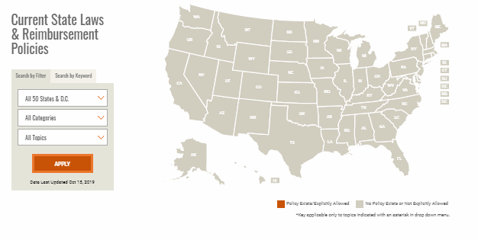
Medicaid & Private Insurance – what do we know?
Center for Connected Health Policy (CCHP) has published: 50 State Telehealth Laws and Reimbursement Policies Report Fall 2019 FINAL.pdf
The CCHP website includes an interactive map to link to the policies for each states for both Medicaid and Private Insurance https://www.cchpca.org/telehealth-policy/current-state-laws-and-reimbursement-policies

Slide 23
Medicaid & Private Insurance – what do we know?
Let’s talk billing
Fee-for-service:
Some state policy includes that the reimbursement rate be equal to the amount that would have been reimbursed had the same service been delivered in-person
Thirty-four states reimburse either a transmission, facility fee, or both. Of these, the facility fee is the most common.
State policy may require reimbursement at center rather than home-based rate
Bundled rate:
Determine if telehealth visit can count towards minimum service delivery to bill the bundled rate.

Slide 24
Funding Opportunities - Possible Next Steps:
Research your state policies and any limitations.
Reach out to your state Medicaid office liaison for IDEA services to work with them regarding what’s needed to implement – codes / modifiers etc.
Reach out to the private insurance authority for your state to work with them regarding what’s needed to implement – codes / modifiers etc.
Determine if changes are needed to database to capture tele-intervention to track utilization and / use for billing.

Slide 25
Chat Box: Sharing, questions, examples and resources

Slide 26
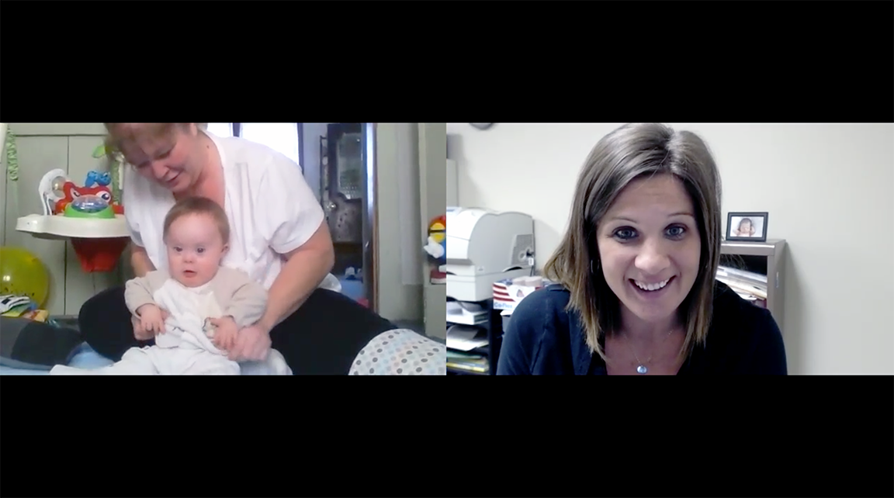
Video Conferencing Technology and Considerations

Slide 27
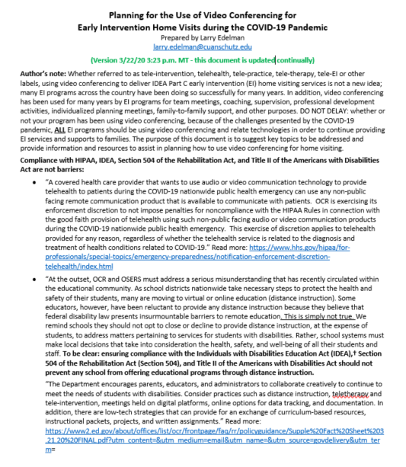
Planning for the Use of Video Conferencing for Early Intervention Home Visits during the COVID-19 Pandemic

Slide 28
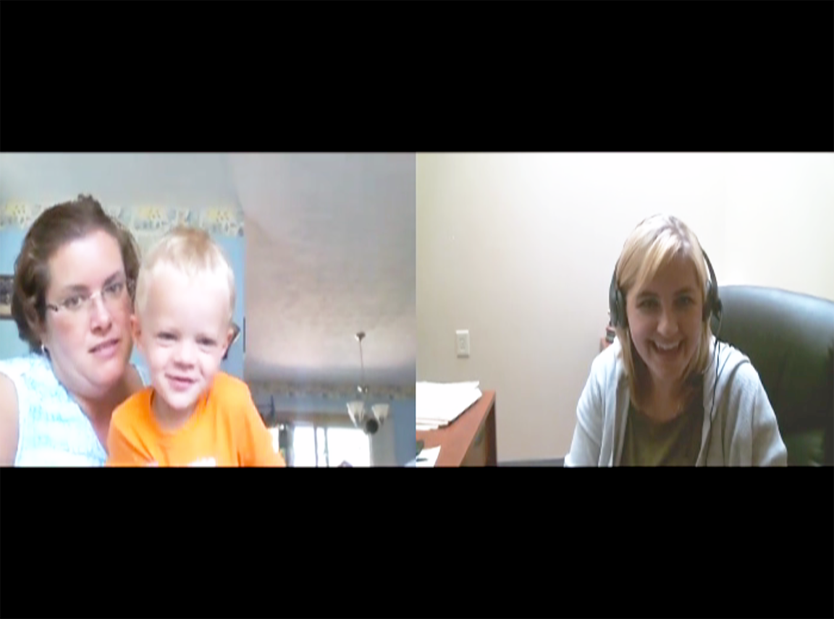
The purpose of this document is to suggest key topics to be addressed and provide information and resources to assist in planning how to use video conferencing for home visiting
TOPICS:
Compliance/Regulations/Standards
Reimbursement
Equipment/software/licensing/bandwidth
Free resources
Skills sets
Desirable features for video platforms
Video conferencing applications
Resources
Illustrations

Slide 29
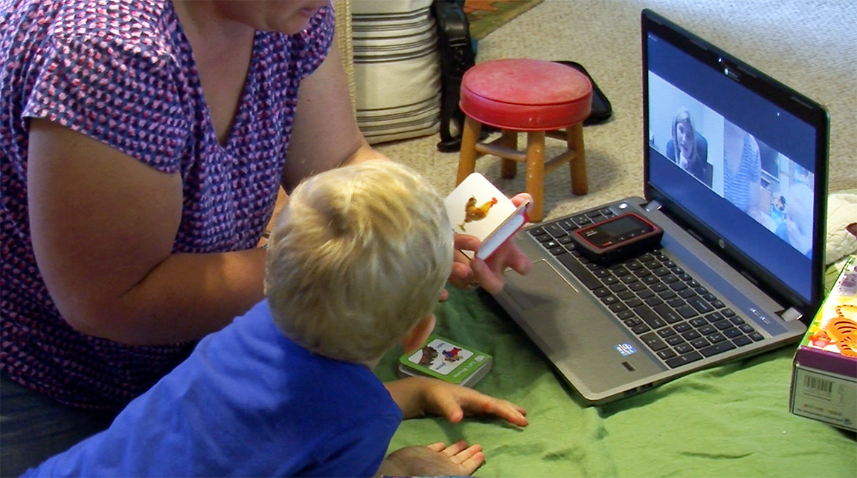
We are all committed to equity
Seek out community partners, e.g., technology providers.

Slide 30
Video Conferencing - Technology & Considerations Possible Next Steps:
Act now! Make planning discussions an immediate priority.
Decide which decisions will be made centrally and which can be made locally, e.g., video conferencing platforms used, consent forms, etc.
Address equity issues.
Seek out community partners, e.g., technology providers.
Provide adequate guidance to state consultants, local program leaders, supervisors, professional development specialists, coaches, and practitioners.
Embrace the balancing act - be thoughtful, yet at the same time act quickly and decisively, avoiding disrupting services to families and children.

Slide 31
Chat Box: Sharing, questions, examples and resources

Slide 32
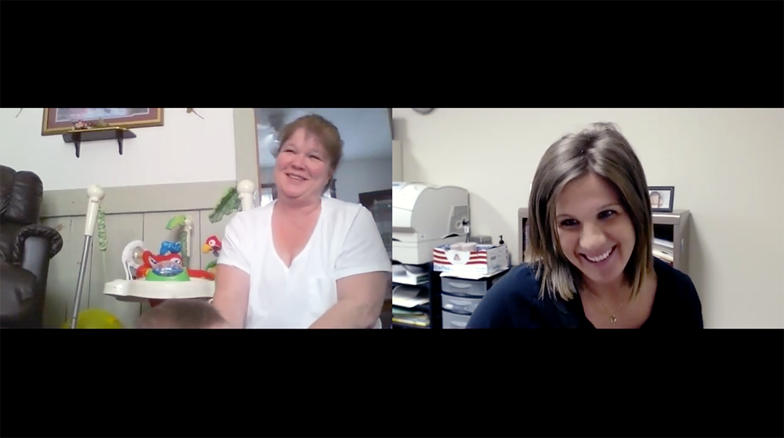
Future Webinars / Support?
What topics would you like to see addressed in future webinars about COVID-19 and the use of tele-intervention and other technologies to help provide services?
Link to survey: https://unc.az1.qualtrics.com/jfe/form/SV_43jlQNkbhjPxrc9

Slide 33
Find out more at ectacenter.org
The ECTA Center is a program of the FPG Child Development Institute of the University of North Carolina at Chapel Hill, funded through cooperative agreement number H326P170001 from the Office of Special Education Programs, U.S. Department of Education. Opinions expressed herein do not necessarily represent the Department of Education's position or policy.

