Slide 1
Recommended Practices for Engaging Families September 11, 2019
aRPy Ambassadors for the DEC Recommended Practices

Slide 2
Webinar Series Content Available https://ectacenter.org/events/webinars.asp

Slide 3
Recapping the Webinar Series Webinar 1 (June)
Overview of the Division for Early Childhood (DEC) of the Council for Exceptional Children (CEC)
Origin and purpose of DEC Recommended Practices (RPs)
Importance and relevance for families and
Access to the DEC Recommended Practices (RPs)

Slide 4
Recapping the Webinar Series Webinar 2 (July)
Focused on Resources and Materials that Support Family Use of the DEC RPs
Shared ECTA Center Suite of Resources that Support Family Use. (Checklists, Practice Guides, Videos)
Examined access and use the resources to support families

Slide 5
Recapping the Webinar Series Webinar 3 (August)
Continued the Focus on Resources and Supports for Parent Centers by:
Providing specific scenarios to illustrate what RPs and resources could be used by a Parent Center
Providing specific scenarios to consider how the resources could be used by a Parent Center

Slide 6
Objectives for Today’s webinar
Participants will become familiar with the purpose and intended benefits of the aRPy Ambassador Initiative
Participants will become familiar with the role of the aRPy Family Ambassador
Participants will become familiar with the qualifications and process for applying to be an aRPy Family Ambassador

Slide 7
What is the purpose of an aRPy Ambassador?
Bring awareness of the importance of the DEC RPs
Share and disseminate information about the RPs
Promote the use of the RPs by practitioners, families and leaders
Share information about materials and products that support the use of the RPs

Slide 8
Who are the aRPy Ambassadors?
Original cohort began– 2016
Professionals from diverse fields
State level professional development and technical assistance providers, university and college faculty, state agency staff
DEC members
https://ectacenter.org/decrp/arpy_ambassadors.asp

Slide 9
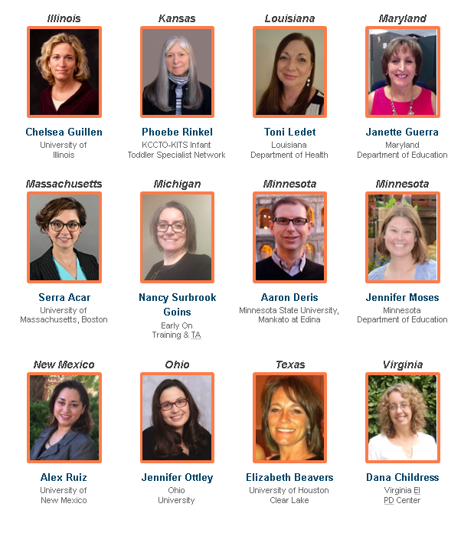
Arpy Ambassadors

Slide 10
Chelsea Guillen aRPy Ambassador, Illinois
A member of the Commission that revised the current RPs
EI Ombudsman
EI Training Program – PD/TA provider
Family member of children who received ei/ecse
Currently serves on the DEC Executive Board

Slide 11
Why I became an Ambassador?
Natural fit with many aspects of my current position
Opportunity to spread the word about the DEC Recommended Practices
Chance to improve practices in the early intervention system
Help ensure that other sectors know about the Practices and how they can support inclusion
Opportunity to help families understand what they should expect from their team

Slide 12
Some Ambassador Activities
Trainings and conference presentations
Facebook live and webinar
Newsletter article
Embedding RPs in professional development offerings and system policies/procedures

Slide 13
What have I gained as an Ambassador?
Deeper understanding of the Practices and the products available to support implementation
Support from other Ambassadors and ECTA/DEC staff
Exposure to different options for presenting materials
Opportunity to reach broader array of audiences

Slide 14
Why a Family Ambassador?
Because families play the most critical role in their children’s development, there is a need to share the DEC Recommended Practices, and the ECTA Center’s resources with families, in order to support family engagement, empowerment, and true partnerships.

Slide 15
Why a Family Ambassador?
To give families tools and resources that can help them advocate for their own children
To nurture and support family leaders through co-training and co-presenting with their professional Ambassador peers in their states.

Slide 16
Family Ambassador Roles
To bring awareness to the existence of the RPs and the resources that support their implementation within the Parent Center network
To collaborate with fellow Family Ambassadors to develop and share strategies and resources for informing families about the RPs

Slide 17
Family Ambassador Roles
To share the DEC RPs and ECTA resources with families and with Parent Center colleagues and staff
In states where there is also a Professional Ambassador, collaborate with that individual to further raise awareness of the RPs

Slide 18
Expectations for Ambassadors
Serve for a minimum of 2 years (with renewal options)
Participate in virtual and face to face orientation meetings
Develop an annual work plan for dissemination and report on activities
Participate in at least one national meeting or conference to collaborate and help disseminate information

Slide 19
Support for Ambassadors
Special recognition, e.g. press releases, announcements/ acknowledgement
DEC conference registration rate
Ready to use materials, presentations, and products
Toolkit with downloadable materials
Travel support, technical assistance and peer support
Private forum for sharing ideas and successes

Slide 20
How do I become an Ambassador?
Share the requirements and discuss the opportunity with your leadership team
Get a letter of support from your agency/organization and/or supervisor
Complete the online application
Commit to participating in the face to face orientation in March/April
Participate in virtual meeting in preparation for the onsite meeting

Slide 21
TIMELINES
Applications available by October 1
Applications will be due by November 8
Ambassadors selected and notified by December 13

Slide 22
WHAT QUESTIONS DO YOU HAVE?

Slide 23
Contact Information
Betsy Ayankoya, ECTA Center: betsy.ayankoya@unc.edu
Peggy Kemp, Executive Director, Division for Early Childhood: peggy@dec-sped.org
Stephanie Moss, Region B PTAC and ECTA Center: stephanie@p2pga.org
DEC: http://www.dec-sped.org/
The Early Childhood Technical Assistance Center: http://ectacenter.org
Region B Parent Technical Assistance Center at Parent to Parent of Georgia: www.p2pga.org

